Slide 1
Secure Multi-Agent AI Framework for RAN Control Loops
End-to-End Implementation | NBUC Project 03 | Swetha Kerahalli, Nokia

Slide 2
Problem Statement
AI-native 6G RANs embed AI in RRC control loops — mobility, handover, resource allocation
Centralized AI = single point of failure; compromised AI can manipulate RRC decisions
Need: secure, distributed, verifiable multi-agent coordination with consensus
References: 3GPP TS 38.331, O-RAN Near-RT RIC, IEEE MobiLLM, NBUC Problem Statement

Slide 3
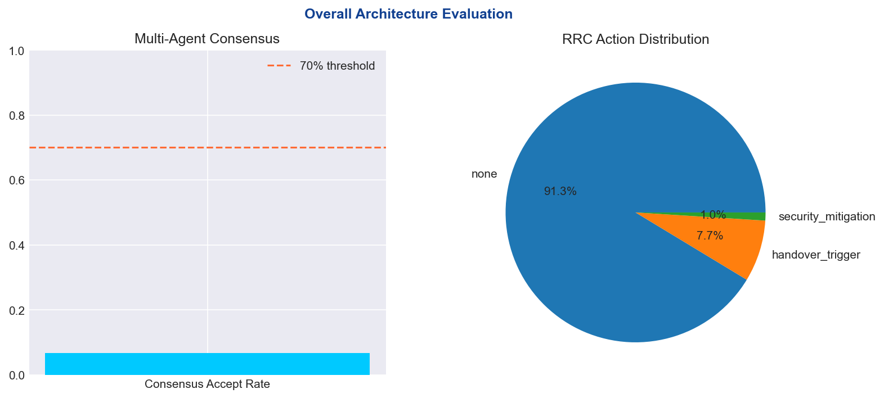
Proposed Architecture
Multi-Agent Layer: 8 specialized agents (Mobility, Security, Resource, Energy, Trust, Beamforming, QoS, Policy)
RAN Control Layer: RRC decisions per TS 38.331 (HO, reconfiguration, beam switch)
Security Layer: Trust engine, anomaly detection, BFT consensus, PQC (Kyber/Dilithium)
O-RAN Integration: Near-RT RIC, E2 interface, xApps/rApps
Digital Twin: 48 cells, 12 gNBs, attack injection & mitigation simulation

Slide 4
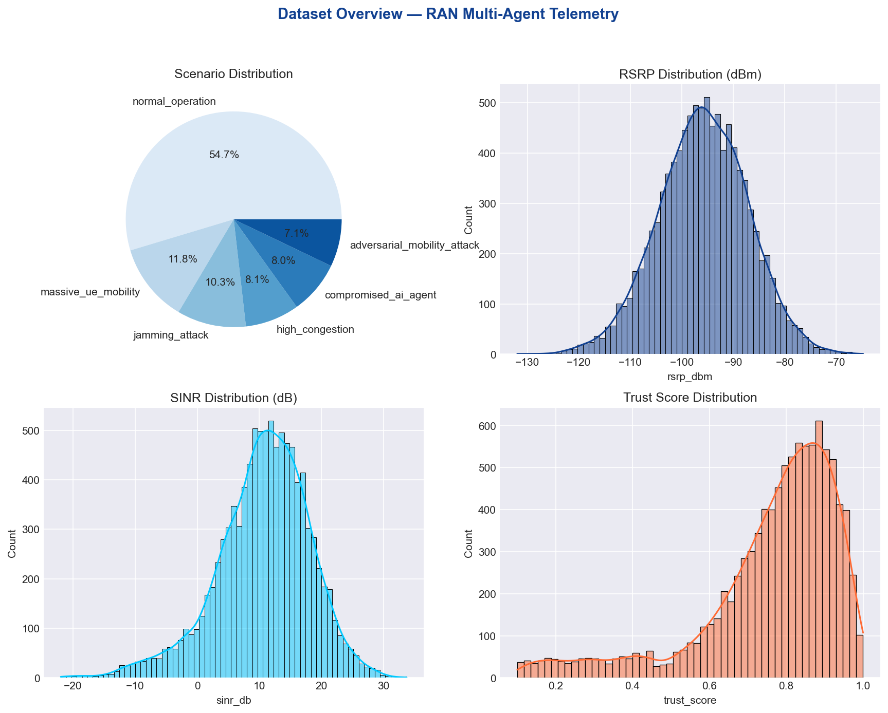
Dataset & Data Split
Synthetic telemetry: 70,000 rows × 42 columns
6 scenarios: normal, jamming, compromised agent, adversarial mobility, massive mobility, congestion
RAG corpus: 70 knowledge chunks (3GPP, O-RAN, MARL, security)
Split: 70% train / 15% validation / 15% test (stratified by scenario)
Features: RSRP, RSRQ, SINR, CQI, PRB, trust, anomaly, agent confidence

Slide 5
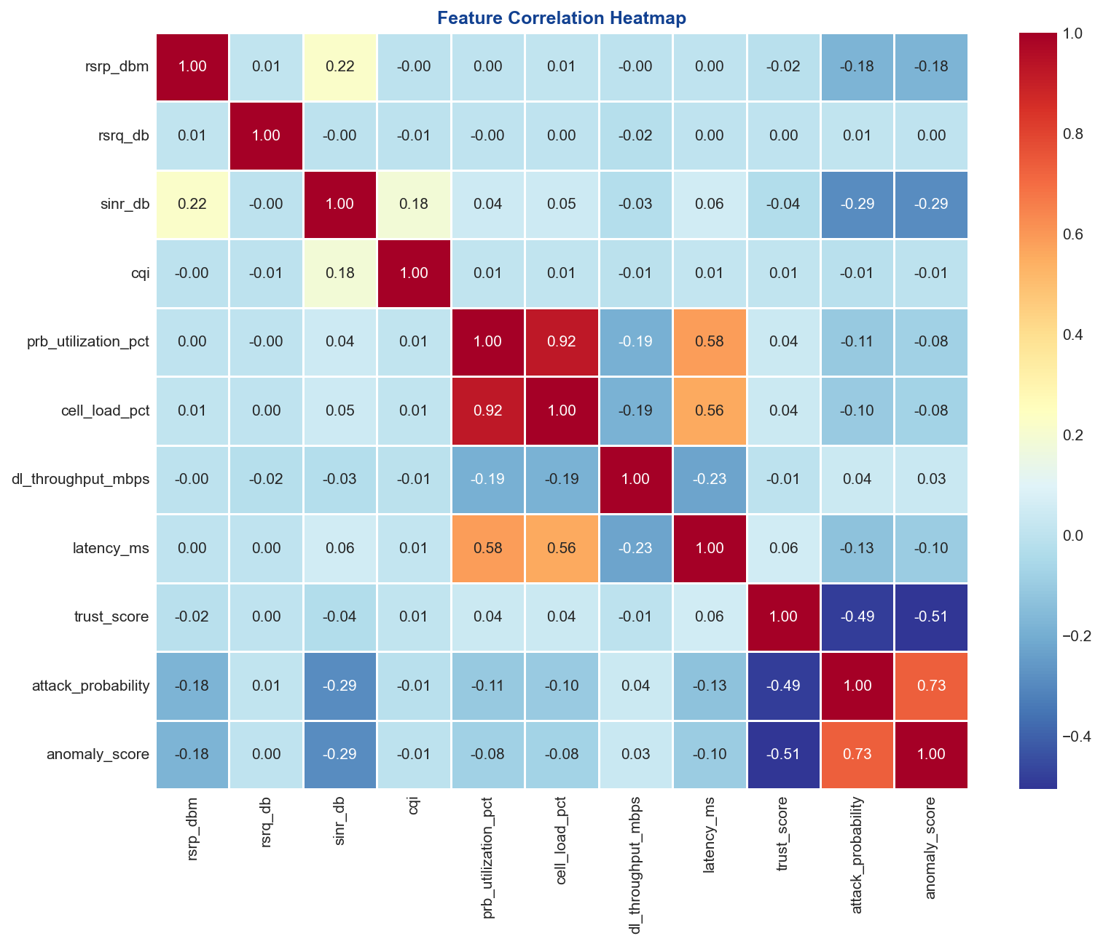
Data Correlation Heatmap & CDFs

Slide 6
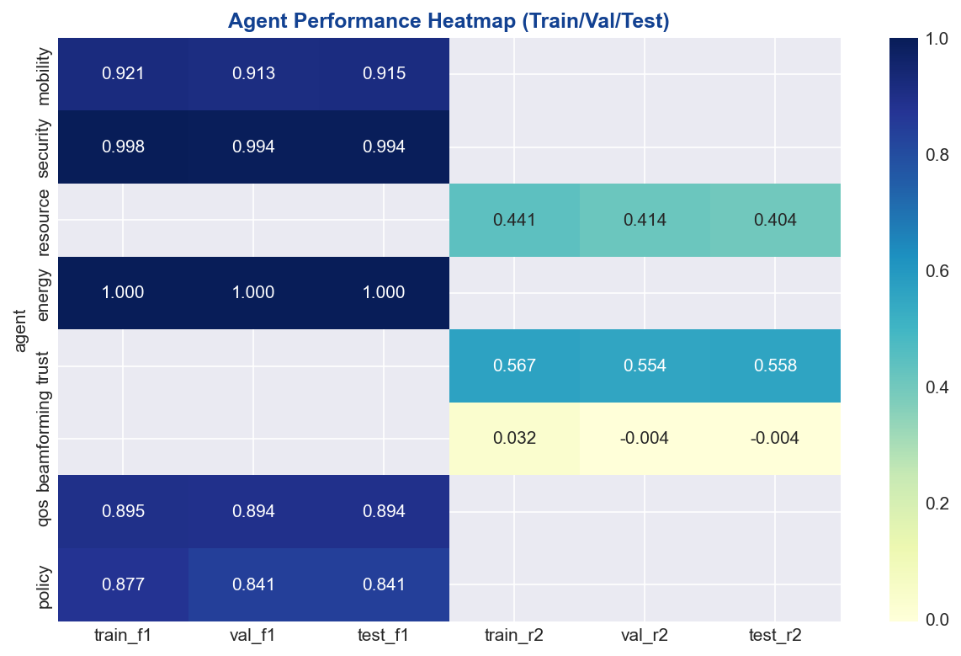
Agent Models — Training / Validation / Testing
Mobility Agent: Gradient Boosting → ho_required (F1 on test)
Security Agent: Random Forest → threat_label (benign/malicious)
Resource Agent: Gradient Boosting → allocated_prb_count (regression)
Trust Agent: MLP → trust_score regression
QoS/Policy/Energy/Beamforming: RF/GB classifiers & regressors
All models: train/val/test metrics saved; learning curves & confusion matrices generated

Slide 7
Test Set Results (Sample)
mobility_agent: test F1=0.915
security_agent: test F1=0.994
resource_agent: test R2=0.404
energy_agent: test F1=1.000
trust_agent: test R2=0.558
beamforming_agent: test R2=-0.004
qos_agent: test F1=0.894
policy_agent: test F1=0.841

Slide 8
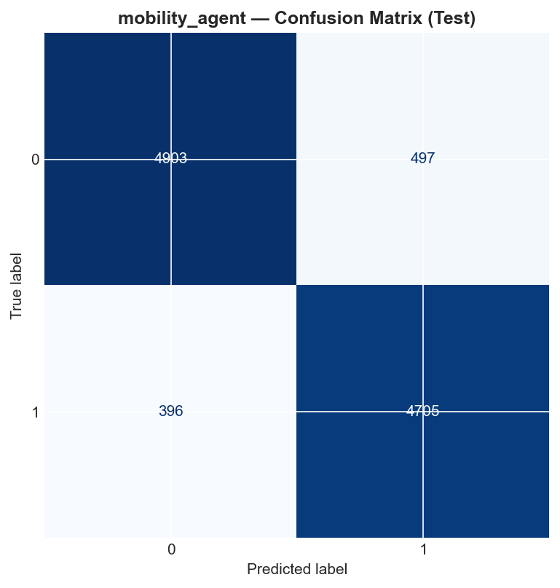
Classification Agent — Confusion Matrix & ROC

Slide 9
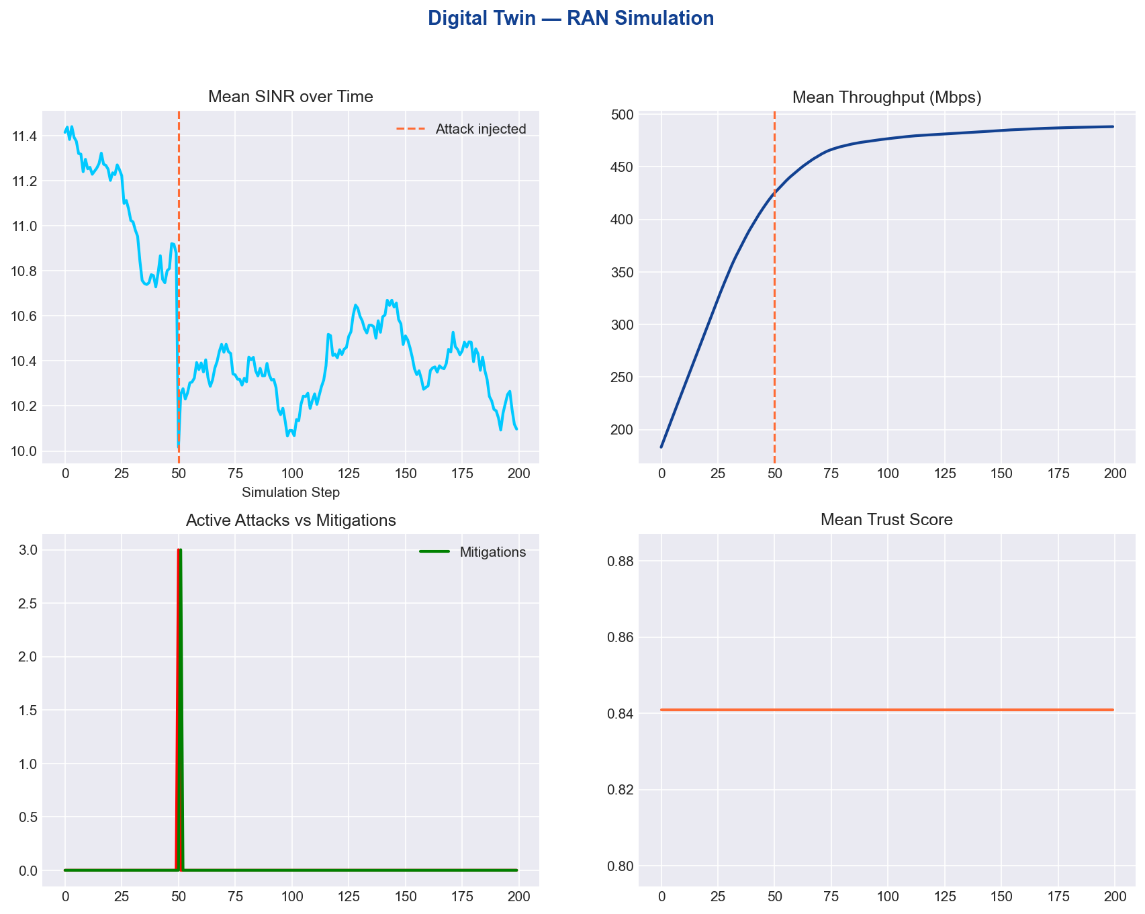
Digital Twin — Time Series KPIs

Slide 10
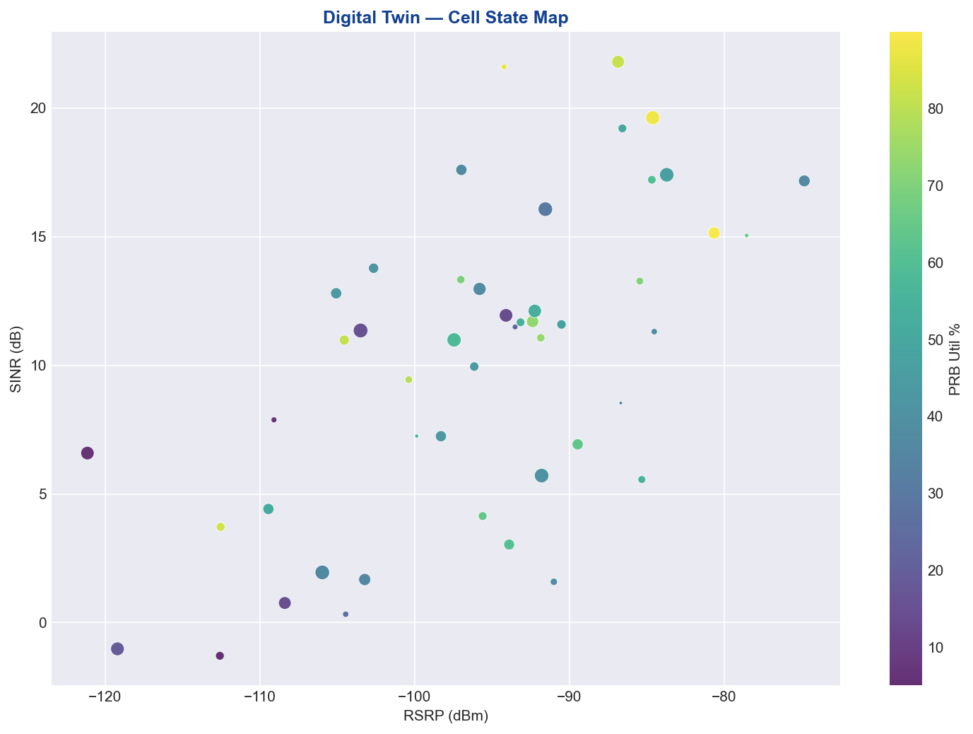
Digital Twin — Cell State Map

Slide 11
Consensus & Orchestration
Weighted trust voting with BFT-inspired validation
Thresholds: majority >70%, trust >0.8, confidence >0.85
MultiAgentCoordinator runs batch inference on test set
Consensus accept rate: 6.7%
Rejected proposals from compromised/low-trust agents

Slide 12
Dashboard & Chatbot
Streamlit dashboard: Overview, Data, Agents, Train/Val/Test, Digital Twin, Chatbot
Plotly interactive charts + static matplotlib plots
RAG chatbot over project knowledge corpus (TF-IDF retrieval)
Launch: streamlit run dashboard/app.py

Slide 13
References
3GPP TS 38.300, 38.331, 38.215, 28.530, 23.288, 33.501
3GPP TR 38.817, TR 23.700-80
O-RAN Near-RT RIC, E2GAP, xApp/rApp specifications
IEEE: MobiLLM, AI-Augmented Predictive Mobility, Jamming-Resilient HO (RL)
NIST PQC: CRYSTALS-Kyber, Dilithium | NBUC Problem Statement — Swetha Kerahalli

Slide 14
Thank You
Questions? | proj3_code/ | Dashboard + Docs + Models

