Slide 1
STUDENT PERFORMANCE
PREDICTION SYSTEM
Machine Learning Capstone Project
Prepared by: Shravani S | SkillOrbit | 25-10-26

Slide 2
Problem & Motivation
Student Performance Prediction System
Academic outcomes can relate to attendance, study time, internal marks, participation, and previous results.
A compact dashboard can help explore these indicators and offer supportive study prompts.
This is an educational prototype—not a validated student assessment tool.
Machine Learning Capstone • Demonstration dataset limitations apply

Slide 3
Project Objectives
Student Performance Prediction System
Prepare tabular data for machine learning.
Explore distributions and feature summaries with charts.
Predict Low, Average, or High performance.
Show transparent improvement suggestions and evaluation metrics.
Machine Learning Capstone • Demonstration dataset limitations apply

Slide 4
Technology Stack
Student Performance Prediction System
Python for application logic.
Pandas and NumPy for data handling.
scikit-learn for preprocessing, Random Forest, and metrics.
Streamlit for the interactive dashboard.
Machine Learning Capstone • Demonstration dataset limitations apply

Slide 5
Dataset & Features
Student Performance Prediction System
360 synthetic demonstration records are bundled so the app runs immediately.
Inputs: attendance, study hours, internal marks, participation, previous score.
Target: Low / Average / High performance.
Synthetic data must not be presented as real student data.
Machine Learning Capstone • Demonstration dataset limitations apply

Slide 6
System Workflow
Student Performance Prediction System
CSV → feature/target selection → preprocessing pipeline.
Stratified 80/20 train/test split (random_state=42).
Random Forest classifier with 250 trees and balanced class weights.
Prediction, dashboard visualizations, evaluation, and rule-based suggestions.
Machine Learning Capstone • Demonstration dataset limitations apply

Slide 7
Model & Evaluation
Student Performance Prediction System
Model: Random Forest classifier.
Preprocessing: median imputation and standard scaling in a pipeline.
Observed demo run: 72.2% hold-out accuracy on 72 synthetic test records.
Observed F1-scores: Average 0.545; High 0.863; Low 0.735.
Metrics describe only the synthetic demonstration run—not real-world accuracy.
Machine Learning Capstone • Demonstration dataset limitations apply

Slide 8
Dashboard Demonstration
Student Performance Prediction System
Prediction tab: class estimate, class probability, input summary, improvement prompts.
Dataset insights tab: record count, average indicators, class distribution, feature summaries.
Model evaluation tab: accuracy, classification report, feature importance.
Capture screenshots from the running local app for the final submission.
Machine Learning Capstone • Demonstration dataset limitations apply

Slide 9
Recommendation Logic
Student Performance Prediction System
Attendance below 75% → encourage consistent class attendance.
Study time below 2 hours/day → suggest a regular study schedule.
Internal marks below 60% → review feedback and weak topics.
Low participation or previous score → encourage practice and foundational revision.
These are transparent rules, not personalised diagnoses.
Machine Learning Capstone • Demonstration dataset limitations apply

Slide 10
Limitations & Responsible Use
Student Performance Prediction System
Synthetic, small dataset; patterns may not generalize.
No fairness audit, external validation, or deployment review yet.
Do not use predictions for grades, admissions, scholarships, or discipline.
Protect privacy and obtain appropriate approval before using real student records.
Machine Learning Capstone • Demonstration dataset limitations apply

Slide 11
Conclusion & Next Steps
Student Performance Prediction System
A runnable end-to-end ML prototype has been implemented in Streamlit.
Replace the demo CSV with a permitted, documented real dataset.
Compare baseline models and use cross-validation.
Regenerate metrics, document data provenance, and validate before deployment.
Machine Learning Capstone • Demonstration dataset limitations apply

Slide 12
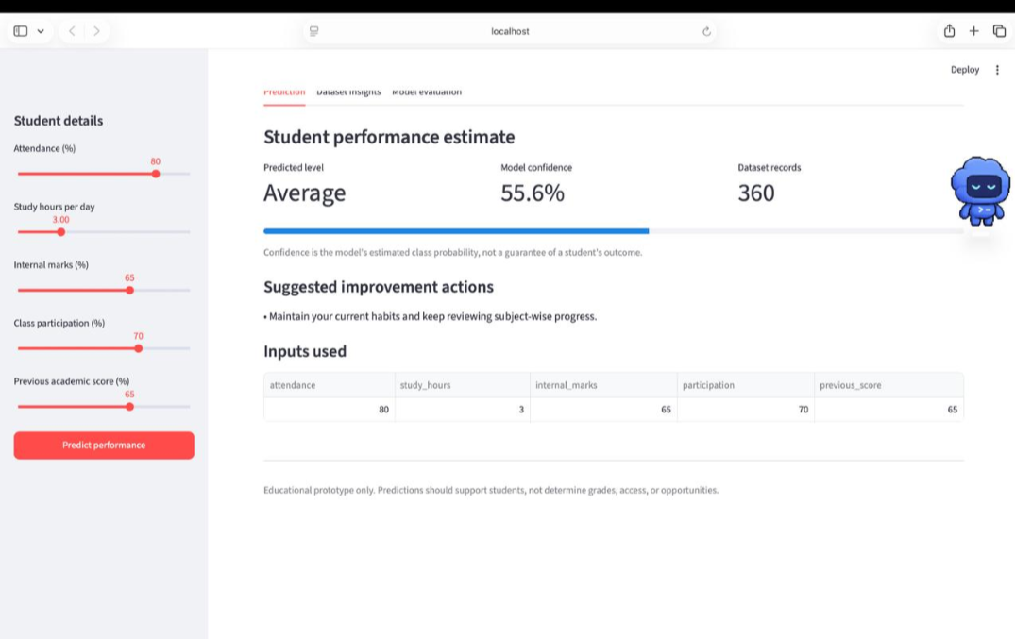
Live Dashboard: Prediction

Slide 13
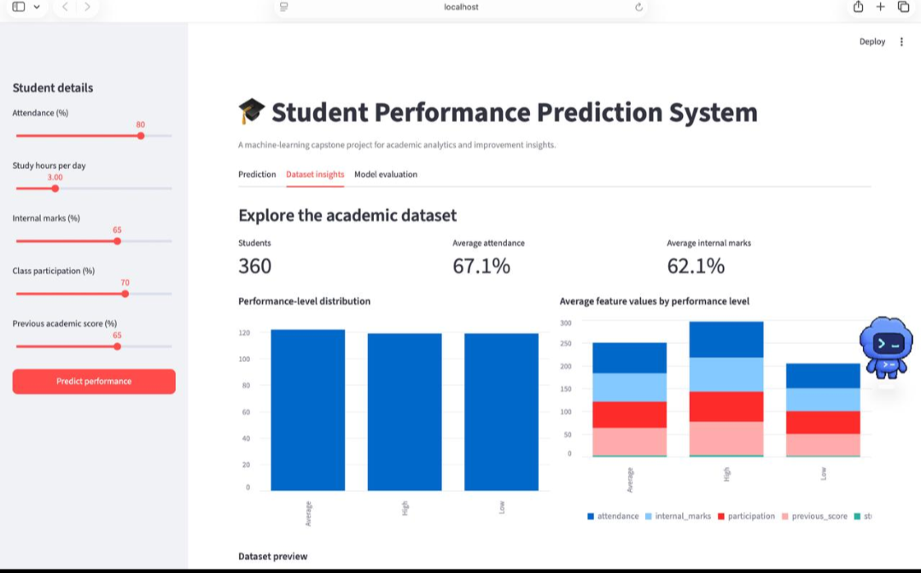
Live Dashboard: Dataset Insights

Slide 14
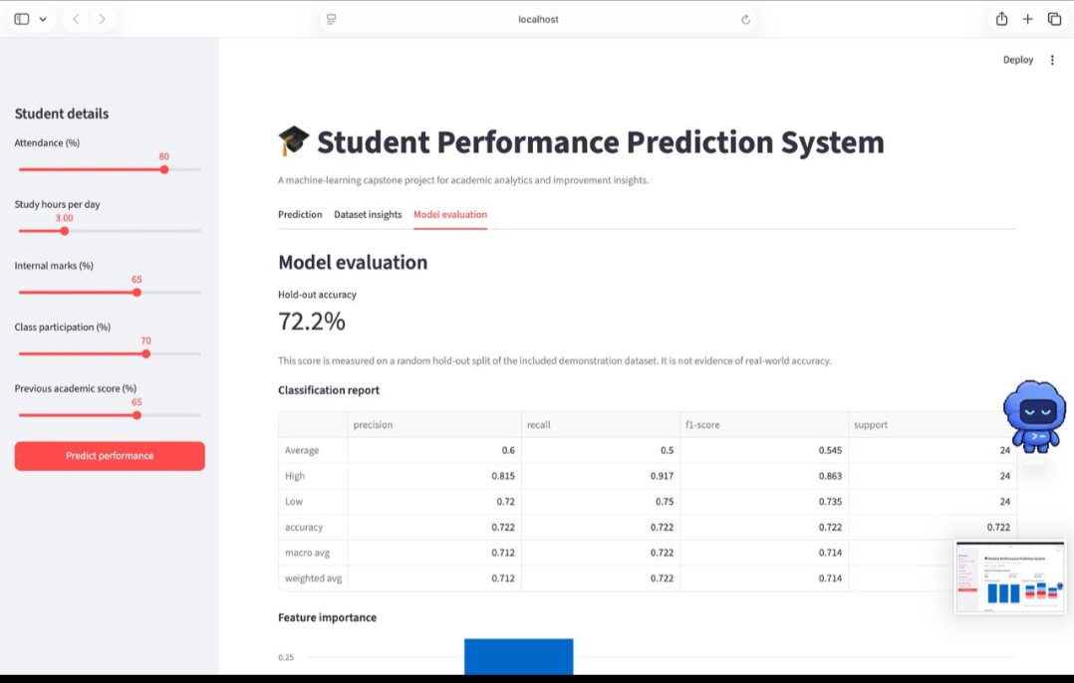
Live Dashboard: Model Evaluation

