Slide 1

Pravasa ಪ್ರವಾಸ
An AI travel planner for Karnataka. Speak or type your trip in Kannada or English and get a complete, mapped, costed plan.
Shravani Yalagatti
Computer Science & Business Systems, JSPM's RSCOE, Pune
github.com/shravanisy2006/Pravasa
Notes:
Hello, I am Shravani. This is Pravasa, which means 'journey' in Kannada: an AI travel planner for Karnataka that understands Kannada and English, by voice or text.

Slide 2



Problem: planning a Karnataka trip is hard
The problem
Who is affected
Karnataka's heritage sites, coast, Malnad hills and wildlife parks are spread across 31 districts. Planning a trip means juggling maps, blogs, weather sites and booking apps, almost all of them in English.
Kannada-first travellers
Elders and families from smaller towns who find English-only apps hard to use
First-time visitors
Why it matters
Don't know distances, best seasons or what is near what
Wrong season: a monsoon-rough coast, or Hampi at 38°C
Unrealistic routes waste a day of driving
Lesser-known places are missed, so local economies lose out
Students and budget travellers
Need a realistic cost before they set out
Notes:
The problem: Karnataka has amazing variety, but planning a trip means juggling many English-only tools. Kannada-first travellers, first-time visitors and budget travellers suffer most: wrong seasons, unrealistic routes and missed places.

Slide 3




Existing system: four tools, none of them a planner
Google Maps
Booking sites and agencies
Blogs and YouTube
General AI chatbots
What it does
What it does
What it does
What it does
Routes and reviews for one place at a time
Ready-made tour packages
Inspiring first-hand trip ideas
Quick itineraries from a prompt
The gap
The gap
The gap
The gap
Doesn't build a multi-day trip or warn about the season
Fixed, costly and mostly in English
Scattered and often outdated; hours of research
Can invent places, timings and prices; no real map or Kannada voice
The gap: no single tool turns “ಮೈಸೂರಿನಿಂದ 3 ದಿನ, ಕಾಡು ಇಷ್ಟ” (3 days from Mysuru, I love forests) into a realistic, mapped and costed plan.
Notes:
Today people use Google Maps, booking sites, blogs and general AI chatbots. Each helps a bit, but none plans a realistic multi-day trip in Kannada, and chatbots can even invent places or prices.

Slide 4
How Pravasa is different
 | The usual way | Pravasa
Asking | Typed English, filters and search boxes | Speak or type in Kannada or English, or tap an example
Places | Generic lists; AI chatbots may invent places | 55 hand-checked Karnataka places; the AI can't add new ones
Route | Guessed distances, one place at a time | Real road distances and a day-by-day map
Timing | No season or weather advice | Weather forecast plus season warnings for each place
Money | Costs found separately | Travel, stay, food and fees estimated against your budget
Take-away | Many open tabs | One page, a Kannada audio summary and a PDF to carry
Notes:
Pravasa takes voice or text in Kannada or English, plans only from verified places, uses real road distances, checks weather and season, estimates costs against your budget, and gives you audio and a PDF.

Slide 5





Approach: from one sentence to a full trip
1 Ask
2 Understand
3 Plan
4 Enrich
5 Deliver
Speak or type in Kannada or English, or tap a one-tap example
Gemini turns the words into settings: days, budget, start city, interests, must-see places
Our planner scores places by interest and best month, then fits each day into about 9 hours
Road routes, weather, photos, traveller notes and hotels, all fetched at once
Map, day-by-day plan, costs, an AI trip story you can listen to, and a PDF
How this differs from the usual AI approach: the AI only understands the request and writes the story. The plan itself comes from clear, testable code over verified data, so Pravasa can't make up a place, a fee or a distance.
Notes:
My approach has five steps: ask, understand, plan, enrich and deliver. The key choice is that the AI handles language, while the trip is planned by my own algorithm over a verified list of places.

Slide 6





Key design decisions
AI for language, code for logic
Verified places only
One AI call for voice
Gemini reads requests and writes stories; the route, days and costs are calculated by our planner.
55 places, each with Kannada name, best months, visiting hours, fees and local food.
Hearing and understanding happen in a single request, with a quicker model first, so voice is fast.
Everything fetched in parallel
Never stuck
Kannada everywhere
Routes, photos, notes, hotels and weather load at the same time and are cached.
If the AI is slow, a built-in summary appears in 20 seconds; if routing fails, distances are estimated.
Full Kannada interface, Kannada Wikipedia text, Kannada speech and a Kannada PDF.
Notes:
Six design decisions make Pravasa reliable and fast: AI only for language, verified places, a single AI call for voice, parallel loading, fallbacks so it never gets stuck, and Kannada everywhere.

Slide 7
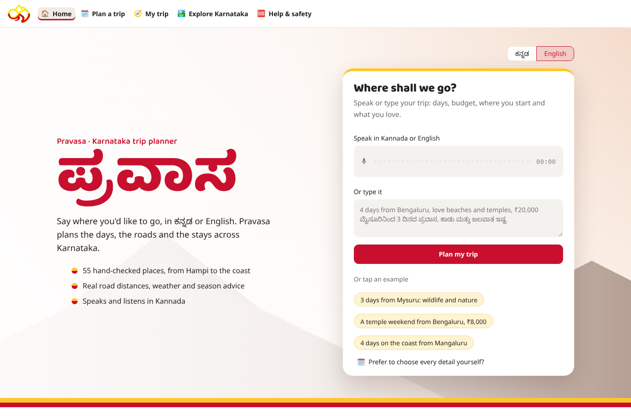
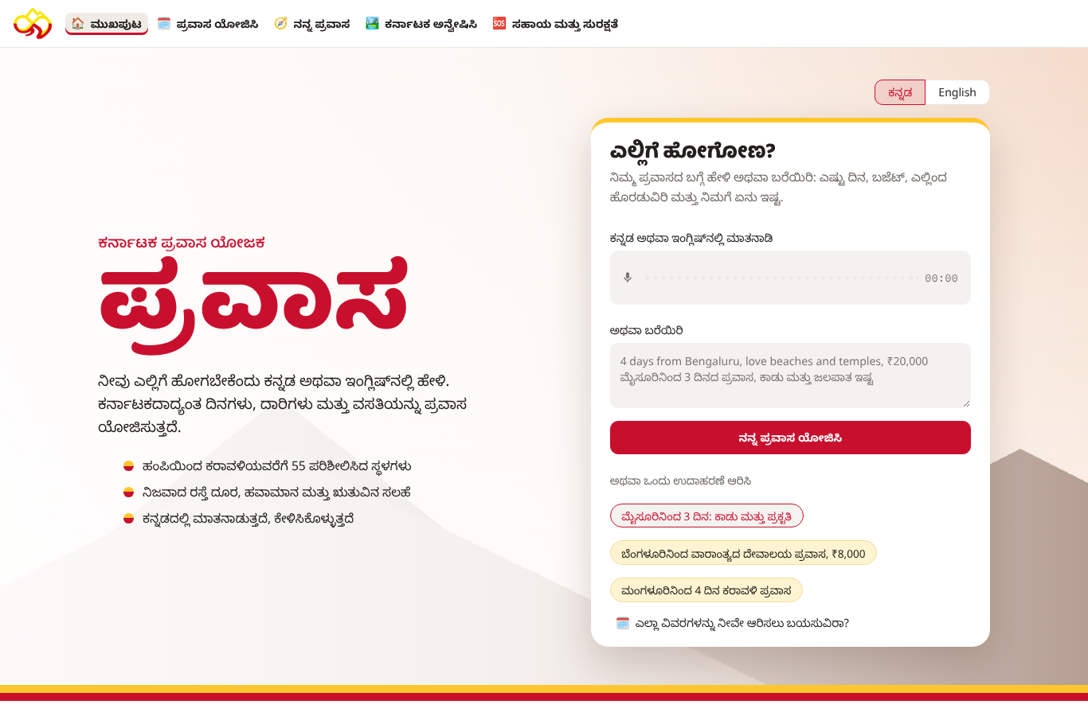
Ask in Kannada or English
English: speak, type, or tap a one-tap example
Kannada: the whole site switches with one tap: menus, plans, PDF
Five pages: Home, Plan a trip, My trip, Explore Karnataka, and Help & safety.
Notes:
This is the home page. You can speak, type or tap an example. One tap switches the whole site to Kannada.

Slide 8
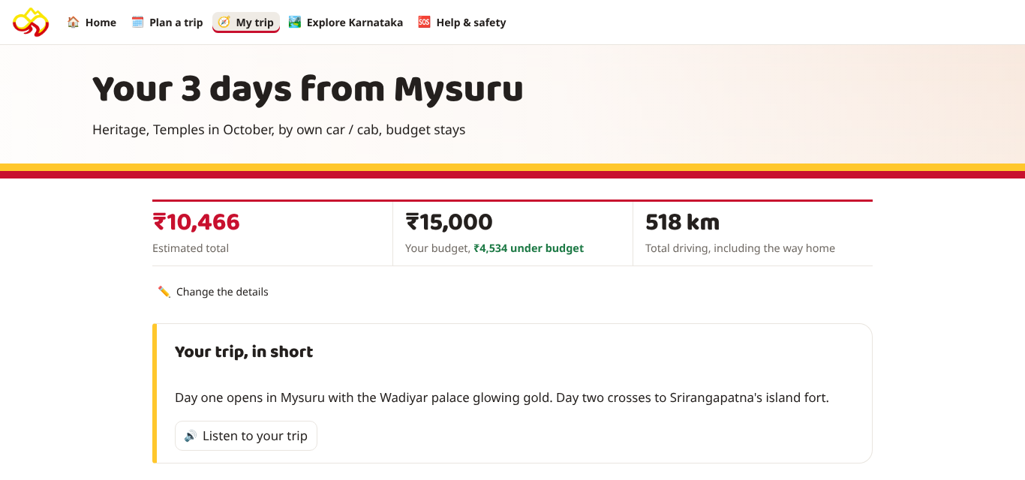



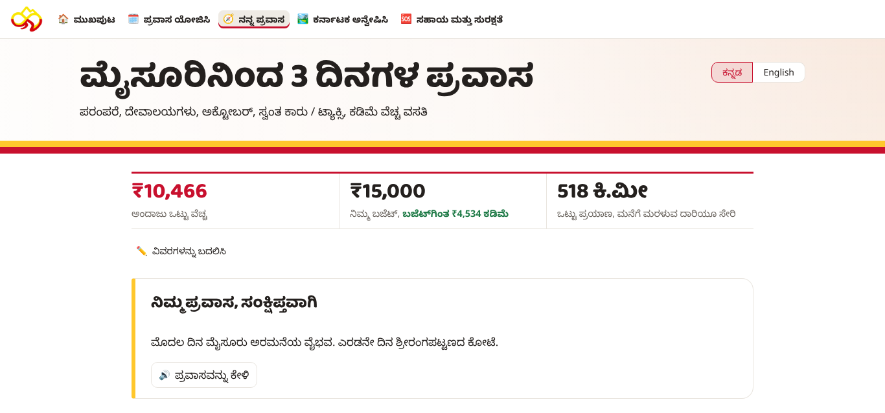



What the traveller gets
Route map with real road distances, one colour per day
Photo gallery, Wikipedia facts and what travellers say
Weather for each day and season warnings
Ways to get there: cab, KSRTC bus, train, auto or walk
Places to stay nearby and nearby sights
Cost breakdown compared with your budget
AI trip story you can listen to in Kannada
PDF of the full plan, plus emergency helplines
Notes:
For every trip you get a route map, a day-by-day plan with photos, weather and season tips, transport options, hotels, nearby places, costs against your budget, a trip story you can listen to, and a PDF.

Slide 9




Tech stack
App
AI
Python 3.12, Streamlit (5 pages, custom CSS), pandas
Google Gemini (google-genai): voice and text understanding, trip story
Maps and routes
Place content
Folium and Leaflet on OpenStreetMap; OSRM road routing
Wikipedia (English and Kannada), Wikimedia Commons photos, Wikivoyage notes
Weather and stays
Voice and documents
Open-Meteo forecast and past-weather archive; OpenStreetMap Overpass for hotels
gTTS for Kannada speech; fpdf2 with HarfBuzz for a correct Kannada PDF
Code and hosting
Cost to run
GitHub; Streamlit Community Cloud with the API key kept in Secrets
Free: open data sources, no login, only one API key (Gemini)
Notes:
Pravasa is built in Python with Streamlit. Gemini handles language. Maps use OpenStreetMap and OSRM, content comes from Wikipedia, weather from Open-Meteo and hotels from OpenStreetMap. gTTS speaks Kannada and fpdf2 writes the PDF.

Slide 10

Architecture and data flow
Pravasa app (Streamlit, Python)
Free online services
Pages
Google Gemini API
Home · Plan a trip · My trip · Explore · Help (Kannada / English via i18n.py)
Speech + text understanding, story
OSRM
ai.py
planner.py
Real road routes
Traveller
Understand voice or text → JSON settings; write the trip story
Score places, fit days, estimate costs (destinations.json, 55 places)
Phone or laptop browser
Wikipedia and Wikimedia
Text, photos, Wikivoyage notes
places.py · weather.py · extras.py · trip_map.py
Open-Meteo
Photos, notes, weather, hotels, transport, map; fetched in parallel and cached
Forecast and past weather
Outputs
OpenStreetMap Overpass
Folium map · day plan · cost chart · gTTS audio (voice.py) · PDF (report.py)
Hotels and stays
Notes:
The traveller's request goes to the Streamlit pages. ai.py asks Gemini to turn it into settings, planner.py builds the trip from our 55-place dataset, and the enrichment modules fetch routes, photos, weather and hotels from free services in parallel. The results come back as a map, plan, audio and PDF.

Slide 11



Conclusion
Summary
Impact
Future scope
Speak or type a trip in Kannada or English
Realistic day-by-day plan from verified places
Map, weather, stays, costs, audio and PDF, free
Kannada-first travellers can plan on their own
Fewer wrong-season trips and wasted drives
Brings visitors to lesser-known places across the state
More places, covering every district
Live bus and train timings, booking links
Offline mode, more languages, traveller reviews
Pravasa makes Karnataka easier to explore, in the traveller's own language.
Notes:
To conclude: Pravasa plans realistic Karnataka trips in Kannada or English, for free. It helps Kannada-first travellers and spreads tourism to lesser-known places. Next I would add more places, live bus and train timings, offline mode and more languages.

Slide 12


Scope and limitations
What it covers
Good to know
Selected places only: trips use 55 hand-picked destinations in 6 regions, not every place in Karnataka.
32 starting cities: every district headquarters plus a few major towns.
Costs are estimates: fees, timings and prices change; please confirm locally.
Distances: real road routes from OSRM; if unavailable, an estimate is shown and marked.
Weather: a real forecast only up to 16 days ahead; otherwise typical weather for that month.
Hotels: listed from OpenStreetMap and may be incomplete; Pravasa does not take bookings.
Photos and text: from Wikipedia and Wikimedia Commons, credited to their authors.
AI features: need internet and a Gemini key; if the AI is slow, a simple summary is shown.
Kannada text: translations are best-effort and still being reviewed.
Independent project: not affiliated with Karnataka Tourism, KSTDC or KSRTC.
Thank you · ಧನ್ಯವಾದಗಳು github.com/shravanisy2006/Pravasa
Notes:
Finally, the scope: Pravasa currently covers 55 selected places and 32 starting cities. Costs and weather beyond 16 days are estimates, hotel data may be incomplete, and it is an independent student project. Thank you.

