Slide 1
Water Potability Prediction
Machine learning classification of water quality
Final project report | October 2026
Notes:
Introduce the project: predicting whether a water sample is potable (safe to drink) from nine water-quality measurements.

Slide 2
Executive summary
3,276
9
69.9%
66.5%
water samples
water-quality features
best CV accuracy (Random Forest)
test accuracy after tuning
1
Random Forest was the strongest of five models (SVM, Random Forest, KNN, Decision Tree, XGBoost) and was tuned with GridSearchCV.
2
The tuned model reaches 66.5% test accuracy and an AUC of 0.66, versus a 61% majority-class baseline.
3
The tuned model reaches 77.5% of Training accuracy.
Notes:
Four headline numbers, then three takeaways. The key honest message: the model beats the majority-class baseline (61%) only modestly, and misses most potable samples.

Slide 3
The dataset
3,276
samples, 0 duplicate rows
pH
Hardness
Solids
Acidity level
Mineral content
Total dissolved solids
9
numeric input features
Chloramines
Sulfate
Conductivity
Chloramine concentration
Sulfate concentration
Electrical conductivity
1
target: Potability (1 = potable, 0 = not)
Organic carbon
Trihalomethanes
Turbidity
Organic carbon content
THM concentration
Water clarity
Notes:
water_potability.csv: 3,276 samples, nine numeric measurements and a binary target. No duplicate rows.

Slide 4
Data quality at a glance
Method Used: Missing values were handled using mean imputation
Missing values per feature
Missing values were in Sulfate (23.8%), pH (15.0%) and Trihalomethanes (4.9%).
They were filled with each column’s mean, so no rows were dropped.
Sulfate is missing in 24% of rows, pH in 15% and Trihalomethanes in 5%.
Notes:
Three features have missing values; Sulfate is the worst at about 24% of rows. The classes are imbalanced: 61% not potable versus 39% potable.

Slide 5
Features correlation
Strongest link: r = 0.034
Solids correlates most with potability, and it is still close to zero.
Features are fairly independent
The strongest feature pair is Solids vs Sulfate at r = -0.17.
Notes:
Correlation of every feature with Potability from the heatmap. All values are within about 0.03 of zero, so no single measurement separates the classes.

Slide 6
Preprocessing pipeline
1
2
3
4
5
Impute
Cap outliers
Split
Scale
Balance
Missing pH, Sulfate and Trihalomethanes filled with the column mean.
IQR rule (1.5 x IQR): extreme values are capped, not removed.
Stratified 80/20 split: 2,620 training and 656 test samples.
StandardScaler fitted on the training data.
SMOTE on the training set: 1,598 samples per class.
Each step is simple and uses standard scikit-learn / imbalanced-learn tools.
Notes:
Five steps: impute, cap outliers, stratified split, scale, SMOTE on the training data only.

Slide 7
Balancing classes with SMOTE
+576 synthetic samples
SMOTE interpolates new potable samples between existing neighbours.
Training set only
The 656-row test set keeps its original split of 400 / 256.
Why balance?
With 61% / 39% classes, models lean towards the majority class.
Notes:
SMOTE creates 576 synthetic potable samples in the training set. The test set is untouched.

Slide 8
Comparing five models
Random Forest leads: 69.9%
Best 5-fold CV accuracy among the five default models.
XGBoost is close: 67.1%
Tree ensembles beat the single Decision Tree (61.0%).
SVM and KNN struggle
They were trained on unscaled features, which hurts distance-based models.
Notes:
5-fold cross-validated accuracy on the SMOTE-balanced training data, default hyperparameters. Random Forest is best.

Slide 9
Tuning the Random Forest
Parameter | Values searched
n_estimators | 100, 200
max_depth | 5, 8, 10
min_samples_split | 10, 20, 30
min_samples_leaf | 5, 10, 15
max_features | sqrt
max_samples | 0.7, 0.8
324
model fits (108 candidates x 3 folds)
66.5%
best cross-validation accuracy
66.5%
accuracy on the held-out test set
Notes:
GridSearchCV with 108 candidates and 3-fold CV (324 fits). The grid limits depth and leaf size to reduce overfitting.

Slide 10
Final test performance
Class | Precision | Recall | F1 | Support
Not potable (0) | 0.66 | 0.94 | 0.77 | 400
Potable (1) | 0.72 | 0.23 | 0.35 | 256
Macro average | 0.69 | 0.59 | 0.56 | 656
77%
0.66
accuracy
ROC AUC
Notes:
Tuned Random Forest on 656 held-out samples. Strong on the not-potable class (recall 0.94) but weak on potable (recall 0.23).

Slide 11
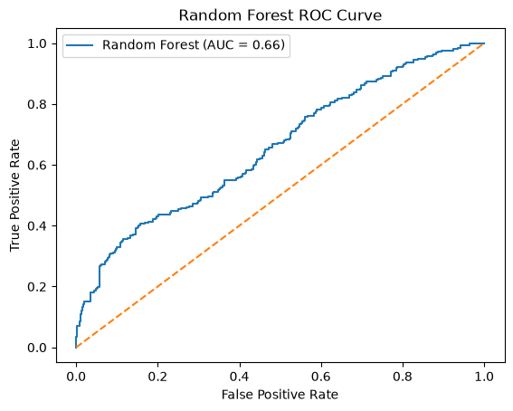
Discrimination: ROC curve
AUC = 0.66
Above the 0.50 of random guessing, but only moderate class separation.
Strongest at low false-positive rates
The curve rises fastest at the start, then flattens towards the diagonal.
The threshold matters
The default 0.5 cut-off favours the majority class; a lower one would raise recall.
Notes:
AUC of 0.66: better than random (0.50) but only moderate separation between the classes.

Slide 12
What drives predictions
Sulfate and pH lead
Both score about 0.16 in the tuned Random Forest.
Hardness, Chloramines, Solids
Mid-range importance, roughly 0.11 to 0.13.
No dominant driver
Importances are flat (0.08 to 0.16), matching the weak correlations.
Tuned Random Forest importances, approximate values read from the notebook plot.
Notes:
Importance values are approximate (read from the notebook plot). Sulfate and pH lead; the rest are fairly flat.

Slide 13
Conclusion and next steps
Conclusion
Random Forest was the best of five models.
Random Forest was tuned with GridSearchCV.
On 656 held-out samples it reaches 66.5% accuracy and an AUC of 0.66.
Measurements alone carry limited signal: correlations are near zero and importances are flat.
Notes:
Close with the key result and a concrete improvement plan.

