Slide 1
IBM University Engagement Project Submission
“Exploring the Power of Agentic AI with IBM Granite and LangFlow”

Slide 2

Project Tile – Nutrition Agent
Domain of Project – Healthcare
Student Name | Recent Passport Photo | Email ID | Mobile number [WhatsApp]
Shravani V S |  | shravanivs0611@gmail.com | 7204660587

Slide 3
Problem Statement -
Problem Statement : Nutrition Agent
The Challenge
Rapid urbanization and increasing population have led to a massive rise in waste generation. Many cities and communities struggle with inefficient waste collection, poor waste segregation, overflowing bins, lack of recycling awareness, and improper disposal methods. Traditional waste management systems often fail to provide real-time monitoring and optimized collection, leading to environmental pollution, health risks, and resource wastage.
The Objective
Build an AI-powered Smart Waste Management Agent that delivers intelligent waste monitoring, segregation guidance, recycling recommendations, and optimized collection management for households, industries, and municipalities. The solution should:
Smart Waste Segregation – Identify and classify waste into biodegradable, recyclable, hazardous, and electronic categories.
Real-Time Bin Monitoring – Monitor waste levels using sensors and notify authorities when bins are full.
Collection Route Optimization – Suggest efficient garbage collection routes to reduce fuel consumption and operational costs.
Recycling Recommendation System – Provide guidance on recycling methods and reusable alternatives.
Citizen Awareness & Assistance – Educate users about proper disposal practices through AI-based interaction.
Complaint & Feedback Management – Allow users to report unclean areas, illegal dumping, or missed collections.
Environmental Analytics Dashboard – Visualize waste generation trends, recycling rates, and environmental impact.
Multi-Agent System
Waste Classification Agent (identifies waste types)
Recycling Advisory Agent (suggests eco-friendly disposal methods)
Collection Management Agent (optimizes pickup schedules)
Awareness & Support Agent (educates and assists citizens)
Sustainability Focus – Promote cleaner cities, improved recycling efficiency, and reduced environmental pollution.

Slide 4
Technology Used
I used LangFlow + IBM watsonx.ai + Granite Models
LangFlow helped in designing the application flow visually, IBM watsonx.ai provided the AI development platform, and Granite Models were used for generating intelliegent responses and processing user queries accuretly.

Slide 5
Proposed Solution -
Proposed Solution: AI-Powered Nutrition Agent
Our proposed solution is an AI-powered Smart Waste Management Agent designed to improve waste collection, segregation, recycling, and environmental sustainability using intelligent automation and real-time monitoring.
The system uses AI, IoT sensors, and data analytics to help citizens and municipal authorities manage waste efficiently and reduce environmental pollution.
Key Features
AI-Based Waste Classification Automatically identifies waste as biodegradable, recyclable, hazardous, or electronic waste.
Smart Bin Monitoring IoT-enabled bins monitor waste levels and send alerts when bins are full.
Optimized Waste Collection AI suggests the shortest and most efficient collection routes to save fuel, time, and operational cost.
Recycling Recommendation System Provides guidance for proper recycling and eco-friendly disposal methods.
Citizen Support & Awareness Educates users about waste segregation and cleanliness through an interactive AI assistant.
Complaint Management System Users can report overflowing bins, illegal dumping, or missed garbage collection.
Analytics Dashboard Displays waste generation statistics, recycling performance, and environmental impact through visual dashboards.

Slide 6
Langflow component Used -
1) Chat Input – Interface where users enter their queries, preferences, or meal details (text/voice/image).
2) IBM watsonx AI Agent - Processes user input using Granite models to generate personalized nutrition insights and recommendations.
3) Name of IBM Granite model - Granite-4-h-small → Fast, efficient for real-time diet recommendations
4) Chat output -Displays AI-generated responses such as diet plans, nutritional analysis, and health suggestions.
5) File component - Stores and retrieves user data, meal logs, and nutritional datasets for analysis and tracking.
]

Slide 7
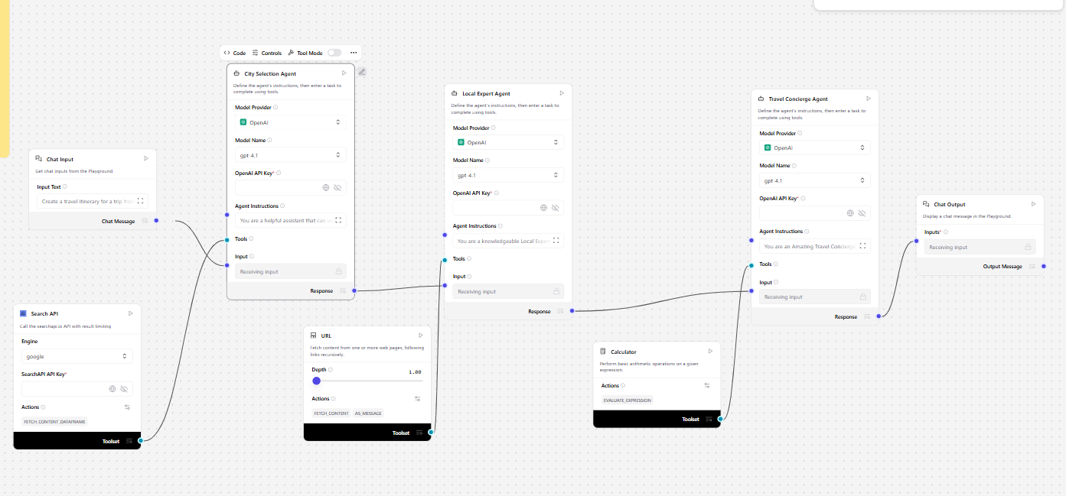
Langflow workflow -

Slide 8

Architecture blueprint

Slide 9

Role of Agentic AI in the solution
Role of Agentic AI in Nutrition Agent
Agentic AI enables the Nutrition Agent to function as an intelligent, autonomous system rather than a simple chatbot. Using IBM watsonx.ai and IBM Granite models, it coordinates multiple specialized agents to deliver personalized nutrition guidance.
Each agent performs a specific role—such as retrieving nutritional data, generating diet plans, providing health advice, and analyzing food logs—while working collaboratively. This multi-agent approach ensures efficient task execution and accurate results.
Agentic AI also brings context awareness, understanding user details like age, health conditions, and fitness goals to generate tailored recommendations. It supports real-time adaptation, continuously updating suggestions based on user inputs like daily meals.
Additionally, agents communicate with each other, enabling better decision-making and improved outcomes.
Overall, Agentic AI makes the system proactive, personalized, and goal-driven, acting like a smart digital nutritionist that helps users maintain a healthy lifestyle.

Slide 10
Technology Used
Langflow platform -For designing and orchestrating multi-agent workflows visually
IBM Grainte model - for eg – ibm-granite-3-2-8b – For natural language understanding, reasoning, and personalization
IBM Cloud – It provides the infrastructure to build, deploy, and scale the Nutrition Agent efficiently. IBM Cloud enables a reliable, secure, and scalable environment for deploying the Nutrition Agent.
RAG– RAG to fetch real data first, then generate intelligent answers, making the Nutrition Agent more trustworthy and effective.
IBM Watsonx.ai - For model deployment, embeddings, and AI governance
Vector Database (FAISS/Chroma) – For RAG-based nutritional data retrieval

Slide 11
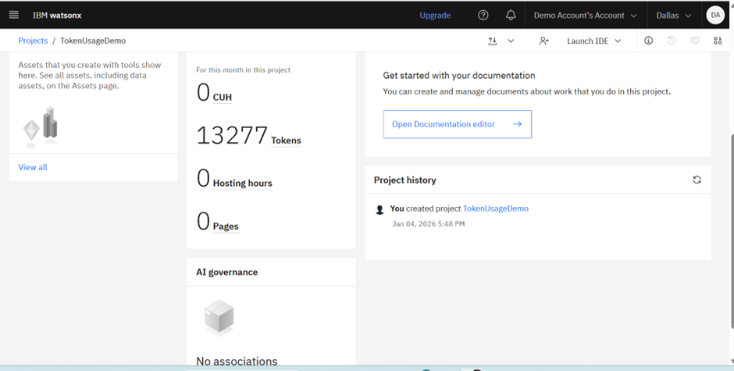
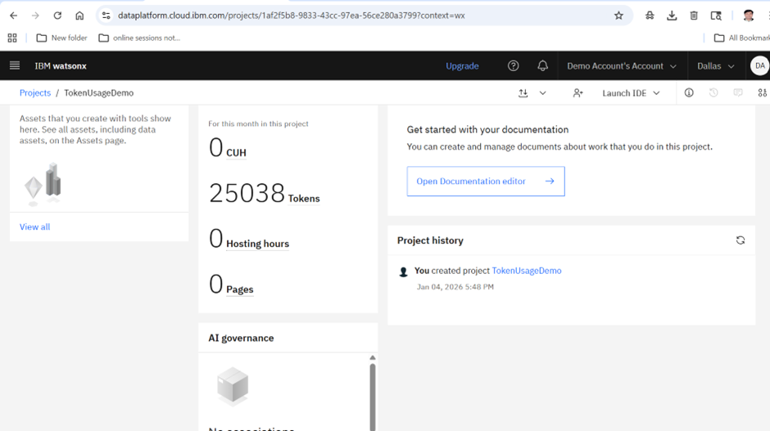
Token Usage
11,761 token are used
·
·
·

Slide 12
Novelty and Uniqueness
The proposed Nutrition Agent stands out by combining Agentic AI, RAG, and personalization into a single intelligent system.
Multi-Agent Intelligence – Instead of a single chatbot, multiple specialized agents collaborate to deliver accurate and context-aware nutrition guidance.
RAG-Based Accuracy – Integrates real-time data retrieval with AI generation, reducing misinformation and ensuring trustworthy recommendations.
Hyper-Personalization – Tailors diet plans based on health conditions, cultural preferences, and fitness goals.
Real-Time Feedback Loop – Continuously adapts recommendations based on daily food logs and user behavior.
Multi-Modal Input – Supports text, voice, and image-based meal tracking for better usability.
Preventive Healthcare Focus – Goes beyond diet planning to provide disease-specific nutrition advice.
Scalable & Enterprise-Ready – Built on IBM watsonx.ai with IBM Granite models, ensuring reliability and governance.
This makes the solution a smart, adaptive, and proactive digital nutritionist, not just a static diet recommendation tool.

Slide 13
Git Hub Link
Git Hub URL- github.com/shravanivs11
·
·

Slide 14
Future Scope
1.Integration with Wearables & Health Devices –
The system can be integrated with smartwatches and fitness trackers to collect real-time data such as steps, calories burned, heart rate, and sleep patterns. This will enable the Nutrition Agent to provide more accurate and dynamic diet recommendations based on actual user activity and health metrics.
2.AI-Powered Voice Assistant & Multilingual Support –
Enhancing the system with a voice-enabled assistant and support for multiple languages will improve accessibility. Users can interact naturally in their preferred language, making the solution more inclusive and suitable for diverse populations, especially in regions with varied linguistic backgrounds.
·
·
·

Slide 15


