Slide 1
DATA ANALYTICS · SQL · MYSQL
Brazilian E-Commerce
Sales Analysis
Uncovering revenue drivers, customer value, and sales trends from 99,441 orders on the Olist marketplace
99,441
R$16.0M
97.0%
ORDERS ANALYZED
TOTAL REVENUE
DELIVERY SUCCESS RATE
Prepared from Olist public e-commerce dataset · 2016–2018

Slide 2
AGENDA
What We'll Cover
01
Project Overview
02
Headline Metrics
Objective, dataset, and analytical approach using SQL & MySQL
Total orders, revenue, average order value, and payment mix
03
Geographic & Customer Insights
04
Product & Seller Performance
Top-performing states and highest-value customers
Best-selling categories and top revenue-generating sellers
05
Order Fulfillment Health
06
Strategic Recommendations
Delivery rates, cancellations, and operational bottlenecks
Actionable insights for retention and revenue optimization
Brazilian E-Commerce Sales Analysis
2

Slide 3



PROJECT OVERVIEW
Approach & Methodology
This analysis explores the Olist Brazilian e-commerce dataset — covering orders, payments, products, sellers, and customers from 2016–2018 — using SQL on MySQL to extract business-critical insights for retention and revenue growth.
DATASET SCOPE
99,441
UNIQUE ORDERS
Data Modeling
8 relational tables (orders, customers, products, sellers, payments, reviews, geolocation) loaded into MySQL
99,441
UNIQUE CUSTOMERS
Exploratory Queries
3,095
ACTIVE SELLERS
Aggregations, joins, and window-style ranking to surface volume and revenue patterns
32,951
PRODUCTS LISTED
Business Translation
73
PRODUCT CATEGORIES
Converted SQL outputs into customer retention and revenue optimization insights
27
BRAZILIAN STATES COVERED
Brazilian E-Commerce Sales Analysis
3

Slide 4
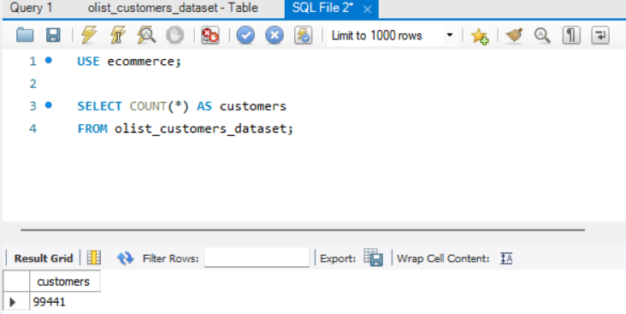
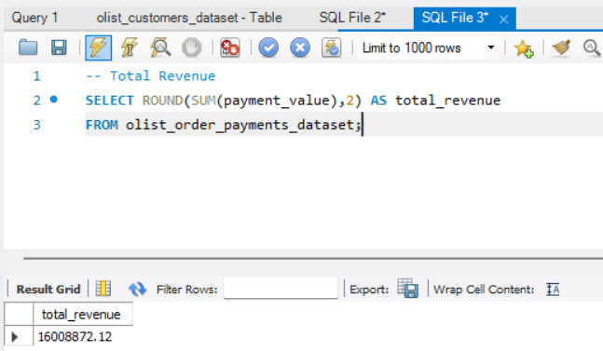
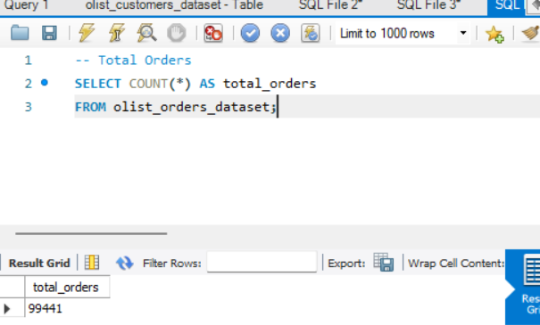
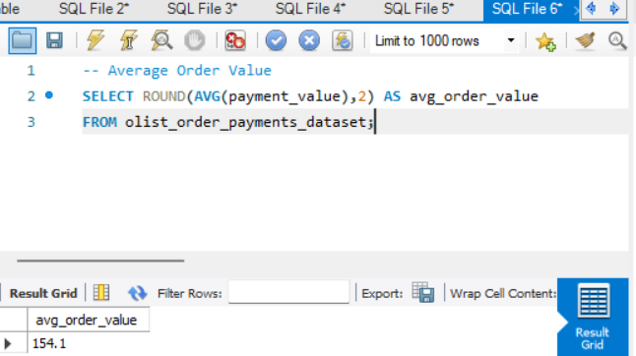
SQL QUERY LOG
Querying the Core Metrics
Four foundational queries against MySQL establish the dataset's scale and baseline economics.
Total Customers
Total Revenue
Total Orders
Average Order Value
Brazilian E-Commerce Sales Analysis
4

Slide 5





HEADLINE METRICS
The Business at a Glance
R$16,008,872
99,441
R$154.10
78.4%
TOTAL REVENUE
TOTAL ORDERS
AVERAGE ORDER VALUE
PAID BY CREDIT CARD
Sum of all payment values across the full order history
Equal to total customer count — one order per customer record
Mean transaction value across all completed payments
Share of total revenue collected through credit card payments
Key takeaway: With 99,441 orders generating R$16.0M and an average order value of just R$154, growth is more likely to come from increasing basket size and repeat purchases than from acquiring more one-time buyers.
Brazilian E-Commerce Sales Analysis
5

Slide 6
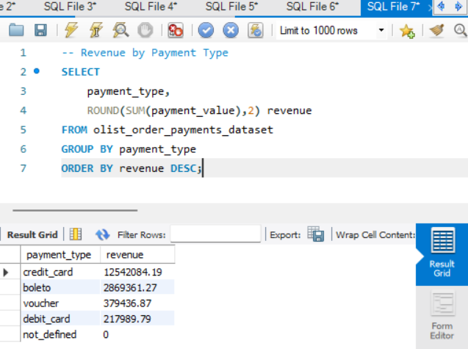
SQL QUERY LOG
Querying Revenue by Payment Type
PAYMENT ANALYSIS
GROUP BY payment_type with SUM(payment_value), ordered by revenue descending.
MySQL Workbench
Brazilian E-Commerce Sales Analysis
6

Slide 7
PAYMENT ANALYSIS
Revenue by Payment Method
SQL: GROUP BY payment_type, ordered by total revenue
Credit Card
78.4%
R$12,542,084
Boleto
17.9%
R$2,869,361
Voucher
2.4%
R$379,437
Debit Card
1.4%
R$217,990
Insight: Credit card dominates at 78% of revenue — a strong signal to prioritize installment offers and card-linked promotions for conversion lift.
Brazilian E-Commerce Sales Analysis
7

Slide 8
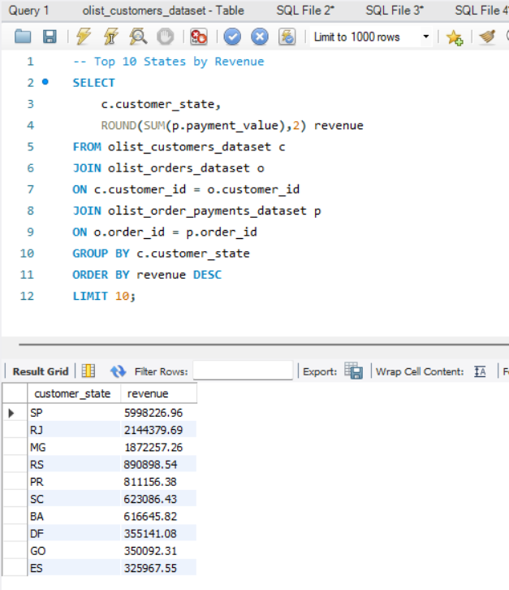
SQL QUERY LOG
Querying Top States by Revenue
GEOGRAPHIC INSIGHTS
JOIN customers → orders → payments, GROUP BY customer_state, ordered by revenue descending.
MySQL Workbench
Brazilian E-Commerce Sales Analysis
8

Slide 9

GEOGRAPHIC INSIGHTS
Top 10 States by Revenue
SQL: JOIN customers → orders → payments, GROUP BY customer_state
SP
R$6.00M
RJ
R$2.14M
MG
R$1.87M
São Paulo Leads
RS
R$0.89M
37.5%
PR
R$0.81M
SC
R$0.62M
of total platform revenue comes from São Paulo state alone — more than the next three states combined.
BA
R$0.62M
DF
R$0.36M
Implication: Logistics and marketing spend concentrated in SP/RJ/MG would reach over 60% of revenue-generating customers.
GO
R$0.35M
ES
R$0.33M
Brazilian E-Commerce Sales Analysis
9

Slide 10
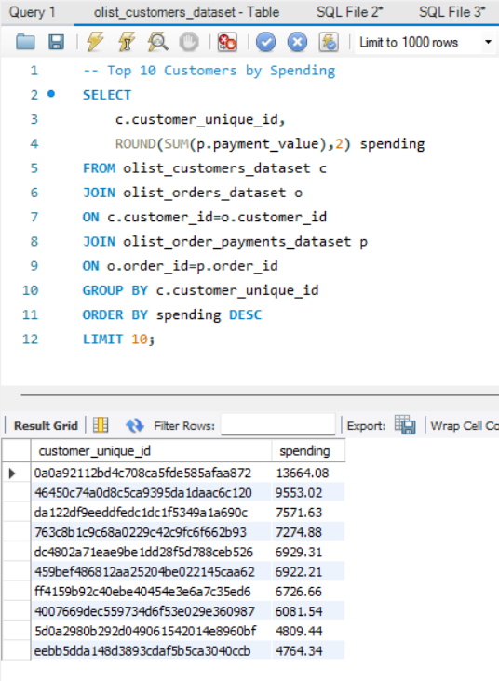
SQL QUERY LOG
Querying Top Customers by Spending
CUSTOMER INSIGHTS
JOIN customers → orders → payments, GROUP BY customer_unique_id, LIMIT 10.
MySQL Workbench
Brazilian E-Commerce Sales Analysis
10

Slide 11

CUSTOMER INSIGHTS
Top 10 Customers by Spending
SQL: JOIN customers → orders → payments, GROUP BY customer_unique_id
1
0a0a9211…faa872
R$13,664.08
6
459bef48…5caa62
R$6,922.21
Customer ID (unique)
Customer ID (unique)
2
46450c74…c6c120
R$9,553.02
7
ff4159b9…c35ed6
R$6,726.66
Customer ID (unique)
Customer ID (unique)
3
da122df9…1a690c
R$7,571.63
8
4007669d…360987
R$6,081.54
Customer ID (unique)
Customer ID (unique)
4
763c8b1c…662b93
R$7,274.88
9
5d0a2980…8960bf
R$4,809.44
Customer ID (unique)
Customer ID (unique)
5
dc4802a7…ceb526
R$6,929.31
10
eebb5dda…040ccb
R$4,764.34
Customer ID (unique)
Customer ID (unique)
Retention priority: The top customer alone spent R$13,664 — a VIP tier with personalized service could meaningfully lift lifetime value.
Brazilian E-Commerce Sales Analysis
11

Slide 12
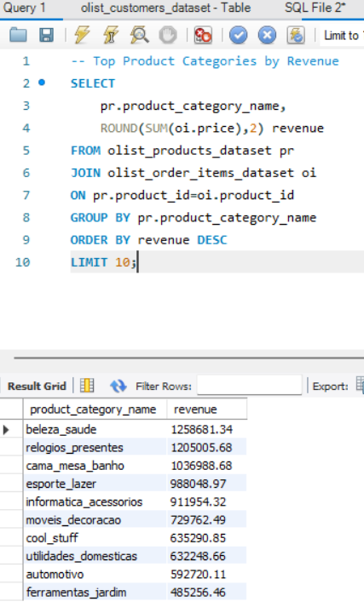
SQL QUERY LOG
Querying Top Product Categories
PRODUCT PERFORMANCE
JOIN products → order_items, GROUP BY product_category_name, ordered by revenue.
MySQL Workbench
Brazilian E-Commerce Sales Analysis
12

Slide 13

PRODUCT PERFORMANCE
Top Product Categories by Revenue
SQL: JOIN products → order_items, GROUP BY product_category_name
Health & Beauty
R$1259K
Watches & Gifts
R$1205K
Bed, Bath & Table
R$1037K
Sports & Leisure
R$988K
Computer Accessories
R$912K
Furniture & Décor
R$730K
Cool Stuff
R$635K
Housewares
R$632K
Automotive
R$593K
Garden Tools
R$485K
Category focus: Health & Beauty and Watches & Gifts lead revenue — strong cross-sell and gift-bundle candidates.
Brazilian E-Commerce Sales Analysis
13

Slide 14
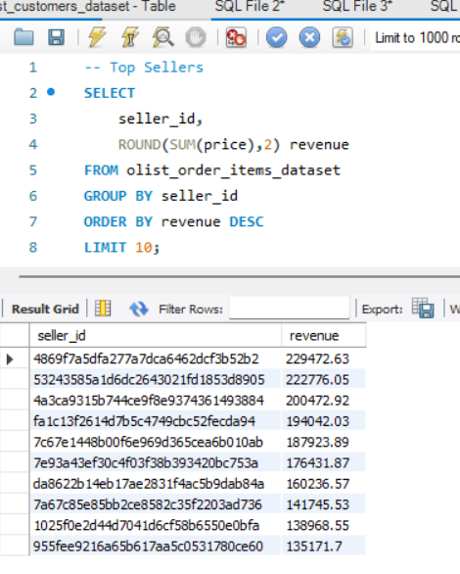
SQL QUERY LOG
Querying Top Sellers by Revenue
SELLER PERFORMANCE
GROUP BY seller_id on order_items, ordered by SUM(price) descending.
MySQL Workbench
Brazilian E-Commerce Sales Analysis
14

Slide 15

SELLER PERFORMANCE
Top 10 Sellers by Revenue
SQL: GROUP BY seller_id on order_items, ordered by SUM(price)
#1
4869f7…52b2
R$229.5K
#2
532435…8905
R$222.8K
#3
4a3ca9…3884
R$200.5K
3,095
#4
fa1c13…da93
R$194.0K
ACTIVE SELLERS
#5
7c67e1…10ab
R$187.9K
#6
7e93a4…753a
R$176.4K
The top 10 sellers account for roughly R$1.79M — under 12% of platform revenue, indicating a long, fragmented tail of smaller sellers.
#7
da8622…b84a
R$160.2K
#8
7a67c8…d736
R$141.7K
#9
1025f0…0bfa
R$139.0K
#10
955fee…ce60
R$135.2K
Brazilian E-Commerce Sales Analysis
15

Slide 16
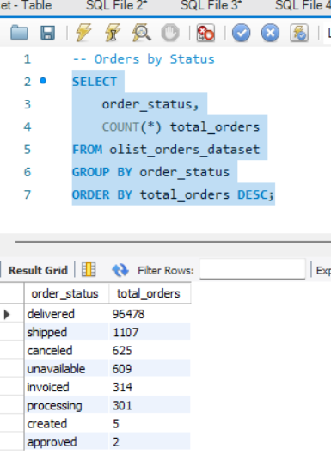
SQL QUERY LOG
Querying Orders by Status
OPERATIONAL HEALTH
GROUP BY order_status on the orders table, ordered by order count descending.
MySQL Workbench
Brazilian E-Commerce Sales Analysis
16

Slide 17
OPERATIONAL HEALTH
Order Fulfillment Status
SQL: GROUP BY order_status, ordered by order count
STATUS
ORDERS
SHARE
Delivered
96,478
97.02%
97.0%
Shipped
1,107
1.11%
Canceled
625
0.63%
DELIVERED
SUCCESSFULLY
Unavailable
609
0.61%
Invoiced
314
0.32%
Processing
301
0.30%
Created
5
0.01%
1.2%
Approved
2
0.00%
CANCELED OR UNAVAILABLE
Brazilian E-Commerce Sales Analysis
17

Slide 18



STRATEGIC RECOMMENDATIONS
Turning Insight Into Action
Launch a VIP Retention Tier
Double Down on SP / RJ / MG
Promote Card-Based Installments
Top customers spend up to R$13,664 — introduce loyalty perks and early access for high-value, repeat buyers.
These three states drive over 60% of revenue; prioritize regional logistics partners and localized campaigns.
Credit card already drives 78% of revenue — expand no-interest installment plans to lift average order value.
Bundle Top Categories
Tighten the Long-Tail Seller Base
Protect the 97.0% Delivery Rate
Health & Beauty and Watches & Gifts lead sales — pair them with lower-performing categories in cross-sell bundles.
Top 10 sellers are under 12% of revenue; support mid-tier sellers with tools to consolidate share and grow volume.
Maintain fulfillment SLAs and monitor canceled/unavailable orders to prevent erosion of customer trust.
Brazilian E-Commerce Sales Analysis
18

Slide 19


THANK YOU
Questions & Discussion
Full SQL query set and result exports available on request · Built with MySQL on the Olist Brazilian E-Commerce dataset

