Slide 1

RETAIL SALES — EXPLORATORY DATA ANALYSIS
Decoding Customer Behaviour
and Sales Performance
An EDA project on a 1,000-transaction retail dataset, built with Python, Pandas, Seaborn and Matplotlib.
Shravani Yadav
Presenter · Data Analysis Project
Notes:
Hello everyone. My name is Shravani Yadav, and today I am presenting my project on Exploratory Data Analysis of a Retail Sales Dataset. The main objective of this project is to analyze retail sales data and identify customer behavior, sales trends, and product performance using Python.

Slide 2

PROJECT OVERVIEW
What This Project Sets Out to Do
This project analyses a real-world style retail transactions dataset to uncover patterns in customer behaviour, sales trends, and product performance — using Python as the primary analytical tool.
DATASET SNAPSHOT
1,000
Retail transactions
Customer Behaviour
8
Understand who is buying — by gender, age, and spending pattern.
Key fields tracked
Sales Trends
Track how revenue shifts across months of the year.
Transaction Date · Customer ID · Gender · Age · Category · Quantity · Price/Unit · Total Amount
Product Performance
Compare revenue contribution across product categories.
02
Notes:
The dataset contains 1000 retail transactions and includes information such as transaction date, customer ID, gender, age, product category, quantity purchased, price per unit, and total amount.

Slide 3



STEP 1 · PREPARATION
Loading the Data & Checking Its Quality
The dataset was loaded with Pandas and inspected end-to-end before any analysis began — shape, data types, missing values, and duplicate records were all reviewed.
0
Dataset Shape
1,000 rows confirmed across 8 columns
MISSING VALUES
Data Types
Each column validated against its expected type
The dataset was confirmed completely clean — no nulls, no duplicates — ready for direct analysis.
Duplicate Records
Checked and none were found
03
Notes:
First, I loaded the dataset using the Pandas library and explored its structure. I checked the dataset shape, data types, missing values, and duplicate records. The dataset was clean and did not contain any missing values.

Slide 4




METHODOLOGY
From Raw Transactions to Business Insight
01
02
03
Data Cleaning
Descriptive Stats
Category Analysis
Shape, types, nulls & duplicates checked
Distributions of age, quantity, price, total
Revenue compared across product categories
04
05
06
Gender Analysis
Age Distribution
Trend & Pattern
Purchasing behaviour by gender
Identifying primary customer age groups
Monthly trend, spending pattern, correlations
04
Notes:
Next, I performed descriptive statistical analysis to understand the distribution of numerical variables such as age, quantity, price per unit, and total amount. This slide summarizes the overall approach I followed across the project.

Slide 5
STEP 2 · CATEGORY ANALYSIS
Sales by Product Category
READING THE CHART
Electronics leads revenue at ~₹1.57L, closely followed by Clothing.
Beauty trails slightly but still contributes a substantial, comparable share.
05
Notes:
I then analyzed sales across different product categories. This helped identify which categories generated higher revenue and contributed more to overall sales.

Slide 6
STEP 3 · GENDER ANALYSIS
Sales by Gender
READING THE CHART
Purchases are almost evenly split between genders — 51.1% Female vs. 48.9% Male. This balance suggests marketing and inventory strategies should serve both segments equally, rather than skewing toward one.
06
Notes:
After that, I performed gender-based analysis to compare purchasing behavior between male and female customers.

Slide 7
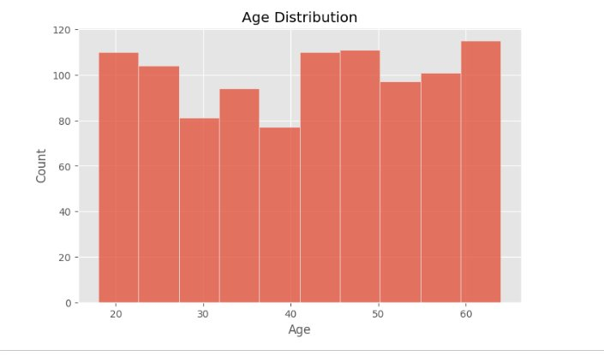
STEP 4 · AGE DISTRIBUTION
Who Are the Customers?
READING THE CHART
Customers span ages 18–64 fairly evenly, with no single age group dominating. Slightly higher counts appear among young adults (20s) and customers in their late 50s–60s.
07
Notes:
I also analyzed the age distribution of customers to understand the primary customer groups making purchases.

Slide 8
STEP 5 · TIME SERIES ANALYSIS
Monthly Sales Trend
READING THE CHART
Sales peak in May (~₹53K) and rebound again in October.
September dips sharply to the year's lowest point (~₹23.5K), suggesting a seasonal lull worth planning around.
08
Notes:
For time series analysis, I converted the date column into a datetime format and examined monthly sales trends. This helped visualize how sales changed over time.

Slide 9
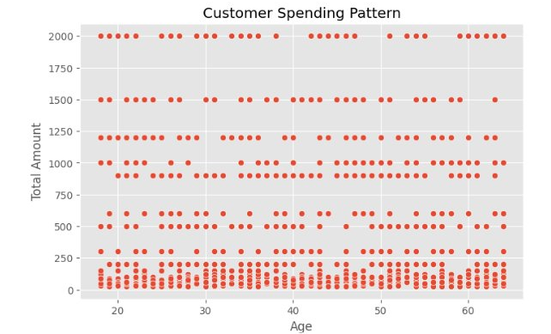
STEP 6 · SPENDING PATTERN
Customer Spending Pattern
READING THE CHART
Spending clusters into fixed price bands (₹2000, ₹1500, ₹1200, etc.) rather than rising smoothly with age. This points to product price points — not customer age — as the main driver of transaction value.
09
Notes:
Additionally, I created a customer spending pattern visualization using a scatter plot to study the relationship between customer age and purchase amount.

Slide 10
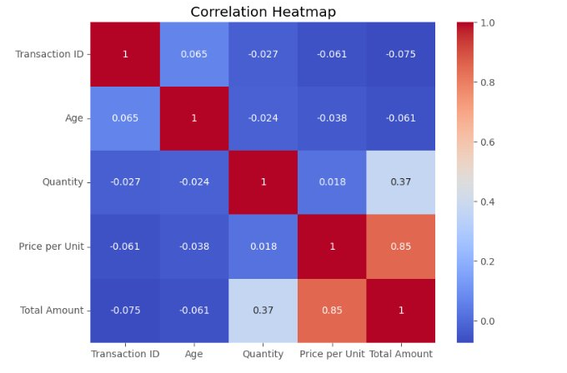
STEP 7 · CORRELATION ANALYSIS
How the Numbers Relate
READING THE CHART
Price per Unit ↔ Total Amount: 0.85 — price is the strongest driver of transaction value. Quantity ↔ Total Amount: 0.37 — a moderate, secondary effect. Age shows almost no correlation with spend.
10
Notes:
To better understand relationships between variables, I generated a correlation heatmap. This provided insights into how numerical features are related to one another.

Slide 11
KEY FINDINGS
What the Data Tells Us
Balanced Audience
Category Leaders
Gender split is nearly even (51.1% F / 48.9% M) — design for both.
Electronics & Clothing generate the most revenue, Beauty close behind.
Price Over Volume
Seasonal Swings
Price per unit (0.85) drives revenue far more than quantity (0.37).
Sales peak in May and dip sharply in September — plan inventory around it.
11
Notes:
Based on the analysis, I observed that customer demographics, product categories, and purchase quantities have a significant impact on sales performance.

Slide 12

CONCLUSION
Skills Built Through This Project
Data Cleaning
Exploratory Analysis
Data Visualization
Business Insight
Validating structure, types & quality
Uncovering trends within raw data
Turning numbers into clear visuals
Translating findings into decisions
Thank You
Shravani Yadav · Retail Sales EDA Project
Notes:
In conclusion, this project helped me gain practical experience in data cleaning, exploratory data analysis, data visualization, and extracting business insights from data. Thank you for watching my presentation.

