Slide 1


Slide 2
IMP Note to Students
It is important to know that just login to the session does not guarantee the attendance.
Once you join the session, continue till the end to consider you as present in the class.
IMPORTANTLY, you need to make the class more interactive by responding to Professors queries in the session.
Whenever Professor calls your number / name ,you need to respond, otherwise it will be considered as ABSENT

Slide 3
Course Name :
Middleware Technologies CSIW ZG524

Slide 4
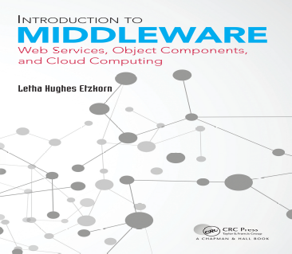
Textbooks
T1: Letha Hughes Etzkorn - Introduction to middleware _ web services, object components, and cloud computing-Chapman and Hall_CRC (2017).
T2: William Grosso - Java RMI (Designing & Building Distributed Applications)
R1: Gregor Hohpe, Bobby Woolf - Enterprise Integration Patterns_ Designing, Building, and Deploying Messaging Solutions -Addison-Wesley Professional (2003)
R2: MongoDB in Action
Note: In order to broaden understanding of concepts as applied to Indian IT industry, students are advised to refer books of their choice and case-studies in their own organizations

Slide 5
Modular Structure
No | Title of the Module
M1 | Introduction and Evolution
M2 | Enterprise Middleware
M3 | Middleware Design and Patterns
M4 | Middleware for Web-based Application and Cloud-based Applications
M5 | Specialized Middleware

Slide 6
CS8: EAI: Message System Management

Slide 7
CS7: EAI: Simple and Composed Messaging

Slide 8
Agenda
Messaging Endpoints.
Simple Messaging.
Composed Messaging.
How to compose routing and transformation patterns into a larger solution.
Overview of Messaging Patterns.

Slide 9
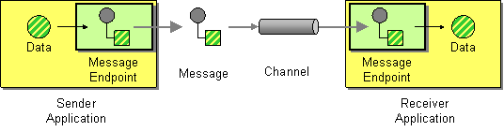
Message Endpoints
Connect an application to a messaging channel using a Message Endpoint, a client of the messaging system that the application can then use to send or receive messages.
Message Endpoint code is custom to both the application and the messaging system’s client API.
One must know what request or piece of data to send to another application or is expecting those from another application.
Messaging endpoint code takes the command or data, makes it into a message, and sends it on a particular messaging channel. It is the endpoint that receives a message, extracts the contents, and gives them to the application in a meaningful way.
Related patterns: Channel Adapter, Competing Consumers, Durable Subscriber, Event-Driven Consumer, Idempotent Receiver, Message Channel, Message Dispatcher, Selective Consumer, Service Activator, Messaging Gateway, Messaging Mapper, Polling Consumer, Transactional Client.

Slide 10
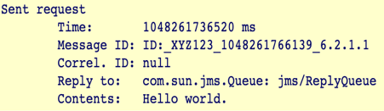
Simple Messaging with illustrative Patterns
Document Message — The default type of message, used as both the request and the reply.
Request-Reply — A pair of messages sent over a pair of channels, allowing the two applications to have a two-way conversation.
Return Address — The channel to send the response on.
Correlation Identifier — The ID of the request that caused this response.
Datatype Channel — All of the messages on each channel should be of the same type.
Invalid Message Channel — What happens to messages that aren’t of the right type.
Publish/Subscribe — Explores how to use a JMS Topic to implement the Observer pattern.
JMS Request-Reply Example
jms/RequestQueue — The Queue the Requestor uses to send the request message to the Replier.
jms/ReplyQueue — The Queue the Replier uses to send the reply message to the Requestor.
jms/InvalidMessages — The Queue that the Requestor and Replier move a message to when they receive a message that they cannot interpret.
Here's how the example works. When the Requestor is started in a command-line window, it starts and prints output like this:

Slide 11
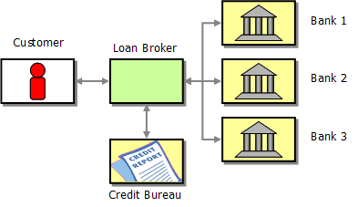
Composed Messaging Example
Design a loan broker system using integration patterns studied.
List the individual tasks that the loan broker needs to perform.
Patterns used to implement Loan Broker
How Broker receives the incoming request.
We cover this topic in much more detail in the following chapter on endpoint patterns. So for now, let's skip over this step and assume the message is somehow received by the broker.
Now, the broker has to retrieve some additional information, i.e. the customer's credit score. A Content Enricher sounds like the ideal
choice for this task.
Once the broker has the complete information, the broker has to determine the appropriate banks to route the request message to. We can accomplish this with another Content Enricher that computes the list of recipients for the request.

Slide 12
CS8: EAI: Message System Management

Slide 13
Agenda
Challenges faced
  Development
  Testing
Monitoring and Controlling
  Control Bus
  Detour
Observing and Analyzing Message Traffic
  Wire Tap
  Message History
  Message Store
  Smart Proxy
Testing and Debugging
  Test Message Injection
  Channel purger

Slide 14
Architect's dream,
Developer's nightmare symptom.
A message-based integration solution may produce, route and transform thousands or even millions of messages in a day. One has to deal with exceptions, performance bottlenecks and changes in the participating systems.
Components are distributed across many platforms and machines that can reside at multiple locations.
Architectural benefits of loose coupling actually make testing and debugging a system harder.
Assumptions made about each other are less in such system and therefore provide flexibility.
Complexity for Testers: Testing a system where a message producer is not aware of who the consumers of this message are, can be challenging.
Asynchronous nature of messaging make things even more complicated.
  For example, the messaging solution may not even be designed for the message producer to receive a reply message from the recipient(s). Likewise, the messaging infrastructure typically guarantees the delivery of the message but not the delivery time. This makes it hard to develop test cases that rely on the results of the message delivery.

Slide 15
Monitoring and Controlling
Messages can be tracked at at two different levels of Abstraction.
  System Management - Monitors how many messages are being sent or how long it took a message to be processed.
  These monitoring solutions do not inspect the message data except maybe for some fields in the message header such as the message identifier or the Message History.
  Business Activity Monitoring (BAM) - Focus on the payload data contained in the message, for example the Dollar value of all orders placed in the last hour.
Note - Many of the patterns presented in this section are general enough that they can be used for either purpose. However, because business activity monitoring is a whole new field in itself and shares many complexities with data warehousing (something we have not touched on at all), we decided to discuss the patterns in the context of system management.

Slide 16
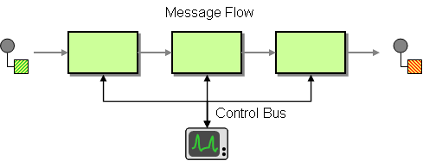
Control Bus
Use a Control Bus to manage an enterprise integration system.
The Control Bus uses the same messaging mechanism used by the application data, but uses separate channels to transmit data that is relevant to the management of components involved in the message flow.
One can use additional steps, such as validation or logging for troubleshooting.

Slide 17
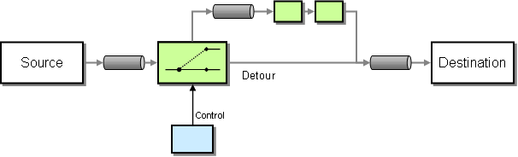
Detour (Validation, Testing or Debugging)
The Detour uses a simple context-based router with two output channels. One output channel passes the unmodified message to the original destination. When instructed by the Control Bus, the Detour routes messages to a different channel. This channel sends the message to additional components that can inspect and/or modify the message. Ultimately, these components route the message to the same destination.

Slide 18
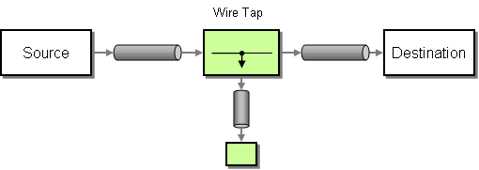
Wire Tap
The Wire Tap is a fixed Recipient List with two output channels. It consumes messages off the input channel and publishes the unmodified message to both output channels.
To insert the Wire Tap into a channel, you need to create an additional channel and change the destination receiver to consume of the second channel

Slide 19
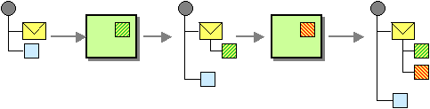
Message History
Message History maintains a list of all components that the message passed through and its origination.
Every component that processes the message (including the originator) adds one entry to the list.
Message History should be part of the message header and not application data because it contains system-specific control information.

Slide 20
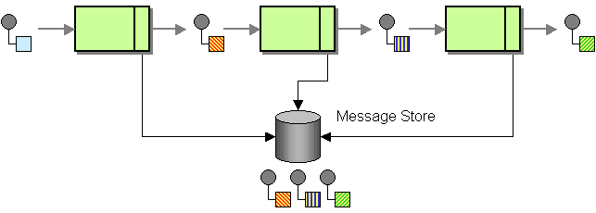
Message Store
Message Store captures information about each message in a central location.
Taking advantage of the asynchronous nature of a messaging infrastructure, a message when send to a channel, a duplicate of the same message is send to a special channel to be collected by the Message Store. This can be performed by the component itself or we can insert a Wire Tap into the channel.
One can consider the secondary channel that carries a copy of the message as part of the Control Bus.
Sending a second message in a 'fire-and-forget' mode will not slow down the flow of the main application messages. It does, however, increase network traffic.
That's why we may not store the complete message, but just a few key fields that are required for later analysis, such as a message ID, or the channel on which the message was sent and a timestamp.

Slide 21
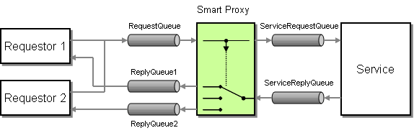
Smart Proxy
In order to track messages sent to request-reply services, a Smart Proxy is inserted into the message stream.
Smart Proxy stores the Return Address supplied by the original requestor and replace it with the address of the Smart Proxy. When the service sends the reply message route it to the original Return Address.

Slide 22
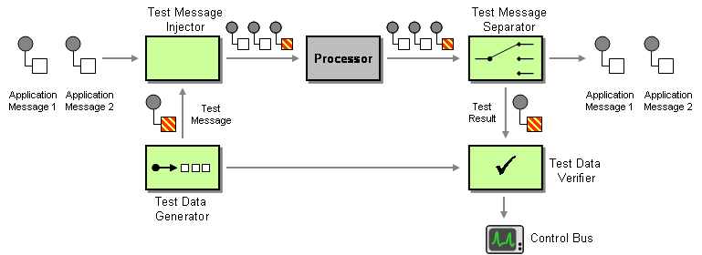
Testing and Debugging
Testing a messaging system before deploying it into production is a good idea. But testing should not stop there. You should be actively verifying that the running messaging system is functioning properly.
You can do this by periodically injecting a Test Message into the system and verifying the results.

Slide 23

Testing and Debugging
Test Message: Troubleshooting message which a component is actively processing messages, but garbles outgoing messages due to an internal fault can be handled using a Test Message.
Channel Purger: When a component fails or misbehaves, it is easy to end up with unwanted messages on a channel. During testing it is very useful to remove all remaining messages from a channel so that the components under test do not receive 'leftover' messages. A Channel Purger does that for us.Use a Channel Purger to remove unwanted messages from a channel.

Slide 24
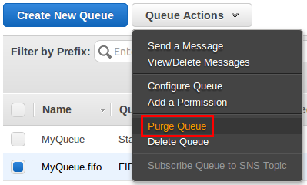
Chanel Purger Amazon-SQS.
Many hosted messaging systems have a built-in function to purge channels. For example, with Amazon's Simple Queuing Service (SQS), you can purge a queue simply from the web user interface.

Slide 25
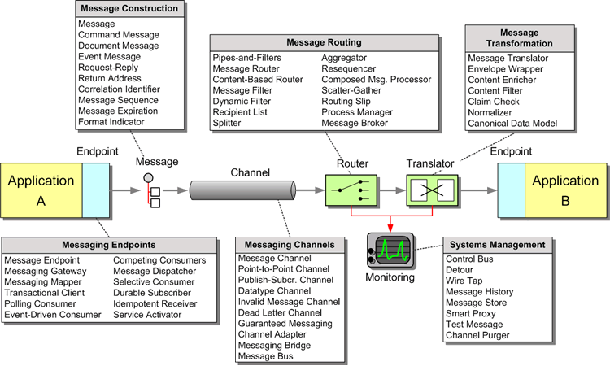
Messaging Overview

Slide 26
Thank You

Slide 27


