Slide 1
Title Layout
Subtitle

Slide 2
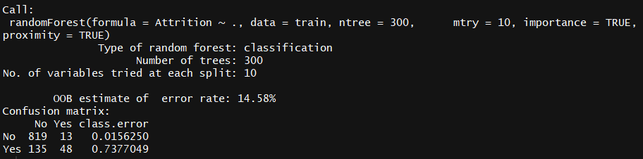
RandomForest Classification
Accuracy Estimate
85.4%
Prediction | No | Yes | Class.error
No | 819 | 13 | 0.015
Yes | 135 | 48 | 0.737

Slide 3
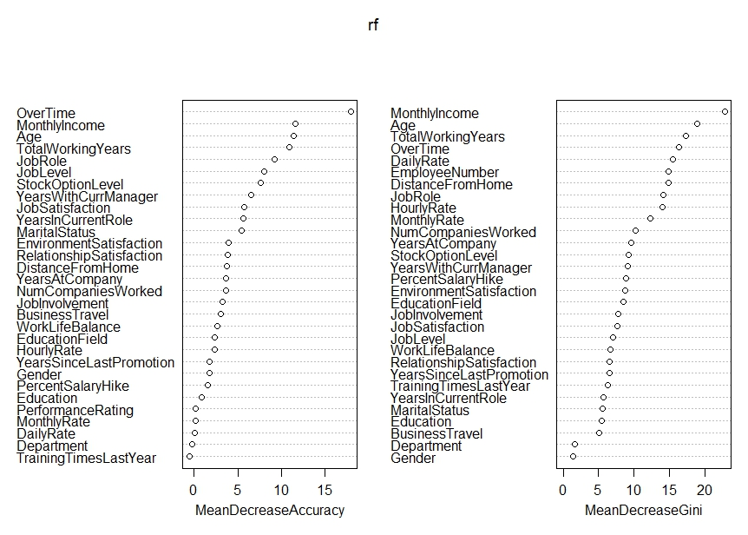
Variable Importance (Train Dataset)
Plot (Left) – Model performance without each feature.
Plot(Right)-How pure the nodes are at the end of the tree without each variable.

Slide 4
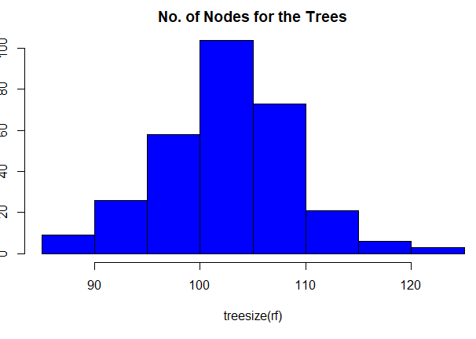
On average 100-105 Trees contain 100 nodes.

Slide 5
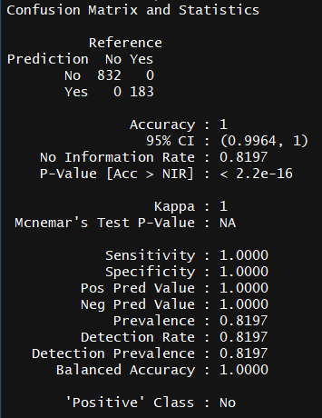
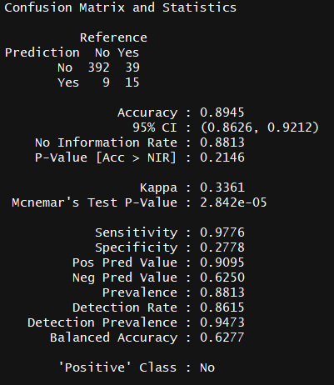


Prediction and Confusion Matrix
Train
Test
The train dataset yielded 100% accuracy when using Attribute as the response feature.
The test dataset has accuracy rate of 89.4%
How accurately the model predicts a No is specified in Sensitivity estimate.

Slide 6
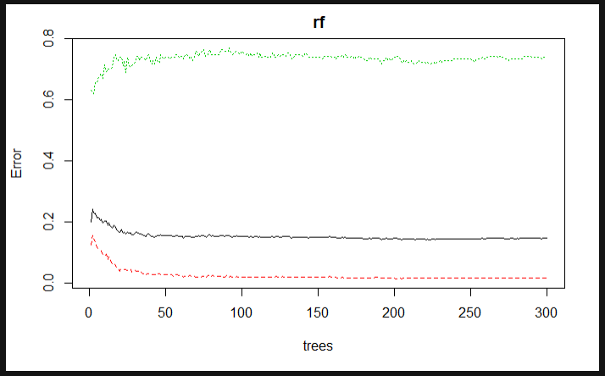
Error Estimate vs Number of Trees
The model is unable to Improve upon the error rate past 50 trees.

Slide 7
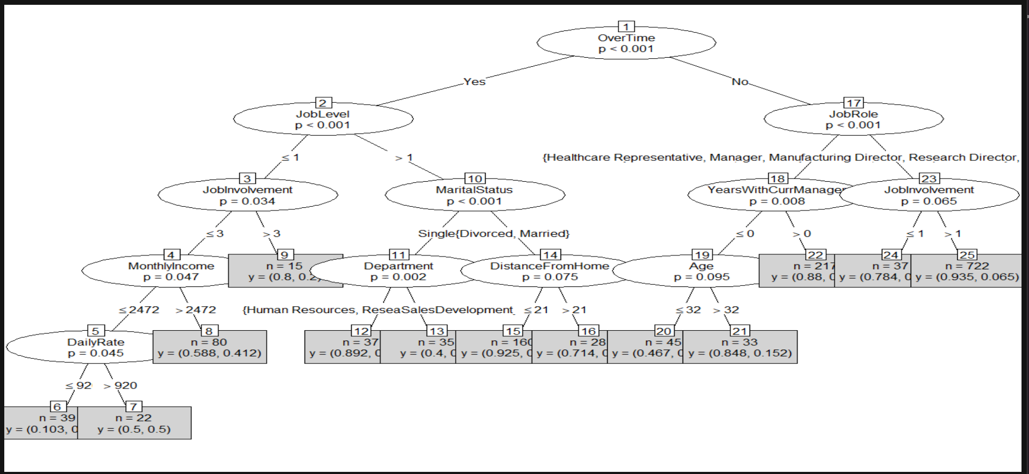
Decision Tree

