Slide 1
Shravankumar's
Making use of MATLAB & Simulink Effectively

Slide 2

Image Formation
f(x,y) = reflectance(x,y) * illumination(x,y)
Reflectance in [0,1], illumination in [0,inf]

Slide 3

Sampling and Quantization

Slide 4

Sampling and Quantization

Slide 5
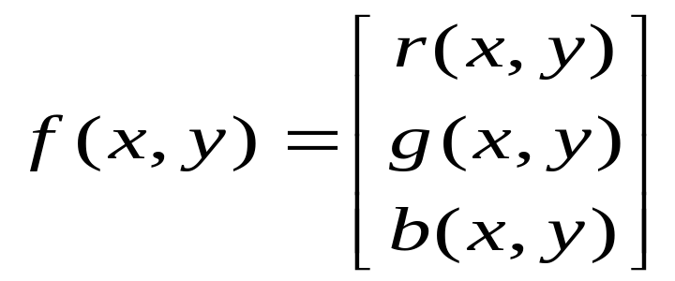
What is an image?
We can think of an image as a function, f, from R² to R:
  f( x, y ) gives the intensity at position ( x, y )
  Realistically, we expect the image only to be defined over a rectangle, with a finite range:
    f: [a,b]x[c,d] → [0,1]
A color image is just three functions pasted together. We can write this as a “vector-valued” function:

Slide 6
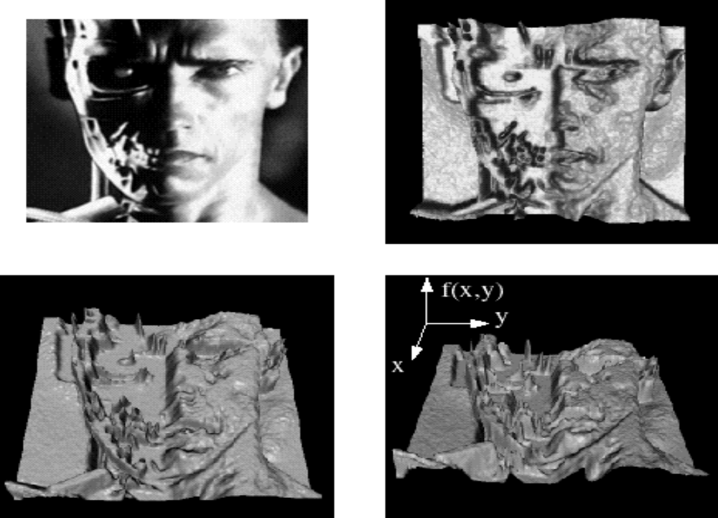
Images as functions

Slide 7

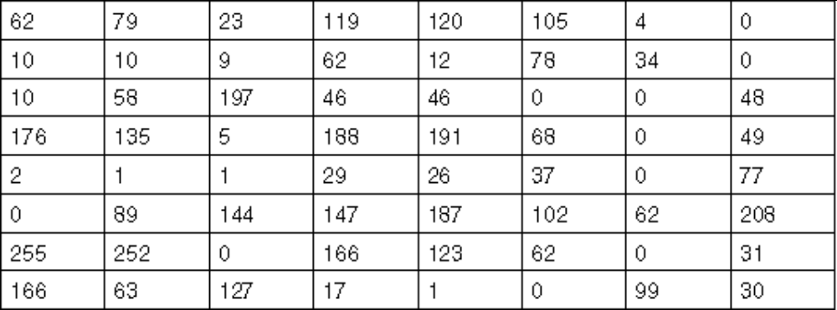
What is a digital image?
We usually operate on digital (discrete) images:
  Sample the 2D space on a regular grid
  Quantize each sample (round to nearest integer)
If our samples are Δ apart, we can write this as:
f[i ,j] = Quantize{ f(i Δ, j Δ) }
The image can now be represented as a matrix of integer values

Slide 8

Image processing
An image processing operation typically defines a new image g in terms of an existing image f.
We can transform either the range of f.
Or the domain of f:
What kinds of operations can each perform?

Slide 9
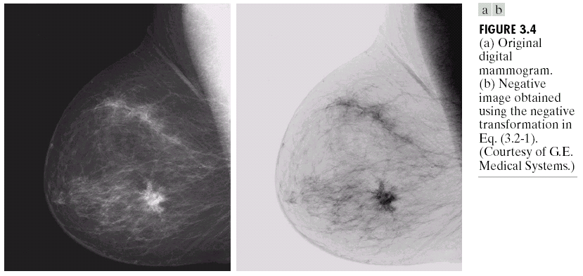
Negative

Slide 10
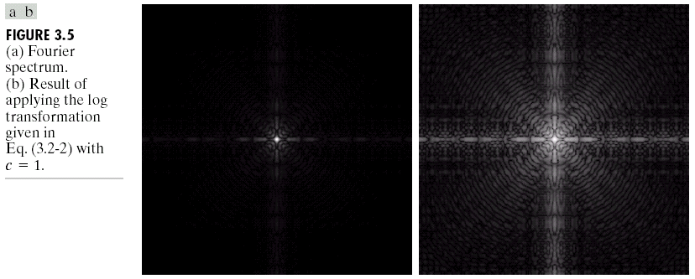
Log

Slide 11
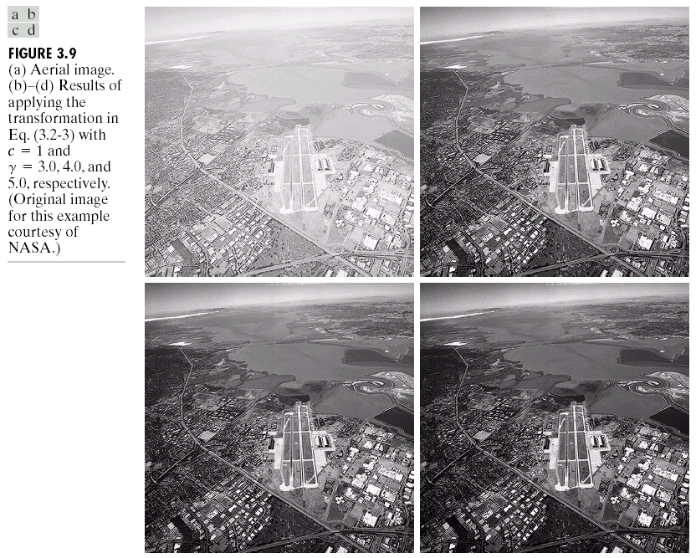
Image Enhancement

Slide 12

Contrast Streching

Slide 13
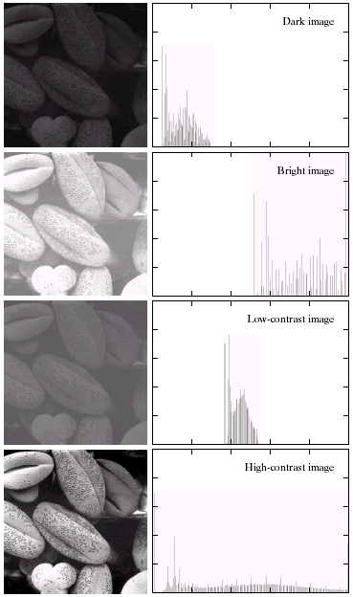

Image Histograms

Slide 14
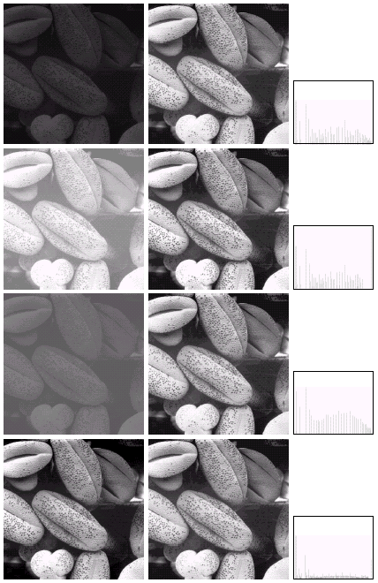

Histogram Equalization

Slide 15
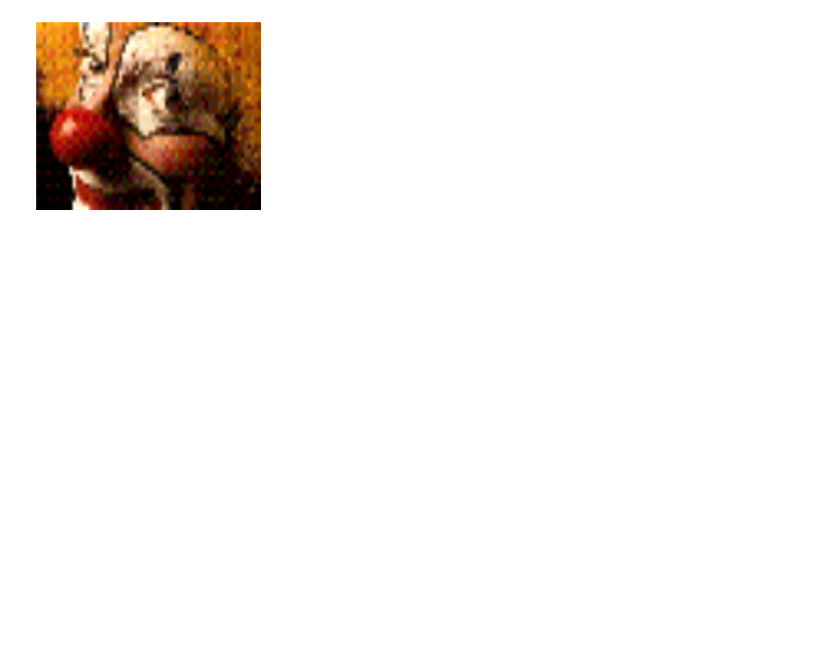

Neighborhood Processing (filtering)
Q: What happens if I reshuffle all pixels within the image?
A: It’s histogram won’t change. No point processing will be affected…
Need spatial information to capture this.

Slide 16
MATLAB and images
The help in MATLAB is very good, use it!
An image in MATLAB is treated as a matrix
Every pixel is a matrix element
All the operators in MATLAB defined on
matrices can be used on images: +, -, *, /, ^, sqrt, sin, cos etc.

Slide 17
Images in MATLAB
MATLAB can import/export several image formats
  BMP (Microsoft Windows Bitmap)
  GIF (Graphics Interchange Files)
  HDF (Hierarchical Data Format)
  JPEG (Joint Photographic Experts Group)
  PCX (Paintbrush)
  PNG (Portable Network Graphics)
  TIFF (Tagged Image File Format)
  XWD (X Window Dump)
  MATLAB can also load raw-data or other types of image data
Data types in MATLAB
  Double (64-bit double-precision floating point)
  Single (32-bit single-precision floating point)
  Int32 (32-bit signed integer)
  Int16 (16-bit signed integer)
  Int8 (8-bit signed integer)
  Uint32 (32-bit unsigned integer)
  Uint16 (16-bit unsigned integer)
  Uint8 (8-bit unsigned integer)

Slide 18
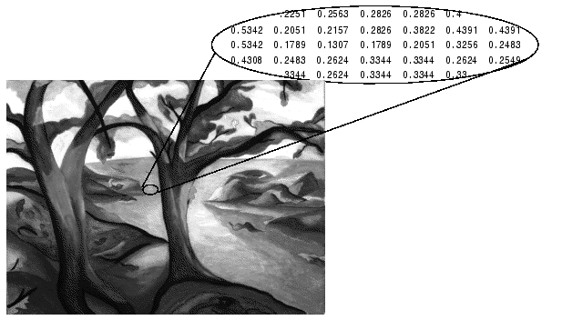
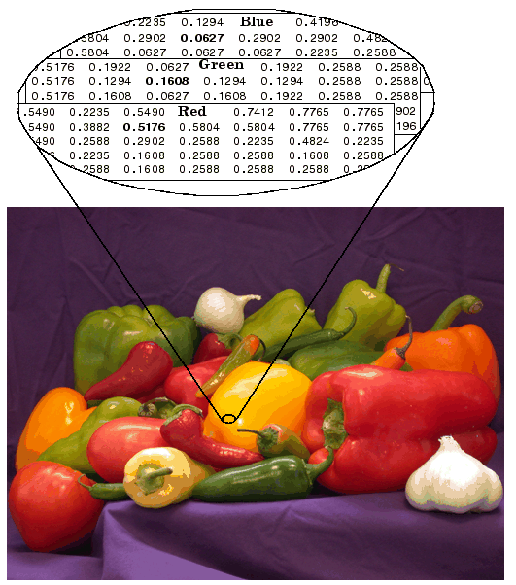
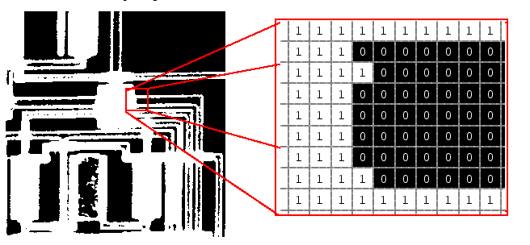
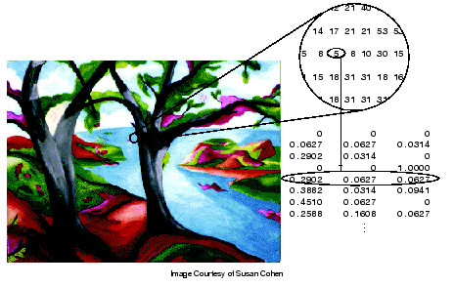
Images in MATLAB
• Binary images : {0,1}
• Intensity images : [0,1] or uint8, double etc.
• RGB images : m-by-n-by-3
• Indexed images : m-by-3 color map
• Multidimensional images m-by-n-by-p (p is the number of layers)

Slide 19
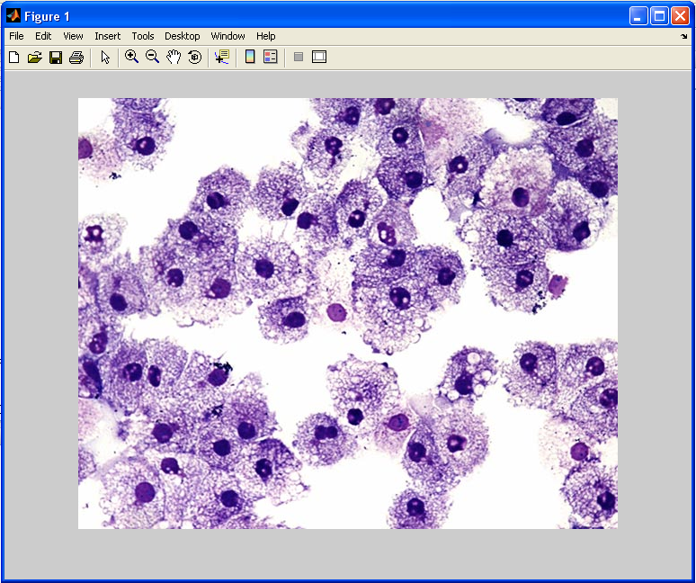
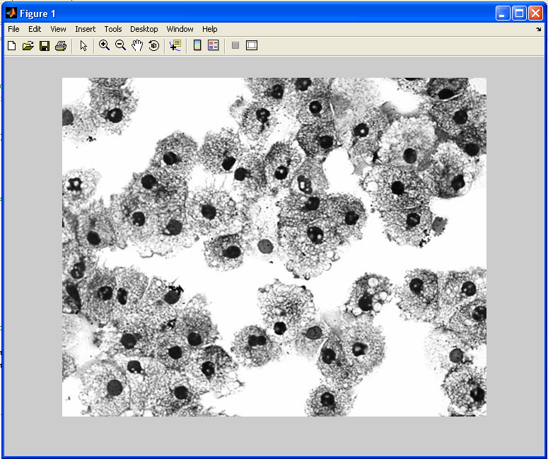
Image import and export
Read and write images in Matlab
>> I=imread('cells.jpg');
>> imshow(I)
>> size(I)
ans = 479 600 3 (RGB image)
>> Igrey=rgb2gray(I);
>> imshow(Igrey)
>> imwrite(lgrey, 'cell_gray.tif', 'tiff')
Alternatives to imshow
>>imagesc(I)
>>imtool(I)
>>image(I)

Slide 20

Images and Matrices
How to build a matrix (or image)?
>> A = [ 1 2 3; 4 5 6; 7 8 9 ];
A = 1 2 3
4 5 6
7 8 9
>> B = zeros(3,3)
B = 0 0 0
0 0 0
0 0 0
>> C = ones(3,3)
C = 1 1 1
1 1 1
1 1 1
>>imshow(A) (imshow(A,[]) to get automatic pixel range)

Slide 21
Images and Matrices
Accesing image elements (row, column)
>> A(2,1)
ans = 4
: can be used to extract a whole column or row
>> A(:,2)
ans =
2
5
8
or a part of a column or row
>> A(1:2,2)
ans =
2
5
X
Y
A =
1 2 3
4 5 6
7 8 9

Slide 22
Image Arithmetic
Arithmetic operations such as addition, subtraction, multiplication and division can be applied to images in MATLAB
  +, -, *, / performs matrix operations
>> A+A
ans = 2 4 6
8 10 12
14 16 18
>> A*A
ans = 30 36 42
66 81 96
102 126 150
To perform an elementwise operation use . (.*, ./, .*, .^ etc)
>> A.*A
ans = 1 4 9
16 25 36
49 64 81
A =
1 2 3
4 5 6
7 8 9

Slide 23
Logical Conditions
equal (==) , less than and greater than (< and >), not equal (~=) and not (~)
find(‘condition’) - Returns indexes of A’s elements that satisfies the condition.
>> [row col]=find(A==7)
row = 3
col = 1
>> [row col]=find(A>7)
row = 3
3
col = 2
3
>> Indx=find(A<5)
Indx = 1
2
4
7
A =
1 2 3
4 5 6
7 8 9

Slide 24
Flow Control
Flow control in MATLAB
- if, else and elseif statements
(row=1,2,3 col=1,2,3)
if row==col
A(row, col)=1;
elseif abs(row-col)==1
A(row, col)=2;
else
A(row, col)=0;
end

Slide 25

Flow Control
Flow control in MATLAB
- for loops
for row=1:3
for col=1:3
if row==col
A(row, col)=1;
elseif abs(row-col)==1
A(row, col)=2;
else
A(row, col)=0;
end
end
end
A =
1 2 0
2 1 2
0 2 1

Slide 26
Flow Control
A =
1 2 3
4 5 6
7 8 9
while, expression, statements, end
Indx=1;
while A(Indx)<6
  A(Indx)=0;
  Indx=Indx+1;
  end
A =
0 2 3
0 5 6
7 8 9

Slide 27
Working with M-Files
M-files can be scripts that simply execute a series of MATLAB statements, or they can be functions that also accept input arguments and produce output.
MATLAB functions:
  Are useful for extending the MATLAB language for your application.
  Can accept input arguments and return output arguments.
  Store variables in a workspace internal to the function.

Slide 28
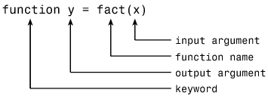
Working with M-Files
Create a new empty m-file
function B=test(I)
[row col]=size(I)
for r=1:row
for c=1:col
if r==c
A(r, c)=1;
elseif abs(r-c)==1
A(r, c)=2;
else
A(r, c)=0;
end
end
end

