Slide 1
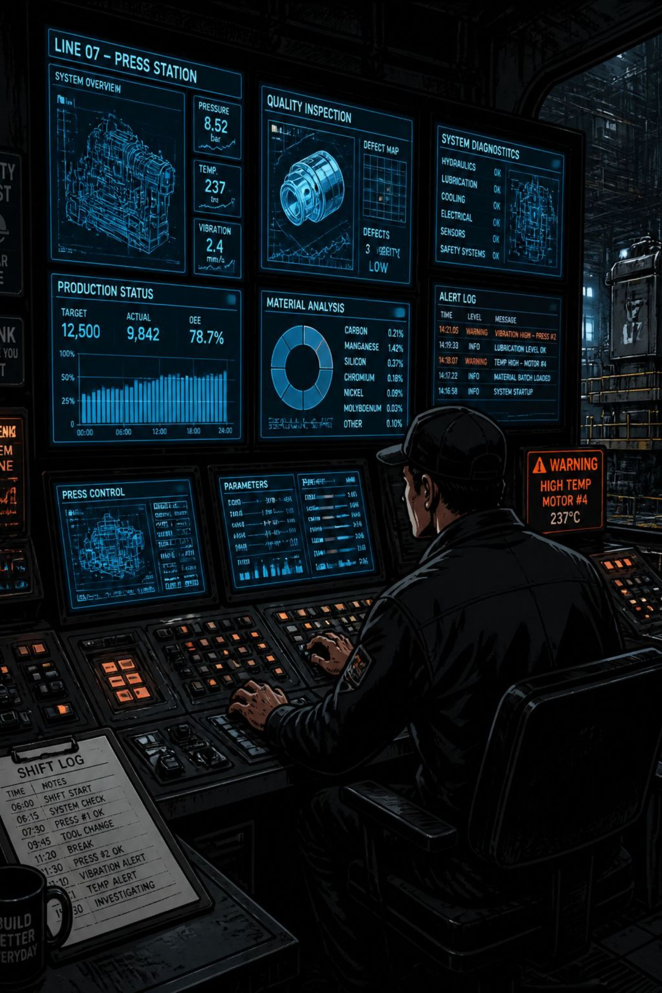
Factories Generate More Data Than They Can Interpret.
Inspection Data → Defect Types → Machines → Batches → Shifts → Process Parameters → Timestamps
The challenge
Observed consequence
Manual analysis fragments signals across reports and misses multi-factor patterns.
Delayed detection, reactive fixes, and unclear investigative starting points.
Core insight
The problem isn't lack of data — it's the inability to turn data into evidence-backed action.

Slide 2
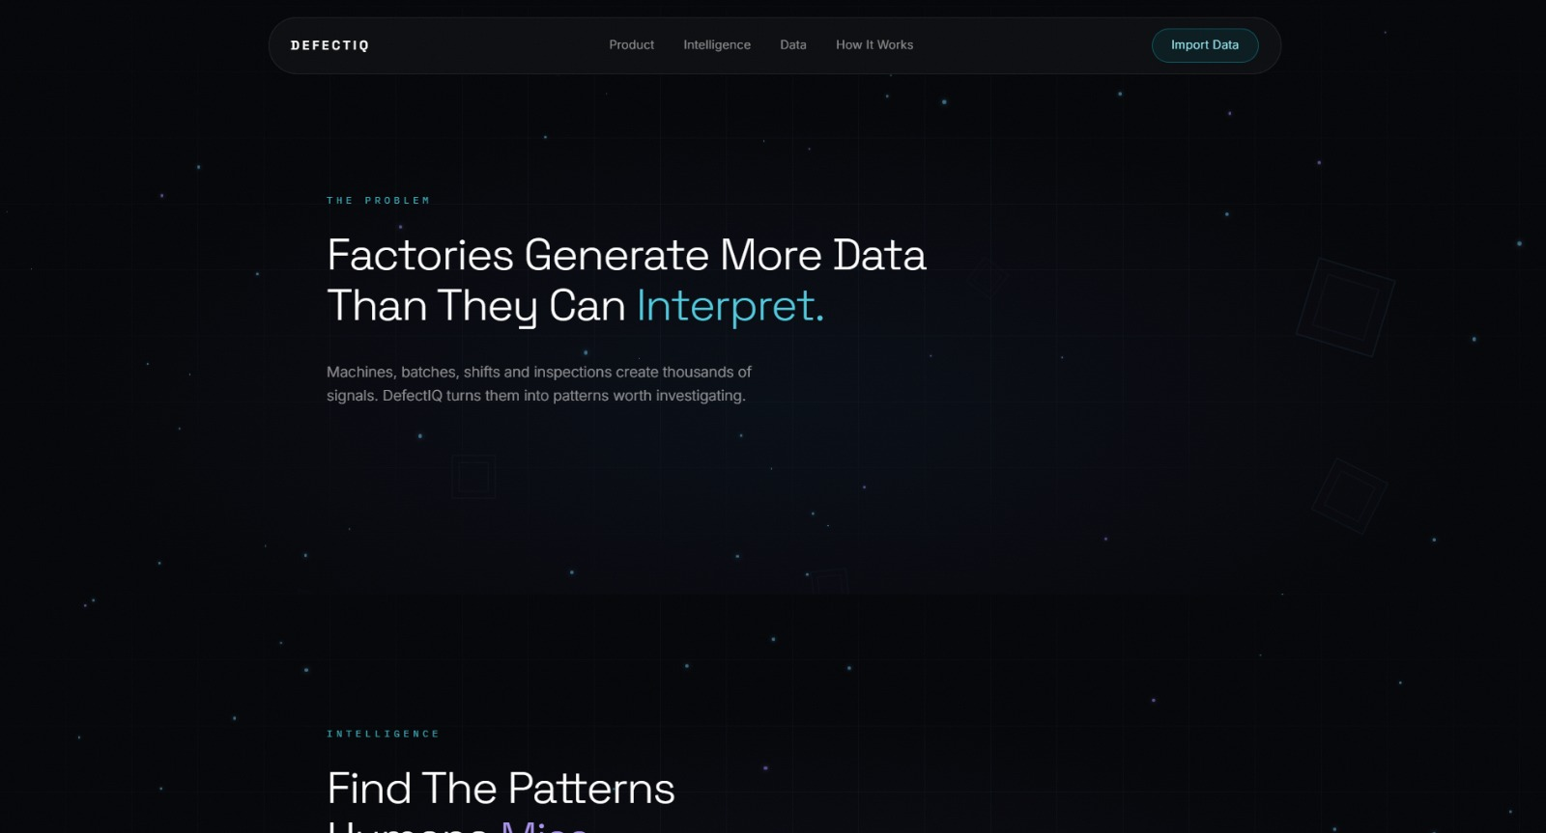

Meet the Manufacturing Defect Pattern Analyzer
An AI-powered manufacturing quality intelligence platform that transforms inspection data into explainable insights.
Analyzes machine, batch, shift, defect type, time, and process variables
Prioritizes patterns for investigation and generates actionable reports
“We transform inspection data into explainable manufacturing insights.”

Slide 3
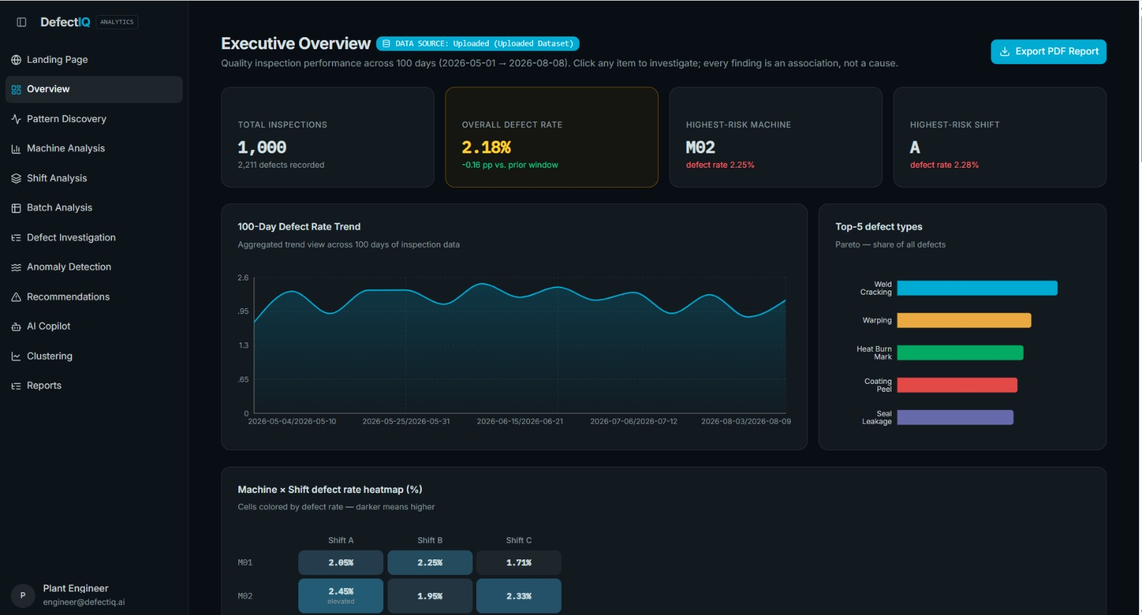
One Dashboard. The Entire Defect Story.
Decision-makers move from overview to investigation without manually combining multiple reports.
Defect Rate
Defect Distribution
High-level trend and recent change indicators.
Breakdown by defect type, machine, and batch.
Machine / Batch Signals
Risk Indicators
Flagged patterns that require engineering validation.
Signals that suggest recurring or concentrated issues.

Slide 4
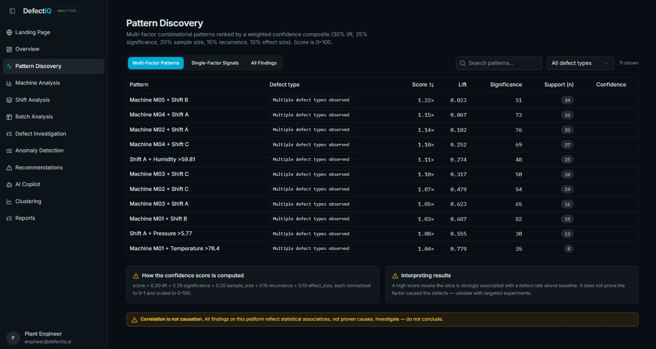
We Don't Just Show Defects. We Find Patterns.
Example pattern
Machine + Shift + Process Condition → Elevated defect rate
The system searches for recurring combinations across dimensions instead of analyzing each variable independently.
Patterns are highlighted when supported by evidence in the observed dataset — requires process validation.

Slide 5
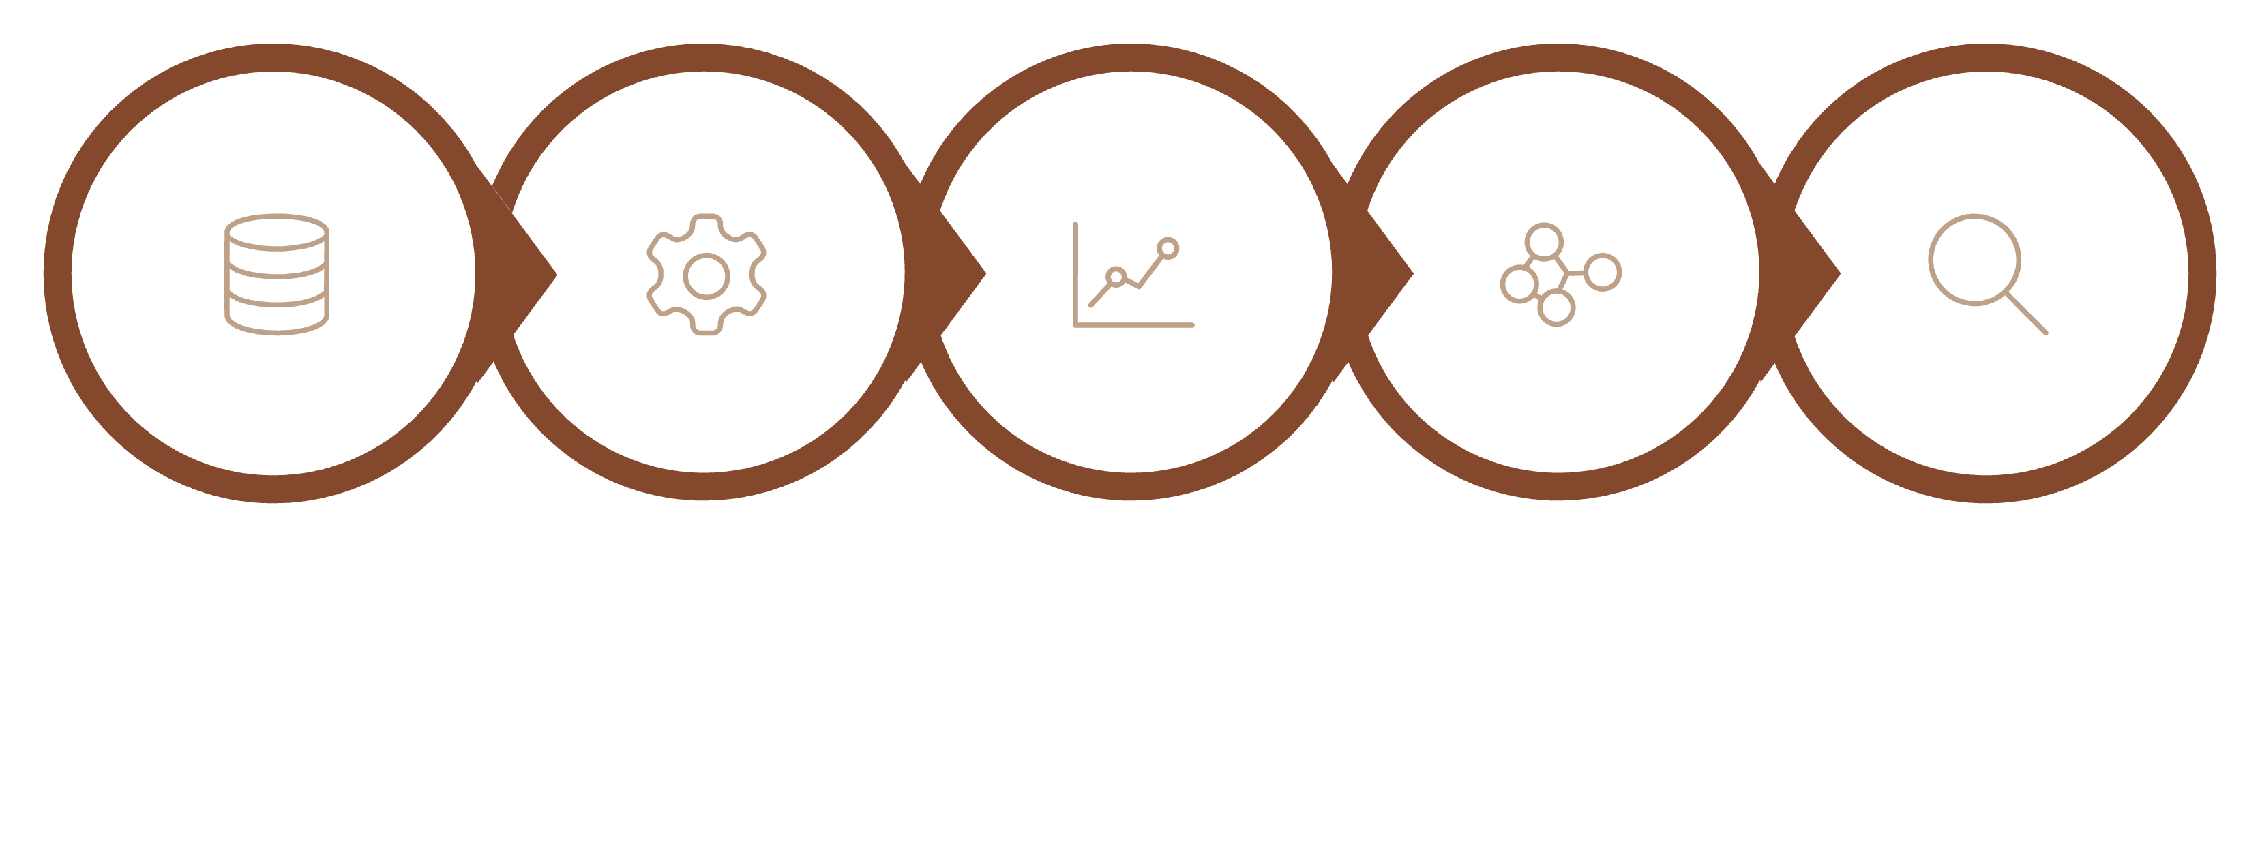

Where AI Meets Manufacturing Analytics
Trend Analysis
Pattern Detect
Data Prep
Feature Eng
Clustering
AI discovers candidate patterns and quantifies supporting evidence; engineering judgment and validation determine causal claims.
01
02
03
04
1. Data Preparation
2. Feature Engineering
3. Clustering & Trend Analysis
4. Evidence Validation → Action
Clean, timestamp-align, and validate inspection records and process telemetry.
Encode machine, batch, shift, defect type, and process variables for analysis.
Group similar defect behaviors and surface trending shifts over time.
Score pattern support in the dataset and translate into prioritized checks for engineers.
AI is used to discover patterns — not to replace engineering judgment.

Slide 6
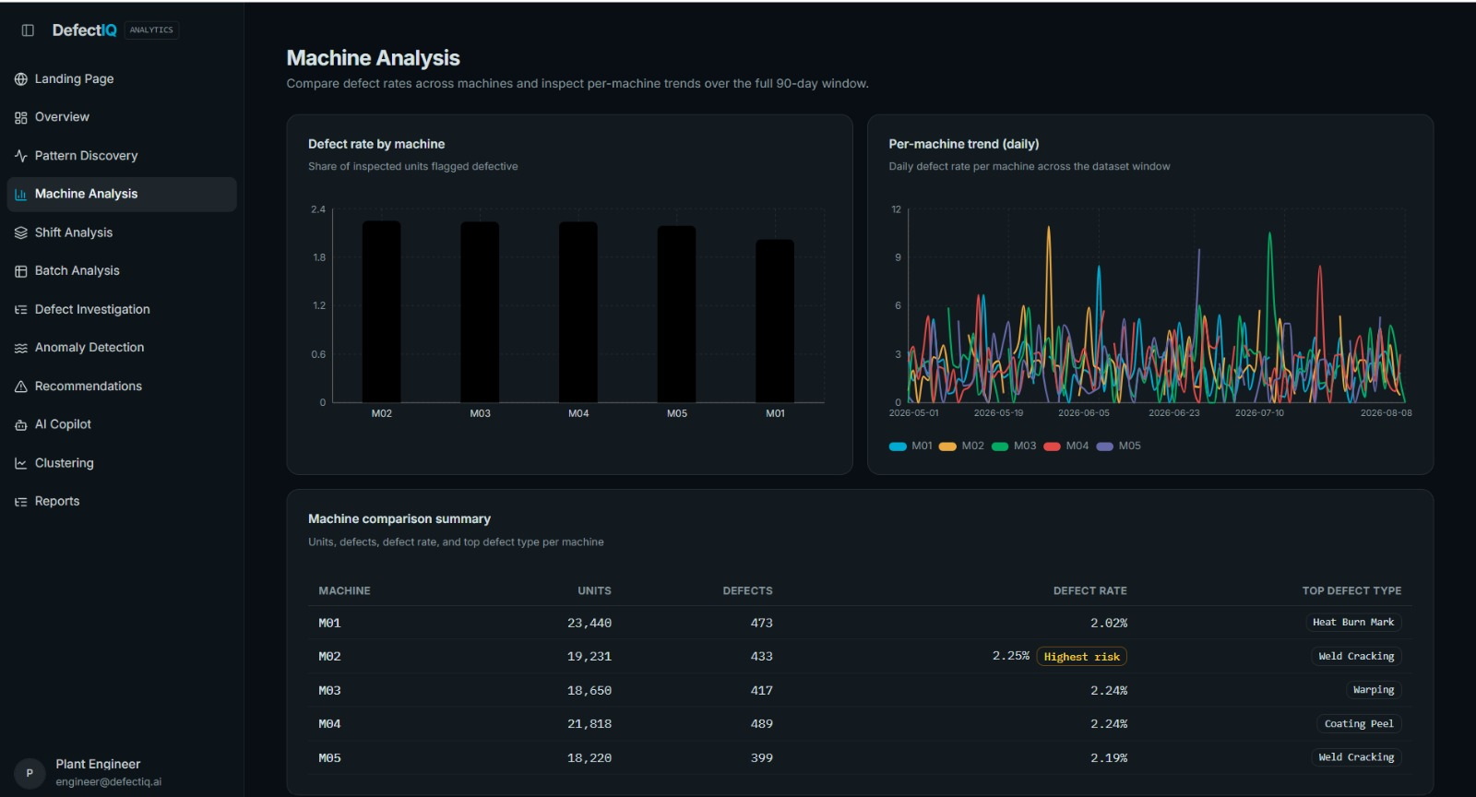
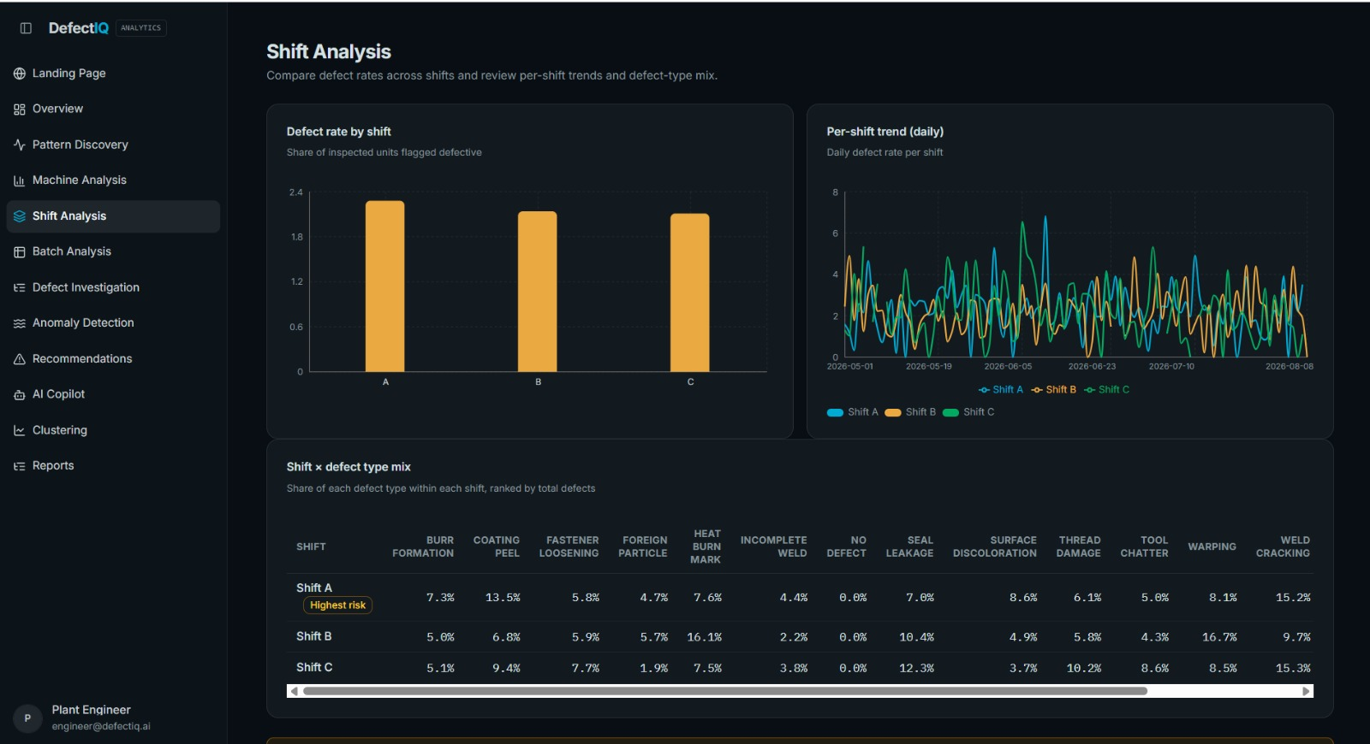
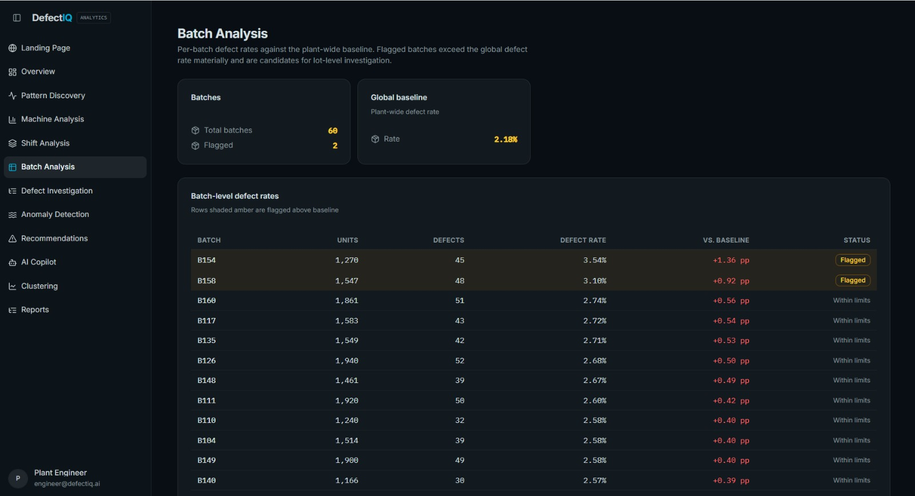

From “What Defects?” to “Where Do They Concentrate?”
Machine
Shift
Batch
Which machines show unusual or elevated defect behavior?
Does defect behavior vary across production shifts? Analysis is at the shift level only.
Which batches show recurring or abnormal defect patterns?
MACHINE × SHIFT × BATCH — Multi-dimensional investigation surfaces concentrated patterns for prioritized review.
Analysis is performed at process/shift level — never as worker-level performance scoring.

Slide 7
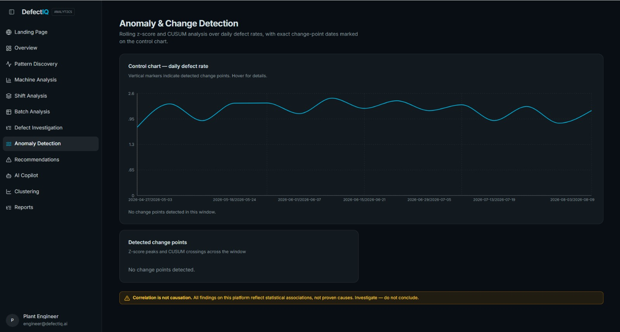

Detect the Change Before It Becomes the Problem.
NORMAL → PATTERN CHANGES → ANOMALY DETECTED → INVESTIGATE → PROCESS CHECK
The system highlights unusual changes in defect behavior so engineers can investigate earlier. Flags are based on observed deviation patterns and require engineering follow-up.
Don't wait for the defect rate to become critical — surface changes for investigation.

Slide 8
Every Highlighted Pattern Needs Evidence.
1
❌ WRONG
2
✅ OUR APPROACH
Evidence Framework
“High Temperature Causes Defects” — an unsupported causal claim.
Observed Pattern — description from dataset
Supporting Data — counts, time windows, and comparison groups
Comparison — baseline vs flagged groups
Confidence / Strength — data support metric (requires process validation)
“Higher temperature was associated with elevated defect rates in the observed data.”
Correlation identifies where to investigate. Engineering validation determines causation.

Slide 9
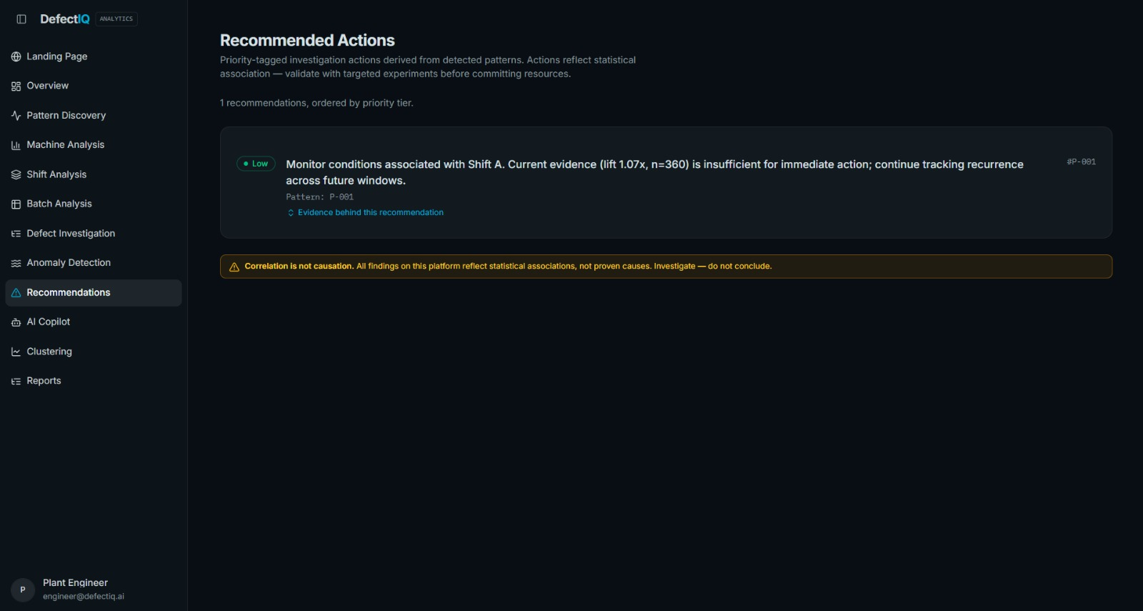

Don't Stop at Detection. Recommend the Next Move.
DETECT
Recurring defect pattern identified from clustered behaviors.
EXPLAIN
Associated machine / shift / batch / process condition (observed in data).
PRIORITIZE
Rank patterns by data support and operational impact for investigation.
ACT
Recommend process checks, inspection focus, or recalibration steps.
VALIDATE
Confirm whether intervention changes defect behavior (requires process validation).
The output is a prioritized starting point for investigation — not a final verdict.

Slide 10

From Data Overload to Manufacturing Intelligence
DATA → PATTERN → EVIDENCE → ACTION
🔎 DISCOVER
Find recurring multi-factor defect patterns.
📈 DETECT
Identify trends and unusual changes.
🧠 EXPLAIN
Provide evidence-backed contributing factors (association not causation).
We turn manufacturing data into decisions engineers can act on. The platform emphasizes evidence, operational prioritization, and engineering validation.
⚙️ ACT
Manufacturing Defect Pattern Analyzer
Recommend prioritized process checks and investigations.

