Slide 1
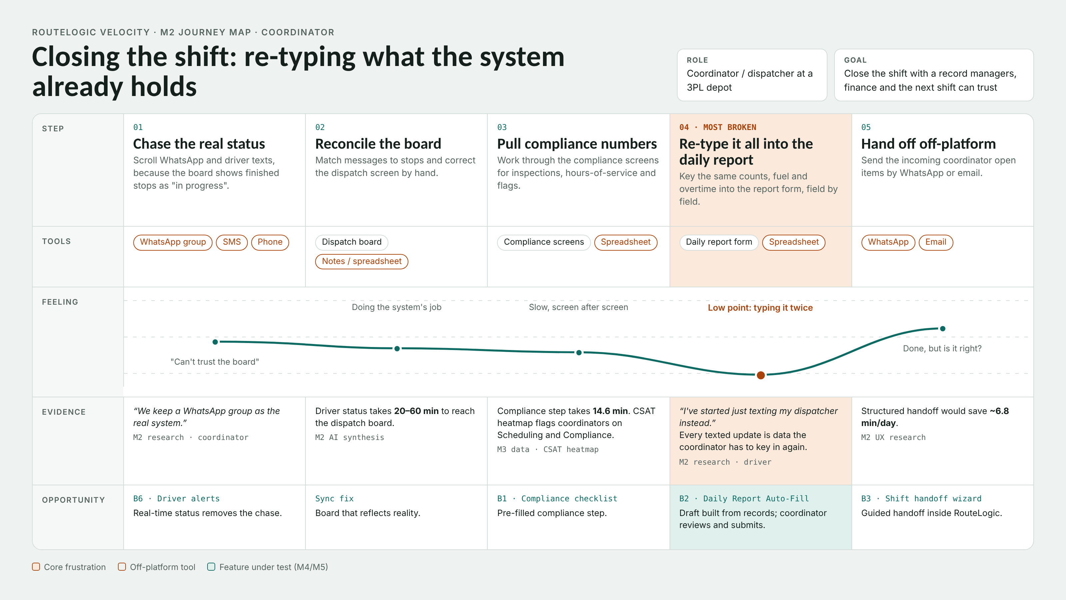
Notes:
Coordinator shift close, 5 manual steps. Worst one is step 4 where they re-type stuff RouteLogic already has, because the live updates came in on WhatsApp and texts. Evidence - WhatsApp as the real system quote, 20-60 min board lag, 14.6 min compliance step, ~6.8 min a day saved on handoff. Opportunities - B6, sync fix, B1, B2 (the one we're testing), B3.

Slide 2
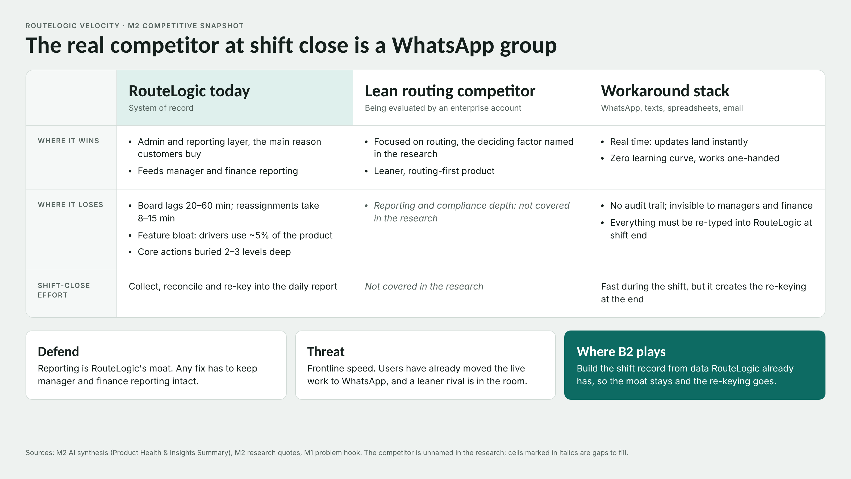
Notes:
RouteLogic wins on admin/reporting and loses on frontline speed and sync. Competitor isnt named in the research so we dont know their reporting depth yet. WhatsApp etc is fast but creates the re-keying at the end of the shift, which is what B2 gets rid of.

