Slide 1
Esigelec online sales portal
Sravan kumar VASAM,
Webcentric project
June 2019

Slide 2
MAIN FEATURES OF USER PORTAL
USER LOGIN & REGISTRATION
SESSION MANAGEMENT OF USERS
BASKET MANAGEMENT TO ADD/REMOVE & PLACE ORDER

Slide 3
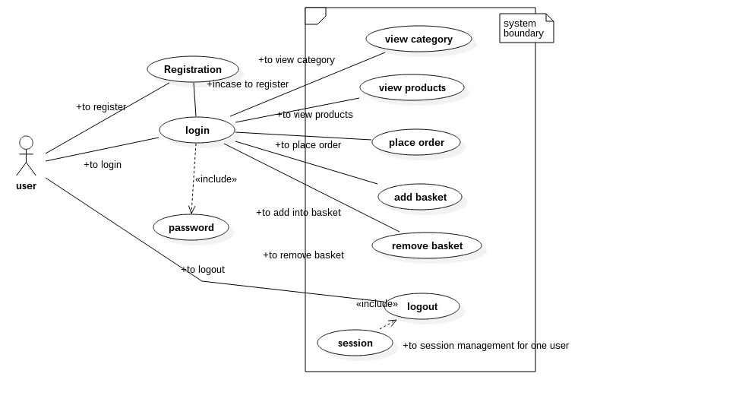
USER USECASE SYSTEM

Slide 4
MAIN FEATURES OF ADMIN PORTAL
ACCESS THE USER DATABASE
ADD THE PRODUCTS OF CHOICE
REMOVE THE PRODUCTS FROM THE DATABSE
ALSO REMOVE THE USER ACCOUNTS FROM THE DATABASE

Slide 5
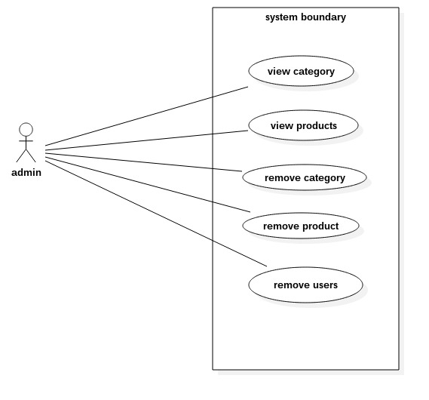
ADMN USECASE SYSTEM

Slide 6
MAIN FEATURES OF USER PORTAL
USER LOGIN & REGISTRATION
SESSION MANAGEMENT OF USERS
BASKET MANAGEMENT TO ADD/REMOVE/PLACE ORDER

Slide 7
MAIN FEATURES OF MANAGER PORTAL
ACCESS TO USER ORDERS
AUTHORIZED TO REMOVE ORDERS

Slide 8
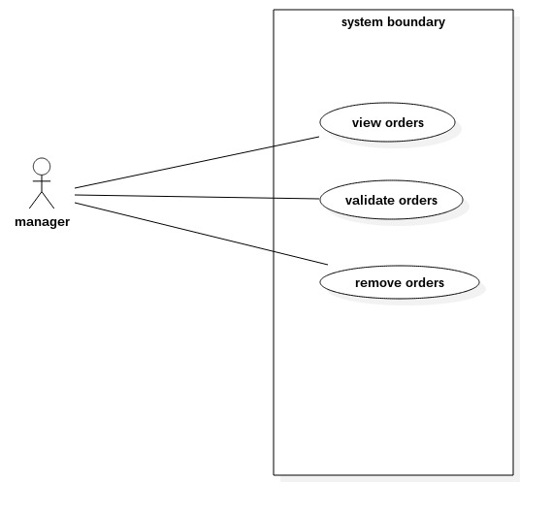
MANAGER USECASE SYSTEM

Slide 9
DEMO
I WILL SHOW THE DEMO OF MY PROJECT

