Slide 1
GLOBAL PATIENT RECORDS · 2015–2024
Cancer Data
Analysis
What 50,000 global patient records reveal about severity, early diagnosis, treatment cost, and survival.

Slide 2
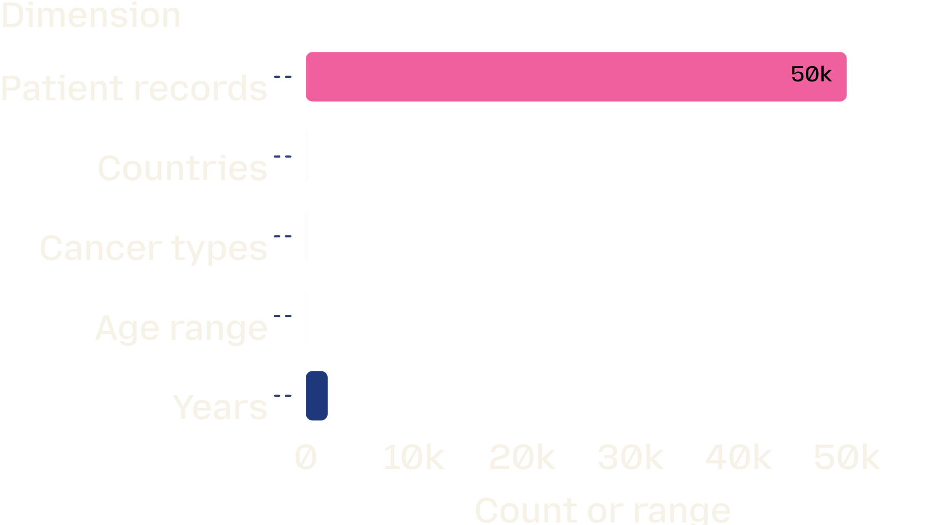
The dataset is broad, balanced, and unusually uniform
50,000 records (2015–2024), 10 countries, 8 cancer types
Age 20–89; gender, country, cancer type, and stage near-evenly represented
No missing values or duplicate rows reported
Age range: 20–89 · Years: 2015–2024

Slide 3
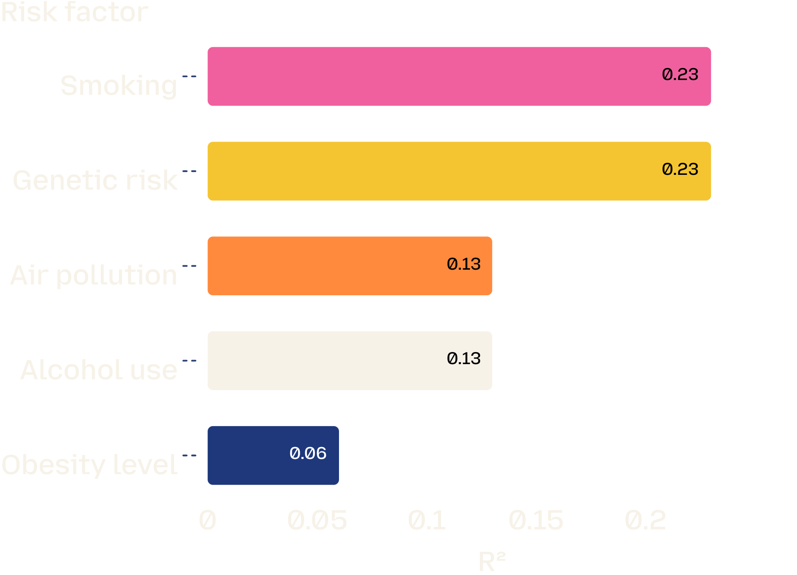
Smoking and genetic risk lead the severity signal
INDIVIDUAL REGRESSIONS
≈23%
Smoking and genetic risk each explain about 23% of the variation in severity.
Air pollution and alcohol use follow at about 13% each; obesity is weaker at 6%. All five risk factors show a positive relationship with severity.

Slide 4
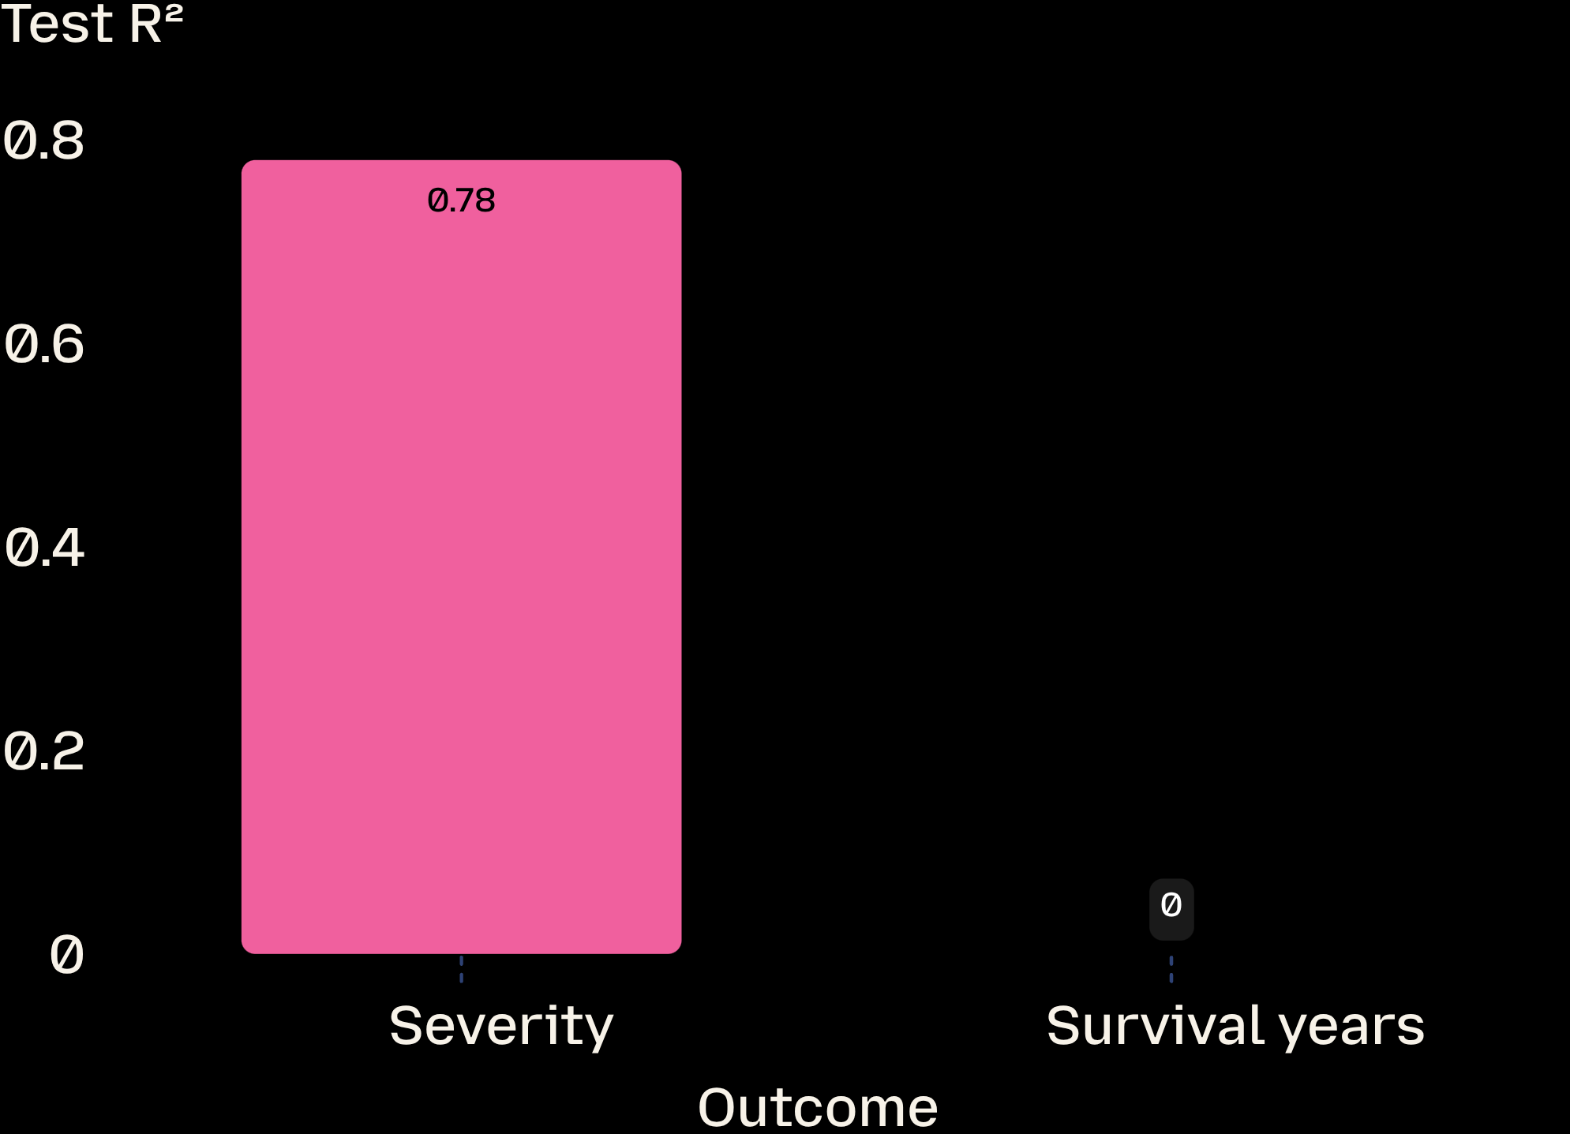
Severity is predictable; survival is not
0.78
Random Forest test R² for severity
Severity correlations are strongest for smoking (r = 0.484) and genetic risk (r = 0.479).
A tuned survival model reached test R² ≈ 0.00, showing the available features explain almost none of survival variation.

Slide 5
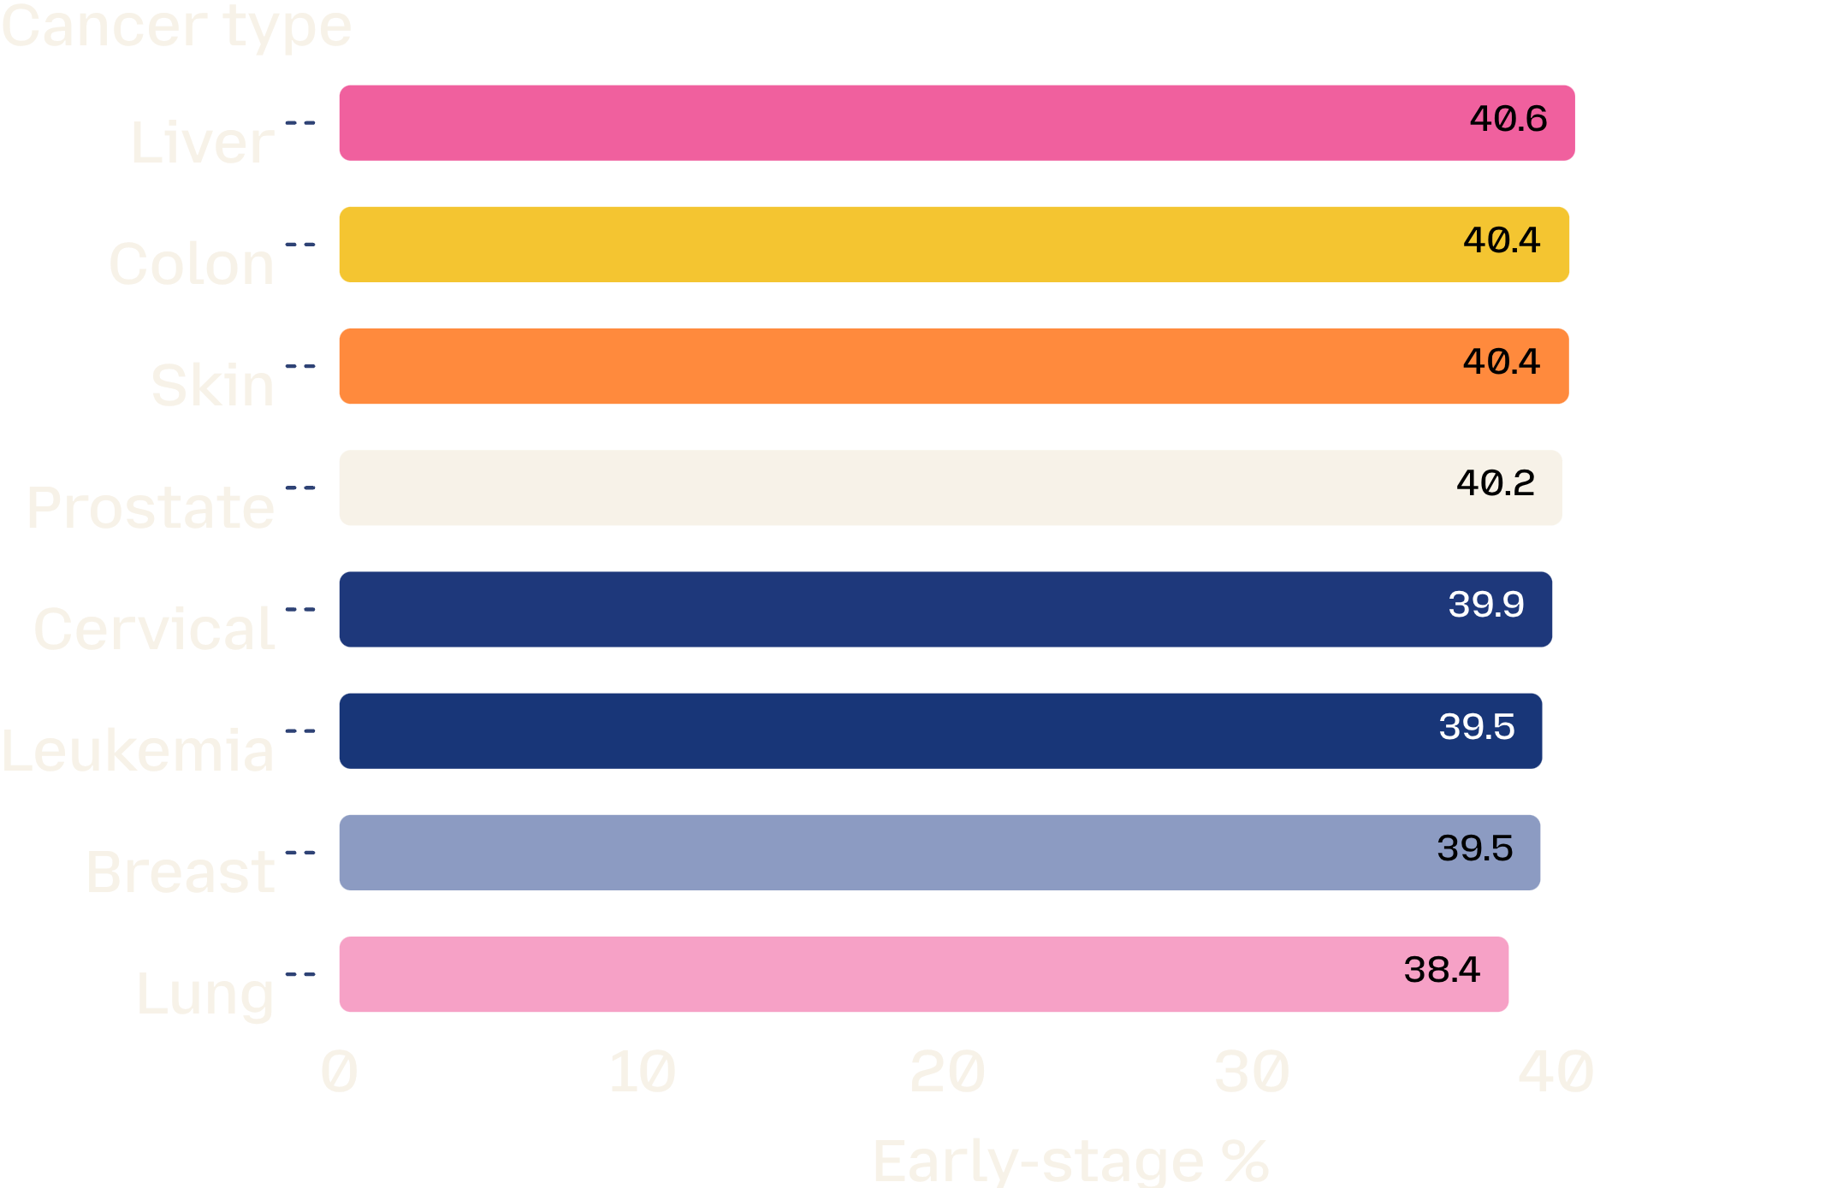
Early diagnosis is stuck near 40%
STAGE 0 + STAGE I
38–41%
The gap is only about two percentage points.
Liver is highest at 40.61%; lung is lowest at 38.43%. Lung remains the clearest screening opportunity.

Slide 6
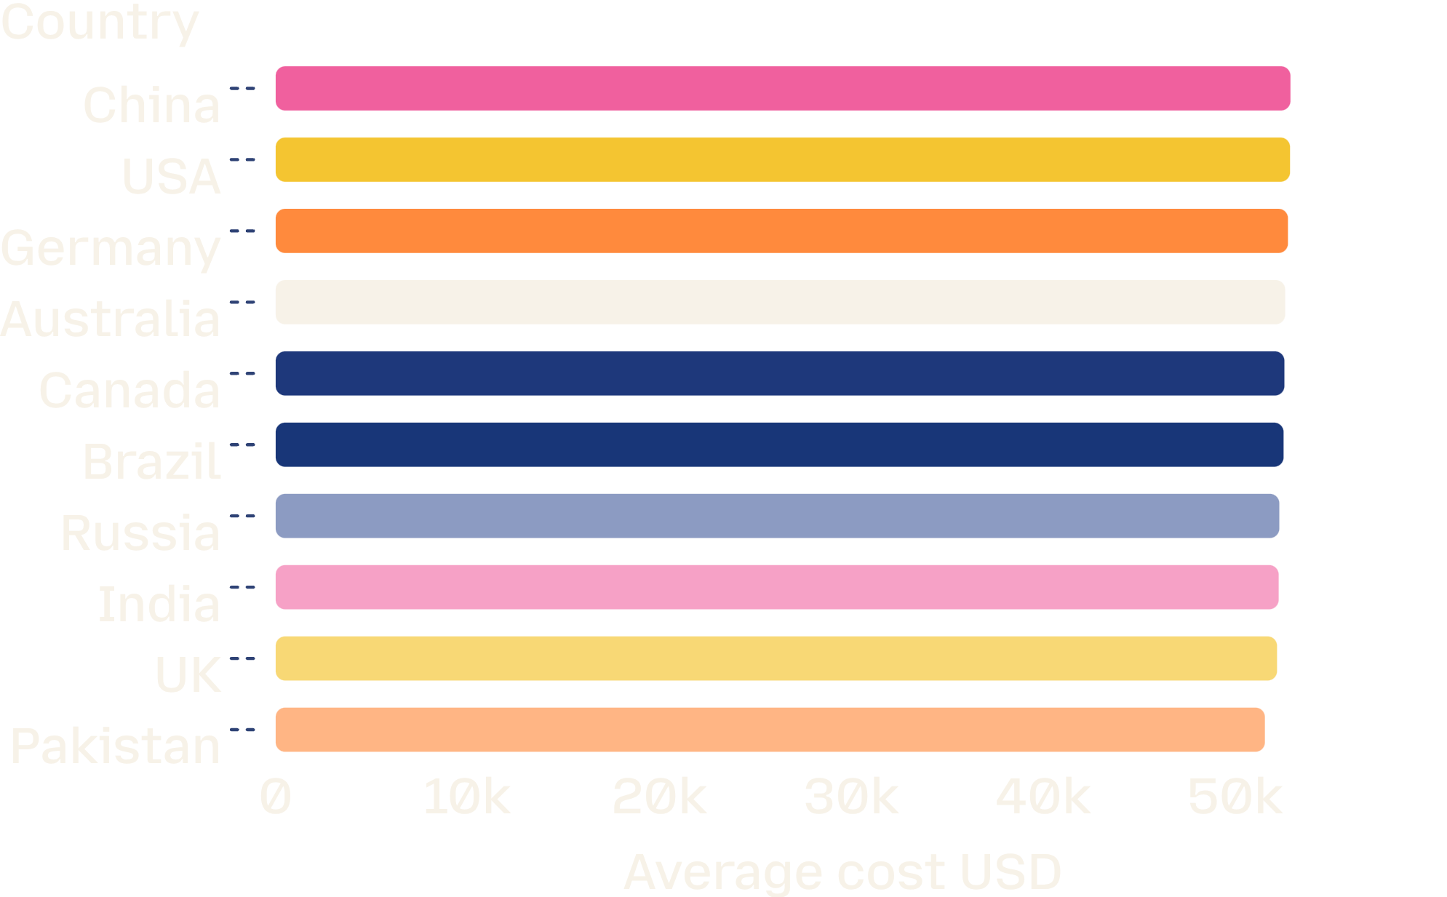
Treatment cost is nearly uniform across countries
$52,467
Average treatment cost
Range in the dataset: $5,000–$100,000.
Country averages span only about $1,300 from highest to lowest. Gender and age-group differences are similarly small.

Slide 7
COST × SURVIVAL
Higher cost does not predict longer survival
r = −0.0004
p = 0.924
Pearson correlation
Association test
The analysis fails to reject the null hypothesis of no association.
In this dataset, spending more is not associated with surviving longer. Spearman correlation is also −0.0004, p = 0.921.

Slide 8
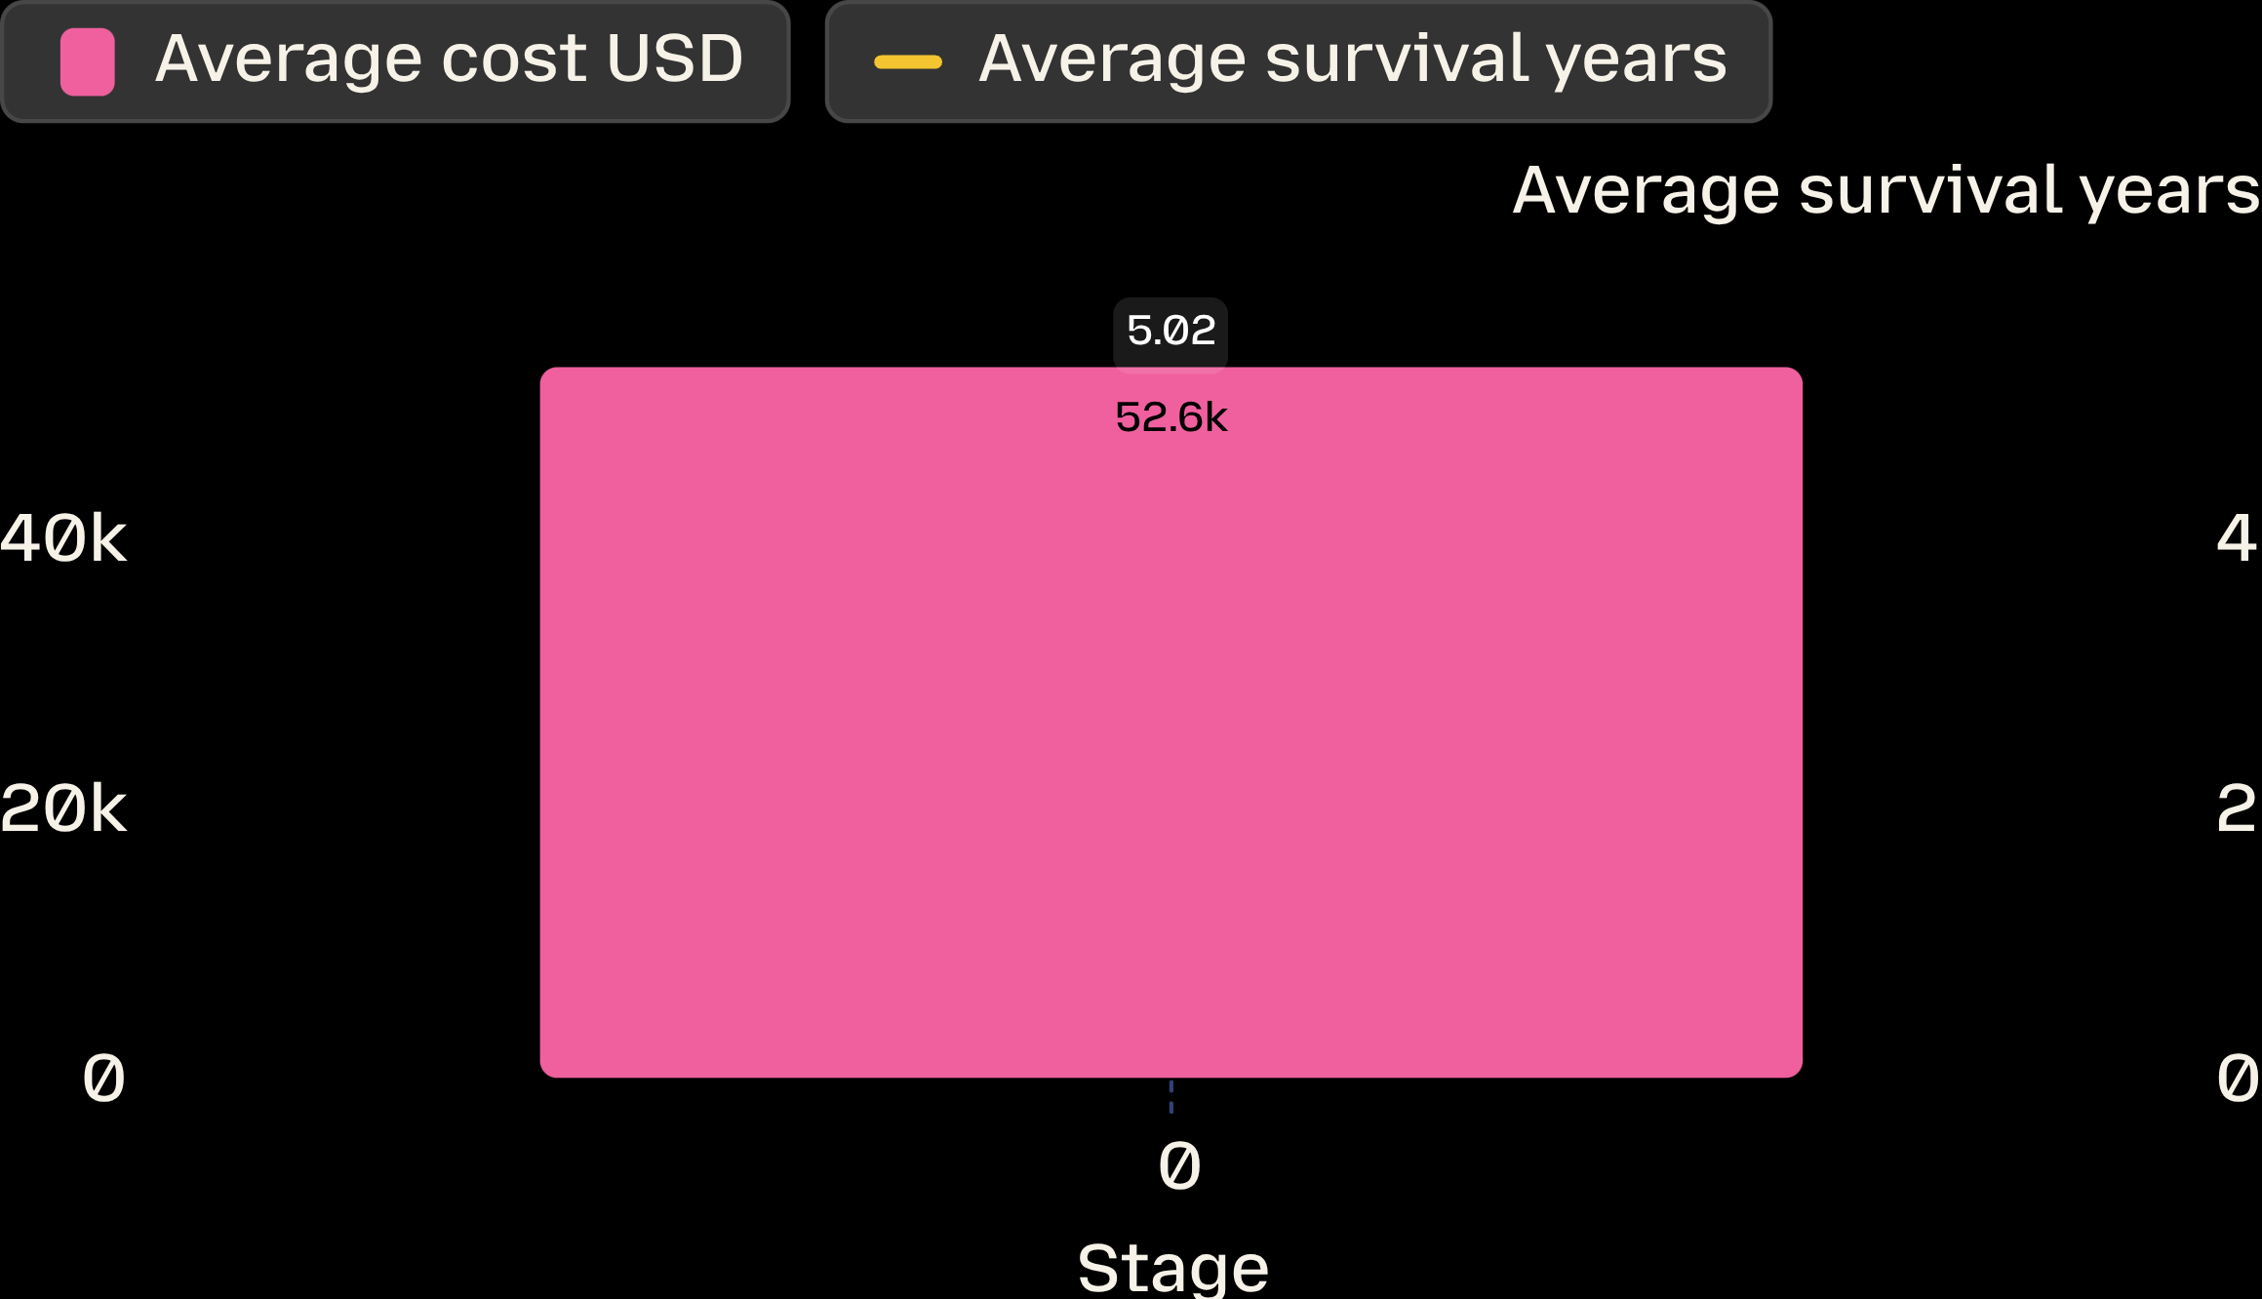
Cancer stage does not separate cost or survival
STAGES 0–IV
Both averages are almost flat.
Average cost stays between $52,083 and $52,708. Average survival stays between 4.97 and 5.04 years.
Kruskal–Wallis: cost p = 0.425; survival p = 0.603.

Slide 9
INTERACTION TEST
Genetic risk does not amplify smoking’s effect
−0.000228
Smoking × genetic-risk interaction coefficient
95% confidence interval: [−0.00115, 0.00069]
p = 0.628
The two factors appear to act independently on severity in this dataset.

Slide 10




What the analysis supports—and what it cannot
Prioritize smoking cessation, air-pollution reduction, alcohol-risk programs, and obesity prevention.
Strengthen lung cancer screening to improve early detection.
Add treatment type, comorbidities, and follow-up dates before drawing conclusions about survival.
Interpret the uniform distributions and flat survival relationships cautiously: the report notes the dataset may be simulated; the severity model may overfit.

