Slide 1
$233,081
CUSTOMER SHOPPING BEHAVIOR
total revenue
Customer
Shopping
Behavior
What 3,900 transactions reveal about revenue mix, loyalty, promotions, and growth opportunities.
3,900 transactions

Slide 2
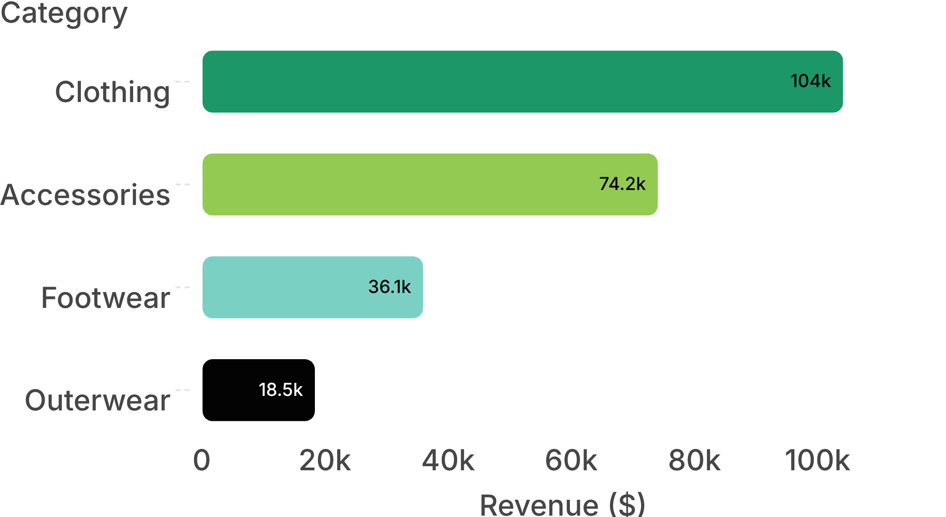
Customer Shopping Behavior
Revenue is concentrated in the core assortment
$104,264
Clothing revenue
Total revenue: $233,081
Clothing + Accessories drive more than 76% of revenue.
Source: customer-shopping-behavior-analysis-repo-efkwcv51
02

Slide 3
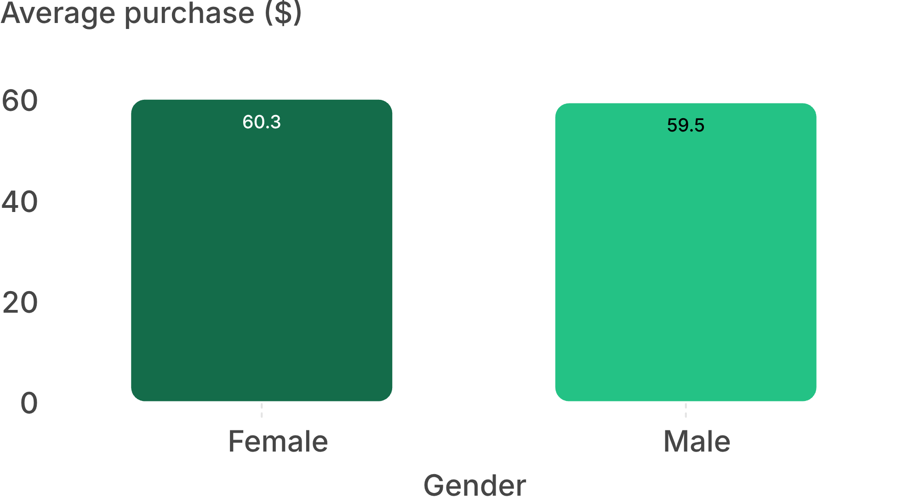
Customer Shopping Behavior
Customers spend about the same across major groups
$59.76
average purchase
Male customers generate 68% of revenue, consistent with their 68% share of customers.
Source: customer-shopping-behavior-analysis-repo-efkwcv51
03

Slide 4
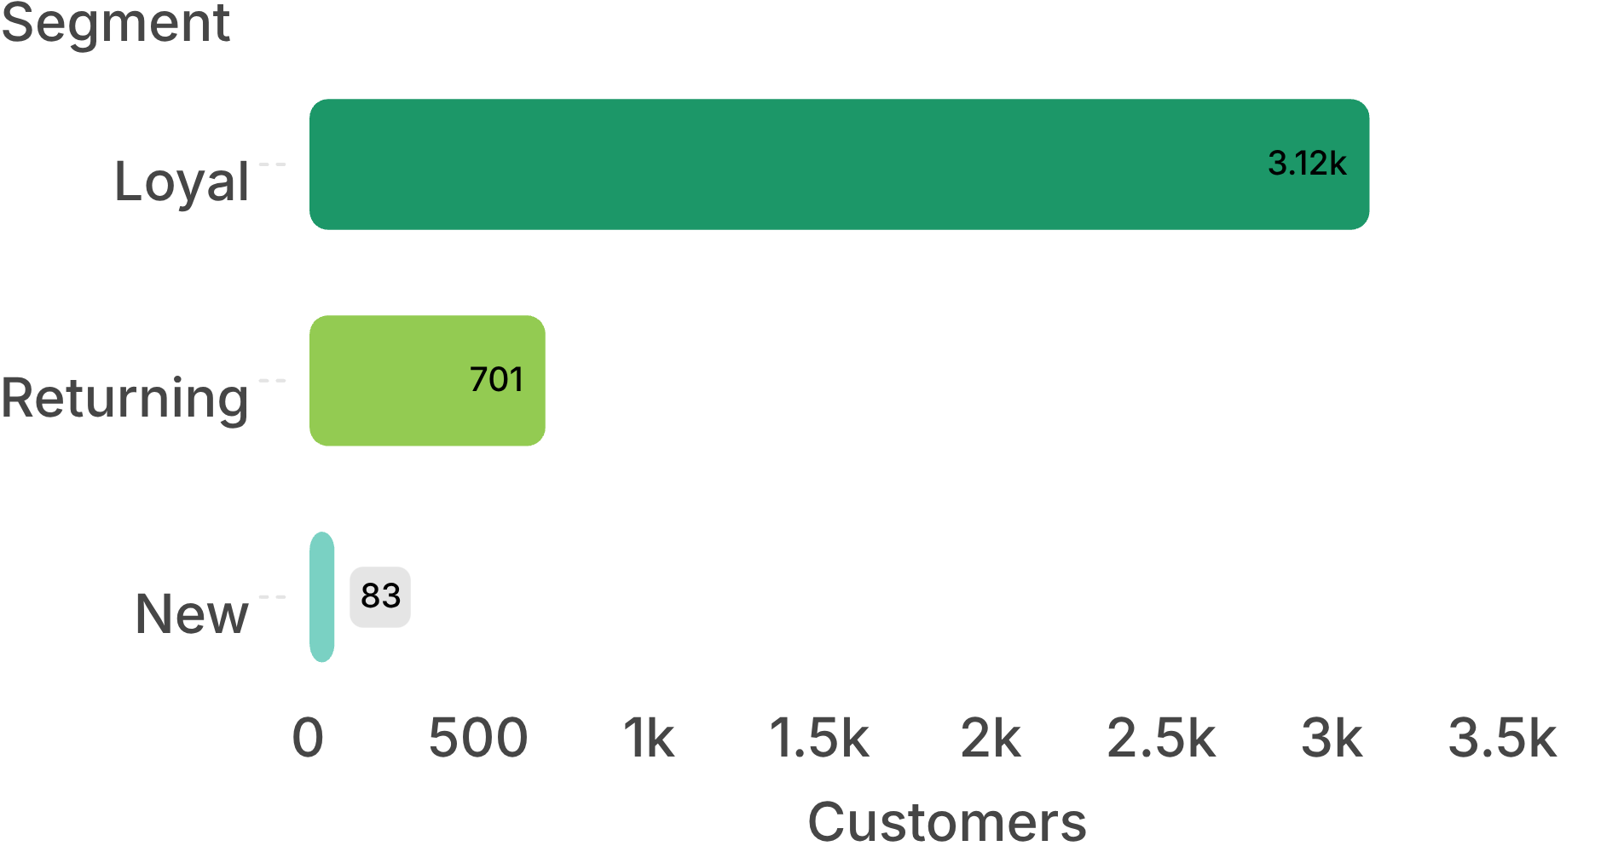
Customer Shopping Behavior
Loyalty is strong, but acquisition is thin
79.9%
loyal customers
Protect the loyal base while building a stronger acquisition engine.
Loyal: 3,116 customers (79.9%); Returning: 701 customers (18.0%); New: 83 customers (only 2.1%).
Source: customer-shopping-behavior-analysis-repo-efkwcv51
04

Slide 5
Customer Shopping Behavior
Subscriptions are not changing spend
27%
$59.49
27.6%
subscriber average spend
of repeat buyers subscribe
of customers subscribe
Non-subscribers average $59.87.
Almost the same as the overall 27% rate.
Subscribers also represent 27% of revenue.
The program needs a clearer value exchange, not simply more promotion.
Source: customer-shopping-behavior-analysis-repo-efkwcv51
05

Slide 6
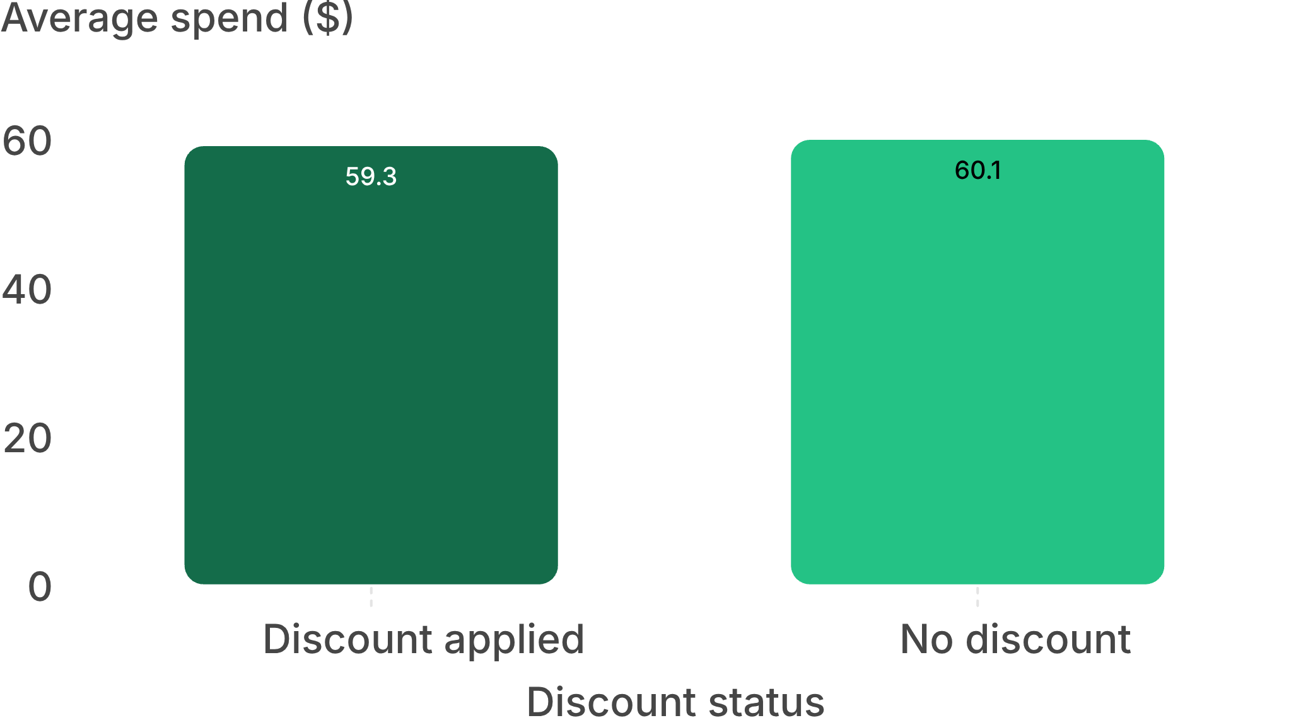
Customer Shopping Behavior
Discounts create volume, not higher basket value
43%
of purchases used a discount
Average spend with a discount: $59.28 vs. $60.13 without.
50% of discounted purchases were still at or above the $59.76 average.
Use discounts selectively, especially for slow-moving inventory.
06

Slide 7



Customer Shopping Behavior
Small service upgrades may unlock more value
$60.48
Top-rated products
Highest discount rates
Gloves 3.86 · Sandals 3.84 · Boots 3.82 · Hat 3.80 · Skirt 3.78
Express-shipping order
Hat · Sneakers · Coat · Sweater · Pants
Standard shipping: $58.46.
Test shipping and product-specific offers instead of broad discounting.
Source: customer-shopping-behavior-analysis-repo-efkwcv51
07

Slide 8
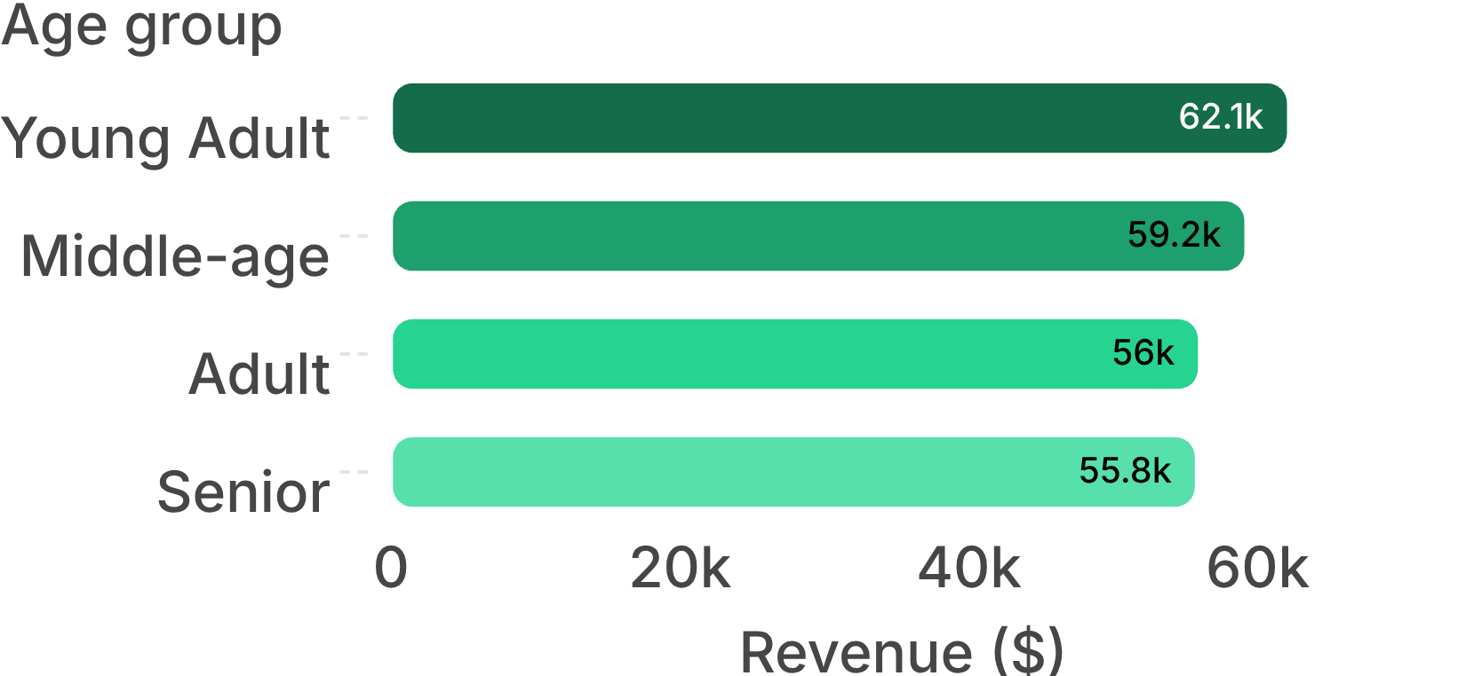
Customer Shopping Behavior
Young adults lead revenue, but demand is broadly distributed
$62,143
Young Adult revenue
All four age groups remain relatively close.
Fall generated the most revenue at $60,018; Summer generated the least at $55,777.
Source: customer-shopping-behavior-analysis-repo-efkwcv51
08

Slide 9
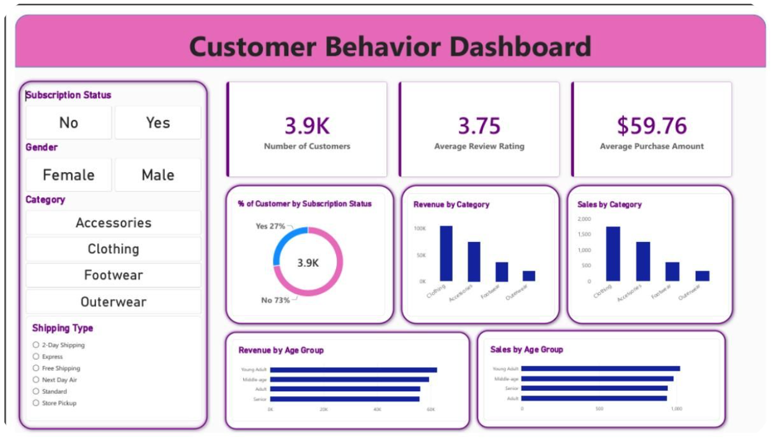
The analytics workflow turns raw transactions into decisions
01
02
03
Clean and feature-engineer
Query the prepared data
Translate findings
Build an interactive Power BI dashboard with KPI cards, charts, and slicers.
Prepare the 3,900-row dataset in Python.
Load it into PostgreSQL and answer 10 business questions with SQL.
Dashboard KPIs: 3.9K customers · 3.75 average review rating · $59.76 average purchase

Slide 10
Customer Shopping Behavior
Four actions follow from the data
Prioritize Clothing and Accessories
Redesign the subscription value
Protect inventory and marketing in the categories driving over 76% of revenue.
Test exclusive products or free shipping because subscribers do not spend more.
Build the top of funnel
Reward the base and test service
Target the 2.1% New segment with acquisition campaigns.
Launch loyalty points and test Express-shipping offers.
Next analytical step: add dates, clustering, and predictive models to move from description to forecasting.
10

