Slide 1

WORLD INDICATORS · 217 COUNTRIES
World indicators
tell one connected story
Income shapes health and digital access, while the pandemic and data gaps complicate the picture.

Slide 2
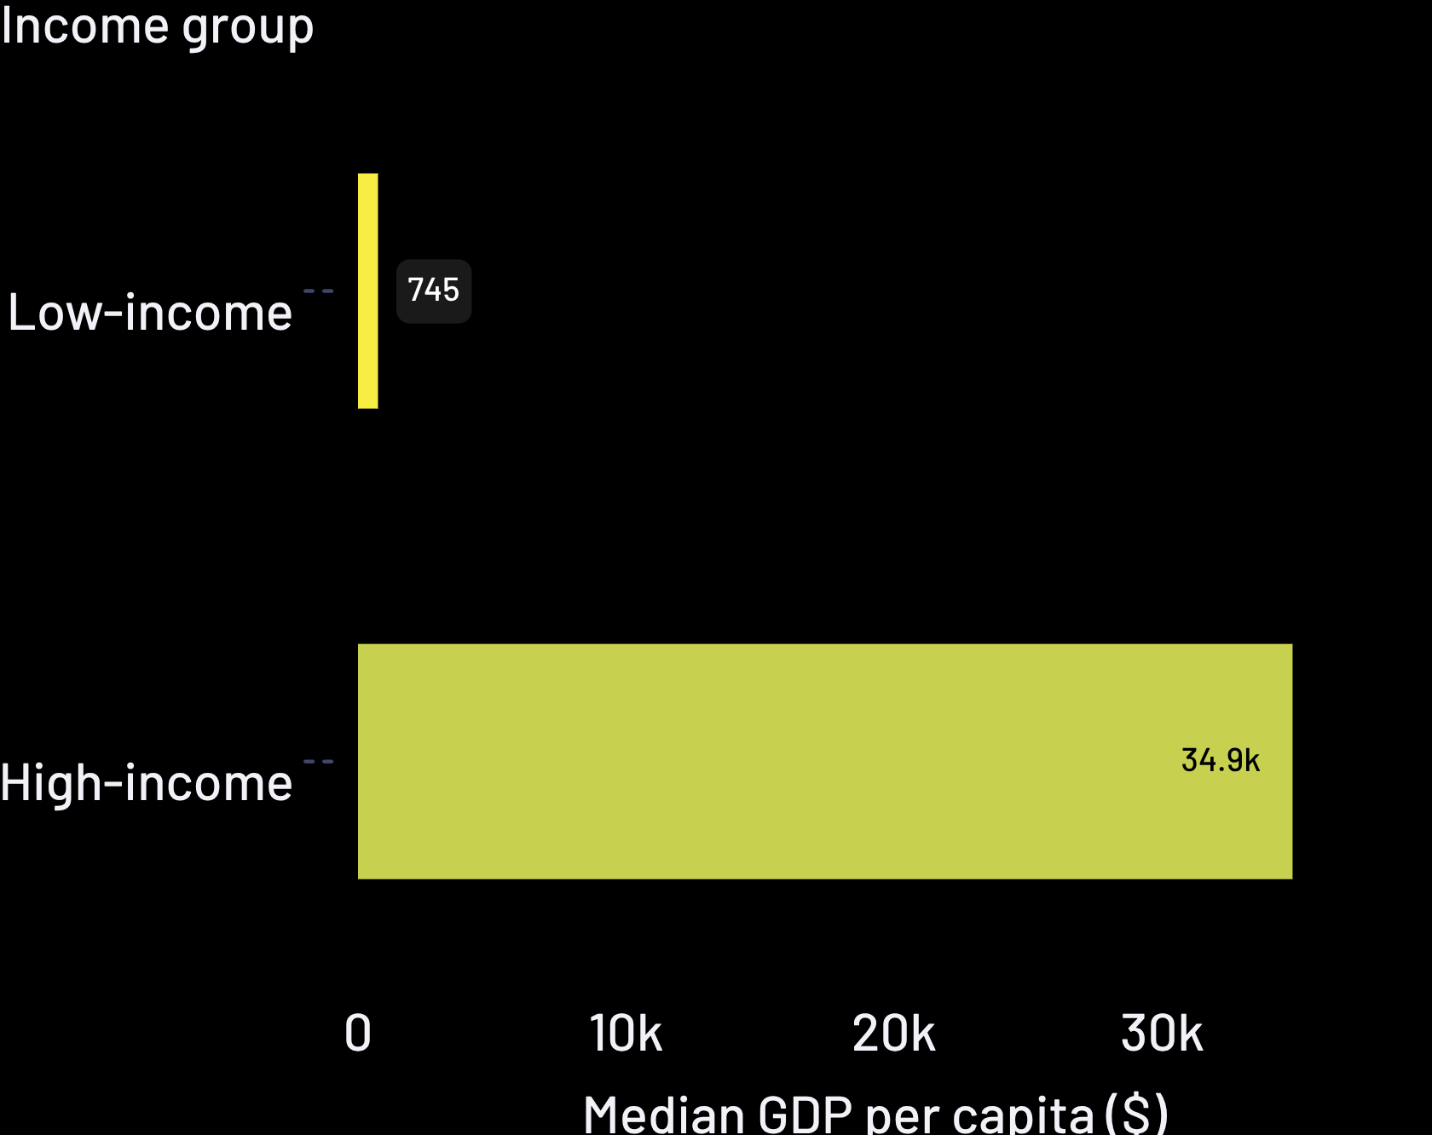
THE CENTRAL RELATIONSHIP
Income is the master variable
Log GDP per capita correlations
Across 217 countries
0.87
Correlation with life expectancy
0.88
Correlation with internet use
In 2022, median GDP per capita ranged from $745 to $34,861. Life expectancy spans 63.6 to 81.2 years across the same groups.

Slide 3
A TEST OF THE STORY
Health spending alone does not close the gap
Model signal | Correlation | Read
Health expenditure → life expectancy | 0.24 | Weak relationship
Log GDP per capita → life expectancy | 0.84 | Much stronger
Income + health spending, 2021 | R² = 0.70 | Still incomplete
Per-capita spending, not share of GDP, is the more useful next test.
Relationships are correlations. Many indicators are modeled estimates.

Slide 4
The pandemic left a
visible fingerprint
GDP growth fell to −5.1% in 2020,
life expectancy fell in 84% of countries
between 2019 and 2021, and
immunization coverage slipped.

Slide 5
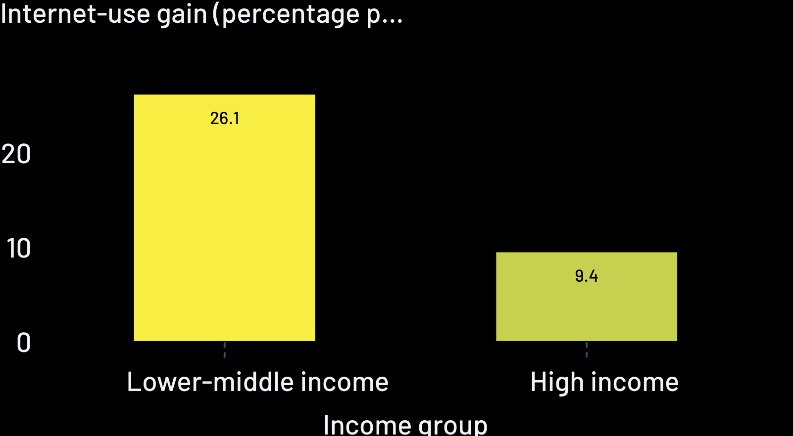
THE CATCH-UP PATTERN
Digital access is catching up fastest in the middle
54% → 81%
Median internet use, 2016 to 2023
26.1 points gained by lower-middle-income countries, 2016–2022; 9.4 points gained by high-income countries.
Starting level and gain are negatively related, a clear catch-up pattern.

Slide 6
THE LIMIT OF CONNECTIVITY
Connectivity is not a shortcut to jobs
0.88
−0.83
0.03
Internet use correlates with GDP per capita
Internet use correlates with infant mortality
Spearman relationship with unemployment: essentially zero
22.5%
Youth unemployment is a regional story in the Middle East and North Africa in 2023.
Connectivity aligns with development, but unemployment remains a regional story.

Slide 7
CONCENTRATION AND COVERAGE
Trade is concentrated, while poverty evidence is thin
Trade concentration
Poverty evidence
34.9%
49.3%
71
Top 5 exporters’ share of exports, 2022
Top 10 exporters’ share of exports, 2022
Countries report at least two poverty observations.
Regional comparisons are unreliable. Largest reported poverty declines include Viet Nam, Uzbekistan and Georgia.

Slide 8
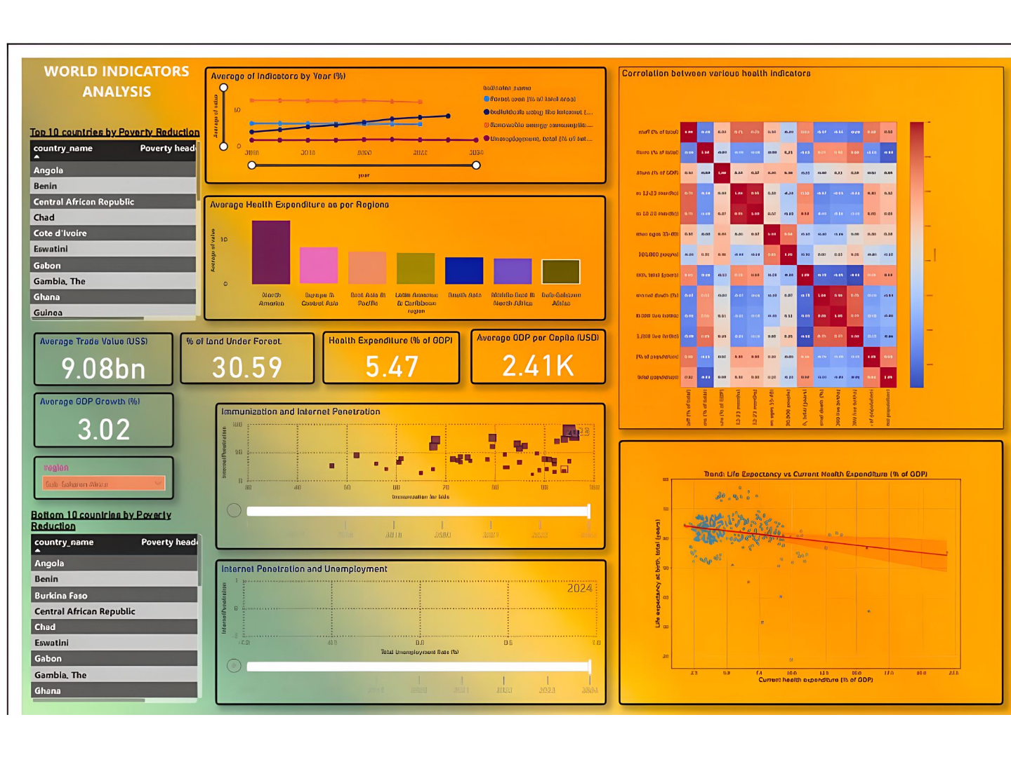
Data quality changes the answer
2016–2023
20%
Country-years with poverty data
Effective analytical window; 2024 is nearly empty.
9%
6.7×
Country-years with cause-of-death data
Including aggregates inflated average trade value until the dashboard was corrected.
Dashboard reference
Missing data is heavy for poverty, Gini and cause of death. Averages are unweighted by population.

Slide 9
DEFAULTS FOR RESPONSIBLE USE
Use the dashboard with disciplined defaults
1
Exclude aggregates
Exclude regional and income aggregates from country averages.
2
Choose robust summaries
Use medians for skewed indicators and state the country count behind every average.
3
Refresh and test
Refresh the source, add per-capita health spending and test population-weighted, fixed-effects models.
Relationships are correlations. Treat the dashboard as a disciplined starting point, not a final answer.

