Slide 1
Samavan (समवन) A friendly browser for the differently abled users of the Internet
Etymology : Samavan stems from the Sanskrit word 'samavan' (समवन) meaning 'help' or 'protect'. Also, we want to connect with it the English word 'someone'. Thus, we want to help someone. :)
Ambuj Tiwari & Shravya Kanchi • 23.09.2016

Slide 2
PURPOSE
A Customized user friendly browser which implements extensions curated based on users’ capabilities.
Overview

Slide 3
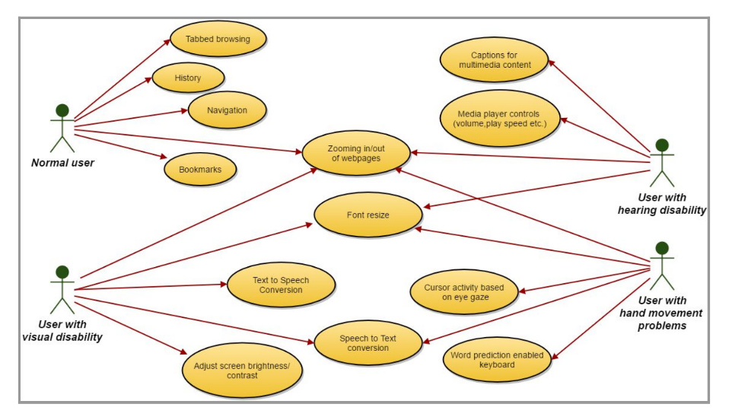

Slide 4
Decisions & Rationale
Use of python as a language of development of the browser.
Can be deployed on all types of systems and machines.
Has the largest support(libraries and developers) base.
It is simple to code.
Time is not a constraint in the current project.
Use of QT designer as a GUI constructor.
Converts GUI elements directly into python code.
Has in-built rendering engine and display functionalities like QWebView.

Slide 5
Schedule

Slide 6
Basic browser with features like navigation, history and bookmarks.
Extensions like multimedia captions, media player controls, screen brightness adjustment.
Final Product
23.09.16
Version 2
Version 3
Version 4
Final Version
Extensions added- speech to text, text to speech, zoom in/out, font resize along with accessibility test.
Extensions like word prediction, eye gaze tracking.

Slide 7
Attention areas
Challenge 1
The best points of tests to conduct to exactly know the disability(ies) of the users.
Challenge 2
Selecting the right solution/extension for a user with a particular disability.

