Slide 1


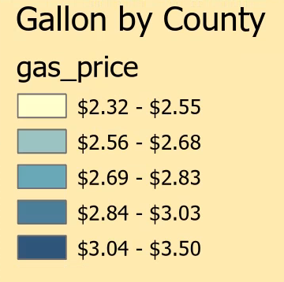
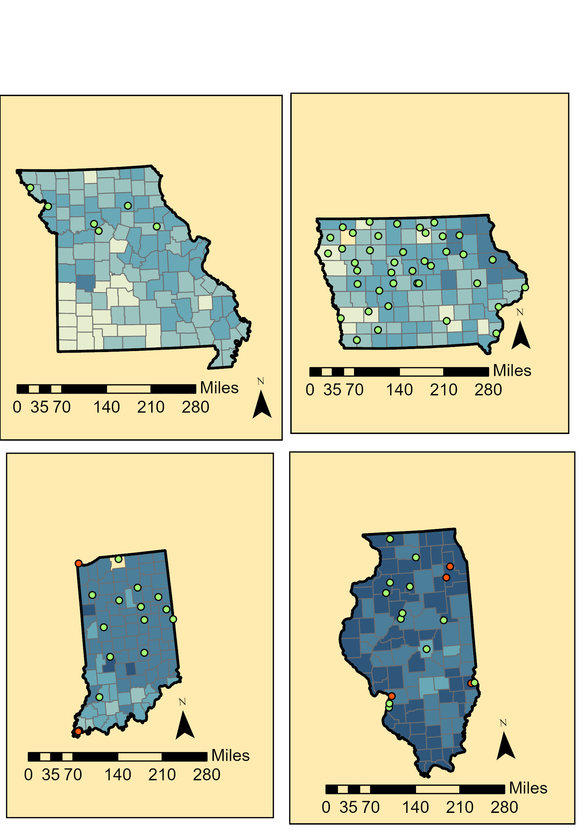
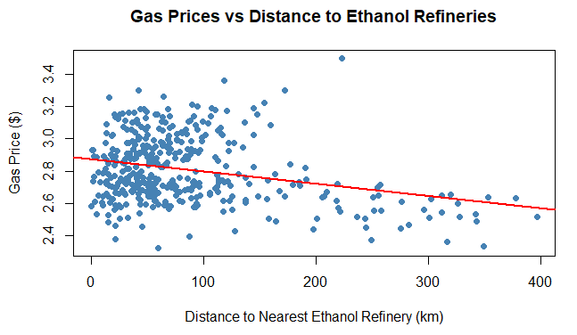
How does Proximity to Ethanol Biorefineries affect Fuel Prices?
Shravya Sunkugari | PSTC 1340 | Fall 2025
Background
Legend
Discussion/ Limitations
U.S. gasoline prices vary due to taxes, supply chains, refinery access, and local market conditions
10% ethanol (E10) is blended into most gasoline & ethanol production is concentrated in the Midwest
In April 2025, select Midwestern states were allowed to sell E15 year-round
Goal: Analyze whether distance to ethanol refineries and E15 policy status influence county-level gasoline prices in four Midwestern, corn-producing states
Average Gasoline Price Per Gallon
 | Estimate | p-value
KM_ETHANOL | –0.001038 | < 2e-16
KM_PETROL | –0.009091 | < 2e-16
E15 | 0.0618 | 0.000585
Proximity to both ethanol and petroleum refineries is significantly and negatively associated with gasoline prices
Counties in E15-policy states have significantly higher average prices
Model does not account for all price determinants (taxes, brand competition, local demand, refinery capacity)
~ 56% of variation in gas prices is unexplained despite controls for distance
States Implementing E15 Policy
Missouri
Illinois
Data
Ethanol biorefinery locations (U.S. EIA)
Petroleum refinery locations (U.S. EIA)
County-level gas prices (AAA)
Methodology
Using ArcGIS Pro:
Calculated road-network distance from each county centroid to the nearest:
  Ethanol refinery
  Petroleum refinery
Joined distance values to county-level gasoline prices
Created maps showing refinery locations and gasoline price variation
Using RStudio:
Ran a multiple linear regression model using the network distance data:
Predictors: Distance to ethanol refinery, distance to petroleum refinery, state adaptation of E15 policy
Response Variable: County level gasoline price
Conclusion
States Not Implementing E15 Policy
Counties farther from ethanol and petroleum refineries have lower gas prices, reflecting external market forces
Illinois and Iowa counties pay about 6 cents more per gallon on average which doesn’t necessarily reflect E15 policies, but all state factors
Factors like taxes and regional market structure drive gasoline price differences across counties more than proximity alone
Iowa
Indiana
GAS_PRICE = β₀​+ β₁​KM_ETHANOL + β₂​KM_PETROL + β₃​E15 + ε
Sources
An Empirical Analysis of the Spatial Variability of Fuel Prices in the United States
https://www.sciencedirect.com/science/article/pii/S0965856418310784
On the Dynamics of Gasoline Market Integration in the United States: Evidence from a Pair-Wise Approach
https://www.sciencedirect.com/science/article/abs/pii/S0140988312002575
The Determinants of Spatial Differences in Retail Diesel Prices
https://www.sciencedirect.com/science/article/pii/S0167718708000283
Spatial Differentiation and Vertical Mergers in Retail Markets for Gasoline
https://jfhoude.econ.wisc.edu/wp-content/uploads/sites/769/2018/08/Houde_AER2012.pdf
Ethanol’s Role in the Fuel Market: Imperfect Substitutes and Market Interactions (CARD Working Paper)
https://www.card.iastate.edu/products/publications/pdf/08wp467.pdf
The Octane Value of Ethanol (Renewable Fuels Association, June 2025)
https://ethanolrfa.org/file/2966/The%20Octane%20Value%20of%20Ethanol%20June%202025.pdf
The Spatial Influence of Fuel Taxes and Ethanol Mandates on Gasoline Pricing
https://www.sciencedirect.com/science/article/abs/pii/S0140988315001425
Imperfect Substitutes: The Elasticity of Substitution Between Gasoline and Ethanol
https://ethanolrfa.org/file/2032/Imperfect-Subsitutes_Pouliot-Babcock_2014.pdf
E15 Market Opportunities: Economic and Regulatory Assessment (USDA)
https://www.usda.gov/sites/default/files/documents/e15-market-opportunities.pdf
Understanding Gasoline Price Dispersion Across Time and Space (FIU Working Paper)
https://economics.fiu.edu/research/pdfs/2016_working_papers/1602.pdf
U.S. Fuel Ethanol Plant Capacity (EIA)- https://www.eia.gov/petroleum/ethanolcapacity/
Global Petroleum Infrastructure Data (Koordinates)- https://koordinates.com/data/?q=petroleum
AAA Gas Prices – Daily Fuel Price Data - https://gasprices.aaa.com/

