Slide 1
PYTHON INTRODUCTION

Slide 2
TOPICS
2
History
Application of Python
Features of Python
Python Virtual Machine

Slide 3
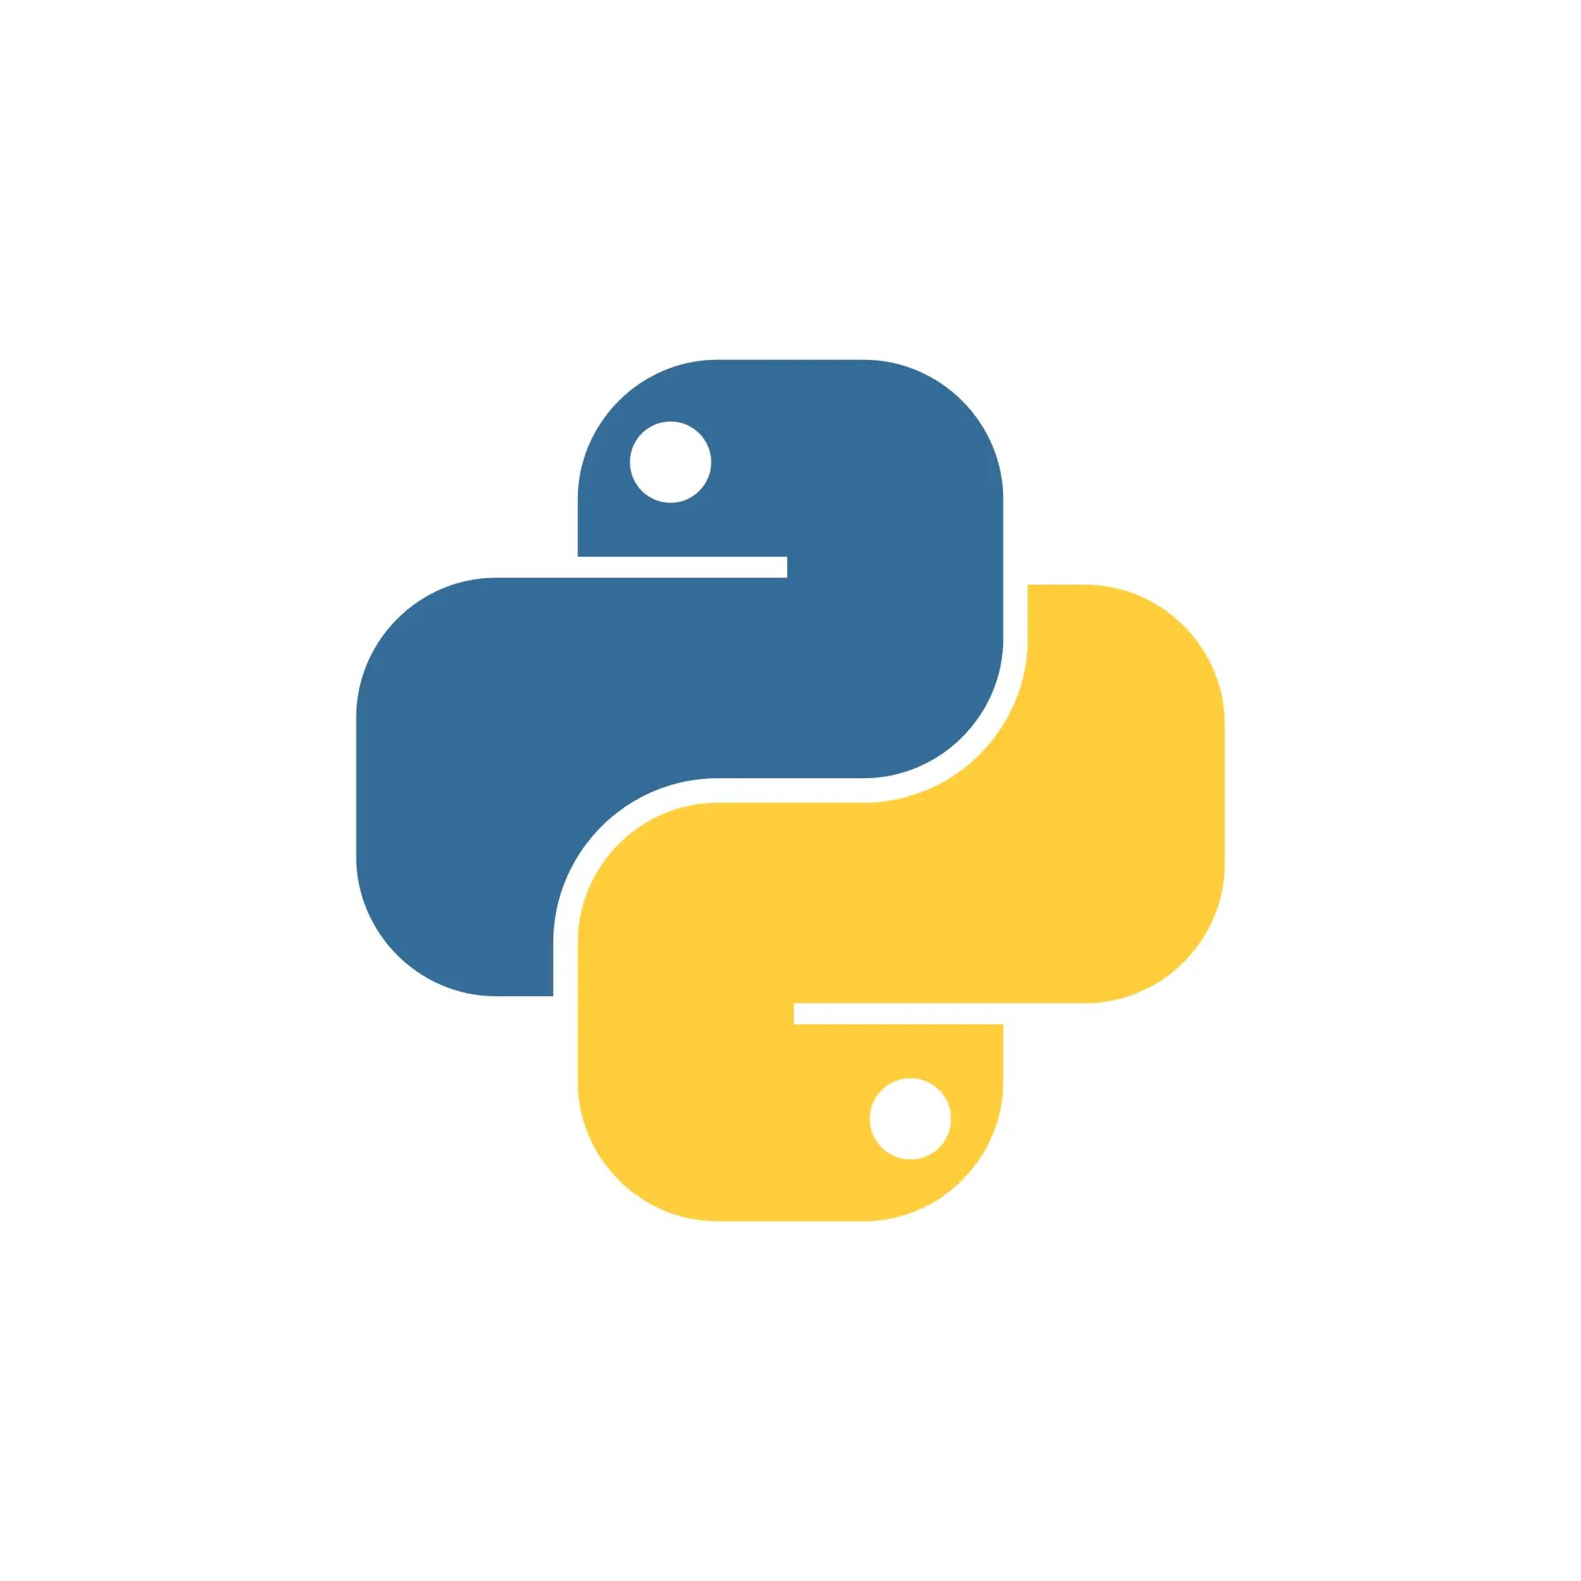
HISTORY
Python was developed by Guido Van Rossum.
He was member of creation of ABC language and was creating a hobby project during Christmas vacation Dec 1989.
Project was named Python, inspired by BBC’s TV Show – ‘Monty Python’s Flying Circus.
Python was made available to public in 20th Feb 1991.
https://docs.python.org/3/

Slide 4

Features of Python
High Level Programming Language
Easy to Learn and Read
Open Source and Free
Extensible and Embeddable
Large Community Support
Dynamically Typed
Interpreted Language
Portable & Platform Independent

Slide 5
High Level Programming Language
5
High level language that are very close to human it means it is easy and understandable for human as comparison to machine level code.
Easy to Learn and Read
Python is very beginner-friendly. You can start coding in Python after just a few hours of learning the basics. It's considered a developer-friendly language.

Slide 6
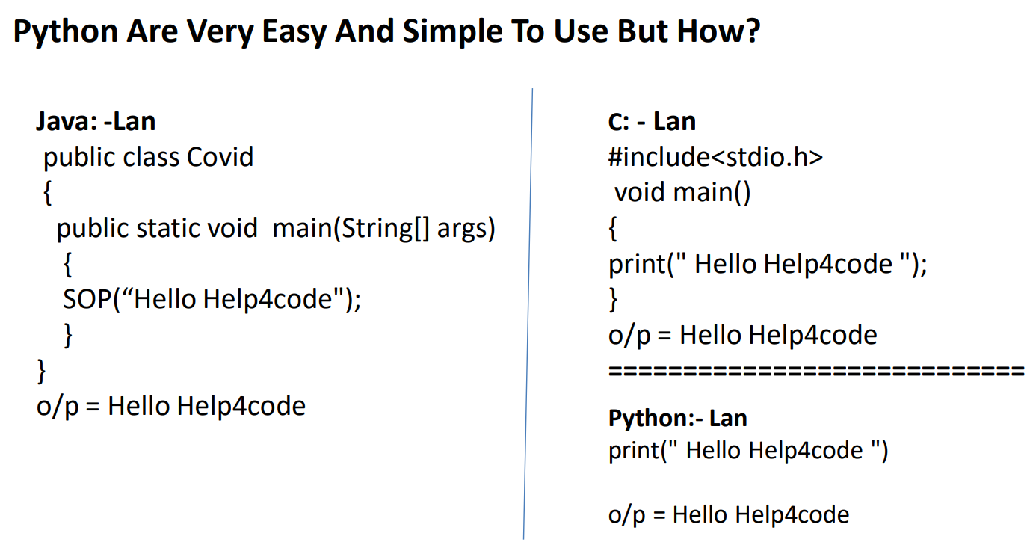

Slide 7
Open Source & Free
7
Python is completely free to use and its source code is publicly available. This openness encourages collaboration and improvement of the language. Flavors of python is customize version of python, such as CPython, Jython, IronPython, and PyPy, catering to different needs and environments.
Extensible & Embedded
Python's extensibility enables integrating modules and libraries written in other languages seamlessly. Its embeddability allows Python to be incorporated into applications to provide scripting capabilities, enhancing their flexibility and functionality.

Slide 8
Large Community Support
8
Python has a massive and active community. This means you can find lots of resources, tutorials, and help online whenever you get stuck.
Dynamically Typed
In Python, you don't need to tell the computer what type of data a variable holds. The type is determined dynamically during the execution of the program. eg:- a=10 (No need to define type like int a = 10)

Slide 9
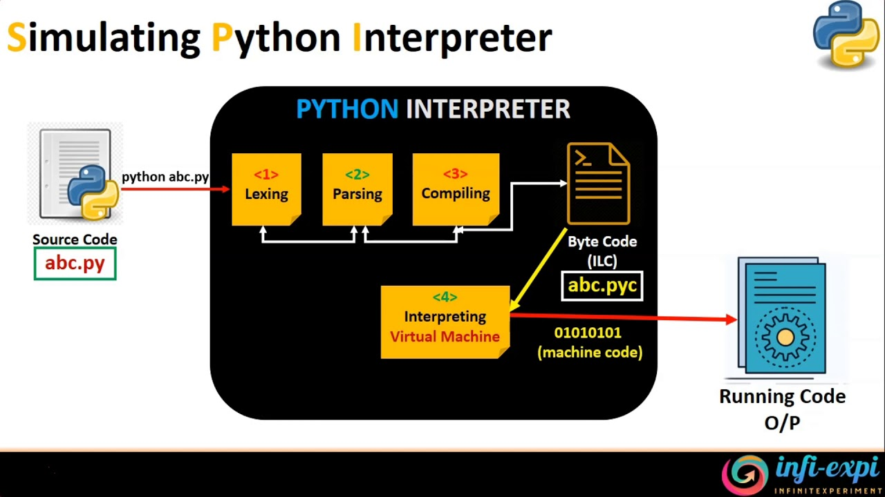
Interpreted Language
9
Python has a massive and active community. This means you can find lots of resources, tutorials, and help online whenever you get stuck.
Portable & Platform Independent
Python code written on one platform (like Windows) can run on others (like Linux or macOS) without needing changes.

Slide 10
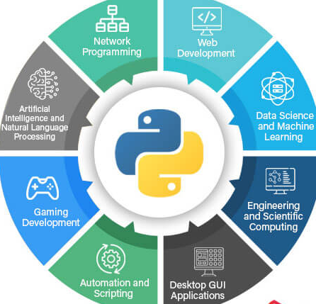
Applications of Python
Standalone Desktop Applications (GUI)
Artificial Intelligence / Machine Learning
Web Development
Game Development
Internet of Things (IOT) Applications
Database

Slide 11
Thank You

