Slide 1
DATA TYPES

Slide 2
IDENTIFIERS
Identifiers in Python are names given to variables, functions, classes, modules, and other entities within a program. They serve as labels or tags to identify these entities uniquely.
Identifiers can consist of uppercase and lowercase letters, digits, and underscores (_). However, they cannot start with a digit.
Special characters like ``, #, @, %, $, etc., are not allowed in identifiers.
Identifiers are case-sensitive, meaning Name and name are considered different identifiers.
Keywords should not be used as identifiers.

Slide 3
IDENTIFIERS
BEST PRACTICES
Use descriptive and meaningful names to improve code readability and maintainability.
Follow the snake_case convention for naming variables, functions, and methods, where words are separated by underscores (e.g., my_variable).
Start class names with an uppercase letter to distinguish them from other identifiers.
Single leading underscores indicate private member.
Double leading underscore indicates strongly private.

Slide 4
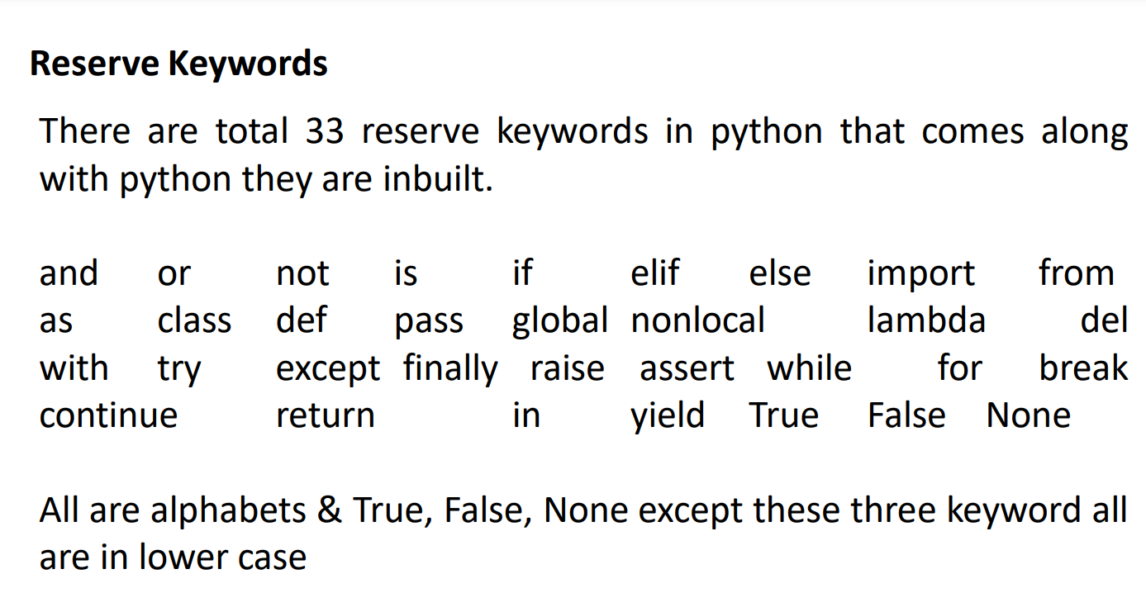

Slide 5
Introduction to data type
A data type specifies the type of value a variable holds.
In python there is no need to define or declare data type explicitly or externally in program.
Data type basically depends on the value we provide because according to value internally the data type class will be assign automatically. Therefore we can say that python is Dynamically Typed language.
type() function we can find the type of data type of variable.

Slide 6
Primitive data types
Python has 4 Fundamental or Primitive data types -
Integers (int): Whole numbers with no decimal places. They can be positive or negative numbers. For instance, 0, 1, 2, 3, -1, -2, and -3 are all integers.
Floats (float): Decimal numbers that are used to represent real numbers. They are used to store fractional values. For example, 3.14, 2.5, and -0.5 are all floats.
Booleans (bool): Represent logical values, either True or False, used for making decisions and performing logical operations.
Strings (str): Sequences of character data used to represent and store textual information. Strings are created using double quotes ("") or single quotes (‘’).

Slide 7
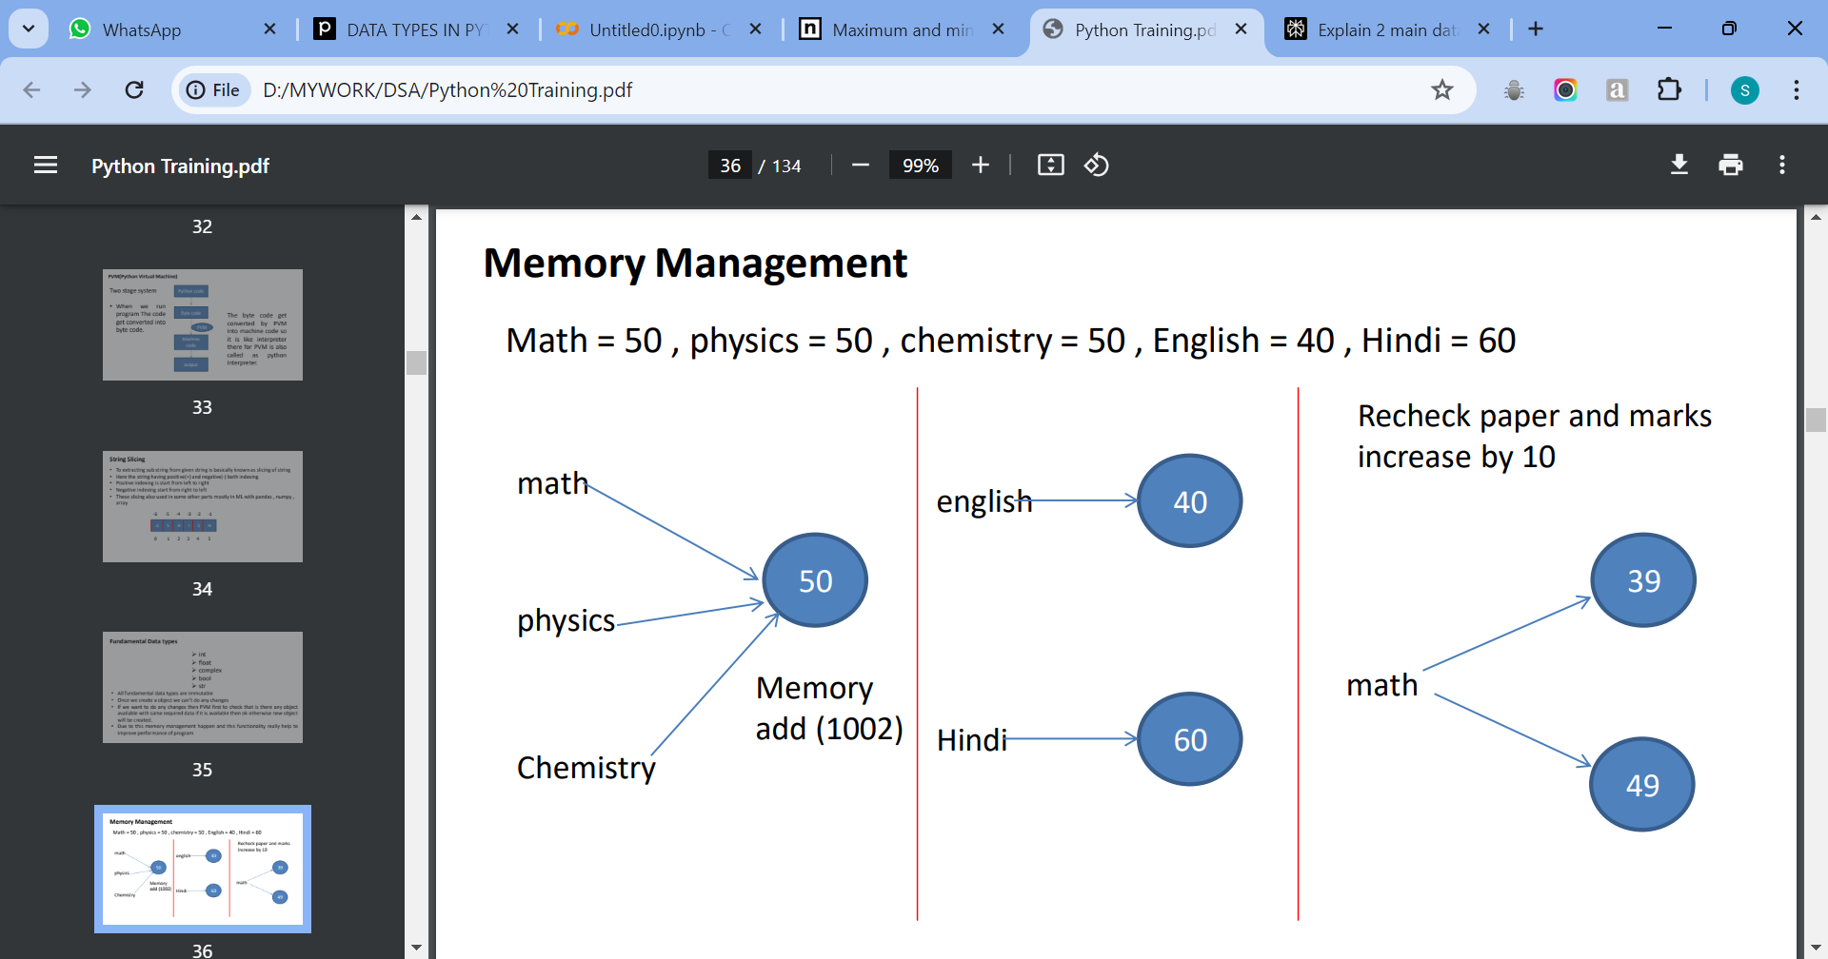

Slide 8
Escape Sequences - Escape sequences are special character combinations that start with a backslash (\) and are used to insert special characters into strings.
\n – New Line, \t – Horizontal Tab, \b – Backspace, etc
Print - The print() function in Python is a versatile tool for displaying output to the console or any other standard output device .
print("Hello,World!") print(123)
name = "Alice“
age = 25
print("Hello,",name,"you are",age, "years old.")
print(len(name))
print("Hello", "Alice", sep="-")
print("Hello, World!", end="\n")

Slide 9
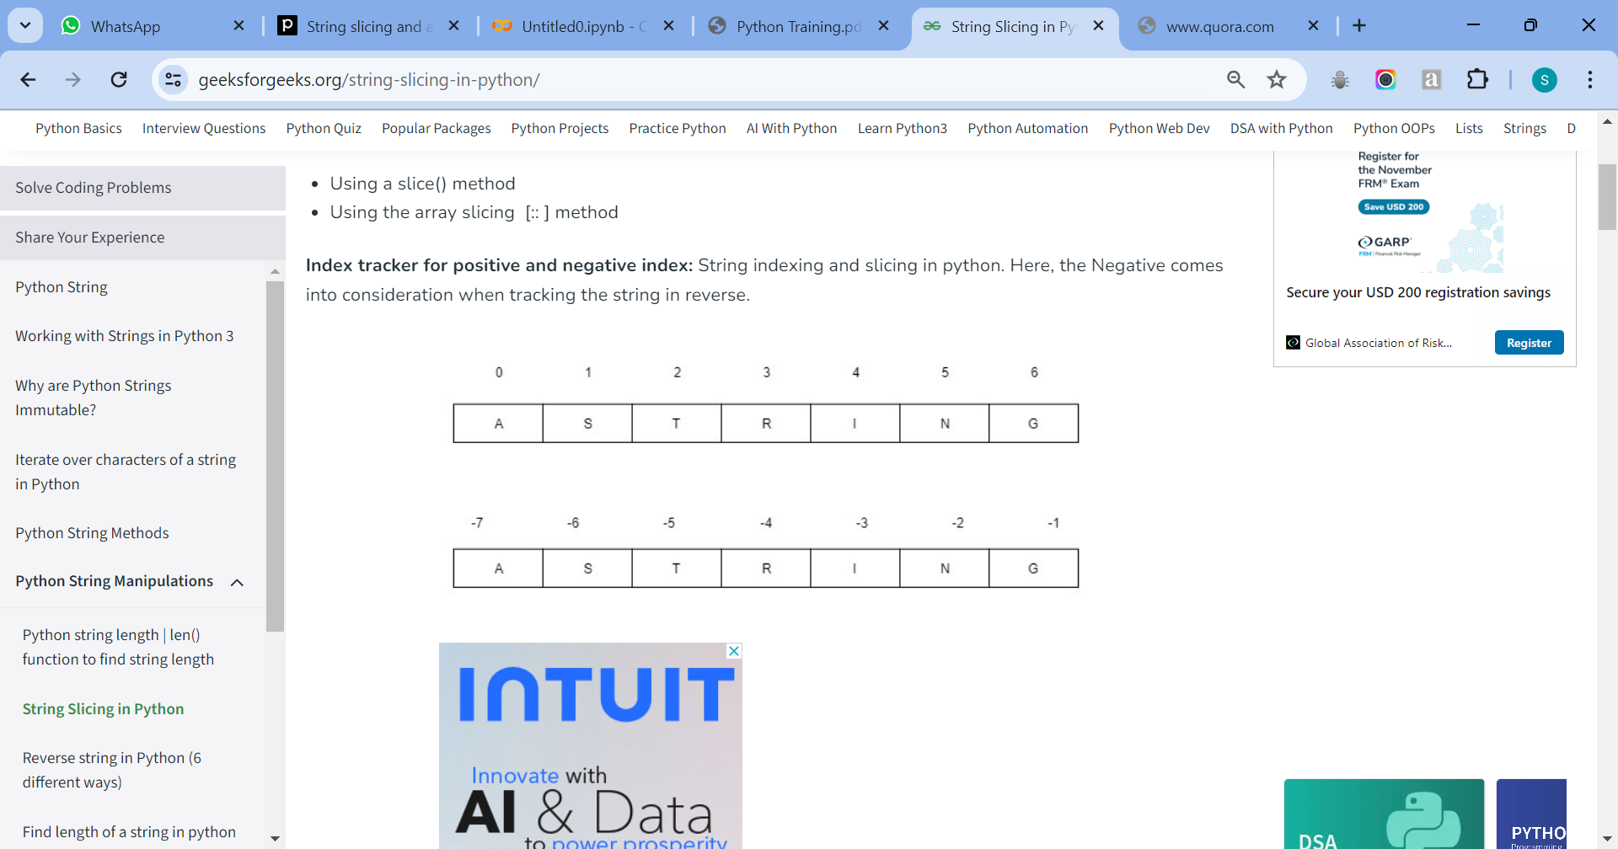
STRING
Indexing is a method to access individual characters within a string.
Strings in Python are ordered sequences of characters, and each character can be accessed directly using a numerical index.
The indexing is zero-based, meaning the first character of the string has an index of 0, the second character has an index of 1, and so on.
The index of the last character will be the length of the string minus one.

Slide 10
string
Python slicing is about obtaining a sub-string from the given string by slicing it respectively from start to end.
Python Slicing can be done in two ways:
String = “ITTraining”
Using a slice() method –
s1 = slice(3)
print(String[s1]) # Output: ITT
Using the array slicing [:: ] method
print(String[1:5:2]) # Output: TR

Slide 11
STRING OPERATIONS
Concatenation (+)
greeting = "Hello "
name = "World"
message = greeting + name print(message) # Output: Hello World
Repetition (*)
print("Python" * 3) # Output: PythonPythonPython
Finding Substrings
String = “HII RAM”
print(“RAM" in String) # Output: True
Counting Occurrences
print(String.count(‘I')) # Output: 2
Changing Case
print(String.upper()) # Output: GEEKSFORGEEKS
print(String.lower()) # Output: geeksforgEEKS
print(String.capitalize()) # Output: GEEKSFORGEEKS
https://www.geeksforgeeks.org/python-string-methods/

Slide 12
TYPE CASTING
Type casting, also known as type conversion, is the process of converting a variable from one data type to another.
There are several ways to perform type casting in Python, including using built-in functions, the (int) function for integer conversion, the (float) function for floating-point conversion, and the (str) function for string conversion.
Additionally, Python automatically converts types in certain contexts, such as arithmetic operations involving mixed types.

Slide 13

Thank you

