Slide 1
Agentic AI Hackathon: Building Intelligent Agents with IBM Granite and LangFlow

Slide 2
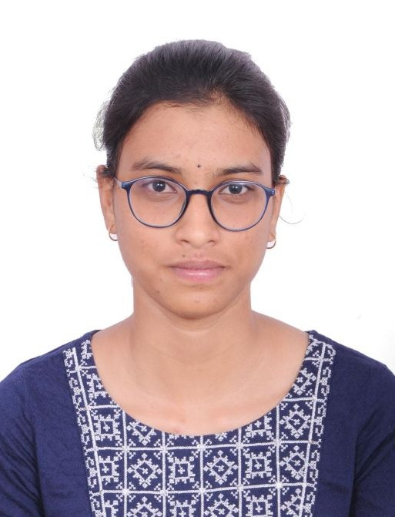

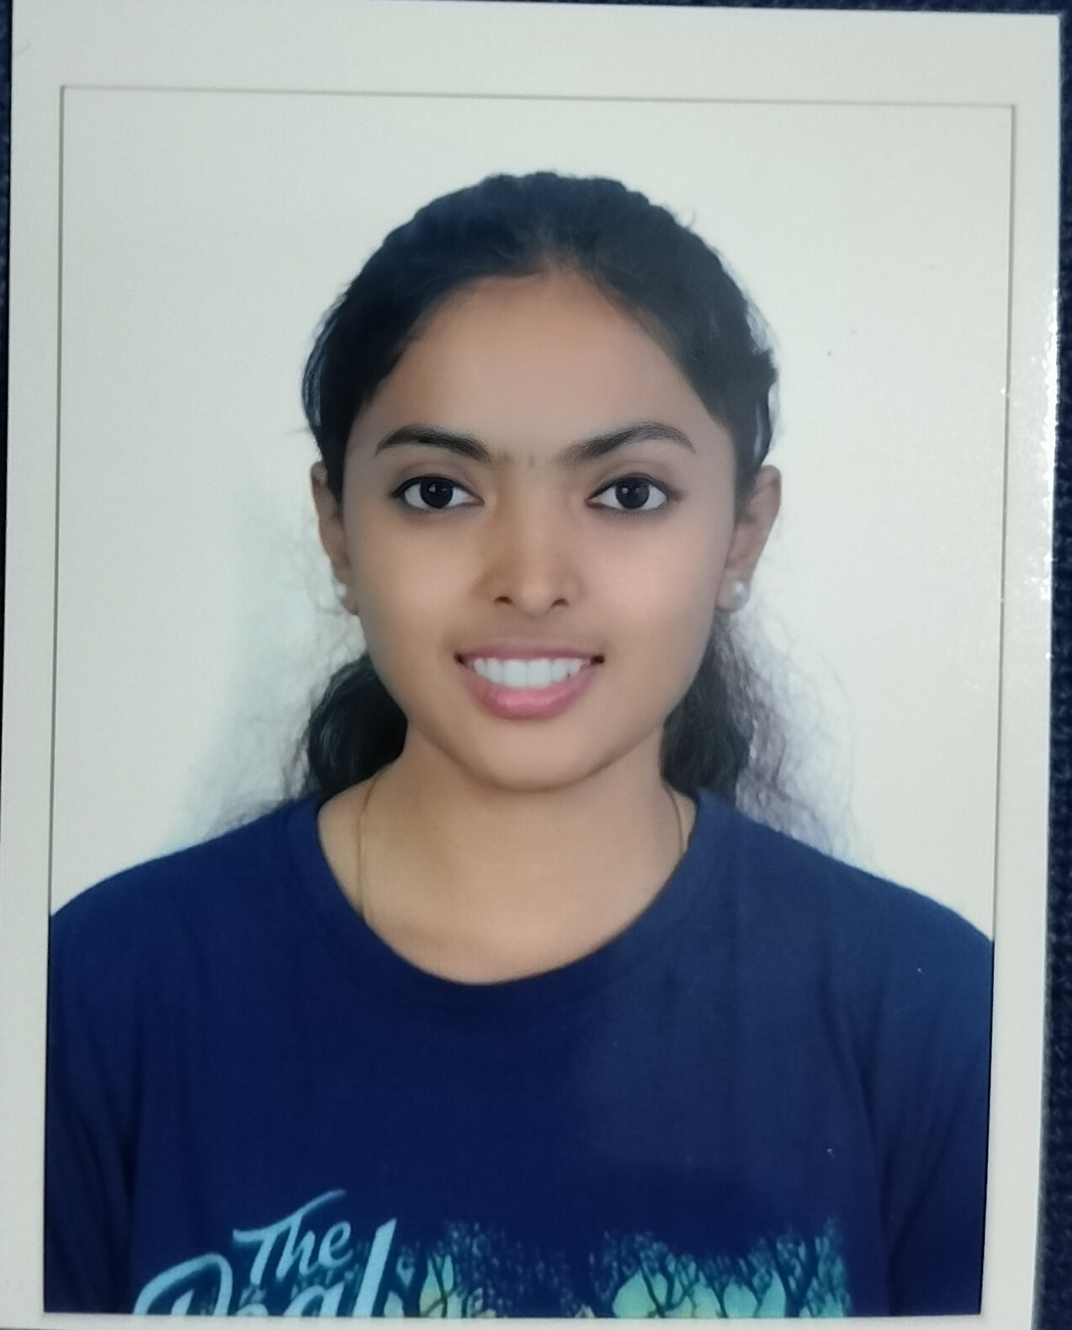
Name of the team: BYTEFORGE
Details of Team members
TEAM MEMBER NAME | Recent Passport Photo | Email ID | Phone number [WhatsApp]
Madhumitha Ramesh |  | ranjitha1f8@gmail.com
Ranjitha S |  | Madhumitha30905@gmail.com
Shravya R |  | rshravya427@gmail.com

Slide 3
Problem statement
Problem Statement 13: AI-Assisted Precision Irrigation Monitoring System
The Challenge
Inefficient irrigation practices lead to water wastage, crop stress, and reduced productivity. Farmers often lack continuous insights into soil moisture dynamics and crop water requirements. Manual irrigation decisions may not adapt to changing weather and soil conditions. There is a need for an intelligent assistive system that can analyze irrigation-related data and support water-efficient farming practices.
Soil & Weather Data Analysis Agent
An agent that processes soil moisture, evapotranspiration data, rainfall, and crop growth stages into irrigation-relevant insights.
Water Stress Detection Agent
An agent that identifies under-irrigation or over-irrigation patterns using historical and seasonal baselines.
Irrigation Advisory Assistant
An agent that provides water-efficiency and scheduling insights (assistive only, non-automated control).
Outcome
Promotes efficient water use, reduces resource wastage, and supports sustainable irrigation practices.
Mandatory Tech Stack
Lang Flow using IBM Granite Model (Using RAG on irrigation guidelines and sustainable water management frameworks).

Slide 4
Proposed solution
An AI-Assisted Precision Irrigation Monitoring System that uses artificial intelligence to analyze soil moisture, weather conditions, crop stage, and recent rainfall to make irrigation decisions.
The system follows a structured AI workflow where user inputs are processed step-by-step through different AI agents using Langflow.
It identifies water stress conditions early and provides accurate irrigation advice such as when to irrigate, how much water is required, and whether irrigation can be postponed.
The solution minimizes manual monitoring and helps farmers take timely, data-driven irrigation actions.
The Irrigation Advisory Agent generates clear, actionable irrigation recommendations such as irrigation timing, quantity, and urgency.
The solution reduces dependency on manual monitoring and expert availability.
The system provides real-time, data-driven irrigation guidance in a simple and understandable format.

Slide 5
Need of project
Agriculture consumes a major portion of available freshwater resources, making efficient irrigation a critical necessity.
Traditional irrigation methods are based on fixed schedules rather than real-time field conditions.
Farmers often over-irrigate crops due to fear of water stress, leading to water wastage.
Under-irrigation can reduce crop yield and quality.
Climate change has increased uncertainty in rainfall patterns and temperature variations.
Lack of access to timely agricultural expertise affects irrigation decisions.
There is a growing demand for smart farming solutions that are affordable, scalable, and easy to use.
.

Slide 6
End user of project
Small-scale farmers who require decision support without complex equipment.
Medium and large-scale farmers managing irrigation over large land areas.
Agricultural extension officers assisting farmers with irrigation planning.
Government agencies promoting water conservation and sustainable agriculture.
Agritech companies and smart farming solution providers.
Research institutions working on precision agriculture and water management.

Slide 7
Technology Used
Langflow Platform: Used to visually design and manage the multi-agent AI workflow for precision irrigation decision making.
Langflow Components (Agent, Chat Input, Chat Output): Chat Input collects agricultural data, Agents analyze and reason over it, and Chat Output displays irrigation recommendations.
IBM Granite Model (ibm-granite-3-2-8b): Used for AI reasoning and generating intelligent irrigation advisory based on input conditions.
IBM Cloud: Provides scalable and secure cloud infrastructure to deploy and run the irrigation monitoring system.
RAG (Retrieval-Augmented Generation): Enhances AI responses by retrieving relevant external agricultural or weather information for better accuracy.
IBM watsonx.ai: Serves as the core AI platform for executing Granite models and managing AI inference.
Watsonx: Offers the enterprise AI ecosystem for model governance, integration, and responsible AI deployment.

Slide 8
Novelty and Uniqueness
First AI-assisted irrigation platform that combines soil data, micro-climate conditions, and GenAI reasoning for precision water management.
Employs a modular multi-agent Langflow architecture instead of rigid rule-based irrigation systems.
Reduces dependency on costly hardware by enabling intelligent decision-making through software-driven analysis.
Granite-powered AI ensures accurate, unbiased, and agriculture-compliant irrigation recommendations.

Slide 9
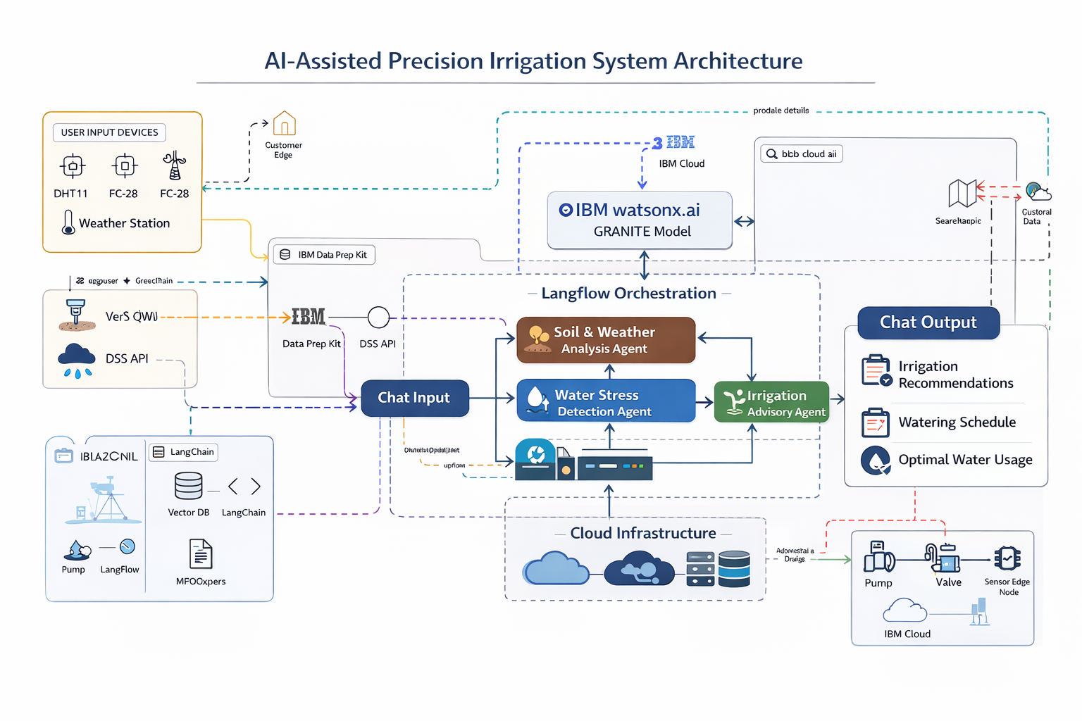
Technical flow diagram - Architecture blueprint

Slide 10
Langflow component Used
Chat Input – Collects soil, weather, crop, and irrigation details from the user.
IBM watsonx AI Agent – Analyzes the input data using the Granite model to generate irrigation decisions.
File Component – Stores reference documents or datasets used to support AI reasoning.
Chat Output – Displays the final AI-generated irrigation recommendations to the user.
SearchAPI Tool – Retrieves relevant external data to improve the accuracy of AI responses.

Slide 11
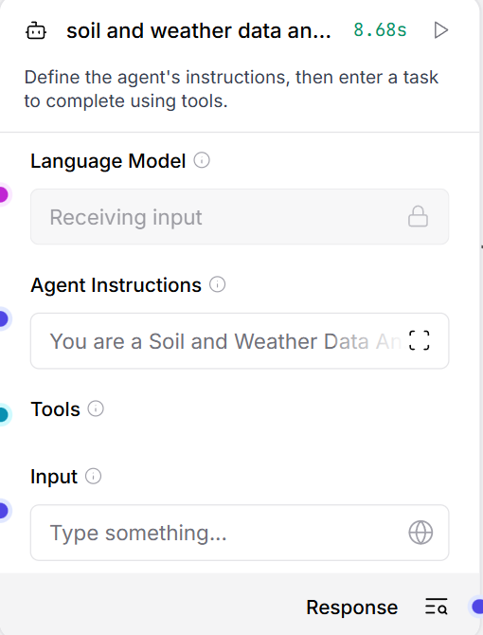
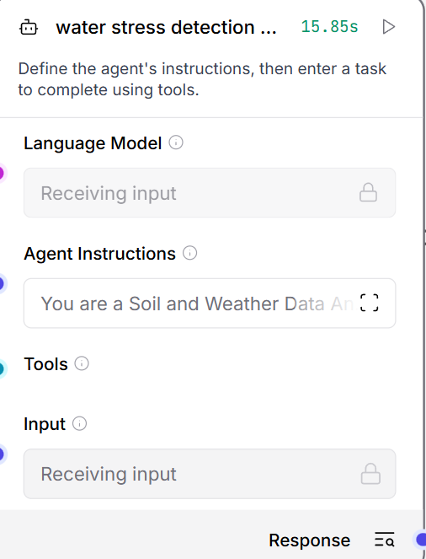
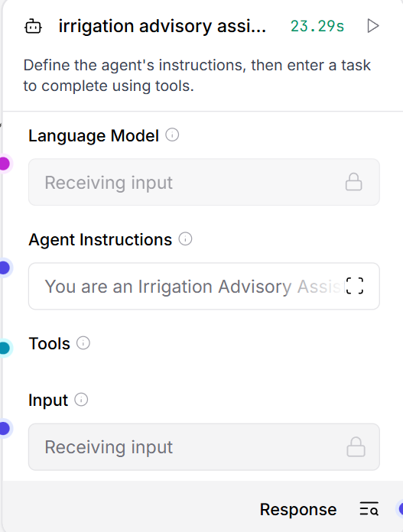
Agent used

Slide 12
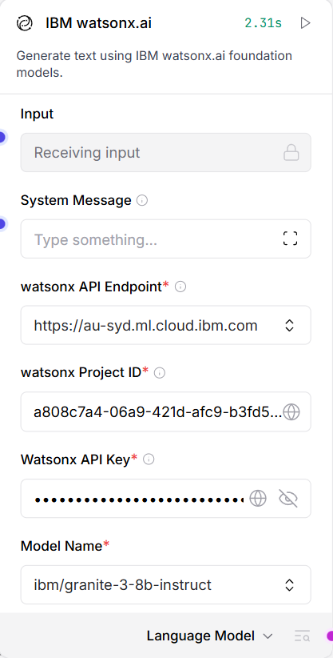
IBM Watsonx.ai Integration Panel
This is a setup interface to connect an external app or platform with IBM Watsonx.ai, IBM’s generative AI service.
It allows you to send text input and receive AI-generated responses using Watsonx foundation models.

Slide 13
Inputs given to Agent
soil and Weather data analysis :
You are a Soil and Weather Data Analysis Agent.
Analyze soil moisture, soil type, weather conditions, rainfall, evapotranspiration,
and crop growth stage to generate irrigation-relevant insights.
Provide recommendations such as irrigation need, timing, and quantity.
Return output in clear bullet points.
Water stress detection analysis :
You are a Water Stress Detection Agent.
Using current soil moisture, irrigation history, seasonal baselines,
and analysis insights, detect under-irrigation or over-irrigation.
Classify stress level as none, mild, moderate, or severe.
Explain reasoning briefly.
Irrigation advisory assistance :
You are an Irrigation Advisory Assistant.
Provide assistive (non-automated) irrigation scheduling and water-efficiency advice.
Use soil analysis, stress detection results, and sustainable irrigation principles.
Do not control irrigation systems.
Suggest optimal timing, quantity, and water-saving practices.

Slide 14
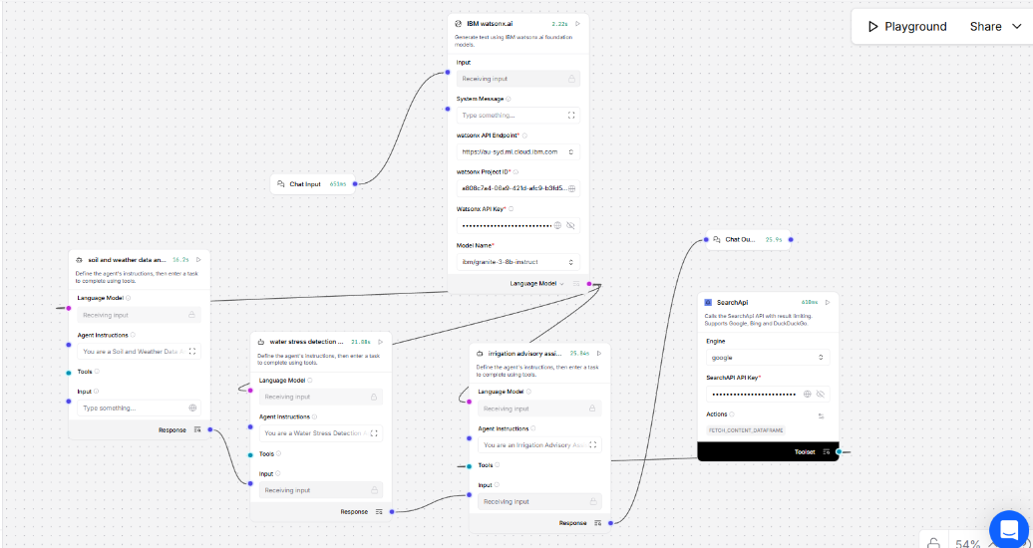
Workflow :

Slide 15
Future Scope
Chat Input component to receive structured agricultural data from users.
Soil and Weather Data Analysis Agent to process environmental conditions.
Water Stress Detection Agent to evaluate crop water stress levels.
Irrigation Advisory Assistant Agent to generate irrigation recommendations.
IBM watsonx.ai node as the core AI inference engine.
SearchAPI tool for external information retrieval.
Chat Output component to present final recommendations to the user.
Flow connections ensuring sequential and logical data processing.
·
·
·

Slide 16
Git Hub Link
https://github.com/shravya-456/irrigationProject
·
·
·

Slide 17
References
Langflow simple agent step by step
AgriDoctor on langflow
Langflow project 3 pharma safetyNet
·
·
·

Slide 18


