Slide 1
SYSTEM STATUS: ONLINE
>_ EX-AI
Explainable AI-Driven User Behavior
Threat Detection Using Random Forest Classifier
BCA Final Year Project · Department of Computer Applications
SUBMITTED BY
SHRAVYA (U18BH23S0043)
GUIDED BY
Mrs. Amrutha Kakkoth

Slide 2
THE PROBLEM
Traditional security tools can't see behavioral threats
Rule-based and signature-based systems catch known attack patterns — but insider threats, credential stuffing, and account hijacking often look like "normal" traffic on the surface. The only signal is in behavior.
WHY IT MATTERS
82%
of breaches involve a human / behavioral element, not just a technical exploit.
Repeated login attempts
Brute-force / credential stuffing signal
Abnormal session duration
Persistence after unauthorized access
Manual monitoring cannot scale to thousands of sessions per day — this project automates that judgment call.
Excessive page access
Automated scraping or reconnaissance
High failed-login count
Dictionary attacks against accounts
EX-AI
02 / 12

Slide 3
OBJECTIVES
What this system sets out to do
01
02
03
Detect
Classify
Score
Flag suspicious user behavior automatically using Machine Learning.
Separate Normal vs Suspicious users with a Random Forest Classifier.
Generate a deviation score measuring how abnormal a session is.
04
05
06
Prioritize
Explain
Visualize
Assign Low / Medium / High risk levels for triage.
Use Explainable AI to show why a prediction was made.
Present everything through a live security dashboard.
EX-AI
03 / 12

Slide 4
SYSTEM ARCHITECTURE
From raw session data to a live verdict
Behavioral features — login_attempts, session_duration, pages_accessed, failed_logins — flow through preprocessing and scaling into a Random Forest Classifier. Predictions are paired with deviation scoring, risk classification and permutation-importance explainability, then served live through a Flask web dashboard.
Dataset
Preprocess
Scale
Train
(Random Forest)
Evaluate
Explain
(XAI)
Serve
(Flask UI)
EX-AI
04 / 12

Slide 5
DATA
The behavioral dataset
4 BEHAVIORAL FEATURES
CLASS DISTRIBUTION
login_attempts
319
81
Frequency of authentication activity
session_duration
Length of the user session, in minutes
NORMAL USERS · 79.8%
SUSPICIOUS USERS · 20.2%
pages_accessed
Breadth of browsing / access behavior
failed_logins
Count of failed authentication attempts
Preprocessing: duplicate check, missing-value check (0 found), feature selection, StandardScaler normalization before training.
400 sessions, labeled Normal / Suspicious — matching the schema of the original Kaggle-style dataset.
EX-AI
05 / 12

Slide 6
THE MODEL
Why Random Forest Classifier
Random Forest builds many decision trees on random subsets of data and averages their output. That ensemble approach reduces overfitting and handles mixed-scale behavioral features reliably without heavy tuning — a strong, explainable baseline for a first cybersecurity ML classifier.
MODEL CONFIG
Algorithm
RandomForestClassifier
Estimators
200 trees
High classification accuracy
Max depth
8
Reduces overfitting vs. a single tree
Train / Test split
80% / 20%
Handles behavioral data efficiently
Widely used in anomaly detection
Random state
42
Library
scikit-learn
EX-AI
06 / 12

Slide 7
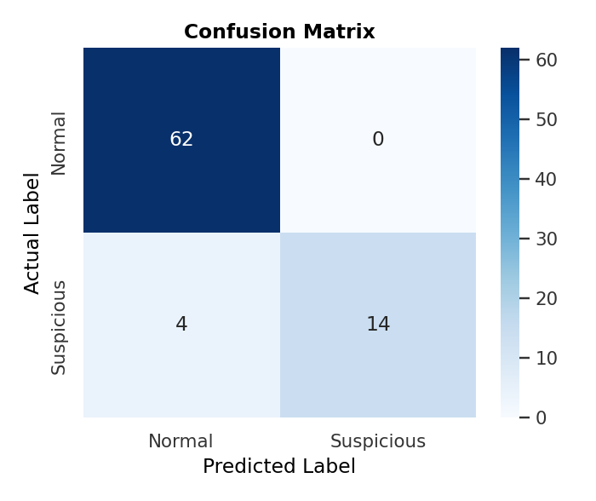
EVALUATION
Model performance on unseen data
CLASSIFICATION REPORT
Class
Precision
Recall
F1
Normal
93.9%
100%
96.9%
Suspicious
100%
77.8%
87.5%
Weighted Avg
95.3%
95.0%
94.8%
95.0%
OVERALL MODEL ACCURACY
EX-AI
07 / 12

Slide 8
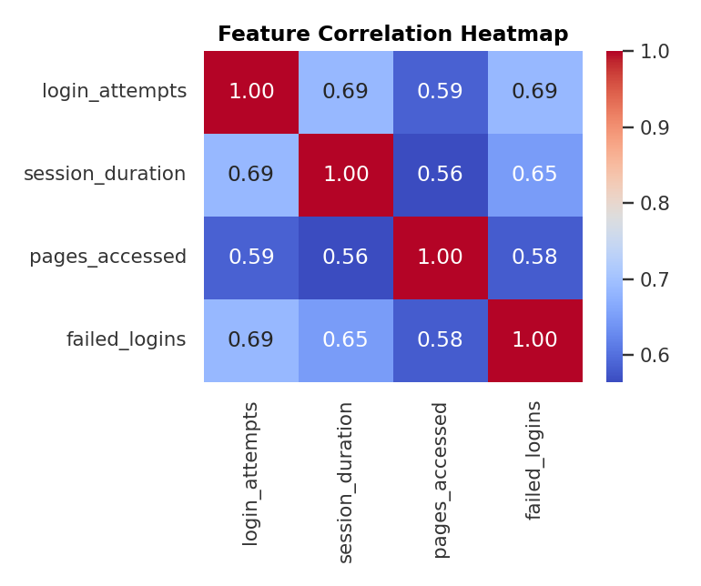
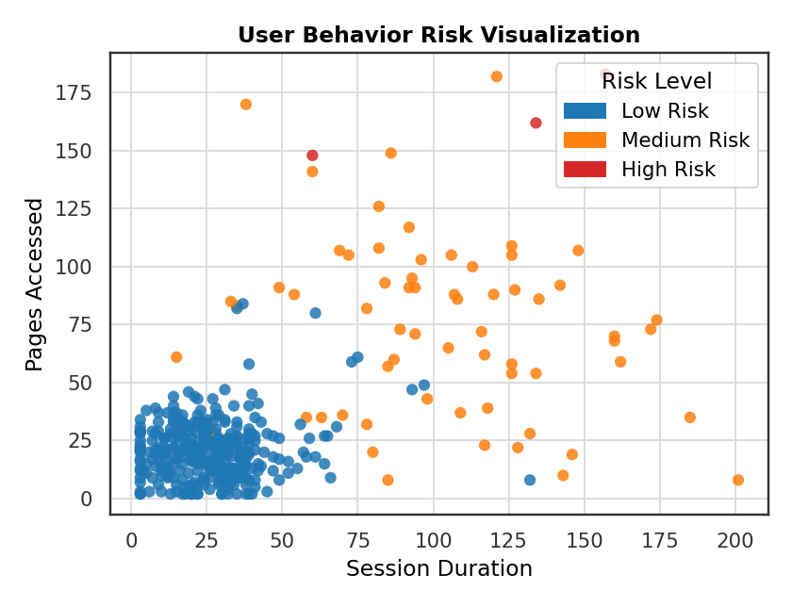
BEHAVIORAL ANALYSIS
Feature relationships & risk separation
EX-AI
08 / 12

Slide 9
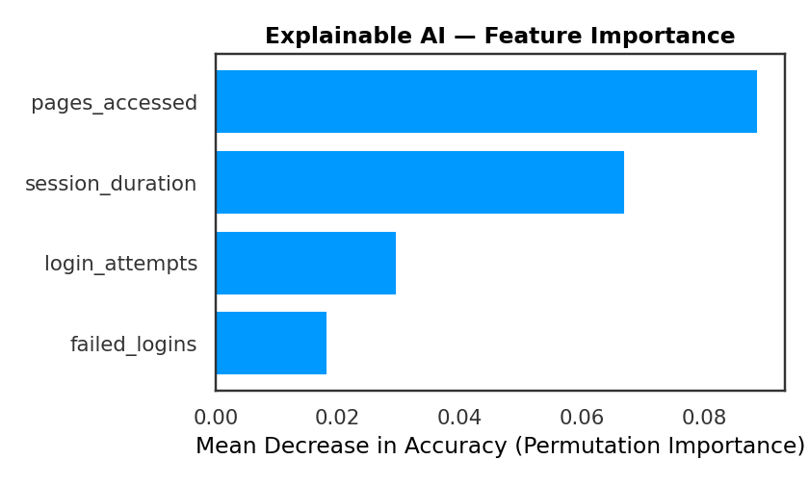
EXPLAINABLE AI
Which features drive a prediction?
PERMUTATION IMPORTANCE
Traditional ML models behave like black boxes. This project uses permutation importance — a model-agnostic Explainable AI technique — to measure how much accuracy drops when a feature is shuffled. A bigger drop means the model relies on that feature more heavily.
pages_accessed and session_duration show the strongest influence on this dataset's predictions.
EX-AI
09 / 12

Slide 10
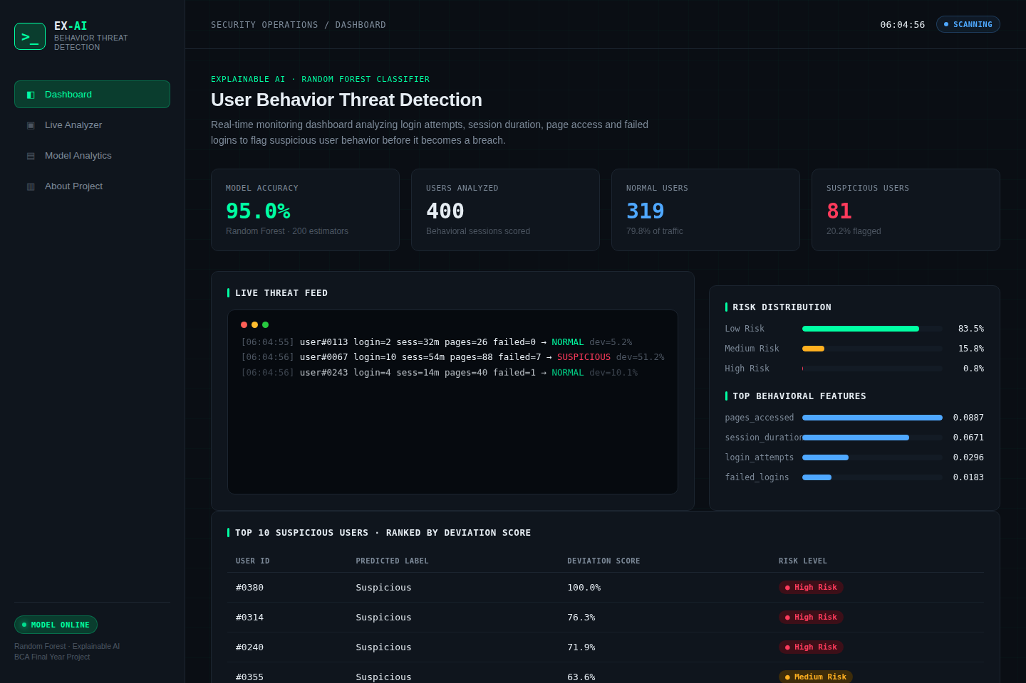
DEPLOYMENT
A real, live security dashboard
Not a Colab widget — a full Flask web app with real-time predictions, styled as an actual SOC monitoring tool.
Dashboard
Live animated threat feed, risk distribution, top suspicious users — ranked by deviation score.
Live Analyzer
Move the sliders, run threat analysis, and get a real prediction from the trained Random Forest model instantly.
EX-AI
10 / 12

Slide 11
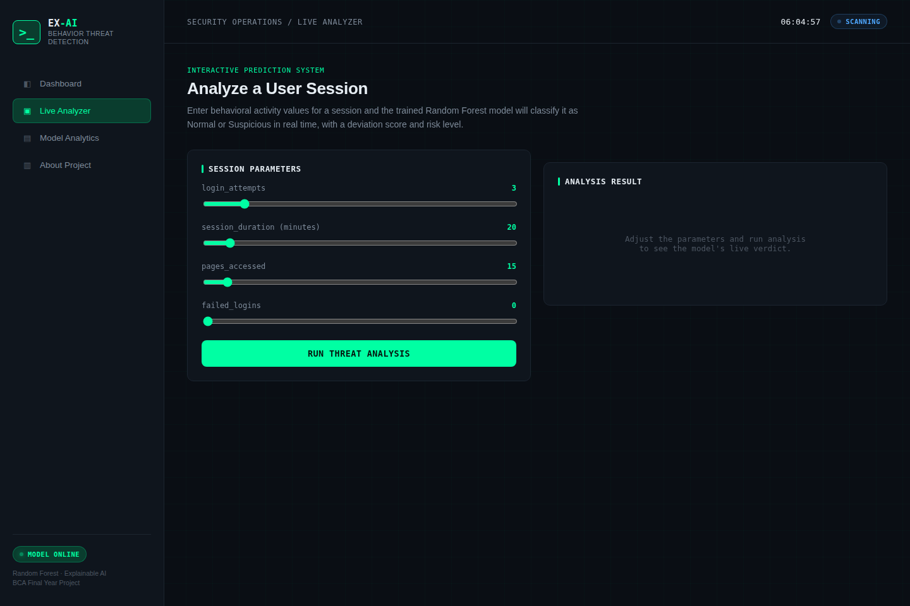
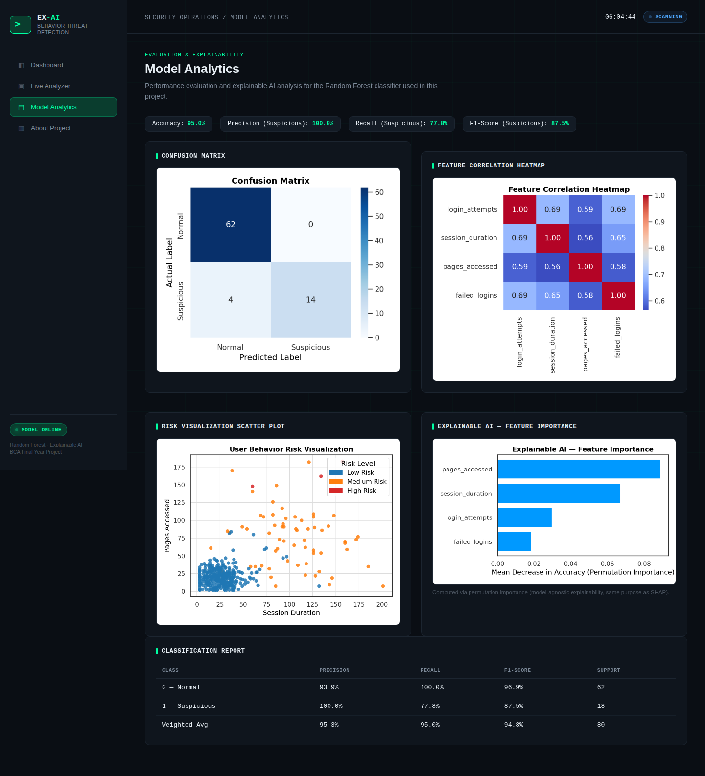
DEPLOYMENT
Interactive prediction & analytics pages
Live Analyzer — real-time prediction with confidence & risk level
EX-AI
11 / 12

Slide 12
CONCLUSION
Outcome & where this goes next
RESULTS
FUTURE SCOPE
95% test accuracy with realistic class overlap (not artificially perfect)
Real-time streaming input instead of static datasets
Deviation scoring + 3-tier risk classification for triage
Larger, real-world labeled cybersecurity datasets
Permutation-importance explainability for model transparency
Deep Learning models (LSTM) for sequential session behavior
Deployed as a live, interactive Flask web dashboard
Cloud deployment with authentication & alerting integrations
EX-AI
12 / 12

