Slide 1
Predictive analysis for retail banking
M. Nishma
B. Shravya

Slide 2
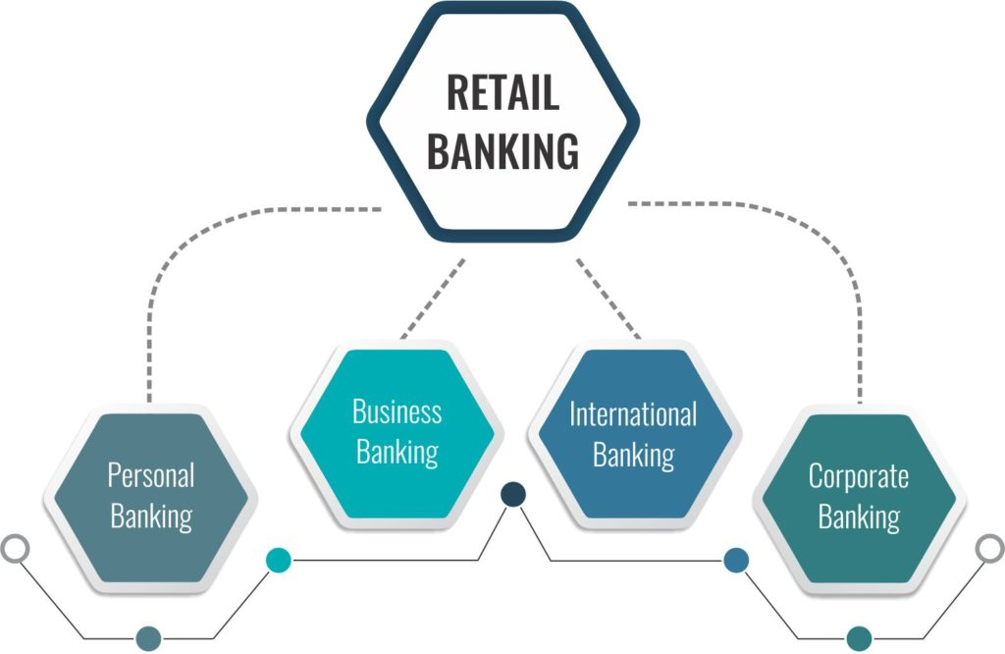
Retail banking:
Retail banking, also known as consumer banking
Typical mass-market banking in which individual customers use local branches of larger commercial banks

Slide 3
Services offered in retail banking:-
Savings and checking accounts
Mortgages( to buy real estate, or alternatively by existing property )
personal loans
Debit/credit cards
Certificates of deposit (CDs)

Slide 4
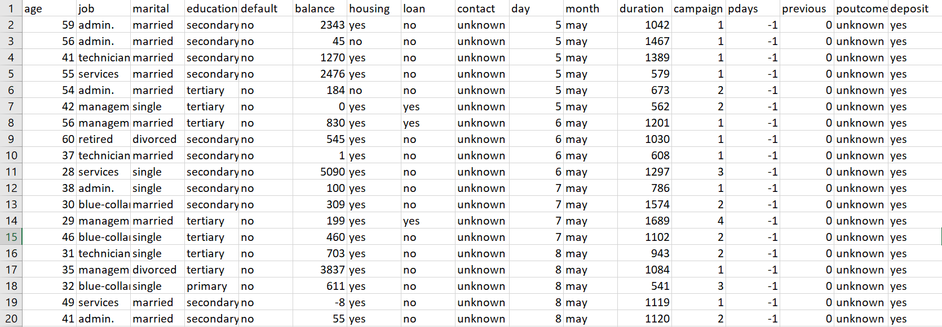
Goal :
Goal is to predict if the client will subscribe a term deposit .
Requirements:
Realtime Dataset

Slide 5
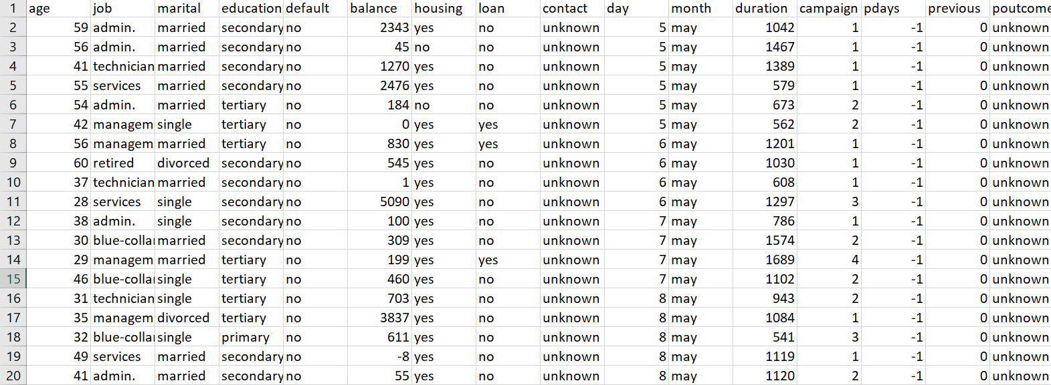
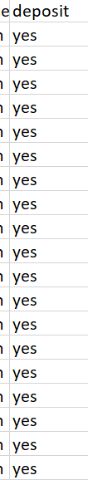
Differentiating independent and dependent variables:

Slide 6
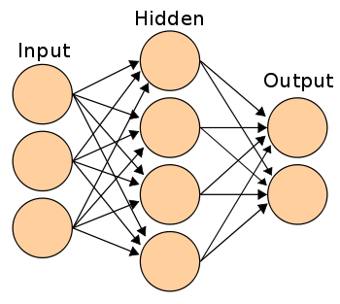
Algorithm used: ANN (Artificial neural network)
ANN:
1. Connectionist systems
2. An ANN is based on a collection of connected units or nodes called artificial neurons
3. There are 3 layers : input layer
hidden layer
output layer

Slide 7
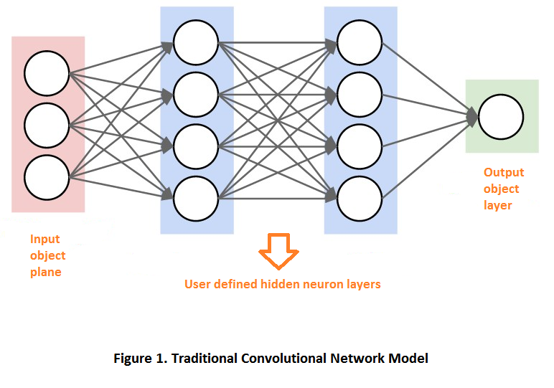

Slide 8
Reason for prediction:
Increased customer knowledge
Customer retention
more real-time capabilities’

Slide 9
Prediction analysis in banking sector:
1. Fraud detection
2. Application screening
3. customer retention
4. knowing customer buying habits
5. Better cash planning
6. Feedback management

Slide 10
Process we followed…
1. Dataset collection
2. Differentiating independent and dependent variables
3. Process the data
4. Split to train and test data
5. Create the model
6. Train the model
7. Test the model

Slide 11
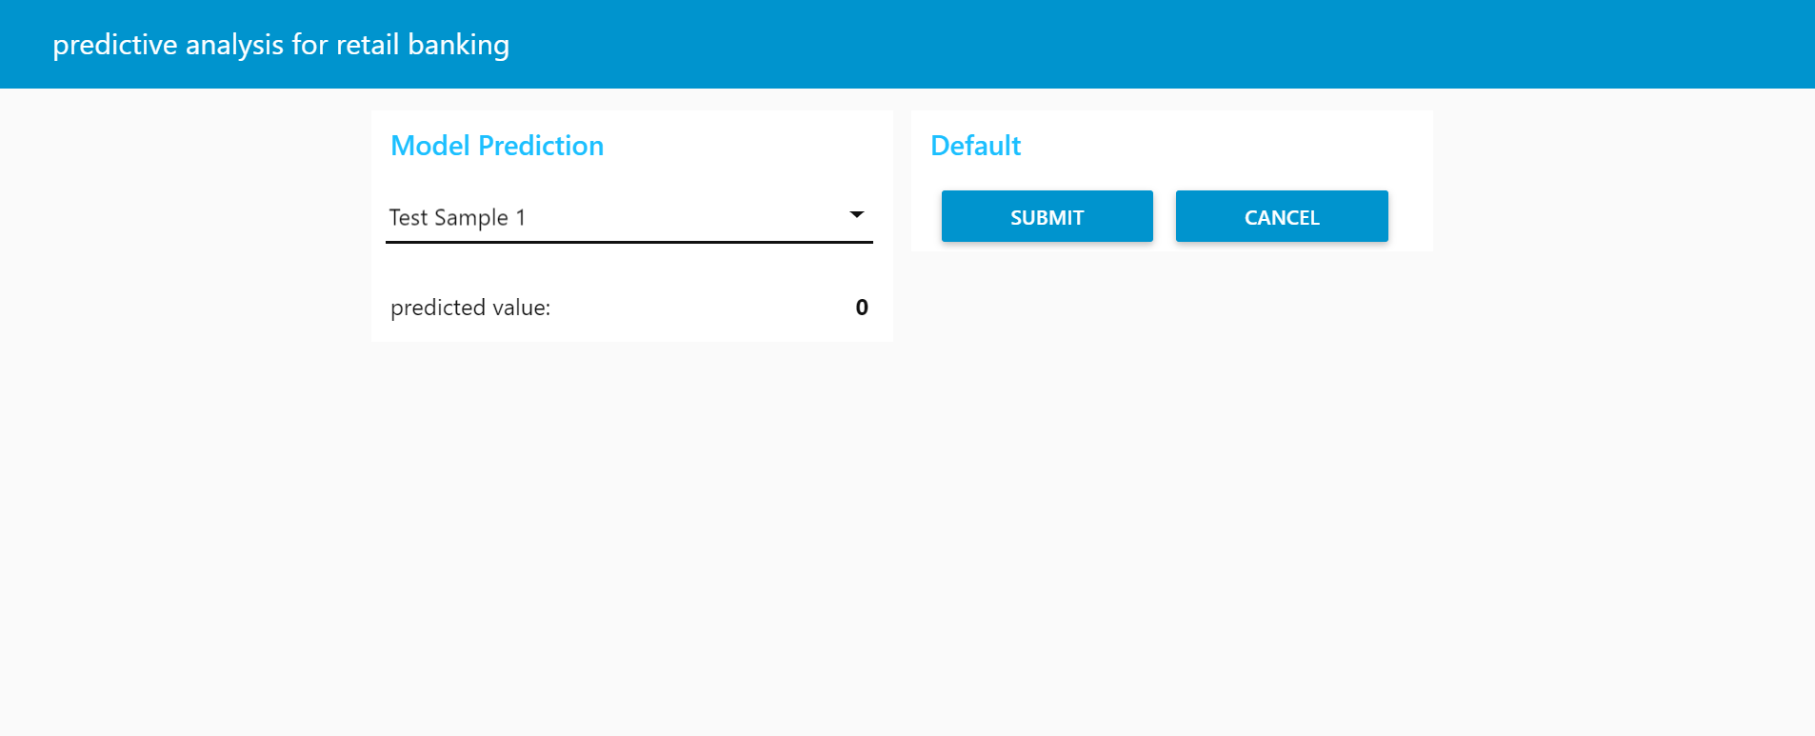
Result:

Slide 12
Thank You
M. Nishma
B. Shravya

