Slide 1
GIT HUB

Slide 2
Terms Used
Repository:
Collection of all the files which consists of all commits.
Branch:
A way to work on a new feature without effecting the code base.
Cloning:
Act of copying / fetching reopsitory from a remote server.
Commit:
Commit the code after certain changes.

Slide 3
GIT:
Distributed version control system.
Manage project / set of files as they change over time.
GIT HUB:
Website for uploading a copy of GIT repositories.
GIT repository hosting service.

Slide 4
Version Control System
Category of software tools that helps a software team to manage changes to the source code over time.
A system for managing the changes in the documents and other computer files.
Standalone software to manage the versions.
Ex: GIT, SVN, CVS, Mercurial, Bazaar

Slide 5
Why GIT?
Our Goals:
Share code easily.
Make track of changes made.
Maintain multiple revisions.
Why GIT?
GIT is distributed.
GIT is powerful.
GIT is easier.

Slide 6
Check out & Check in
Checkout:
Act of switching between different versions of a target entity in the local system.
Fetching files from local repository
Operates on:
Files
Commits
Branches
Checkin:
The very last thing done after committing.
Clone: Fetching files from remote repository git server

Slide 7
Terms Used
Repository:
Collection of all the files which consists of all commits.
Branch:
A way to work on a new feature without effecting the code base.
Cloning:
Act of copying / fetching reopsitory from a remote server.
Commit:
Commit the code after certain changes.

Slide 8
Pull:
Process of downloading commits that does not exist on local machine from a remote repospitory.
Push:
Process of adding local changes to remote repository.
Merge:
Act of integrating another branch into current working branch.
Sync:
Sync local code to public repository.
Fetch:
Download changes from repo, but donot copy to code.

Slide 9
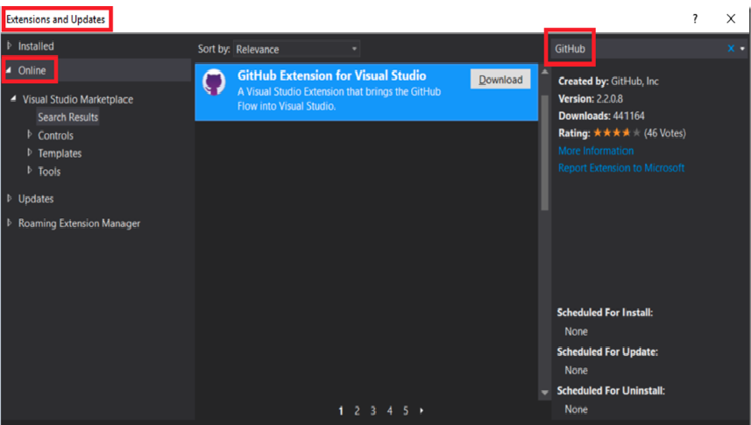
Install GIT HUB into Visual studio by clicking tools -> Extension and updates

Slide 10
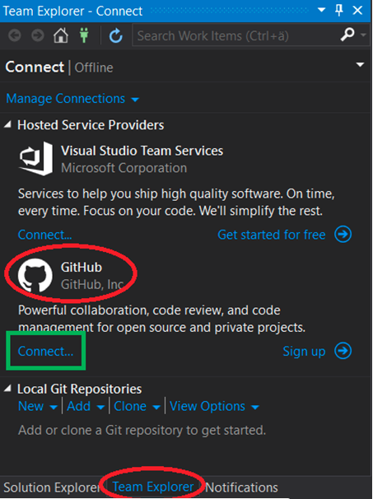
Create GIT HUB repo and log in. If you don't have an account, create one and then connect.

Slide 11
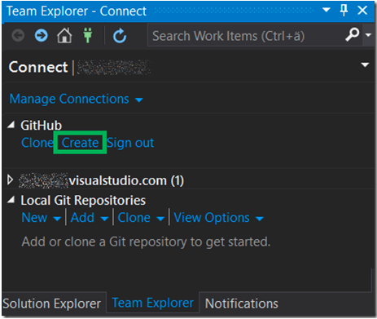
Create a GIT HUB repository.

Slide 12
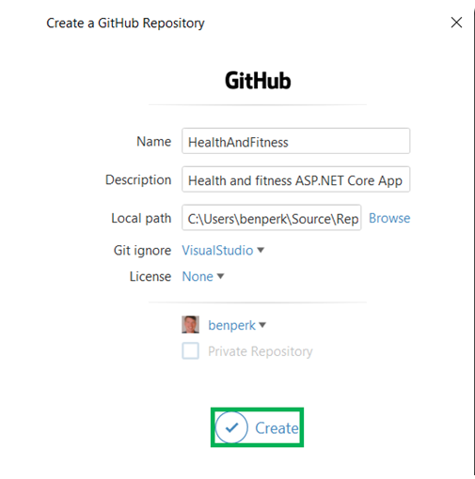

Slide 13
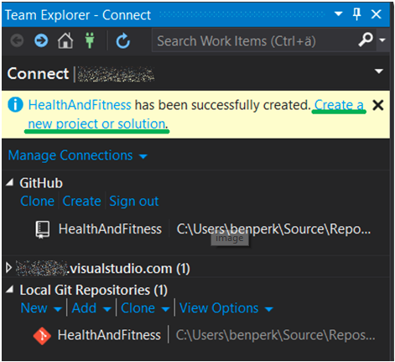
Create a project for the repository.

Slide 14
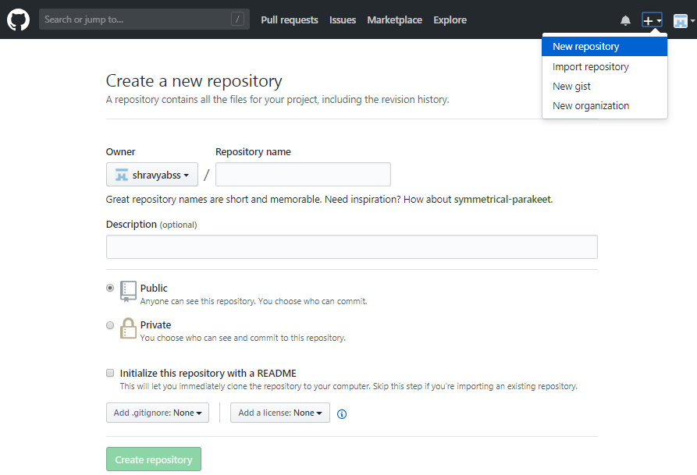
Create new repository from GIT HUB

Slide 15
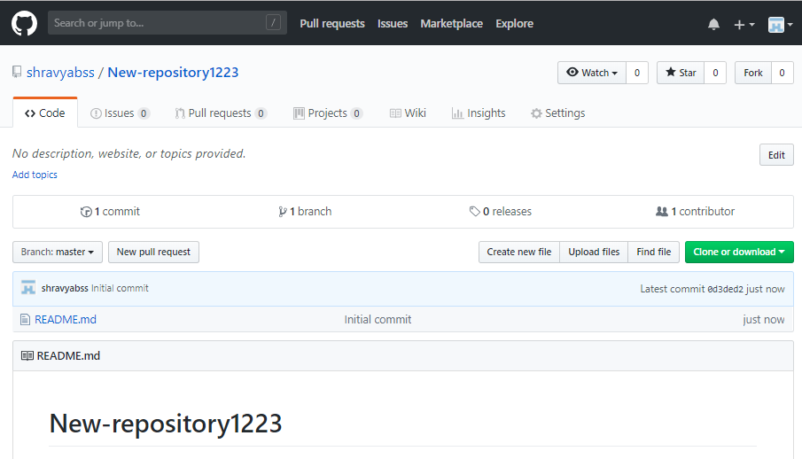
After creation of new repository

Slide 16
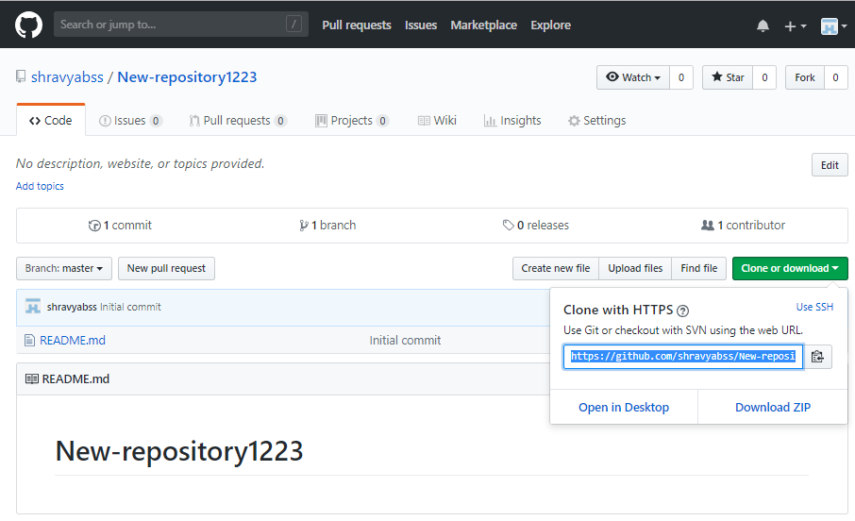
Check out with SVN using URL

Slide 17
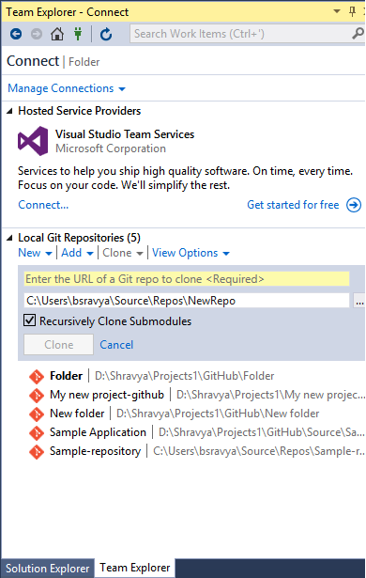
Copy the path in visual studio team explorer

Slide 18
Create a new project in visual studio. Make sure that a seperate folder should be maintained for a different file.
The visual studio file path and git hub clone path should be in the same folder.

Slide 19
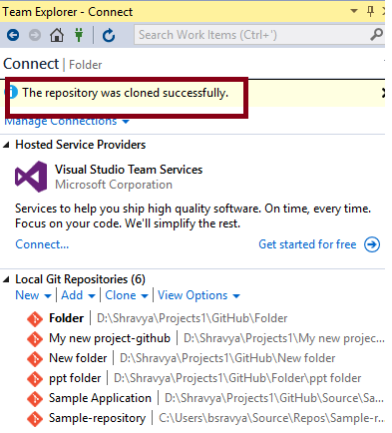

Slide 20
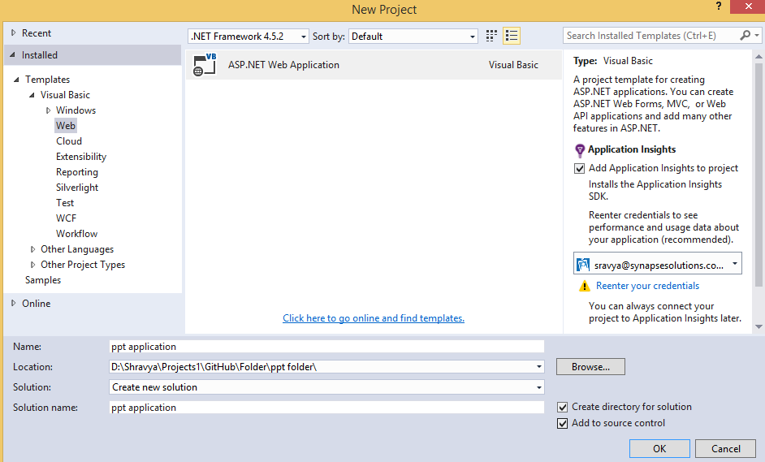
Make sure that there is no path mismatch between Github and VS file.

Slide 21
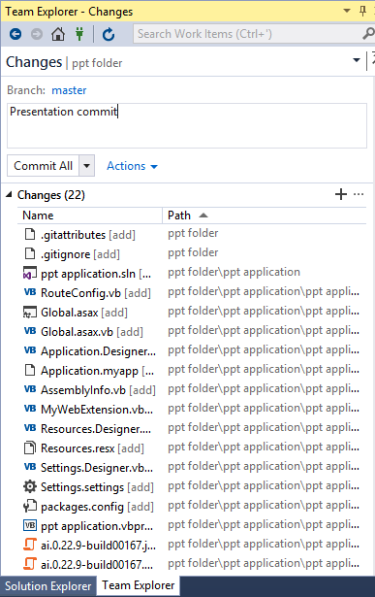

Slide 22
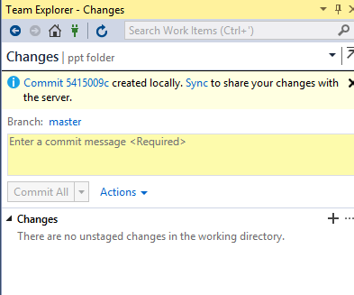
On clicking Commit All

Slide 23
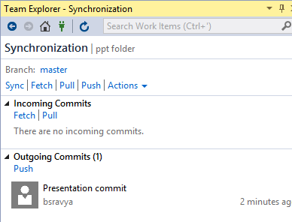
On clicking Sync in the above display

Slide 24
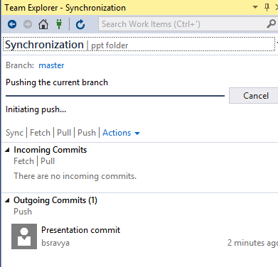
On clicking push in the outgoing commits

Slide 25
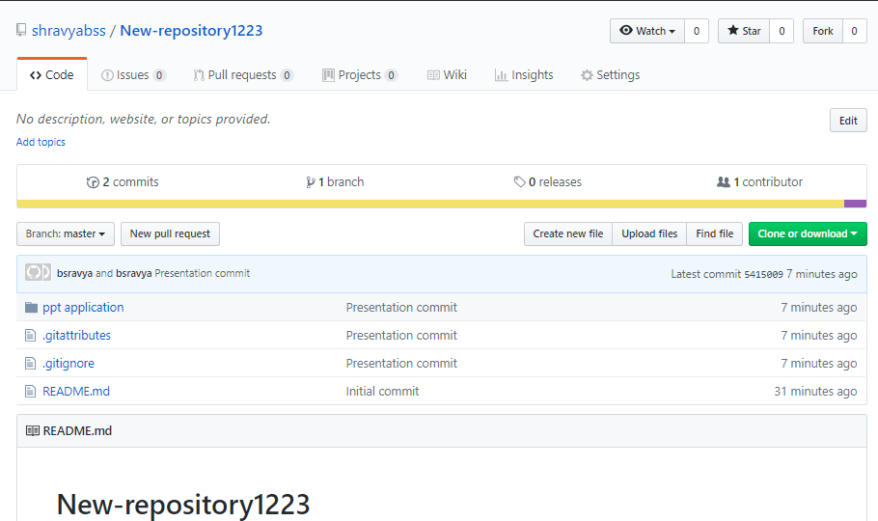

Slide 26
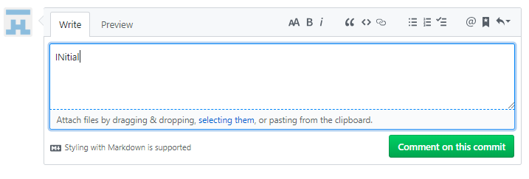
Editing the committed file for fetching

Slide 27
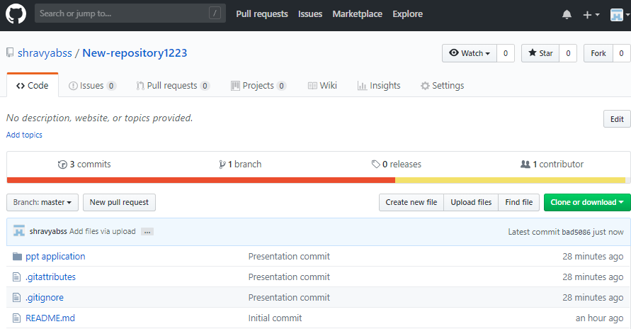
Uploading a file in GIT HUB for fetching

Slide 28
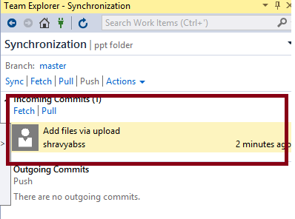
Downloaded the file using fetch command in VS

Slide 29
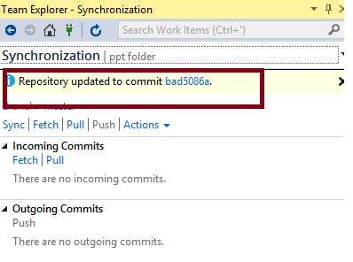
Pull command in VS file

Slide 30
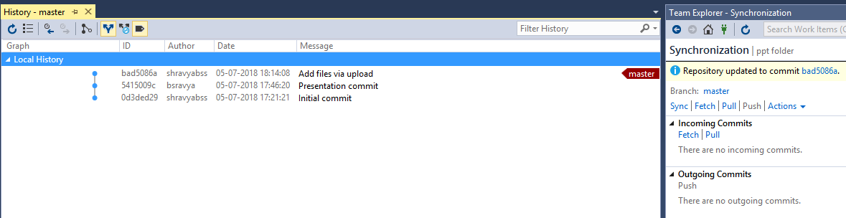
View history for the committed files

Slide 31
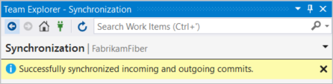
On clicking sync in home, a confirmation message will be displayed

Slide 32
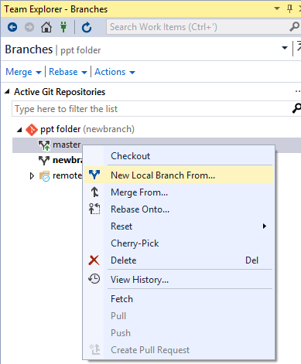
Creating a new branch – go to branches in home, right click on target branch

Slide 33
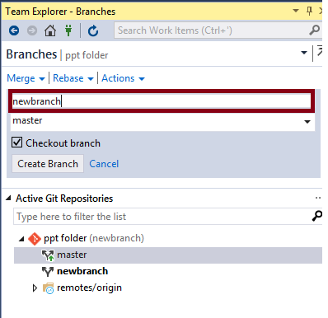
Addition of new branch

Slide 34
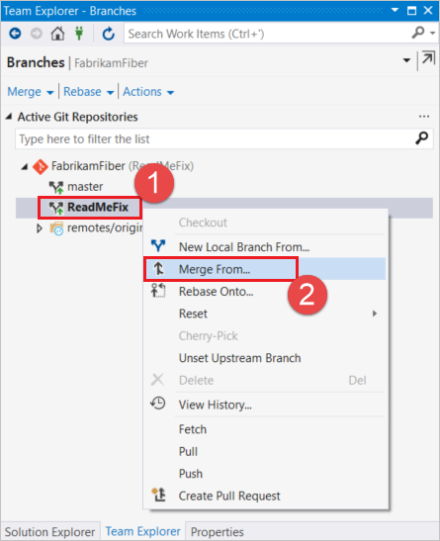
Merging files

Slide 35
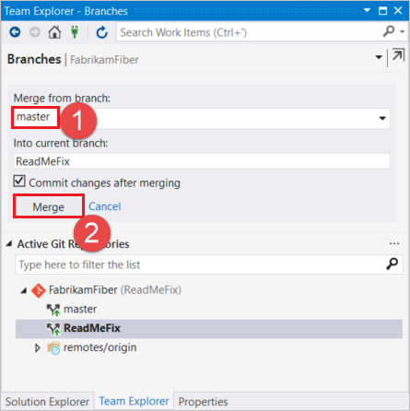
Merging files with master in this case

Slide 36
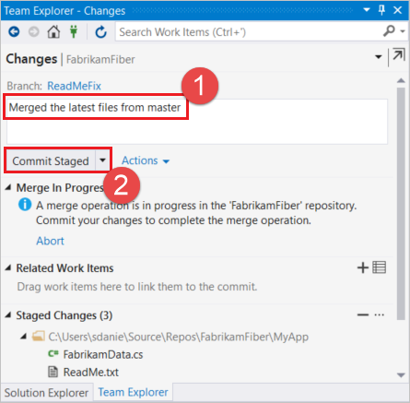
Enter commit message and select commit staged to commit

Slide 37
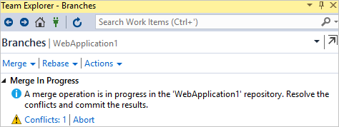
While merging you will be notified about merge conflicts if any. Click on the conflicts to resoolve.

Slide 38
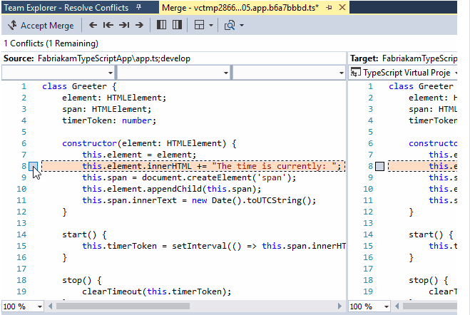
Resolving conflicts – After checking the required fields click on accept merge

Slide 39
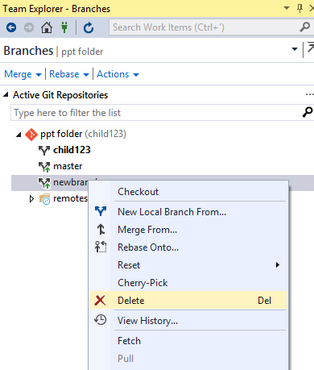
Deleting a branch

