Slide 1
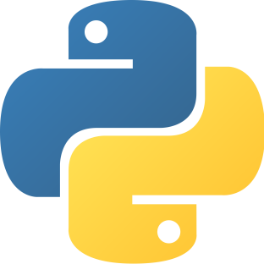
Python Concept

Slide 2
Table of Content:
History
Overview
Language features
Why Python?
Basic Syntax
Data Types
Types of Operator
Multithreaded Programming
Tuples
Conculsion

Slide 3
History:
Python is a general-purpose interpreted, interactive, object-oriented, and high-level programming language.
It was created by Guido van Rossum during 1985- 1990. Like Perl, Python source code is also available under the GNU General Public License (GPL).
This tutorial gives enough understanding on Python programming language.

Slide 4
Overview:
Python is Interpreted
Python is Interactive
Python is Object-Oriented
Python is a Beginner's Language

Slide 5
Language features:
Indentation instead of braces
Several sequence types
(i) Strings ’…’: made of characters, immutable
(ii) Lists […]: made of anything, mutable
(iii) Tuples (…) : made of anything, immutable
Powerful subscripting (slicing)
Functions are independent entities (not all functions are methods)
Exceptions as in Java
Simple object system Iterators (like Java) and generators

Slide 6
Interesting, right?
This is just a sneak preview of the full presentation. We hope you like it! To see the rest of it, just click here to view it in full on PowerShow.com. Then, if you’d like, you can also log in to PowerShow.com to download the entire presentation for free.

