Slide 1



#LifeKoKaroLift
Diploma in Data Science
1
18-09-2021

Slide 2




Course : Machine Learning
EEdiditt MaMasterster tetextxt ststyleyless
Lecture On : Advanced Regression
Instructor : Siddhesh Gunjal
18-09-2021
2

Slide 3

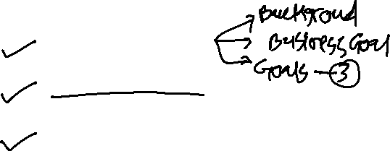
Agenda
Problem Statement
Concept Revision
Discussion over solution approach
18-09-2021
Data Science Certification
3

Slide 4


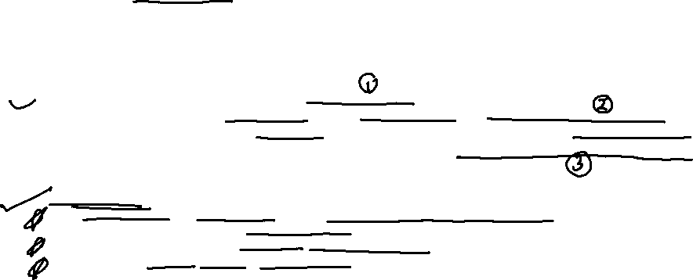
Problem Statement - Part I
Background : A US-based housing company named Surprise Housing has decided to enter the Australian market. The company uses data analytics to purchase houses at a price below their actual values and flip them on at a higher price. For the same purpose, the company has collected a data set from the sale of houses in Australia.
Business Goal : You are required to model the price of houses with the available independent variables. This model will then be used by the management to understand how exactly the prices vary with the variables. They can accordingly manipulate the strategy of the firm and concentrate on areas that will yield high returns. Further, the model will be a good way for management to understand the pricing dynamics of a new market.
Analytical Goal :
A regression model using regularization in order to predict the actual value of the prospective
properties and decide whether to invest in them or not
Which variables are significant in predicting the price of a house, and
How well those variables describe the price of a house.

Slide 5
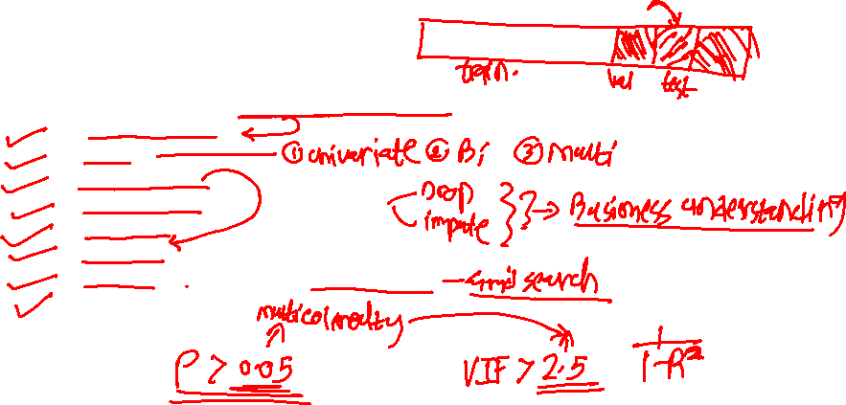
Assignment Steps:-
Steps are:
Load the data and understand the variables
Data Inspection
EDA
Train-Test Split
Missing Value Imputation if required
Scaling if required
Modelling
Tuning with Regularization (Ridge & Lasso)
Model Evaluation

Slide 6
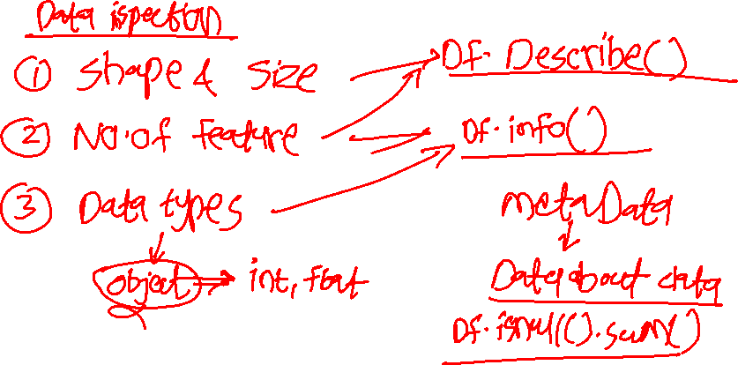

Slide 7
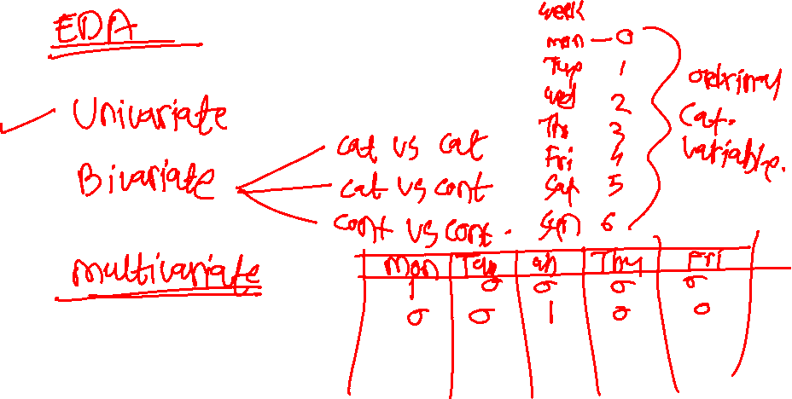

Slide 8
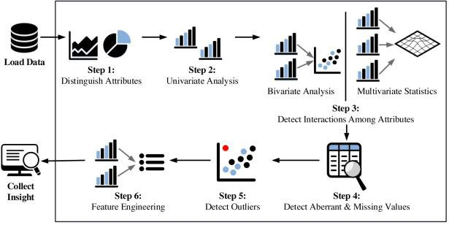
Fundamental steps of EDA process

Slide 9
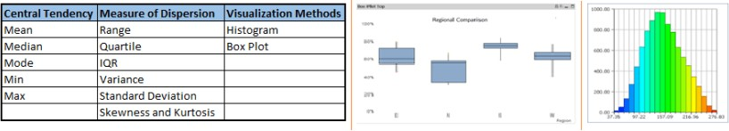
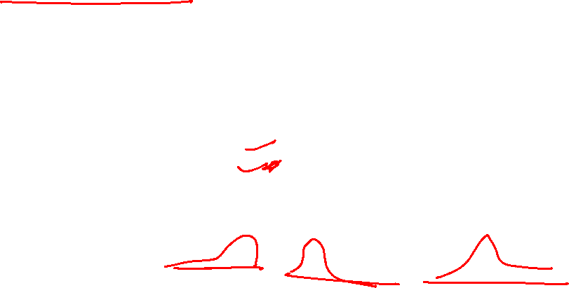
Univariate Analysis
At this stage, we explore variables one by one. Method to perform univariate analysis will depend on whether the variable type is categorical or continuous.

Slide 10
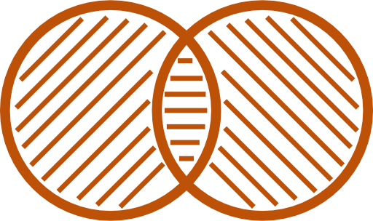
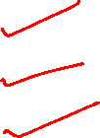
Bi-variate Analysis
Bi-variate Analysis finds out the relationship between two variables. Here, we look
for association and disassociation between variables at a pre-defined significance level.We can perform bi-variate analysis for any combination of categorical and continuous variables.
The combination can be:
Categorical & Categorical
Categorical & Continuous
Continuous & Continuous.

Slide 11
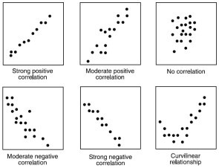

Continuous vs continuous
While doing bi-variate analysis between two continuous variables, we should look at scatter plots. It is a nifty way to find out the relationship between two variables. The pattern of scatter plot indicates the relationship between variables. The relationship can be linear or non-linear.

Slide 12
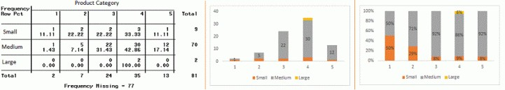
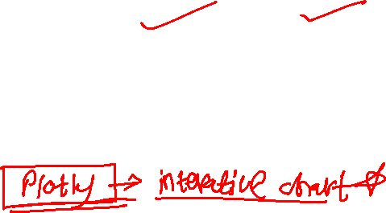
Categorical & Categorical
Two-way table: We can start analyzing the relationship by creating a two-way table of count and count%. The rows represents the category of one variable and the columns represent the categories of the other variable. We show count or count% of observations available in each combination of row and column categories.
Stacked Column Chart: This method is more of a visual form of Two-way table.

Slide 13
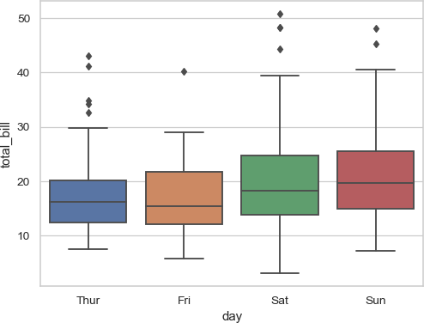
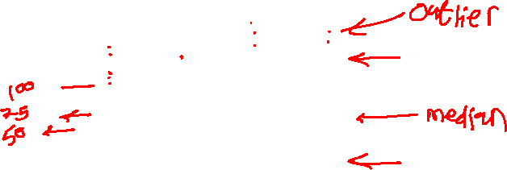
Categorical & continuous
While exploring relation between categorical and continuous variables, we can draw box plots for each level of categorical variables

Slide 14
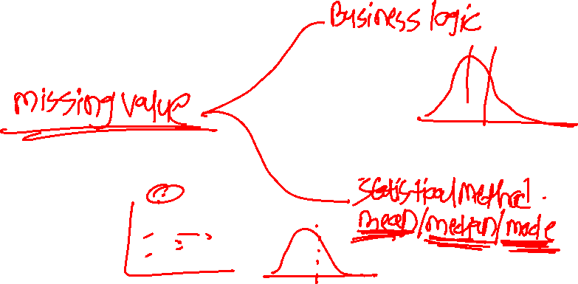

Slide 15
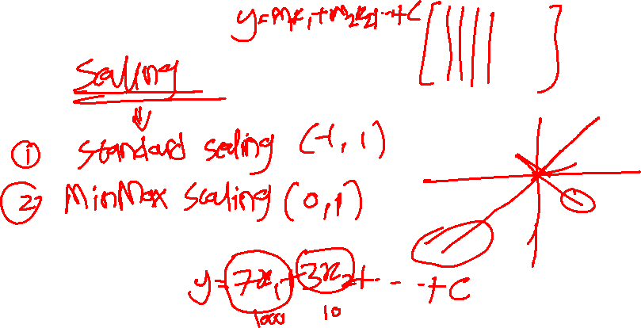

Slide 16
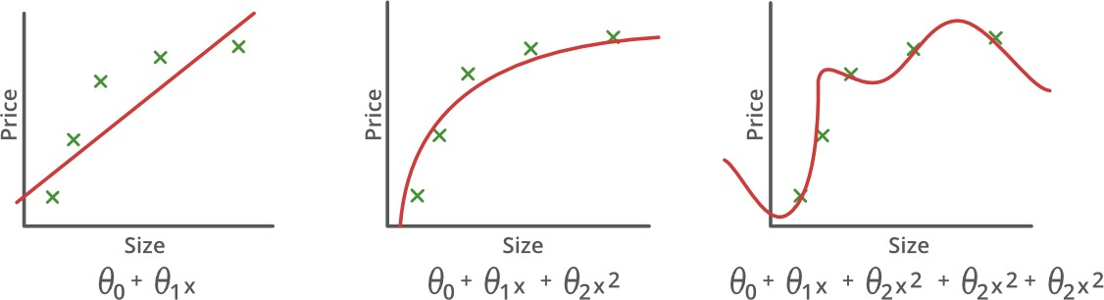
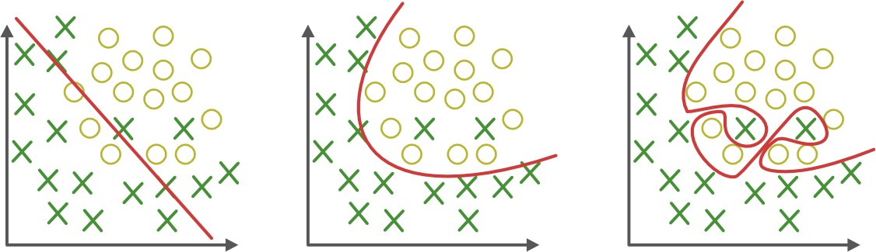
What & Why of Overfitting and Underfitting
Underfitting
Good-Fit
Overfitting

Slide 17
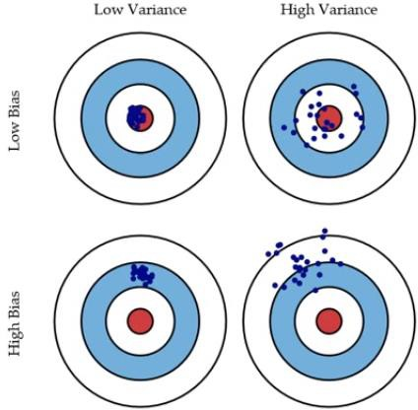
Bias and Variance in regression models
The prediction error for any machine learning algorithm can be broken down into three parts:
Bias Error
Variance Error
Irreducible Error
The irreducible error cannot be reduced regardless of what algorithm is used. It is the error introduced from the chosen framing of the problem and may be caused by factors like unknown variables that influence the mapping of the input variables to the output variable.
Low Bias: Suggests less assumptions about the form of the target function.
High-Bias: Suggests more assumptions about the form of the target function.
Low Variance: Suggests small changes to the estimate of the target function with changes to the training dataset.
High Variance: Suggests large changes to the estimate of the target function with changes to the training dataset.

Slide 18
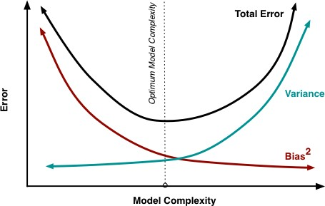
Bias-Variance Trade-Off
The goal of any supervised machine learning algorithm is to achieve low bias and low variance. In turn the algorithm should achieve good prediction performance.
Parametric or linear machine learning algorithms often
have a high bias but a low variance.
Non-parametric or non-linear machine learning algorithms often have a low bias but a high variance.
The parameterization of machine learning algorithms is often a battle to balance out bias and variance.

Slide 19
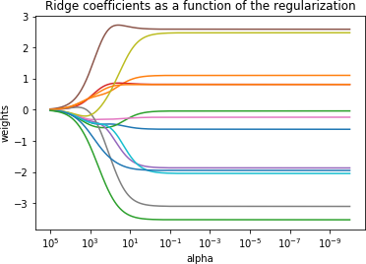

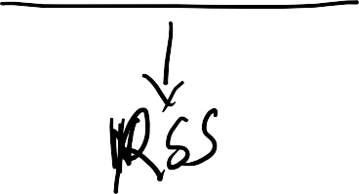
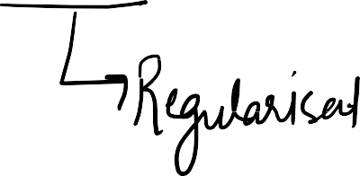

Ridge Regression
RSS is modified by adding the shrinkage quantity.
Now, the coefficients are estimated by minimizing this function. Here, λ is the tuning parameter that decides how much we want to penalize the flexibility of our model.
The increase in flexibility of a model is represented by increase in its coefficients, and if we want to minimize the above function, then these coefficients need to be small.
https://towardsdatascience.com/ridge-regression-a-graphical-tale-of-two-concepts-8fac90e6f8e1

Slide 20
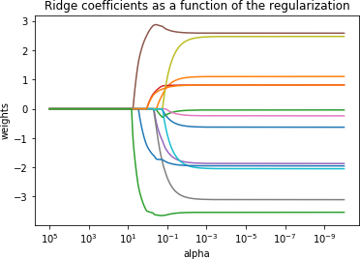

Lasso Regression
Lasso is another variation, in which the above
function is minimized. Its clear that
this variation differs from ridge regression only in penalizing the high coefficients.

Slide 21
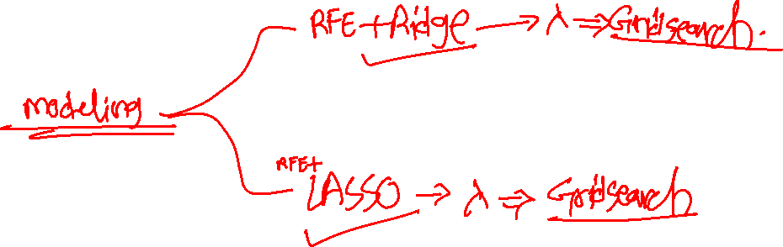

Slide 23
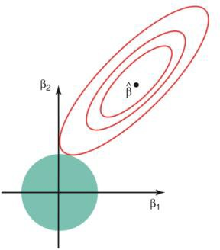
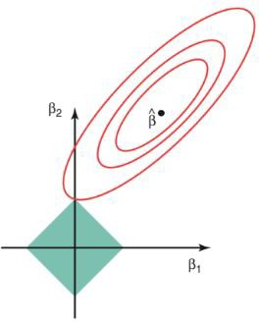
Regularized Linear Regression
The ridge regression is expressed by β1² + β2² ≤ s. This implies that ridge regression coefficients have the smallest RSS(loss function) for all points that lie within the circle given by β1² + β2²
≤ s
The lasso, the equation becomes,|β1|+|β2|≤ s. This implies that lasso coefficients have the smallest RSS(loss function) for all points that lie within the diamond given by
|β1|+|β2|≤ s.

Slide 24
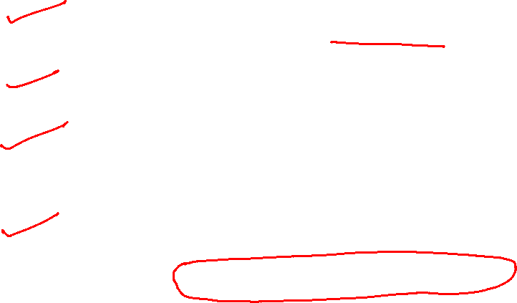
Problem Statement - Part II
Question 1
What is the optimal value of alpha for ridge and lasso regression? What will be the changes in the model if you choose double the value of alpha for both ridge and lasso? What will be the most important predictor variables after the change is implemented?
Question 2
You have determined the optimal value of lambda for ridge and lasso regression during the assignment. Now, which one will you choose to apply and why?
Question 3
After building the model, you realized that the five most important predictor variables in the lasso model are not available in the incoming data. You will now have to create another model excluding the five most important predictor variables. Which are the five most important predictor variables now?
Question 4
How can you make sure that a model is robust and generalizable? What are the implications of the same for the accuracy of the model and why?
Please limit your answers to less than 500 words per
question.
18-09-2021
25

Slide 25

Code
18-09-2021
26

Slide 26
#LifeKoKaroLift
Thank You!
21
18-09-2021

