Slide 1

​EXPLORATORY DATA ANALYSIS ON AMEO DATA

Slide 2
ABOUT ME
Pursuing Data science Course
Data science is at the forefront of technological and business innovation. Ultimately, my desire to learn data science is driven by a commitment to lifelong learning.I'm eager to immerize myself in this field, continuously refine my skills.
I am Currently working as a DataScience Intern.

Slide 3
DATA CLEANING
1) Handling Missing Values :Missing values can significantly impact the quality of data analysis. They are addressed by either removing data entries with missing values or imputing them
2) Removing Duplicate Values :Duplicate entries can skew data analysis and lead to inaccurate results. The process of removing duplicates involves identifying and eliminating repeated entries in the dataset. This step ensures that each data point is unique, providing a more accurate representation of the dataset.
3)Outlier Treatment:Outliers are data points that significantly differ from other observations. They can be the result of variability in the measurement or indicate experimental errors.

Slide 4
UNIVARIATE ANALYSIS
Univariate analysis is the simplest form of analyzing data. “Uni” means “one”, so in other words, your data has only one variable. It doesn’t deal with causes or relationships (unlike regression) and it’s major purpose is to describe; it takes data, summarizes that data and finds patterns in the data.
Here are some plots of Univariate Plots.
Histogram,Bar Chart,Box Plot,Pie Chart,Density Plot,Dot Plot,Violin Plot,Frequency Polygon,Cumulative Frequency Plot.

Slide 5
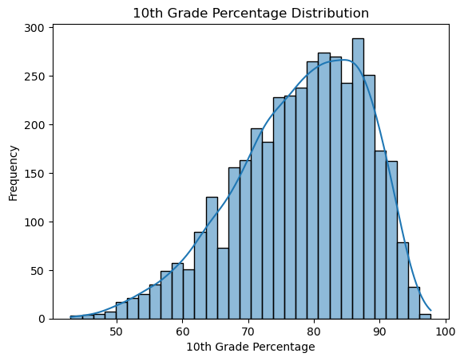
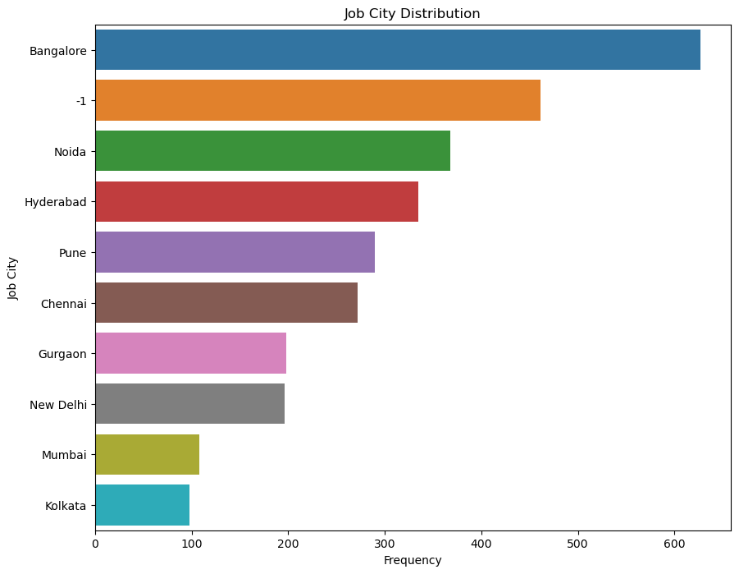
NUMERICAL
The hist plot with kde tells about the distribution of 10Percentage.
It tells that the high perecentage is about 88 percent of frequency around 280-290 and the less percentage is 10 to 50 and 96-100 of frequency around 10.
The plot is left skewed,it mean the mean is less than median.
CATEGORICAL
The above barplot gives insights about the to designations Distribution.
The top designation is Software Engineer.

Slide 6
BIVARIATE ANALYSIS
Bivariate analysis involves the analysis of two variables, for the purpose of determining the empirical relationship between them. This type of analysis can uncover a relationship between two variables, but it does not confirm causation.
Some of the bivariate plots
Scatter Plot,Line Plot,Bar Plot,Box Plot,Violin Plot,Heatmap,Pair Plot,Bubble Chart,Area Plot and Joint Plot.

Slide 7
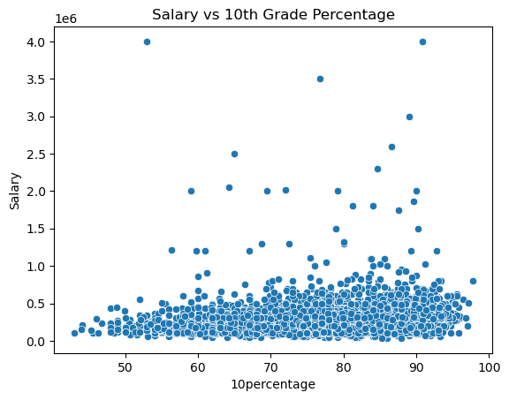
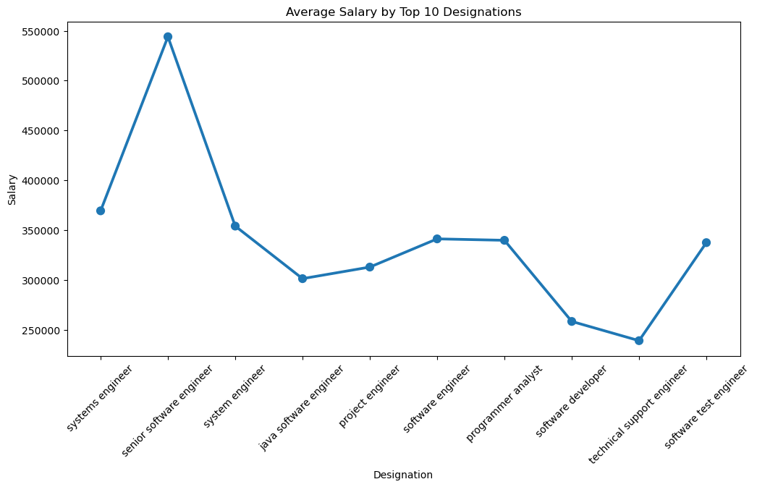
NUMERICAL AND NUMERICAL:
The above scatterplot tells about the distribution of Salary and 10percentage.
The salary distribution around the percentage of 80 to 90.
The highest salary package is 4000000 of50 to 60 10percentage.
CATEGORICAL AND NUMERICAL:
This approach will give a visual representation of how average salaries compare across the top 10 most frequent designations.
The high salary 0f 500000 for the designation of senior software engineer.

Slide 8
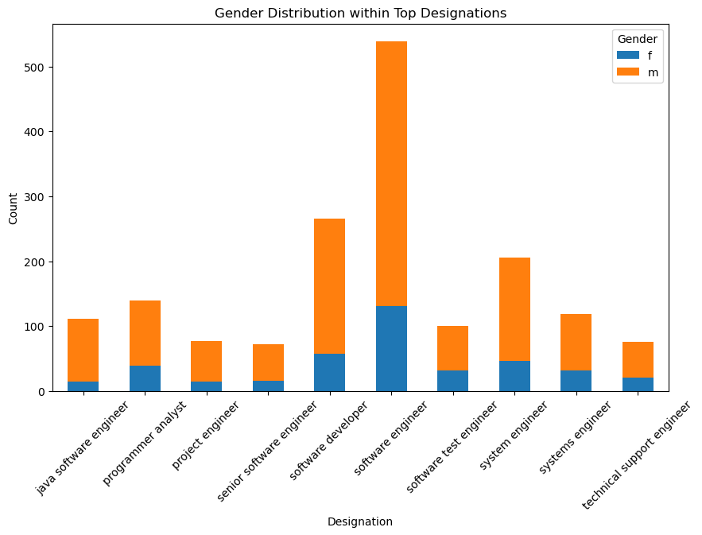
CATEGORICAL AND CATEGORICAL
The above stacked bar plot tells gives insights about designation according to gender.
The blue are female and orange are male.
The male and female both the genders of top designation is software engineers.
There is a relationship with the gender for the designation comparing with gender male are more with the software designations.

Slide 9
CONCLUSION
The exploration of this data has provided valuable insights into the professional landscape represented within. By understanding the nuances and trends highlighted through our analysis, stakeholders can make informed decisions to address potential disparities, capitalize on emerging trends, and strategically navigate the professional environment.
CHALLENGES
During my project, I faced challenges with outliers and bivariate data manipulation. Identifying and handling outliers required careful statistical analysis to ensure accuracy. For bivariate analysis, selecting appropriate plots and transforming data was crucial. Overcoming these obstacles deepened my understanding of data analysis techniques, enhancing my problem-solving skills.

Slide 10


