Slide 1
Chapter 1 Introduction

Slide 2
What is a Microprocessor?
The word comes from the combination - micro and processor.
Processor means a device that processes whatever. In this context processor means a device that processes numbers, specifically binary numbers, 0’s and 1’s.

Slide 3
What about micro?
Micro is a new addition.
In the late 1960’s, processors were built using discrete elements.
These devices performed the required operation, but were too large and too slow.
In the early 1970’s the microchip was invented. All of the components that made up the processor were now placed on a single piece of silicon. The size became several thousand times smaller and the speed became several hundred times faster. The “Micro”Processor was born.

Slide 4
Definition of the Microprocessor
The microprocessor is a programmable, clock-driven, register based electronic device that takes in numbers, performs on them arithmetic or logical operations according to the program stored in memory and then produces result as output.
In other words, It reads binary instructions from a storage device called MEMORY, accepts binary data as input and processes data according to those instructions, and provide results as output.
The microprocessor is a programmable integrated device that has computing and decision-making capability similar to that of central processing unit.

Slide 5
3 Differentiating factors
Three basic characteristics differentiate microprocessors:
Instruction set: The set of instructions that the microprocessor can execute.
bandwidth : The number of bits processed in a single instruction.
clock speed : Given in megahertz (MHz), the clock speed determines how many instructions per second the processor can execute.
In both cases, the higher the value, the more powerful the CPU.
-For example, a 32-bit microprocessor that runs at 50MHz is more powerful than a 16-bit microprocessor that runs at 25MHz.

Slide 6
Definition (Contd.)
Lets expand each of the underlined words:
Programmable device: The microprocessor can perform different sets of operations on the data it receives depending on the sequence of instructions supplied in the given program. By changing the program, the microprocessor manipulates the data in different ways.
Instructions: Each microprocessor is designed to execute a specific group of operations. This group of operations is called an instruction set. This instruction set defines what the microprocessor can and cannot do.

Slide 7
Definition (Contd.)
Takes in: The data that the microprocessor manipulates must come from somewhere.
It comes from what is called “input devices”.
These are devices that bring data into the system from the outside world.
These represent devices such as a keyboard, a mouse, switches, and the like.

Slide 8
Definition (Contd.)
Numbers:
The microprocessor has a very narrow view on life. It only understands binary numbers.
A binary digit is called a bit (which comes from binary digit).
The microprocessor recognizes and processes a group of bits together. This group of bits is called a “word”.
The number of bits in a Microprocessor’s word, is a measure of its “abilities”.

Slide 9
Definition (Contd.)
Words, Bytes, etc.
The earliest microprocessor (the Intel 8088 and Motorola’s 6800) recognized 8-bit words.
They processed information 8-bits at a time. That’s why they are called “8-bit processors”.
Later microprocessors (8086 and 68000) were designed with 16-bit words.
A group of 8-bits were referred to as a “half-word” or “byte”.
A group of 4 bits is called a “nibble”.
Also, 32 bit groups were given the name “long word”.
Today, all processors manipulate at least 32 bits at a time and there exists microprocessors that can process 64, 80, 128 bits or more at a time.

Slide 10

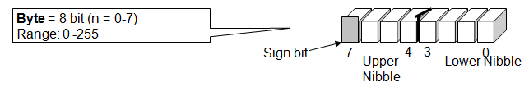
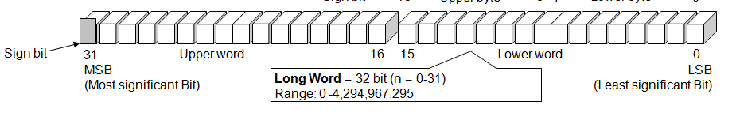
DATA SIZE
Nibble | 4 bit
Byte | 8 bit
Word | 16 bit
Long word | 32 bit

Slide 11
Definition (Contd.)
Arithmetic and Logic Operations:
Every microprocessor has arithmetic operations such as add and subtract as part of its instruction set.
Most microprocessors will have operations such as multiply and divide.
Some of the newer ones will have complex operations such as square root.
In addition, microprocessors have logic operations as well. Such as AND, OR, XOR, shift left, shift right, etc.
Again, the number and types of operations define the microprocessor’s instruction set and depends on the specific microprocessor.

Slide 12
Definition (Contd.)
Program:
A program is a sequence of instructions that bring data into the microprocessor, processes it and sends it out.
There are many programming languages (C, C++, FORTRAN, and JAVA…) However, these programming languages can be grouped into three main levels.

Slide 13
Definition (Contd.)
Programming Languages
Machine language
Machine language is the lowest level programming language. It is a language intended to be understood by the microprocessor (the machine) only. In this language, every instruction is described by binary patterns.
e.g. 11001101
This is the form in which instructions are stored in memory. This is the only form that the microprocessor understands.

Slide 14
Definition (Contd.)
Programming Languages
Assembly language
This language is more understandable by humans. In this language, the binary patterns are assigned mnemonics (short abbreviated names).
e.g. “Add 1,2”

Slide 15
Definition (Contd.)
Programming Languages
High level languages
These are languages like C, PASCAL and FORTRON. These are more natural for humans to use than assembly or machine languages. They are also more compact (i.e. it takes less statements to write the program).
One high level instruction translates into many assembly or machine language instructions.
e.g. x = y + z may translate into:
MOV R₁ ,1000 MOV R_{2 ,} 1004
ADD R₁, R₂
MOV X, R₁

Slide 16
Definition (Contd.)
Programming Languages
The new level being developed: is ultra high level languages which would contain things like C++, and JAVA.
Here a single instruction may translate into hundreds of assembly or machine language instructions.

Slide 17
Definition (Contd.)
Stored in memory :
First, what is memory?
Memory is the location where information is kept while not in current use.
Memory is a collection of storage devices.
Usually, each storage device holds one bit. Also, in most kinds of memory, these storage devices are grouped into groups of 8. These 8 storage locations can only be accessed together.
So, one can only read or write in terms of bytes to and form memory.
Memory is usually measured by the number of bytes it can hold. It is measured in Kilos, Megas and lately Gigas. A Kilo in computer language is 2¹⁰ =1024. So, a KB (KiloByte) is 1024 bytes. Mega is 1024 Kilos and Giga is 1024 Mega.

Slide 18
Definition (Contd.)
Stored in memory:
When a program is entered into a computer, it is stored in memory. Then as the microprocessor starts to execute the instructions, it brings the instructions from memory one at a time.
Memory is also used to hold the data.
The microprocessor reads (brings in) the data from memory when it needs it and writes (stores) the results into memory when it is done.

Slide 19
Definition (Contd.)
Produces: For the user to see the result of the execution of the program, the results must be presented in a human readable form.
The results must be presented on an output device.
This can be the monitor, a paper from the printer, a simple LED or many other forms.

Slide 20
A Microprocessor-based system
From the above description, we can draw the following block diagram to represent a microprocessor-based system:
Input
Output
Microprocessor
Memory

Slide 21
Inside The Microprocessor
Internally, the microprocessor is made up of 3 main units.
The Arithmetic/Logic Unit (ALU)
The Control Unit.
An array of registers for holding data while it is being manipulated.

Slide 22
Organization of a microprocessor-based system
Let’s expand the picture a bit.
I/O
Input / Output
ALU
Register
Array
System Bus
Control
Memory
ROM RAM

Slide 23
Organization of the Microprocessor
The microprocessor can be divided into three main pieces:
Arithmetic/Logic Unit
Performs all computing and logic operations such as addition and subtraction as well as AND, OR and XOR.
Register Array
A collection of registers within the microprocessor itself. These are used primarily for data storage during program execution. The number and the size of these registers differ from one microprocessor to the other.
Control Unit
As the name implies, the control Unit controls what is happening in the microprocessor. It provides the necessary control and timing signals to all operations in the microprocessor as well as its contact to the outside world.

Slide 24
Components of a microprocessor/controller
CPU: Central Processing Unit
I/O: Input /Output
Bus: Address bus & Data bus
Memory: RAM & ROM
Timer
Interrupt
Serial Port
Parallel Port

Slide 25
General-purpose microprocessor:
CPU for Computers
Commonly no RAM, ROM, I/O on CPU chip itself
Many chips on motherboard
Data Bus
CPU
General-Purpose Micro-processor
I/O Port
Serial COM Port
RAM
ROM
Timer
Address Bus
Notes:
Intel’s x86: 8086,8088,80386,80486, Pentium
Motorola’s 680x0: 68000, 68010, 68020,68030,6040

Slide 26
Examples of micro processor
Intel 8085
Intel 8086 etc

Slide 27
MICROCONTROLLER
Microcontroller is designed to be all of that in one.
No other specialized external components are needed for its application because all necessary circuits which otherwise belong to peripherals are already built into it.
It in any case saves the time and space needed to design a device.

Slide 28
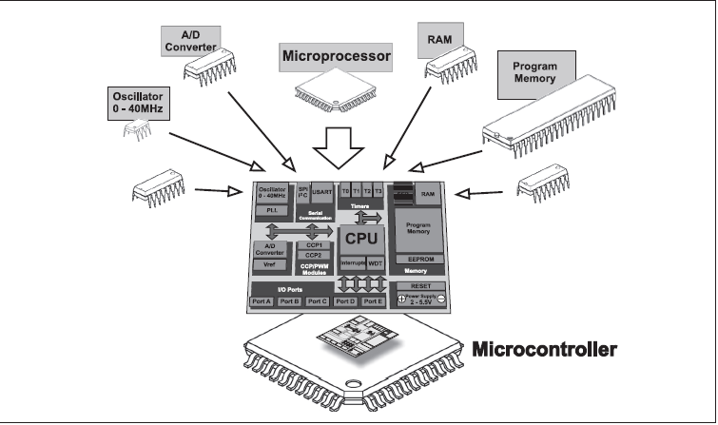
Microcontroller

Slide 29
Microcontroller
A single-chip computer
On-chip RAM, ROM, I/O ports...
Microcontrollers are used in automatically controlled products and devices, such as automobile engine control systems, implantable medical devices, remote controls, office machines, appliances, power tools, toys and other embedded systems.
Example：Motorola’s 6811, Intel’s 8051, Zilog’s Z8 and PIC 16X
CPU
RAM
ROM
A single chip
Serial COM Port
I/O Port
Timer
Microcontroller

Slide 30
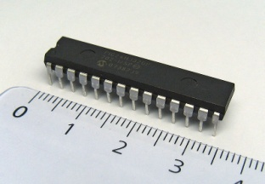
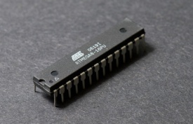
Some Popular Microcontrollers…
8051
Microchip Technology PIC
Atmel AVR
Texas Instruments MSP430 (16-bit)

Slide 31
MICROCONTROLLER VERSUS MICROPROCESSOR
A microcontroller differs from a microprocessor in many ways. The first and most important difference is its functionality.
In order the microprocessor may be used, other components such as memory or components for data transfer must be added to it.
Even though the microprocessor is considered to be a powerful computer machine, the weak point is that it is not adjusted to communication to peripheral environment.

Slide 32
MICROCONTROLLER VERSUS MICROPROCESSOR
Simply, in order to communicate with peripheral environment, the microprocessor must use specialized circuits added as external chips. Microprocessors are the pure heart of the computers.
On the other hand, the microcontroller is designed to be all of that in one. No other specialized external components are needed for its application because all necessary circuits which otherwise belong to peripherals are already built into it. It in any case saves the time and space needed to design a device.

Slide 33
Microprocessor Vs. Microcontroller
Microprocessor
CPU is stand-alone, RAM, ROM, I/O, timer are separate
Designer can decide on the amount of ROM, RAM and I/O ports.
Expensive
Versatility
General-purpose
High processing power
High power consumption
Typically 32/64 – bit
Microcontroller
CPU, RAM, ROM, I/O and timer are all on a single chip
Fixed amount of on-chip ROM, RAM, I/O ports
For applications in which cost, power and space are critical
Single-purpose (control-oriented)
Low processing power
Low power consumption
Bit-level operations
Typically 8/16 bit
Notes:
versatility 多用途的: any number of applications for PC

