Slide 1
TCP/IP MODEL

Slide 2
TCP/IP PROTOCOL SUITE
The layers in the TCP/IP protocol suite do not exactly match those in the OSI model.
The original TCP/IP protocol suite was defined as having four layers: host-to-network, internet, transport, and application.
However, when TCP/IP is compared to OSI, we can say that the TCP/IP protocol suite is made of five layers: physical, data link, network, transport, and application.

Slide 3
TCP/IP Protocol Suite
The TCP/IP protocol suite is a hierarchical protocol , made of five layers:
Physical layer
Data link layer
Network layer
Transport layer
Application layer.

Slide 4
TCP/IP Protocol Suite
The term hierarchical means that each upper-level protocol is supported by one or more lower-level protocols.
TCP/IP protocol suite contain relatively independent protocols that can be mixed and matched depending on the needs of the system.

Slide 5
TCP/IP Model
TCP/IP Model
Application Layer
Application programs using the network
Transport Layer (TCP/UDP)
Management of end-to-end message transmission,
error detection and error correction
Network Layer (IP)
Handling of datagrams : routing and congestion
Data Link Layer
Management of cost effective and reliable data delivery,
access to physical networks
Physical Layer
Physical Media

Slide 6
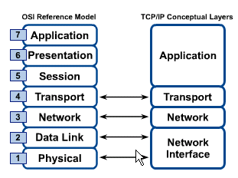
OSI & TCP/IP Models
TCP/IP Model

Slide 7
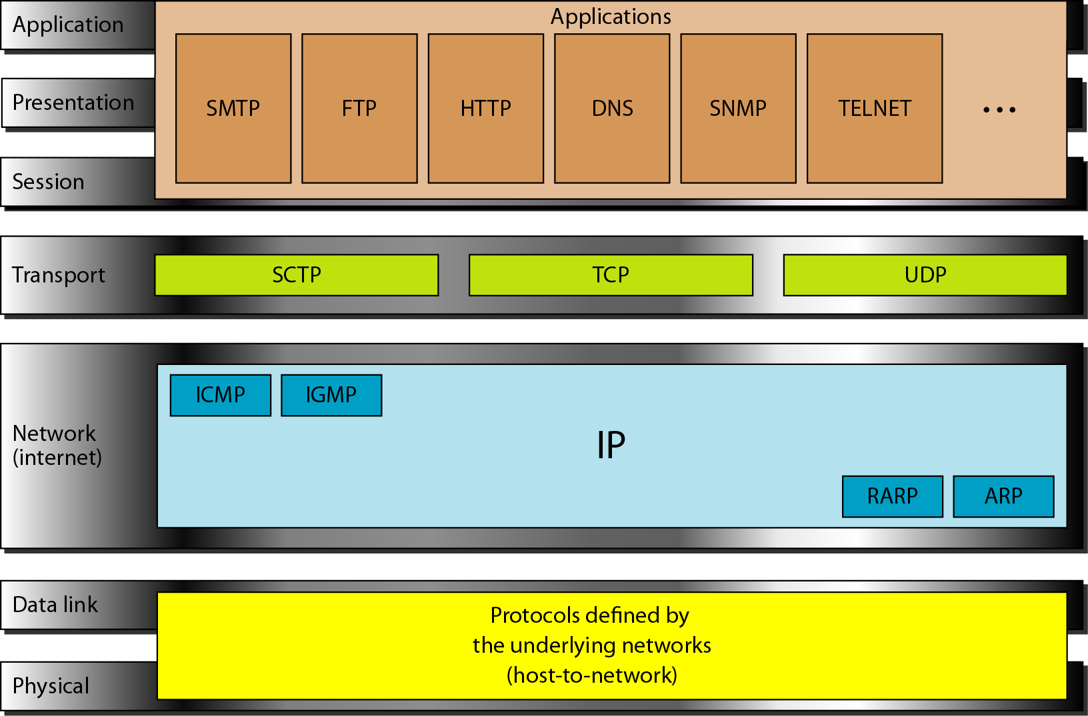
PROTOCOLS IN TCP/IP and OSI model

Slide 8
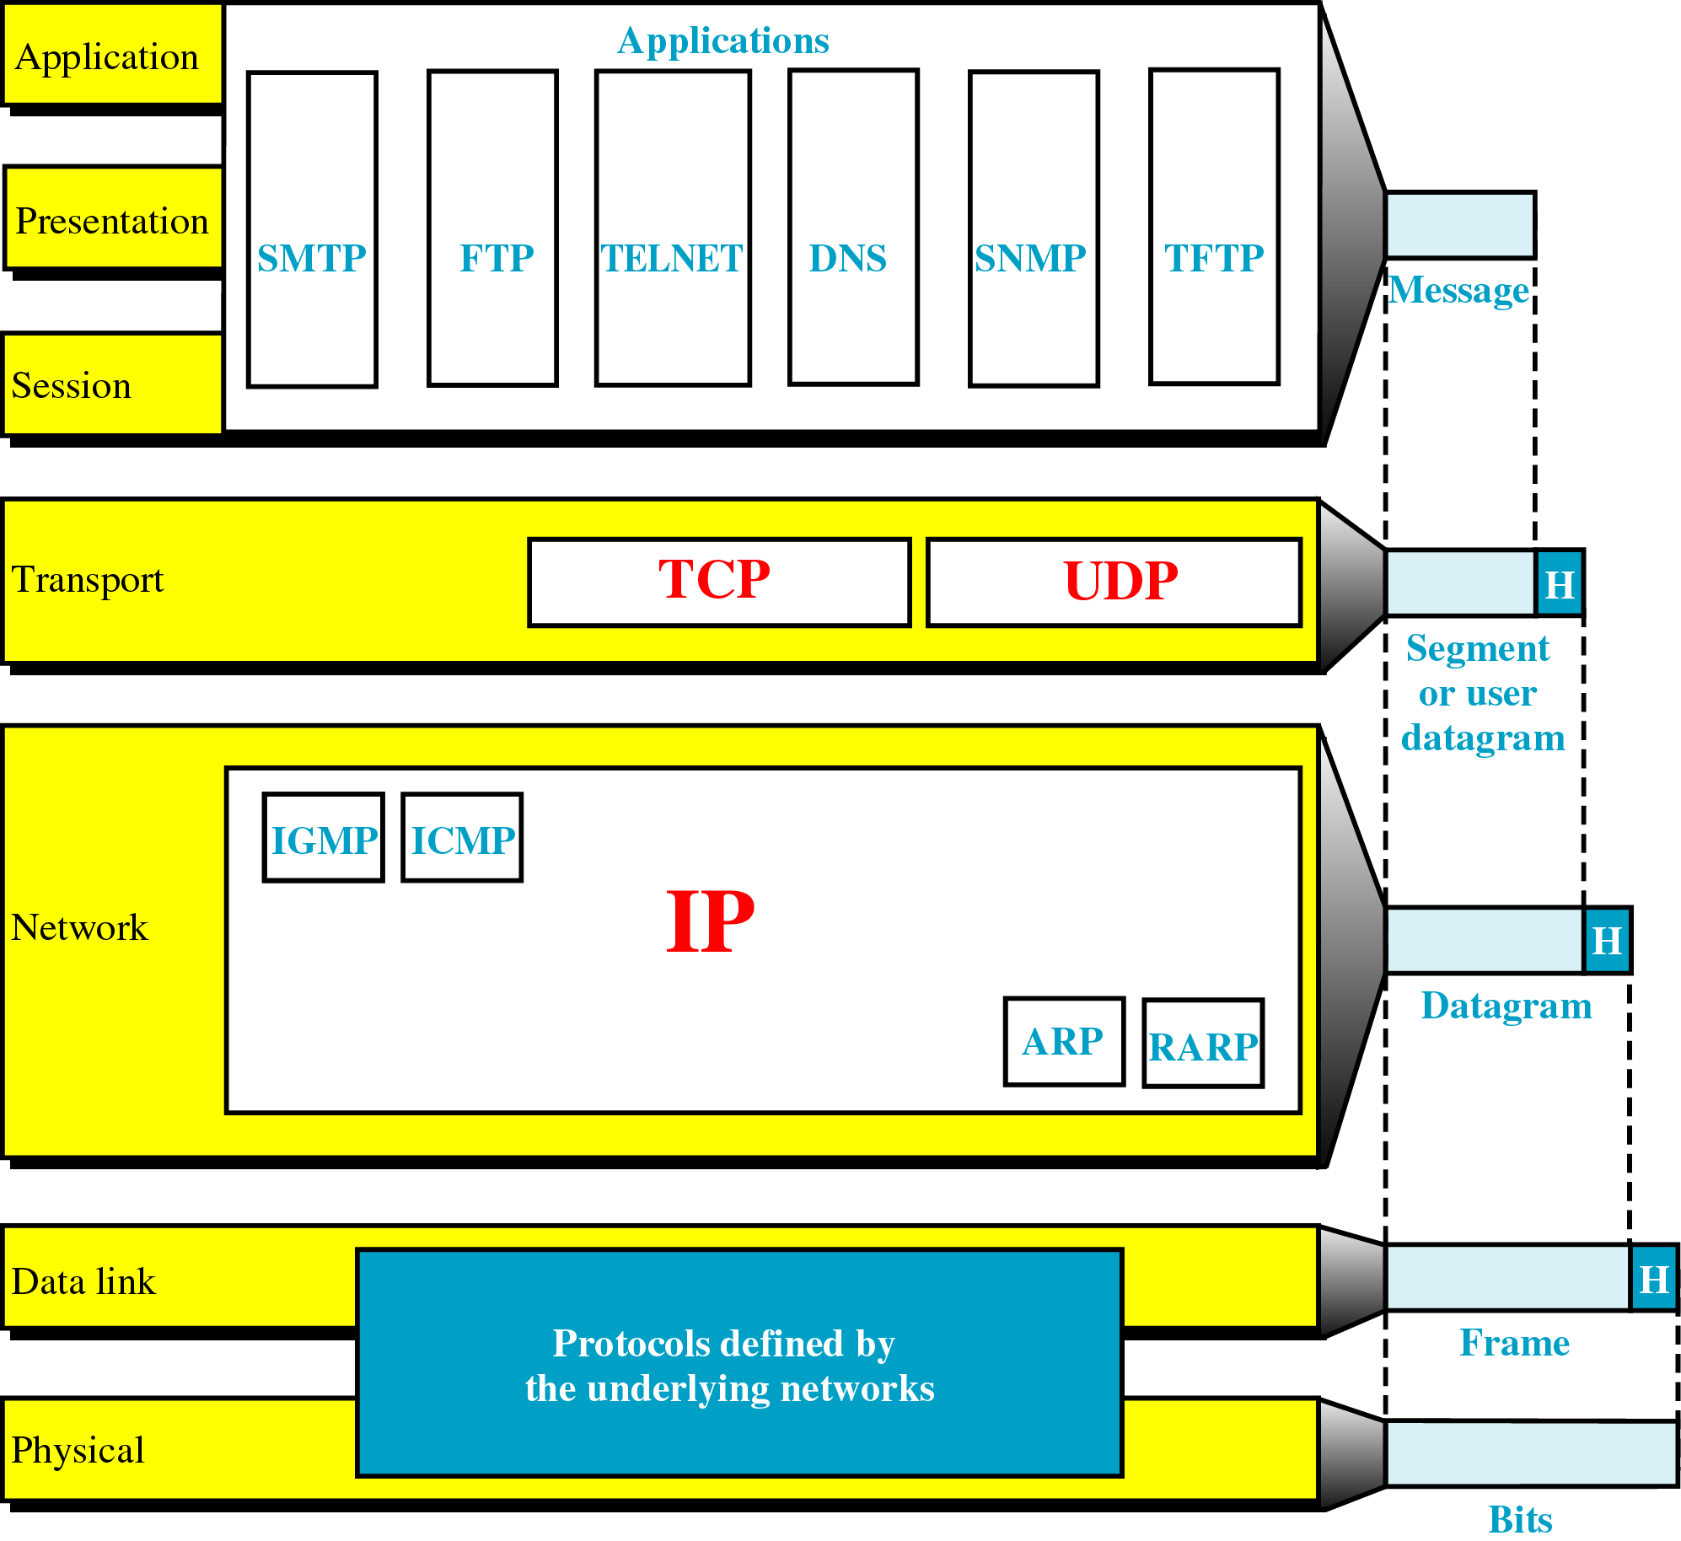
TCP/IP and the OSI Model

Slide 9
IP PROTOCOL
Transmission mechanism used by the TCP/IP protocols.
Unreliable and connectionless protocol-a best-effort delivery service.
The term best effort means that IP provides no error checking or tracking.
Best-effort means that datagrams may:
– be lost;
– arrive out of order;
– even be duplicated.
IP transports data in packets called datagram, each of which is transported separately.

Slide 10
FOUR supporting protocols
ARP
RARP
ICMP
IGMP

Slide 11
Address Resolution Protocol(ARP)
The Address Resolution Protocol (ARP) is used to associate a logical address with a physical address.
On a typical physical network, such as a LAN, each device on a link is identified by a physical or station address, usually imprinted on the network interface card (NIC).
ARP is used to find the physical address of the node when its Internet address is known.

Slide 12
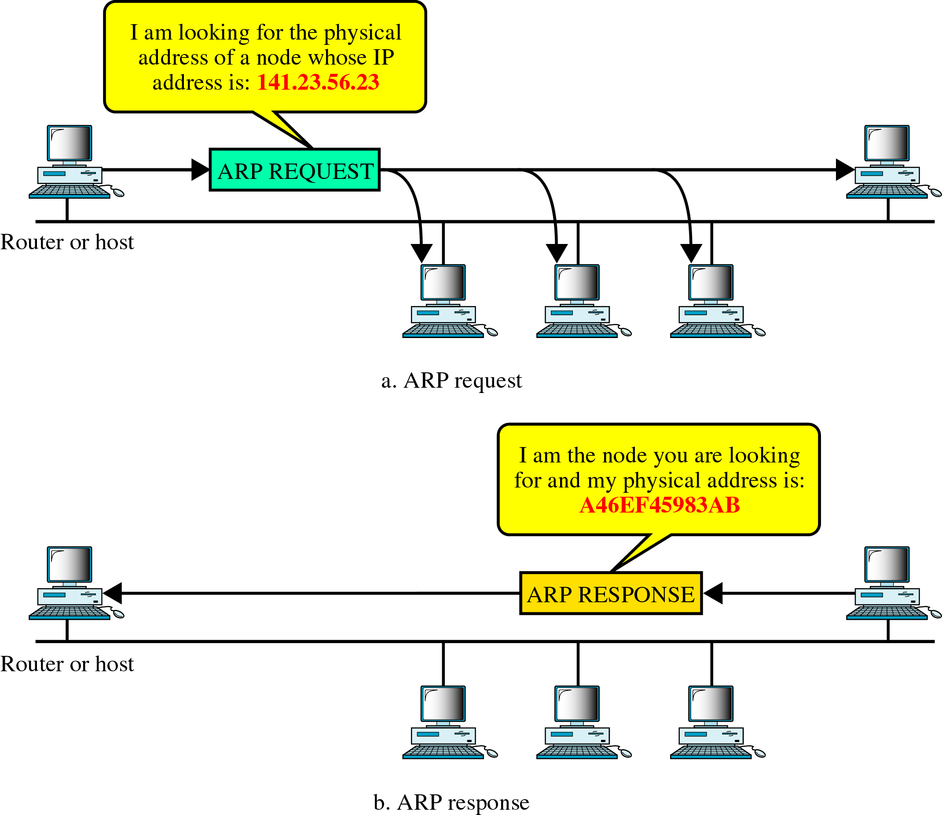
Figure 24-13
ARP

Slide 13
Reverse Address Resolution Protocol
The Reverse Address Resolution Protocol (RARP) allows a host to discover its Internet address when it knows only its physical address.
It is used when a computer is connected to a network for the first time or when a diskless computer is booted.

Slide 14
ICMP & IGMP
Internet Control Message Protocol:
A mechanism used by hosts and gateways to send notification of datagram problems back to the sender.
Sends query and error reporting messages.
Internet Group Message Protocol:
Used to facilitate the simultaneous transmission of a message to a group of recipients.

Slide 15
TRANSPORT layer protocols
UDP
TCP
SCTP

Slide 16
User Datagram Protocol
The User Datagram Protocol (UDP) is the simpler of the two standard TCP/IP transport protocols.
A process-to-process protocol that adds only port addresses, checksum error control and length information to the data from the upper layer.

Slide 17
Transmission Control Protocol
The Transmission Control Protocol (TCP) provides full transport-layer services to applications.
Reliable stream transport protocol.
Stream → Connection-oriented: A connection must be established between both ends of a transmission before either can transmit data.
Sending end :
TCP divides a stream of data into smaller units called segments.
Each segment includes a sequence number for reordering after receipt, together with an acknowledgment number for the segments received.
Segments are carried across the internet inside of IP datagrams.
Receiving end:
TCP collects each datagram as it comes in and reorders the transmission based on sequence numbers.

Slide 18
Stream Control Transmission Protocol (SCTP)
The Stream Control Transmission Protocol (SCTP) provides support for newer applications such as voice over the Internet. (VoIP)
VoIP - a category of hardware and software that enables people to use the Internet as the transmission medium for telephone calls by sending voice data in packets using IP
It is a transport layer protocol that combines
the best features of UDP and TCP.

Slide 19
ADDRESSING
Four levels of addresses are used in an internet employing the TCP/IP protocols:
Physical address
Logical address
Port address and
Specific address.

Slide 20
DEVICES :
Hub: A distributor that has a lot of ports which connected to computers.
Switches: Like a hub but it transmit packets to it destination
Bridge: Used to connect two similar LANs.
Routers: Choose the best path to transmit the packet.
Gateway: Used to connect two different LANs and connect different application protocols.
Repeaters: Repeats signals that travels via long distance

Slide 21
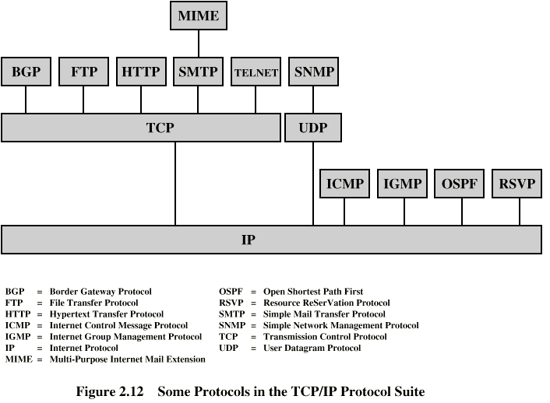
Some Protocols in TCP/IP Suite

