Slide 1
IT 1122
Mobile and Wireless Communication
Frequency Reuse & Channel Assignment
IT1122 Dr.Suresh Sankaranarayanan
20/07/2016

Slide 2
Introduction
The cellular concept was a major breakthrough in solving the problem of spectral congestion and user capacity.
It offered very high capacity in a limited spectrum allocation without any major technological changes.
The cellular concept is a system level idea which calls for replacing a single, high power transmitter (large cell) with many low power transmitters (small cells), each providing coverage to only a small portion of the service area.
Each base station is allocated a portion of the total number of channels available to the entire system, and nearby base stations are assigned different groups of channels so that all the available channels are assigned to a relatively small number of neighboring base stations.
IT1122 Dr.Suresh Sankaranarayanan
20/07/2016

Slide 3
Neighboring base stations are assigned different groups of channels so that the interference between base stations (and the mobile users under their control) is minimized.
By systematically spacing base stations and their channel groups throughout a market, the available channels are distributed throughout the geographic region and may be reused as many times as necessary, so long as the interference between co-channel stations is kept below acceptable levels.
As the demand for service increases (i.e., as more channels are needed within a particular market), the number of base stations may be increased (along with a corresponding decrease in transmitter power to avoid added interference), thereby providing additional radio capacity with no additional increase in radio spectrum.
IT1122 Dr.Suresh Sankaranarayanan
20/07/2016

Slide 4
This fundamental principle is the foundation for all modem wireless communication systems, since it enables a fixed number of channels to serve an arbitrarily large number of subscribers by reusing the channels throughout the coverage region.
Furthermore, the cellular concept allows every piece of subscriber equipment within a country or continent to be manufactured with the same set of channels, so that any mobile may be used anywhere within the region.
IT1122 Dr.Suresh Sankaranarayanan
20/07/2016

Slide 5
Frequency Reuse
Cellular radio systems rely on an intelligent allocation and reuse of channels throughout a coverage region .
Each cellular base station is allocated a group of radio channels to be used within a small geographic area called a cell.
Base stations in adjacent cells are assigned channel groups which contain completely different channels than neighboring cells
The base station antennas are designed to achieve the desired coverage within the particular cell.
By limiting the coverage area to within the boundaries of a cell, the same group of channels may be used to cover different cells that are separated from one another by distances large enough to keep interference levels within tolerable limits.
The design process of selecting and allocating channel groups for all of the cellular base stations within a system is called frequency reuse or frequency planning
IT1122 Dr.Suresh Sankaranarayanan
20/07/2016

Slide 6
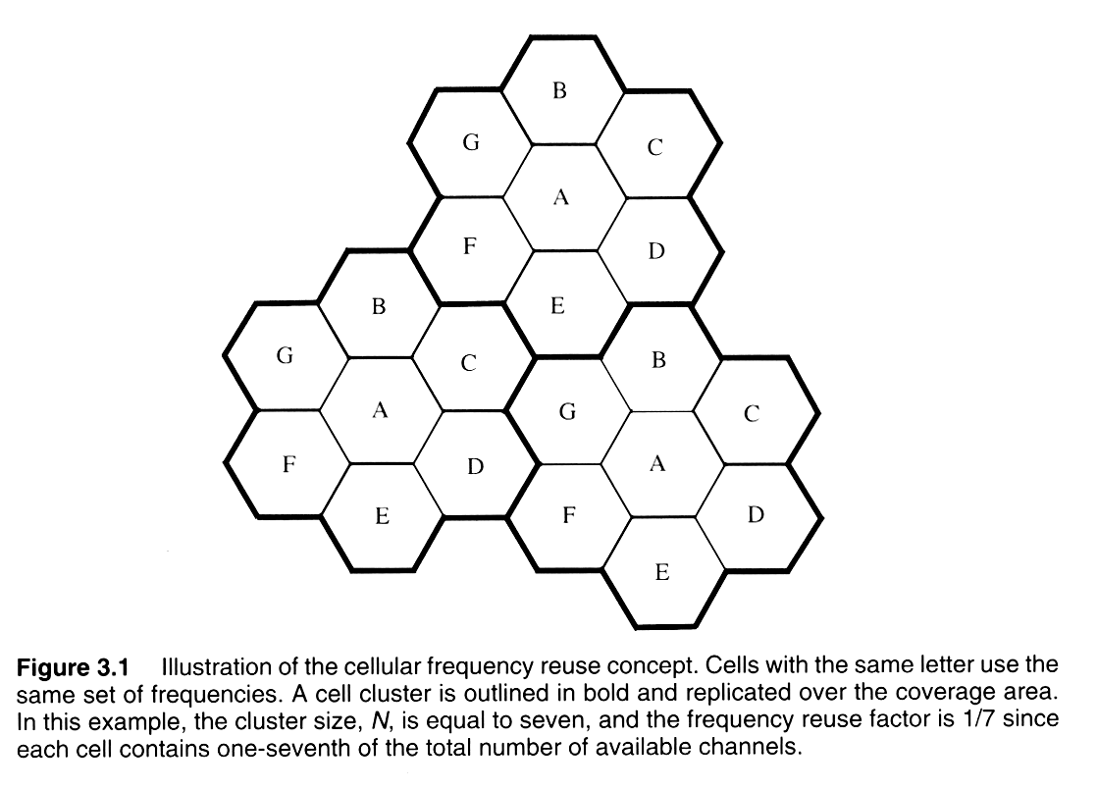
IT1122 Dr.Suresh Sankaranarayanan
20/07/2016

Slide 7
consider a cellular system which has a total of S duplex channels available for use. If each cell is allocated a group of k channels (k<S), and if the S channels are divided among N cells into unique and disjoint channel groups which each have the same number of channels, the total number of available radio channels can be expressed as
S = kN ……………………..(1)
The N cells which collectively use the complete set of available frequencies is called a cluster. If a cluster is replicated M times within the system, the total number of duplex channels, C, can be used as a measure of capacity and is given
C = MkN = MS……………..(2)
IT1122 Dr.Suresh Sankaranarayanan
20/07/2016

Slide 8
As seen from equation.2, the capacity of a cellular system is directly proportional to the number of times a cluster is replicated in a fixed service area.
The factor N is called the cluster size and is typically equal to 4, 7, or 12.
If the cluster size N is reduced while the cell size is kept constant, more clusters are required to cover a given area and hence more capacity (a larger value of C) is achieved.
A large cluster size indicates that the ratio between the cell radius and the distance between co-channel cells is large.
Conversely, a small cluster size indicates that co-channel cells are located much closer together.
The value for N is a function of how much interference a mobile or base station can tolerate while maintaining a sufficient quality of communications
IT1122 Dr.Suresh Sankaranarayanan
20/07/2016

Slide 9
From a design viewpoint, the smallest possible value of N is desirable in order to maximize capacity over a given coverage area (i.e.. to maximize C in equation .2).
The frequency reuse factor of a cellular system is given by I /N, since each cell within a cluster is only assigned 1/N of the total available channels in the system
Example Problem 1: If total of 33 MHz of Bandwidth is allocated to a FDD cellular telephone system uses two 25 KHz simplex channel to provide full duplex voice and control channels. Compute the number of channels available per cell if a system uses
  Four Cell reuse
  Seven Cell reuse
  12 cell reuse
IT1122 Dr.Suresh Sankaranarayanan
20/07/2016

Slide 10
Solution:
Given
  Total Bandwidth = 33 MHz
  Channel Bandwidth = 25 kHZ x 2 Simplex channels = 50 kHz/ Duplex channels
  Total Available channels = 33000/50 = 660 channels
  N = 4, 660/4 = 165 channels
  N = 7, 660/7 = 95 Channels
  N = 12, 660/12 = 55 Channels
IT1122 Dr.Suresh Sankaranarayanan
20/07/2016

Slide 11
Channel Assignment
For efficient utilization of the radio spectrum, a frequency reuse scheme that is consistent with the objectives of increasing capacity and minimizing interference is required.
A variety of channel assignment strategies have been developed to achieve these objectives.
Channel assignment strategies can be classified as either fixed or dynamic.
The choice of channel assignment strategy impacts the performance of the system, particularly as to how calls are managed when a mobile user is handed off from one cell to another
IT1122 Dr.Suresh Sankaranarayanan
20/07/2016

Slide 12
Fixed Channel Assignment
In a fixed channel assignment strategy; each cell is allocated a predetermined set of voice channels.
Any call attempt within the cell can only be served by the unused channels in that particular cell.
If all the channels in that cell are occupied, the call is blocked and the subscriber does not receive service.
Several variations of the fixed assignment strategy exist.
In one approach, called the borrowing strategy, a cell is allowed to borrow channels from a neighboring cell if all of its own channels are already occupied.
The mobile switching center (MSC) supervises such borrowing procedures and ensures that the borrowing of a channel does not disrupt or interfere with any of the calls in progress in the donor cell
IT1122 Dr.Suresh Sankaranarayanan
20/07/2016

Slide 13
Dynamic Channel Assignment
In a dynamic channel assignment strategy, voice channels are not allocated to different cells permanently.
Instead, each time a call request is made, the serving base station requests a channel from the MSC.
The switch then allocates a channel to the requested cell following an algorithm that takes into account the likelihood of fixture blocking within the cell, the frequency of use of the candidate channel, the reuse distance of the channel, and other cost functions
Accordingly, the MSC only allocates a given frequency if that frequency is not presently in use in the cell or any other cell which falls within the minimum restricted distance of frequency reuse to avoid co-channel interference
Dynamic channel assignment reduce the likelihood of blocking, which increases the trunking capacity of the system, since all the available channels in a market are accessible to all of the cells
IT1122 Dr.Suresh Sankaranarayanan
20/07/2016

Slide 14
Dynamic channel assignment strategies require the MSC to collect real-time data on channel occupancy, traffic distribution, arid radio signal strength indications (RSSI) of all channels on a continuous basis.
This increases the storage and computational load on the system but provides the advantage of increased channel utilization and decreased probability of a blocked call.
IT1122 Dr.Suresh Sankaranarayanan
20/07/2016

