Slide 1
IT 1122
Mobile and Wireless Communication
Trunking and Grade of Service
IT1122 Dr.Suresh Sankaranarayanan
27/06/2016

Slide 2
Introduction
Cellular radio systems rely on trunking to accommodate a large number of users in a limited radio spectrum.
The concept of trunking allows a large number of users to share the relatively small number of channels in a cell by providing access to each user, on demand, from a pool of available channels
In a trunked radio system, each user is allocated a channel on a per call basis, and upon termination of the call, the previously occupied channel is immediately returned to the pool of available channels.
The telephone company uses trunking theory to determine the number of telephone circuits that need to be allocated for office buildings with hundreds of telephones, and this same principle is used in designing cellular radio systems
To design trunked radio systems that can handle a specific capacity at a specific "grade of service", it is essential to understand trunking theory and queuing theory
IT1122 Dr.Suresh Sankaranarayanan
27/06/2016

Slide 3
The fundamentals of trunking theory were developed by Erlang, in late 19th century,
Erlang represents the amount of traffic intensity carried by a channel that is completely occupied (i.e. 1 call-hour per hour or 1 call-minute per minute).
For Example, a radio channel that is occupied for 30 minutes during an hour carries 0.5 Erlangs of traffic
IT1122 Dr.Suresh Sankaranarayanan
27/06/2016

Slide 4
Grade of Service
Grade of service (GOS) is a measure of the ability of a user to access a trunked system during the busiest hour.
The grade of service is a benchmark used to define the desired performance of a particular trunked system by specifying a desired likelihood of a user obtaining channel access given a specific number of channels available in the system
It is the wireless designer's job to estimate the maximum required capacity and to allocate the proper number of channels in order to meet the GOS.
GOS is typically given as the likelihood that a call is blocked, or the likelihood of a call experiencing a delay greater than a certain queuing time.
IT1122 Dr.Suresh Sankaranarayanan
27/06/2016

Slide 5
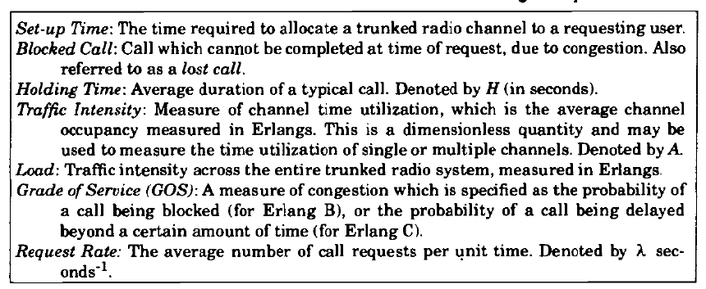
Common Terms used in Trunking Theory
IT1122 Dr.Suresh Sankaranarayanan
27/06/2016

Slide 6



Traffic Intensity offered by each user is equal to the Call request rate multiplied by the holding time. That is each user generates a traffic intensity of A_{u} Erlangs given by
Where H is the average duration of call and is the average number of call requests per unit time.
For a system containing U users and an unspecified number of channels, the total offered traffic intensity A, is given as
A= UA_{u}
Furthermore, in a C channel trunked system, if the traffic is equally distributed among the channels, then the traffic intensity per channel, is given as
IT1122 Dr.Suresh Sankaranarayanan
27/06/2016

Slide 7
The offered traffic is not necessarily the traffic which is carried by the trunked system, only that which is offered to the trunked system.
When the offered traffic exceeds the maximum capacity of the system, the carried traffic becomes limited due to the limited capacity (i.e. limited number of channels).
The maximum possible carried traffic is the total number of channels, C, in Erlangs.
There are two types of trunked systems which are commonly used.
The first type offers no queuing for call requests.
That is, for every user who requests service, it is assumed there is no setup time and the user is given immediate access to a channel if one is available.
If no channels are available, the requesting user is blocked without access and is free to try again later.
This type of trunking is called blocked calls cleared and assumes that calls arrive as determined by' a Poisson distribution.
IT1122 Dr.Suresh Sankaranarayanan
27/06/2016

Slide 8
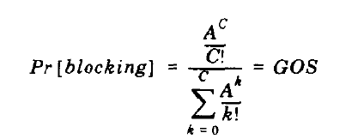
Erlang B formula determines that a call is blocked and is measure of GoS for a trunked system which provided no queuing for blocked calls. Erlang B formula is given by
where C is the number of trunked Channels offered by a trunked Radio system and A is the total offered traffic.
IT1122 Dr.Suresh Sankaranarayanan
27/06/2016

Slide 9
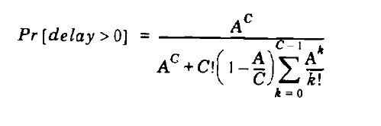
The second kind of trunked system is one in which a queue is provided to hold calls which are blocked.
If a channel is not available immediately, the call request may be delayed until a channel becomes available.
This type of trunking is called Blocked Calls Delayed, and its measure of GOS is defined as the probability that a call is blocked after waiting a specific length of time in the queue
To find the GOS, it is first necessary to find the likelihood that a call is initially denied access to the system.
The likelihood of a call not having immediate access to a channel is determined by the Erlang C formula derived
IT1122 Dr.Suresh Sankaranarayanan
27/06/2016

