Slide 1
IT 1122
Mobile and Wireless Communication
Capacity in Cellular System
IT1122 Dr.Suresh Sankaranarayanan
27/06/2016

Slide 2
Introduction
As the demand for wireless service increases, the number of channels assigned to a cell eventually becomes insufficient to support the required number of users.
At this point, cellular design techniques are needed to provide more channels per unit coverage area.
Techniques such as cell splitting, sectoring, and coverage zone approaches are used in practice to expand the capacity of cellular systems.
Cell splitting allows an orderly growth of the cellular system.
Sectoring uses directional antennas to further control the interference and frequency reuse of channels.
The zone microcell concept distributes the coverage of a cell and extends the cell boundary to hard-to-reach places
IT1122 Dr.Suresh Sankaranarayanan
27/06/2016

Slide 3
Cell splitting increases the number of base stations in order to increase capacity
sectoring and zone microcells rely on base station antenna placements to improve capacity by reducing co-channel interference.
Cell splitting and zone in Microcell techniques do not suffer the trunking inefficiencies experienced by sectored cells, and enable the base station to oversee all handoff chores related to the microcells, thus reducing the computational load at the MSC.
IT1122 Dr.Suresh Sankaranarayanan
27/06/2016

Slide 4
Cell Splitting
Cell splitting is the process of subdividing a congested cell into smaller cells, each with its own base station and a corresponding reduction in antenna height and transmitter power.
Cell splitting increases the capacity of a cellular system since it increases the number of times that channels are reused.
By defining new cells which have a smaller radius than the original cells and by installing these smaller cells (called microcells) between the existing cells, capacity increases due to the additional number of channels per unit area
Imagine if every cell were reduced in such a way that the radius of every cell was cut in half.
In order to cover the entire service area with smaller cells, approximately four times as many cells would be required.
This can be easily shown by considering a circle with radius R. The area covered by such a circle is four times as large as the area covered by a circle with radius R/2.
IT1122 Dr.Suresh Sankaranarayanan
27/06/2016

Slide 5
The increased number of cells would increase the number of clusters over the coverage region, which in turn would increase the number of channels, and thus capacity, in the coverage area.
Cell splitting allows a system to grow by replacing large cells with smaller cells, while not upsetting the channel allocation scheme required to maintain the minimum co-channel reuse ratio Q
IT1122 Dr.Suresh Sankaranarayanan
27/06/2016

Slide 6
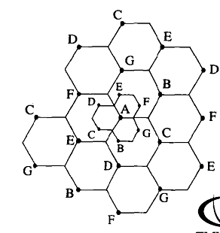
IT1122 Dr.Suresh Sankaranarayanan
27/06/2016

Slide 7
Sectoring
cell splitting achieves capacity improvement by essentially rescaling the system. By decreasing the cell radius R and keeping the co-channel reuse ratio D/R unchanged, cell splitting increases the number of' channels per unit area.
However, another way to increase capacity is to keep the cell radius unchanged and seek methods to decrease the D/R ratio.
In this approach, capacity improvement is achieved by reducing the number of cells in a cluster and thus increasing the frequency reuse.
However, in order to do this, it is necessary to reduce the relative interference without decreasing transmit power
The co-channel interference in a cellular system may be decreased by replacing a single omni-directional antenna at the base station by several directional antennas, each radiating within a specified sector.
By using directional antennas, a given cell will receive interference and transmit with only a fraction of available co-channel cells.
IT1122 Dr.Suresh Sankaranarayanan
27/06/2016

Slide 8
The technique for decreasing co-channel interference and thus increasing system capacity by using directional antennas is called sectoring.
The factor by which the co-channel interference is reduced depends on the amount of sectoring used.
A cell is normally partitioned into three 120 degree sectors or six 60° sectors
IT1122 Dr.Suresh Sankaranarayanan
27/06/2016

Slide 9
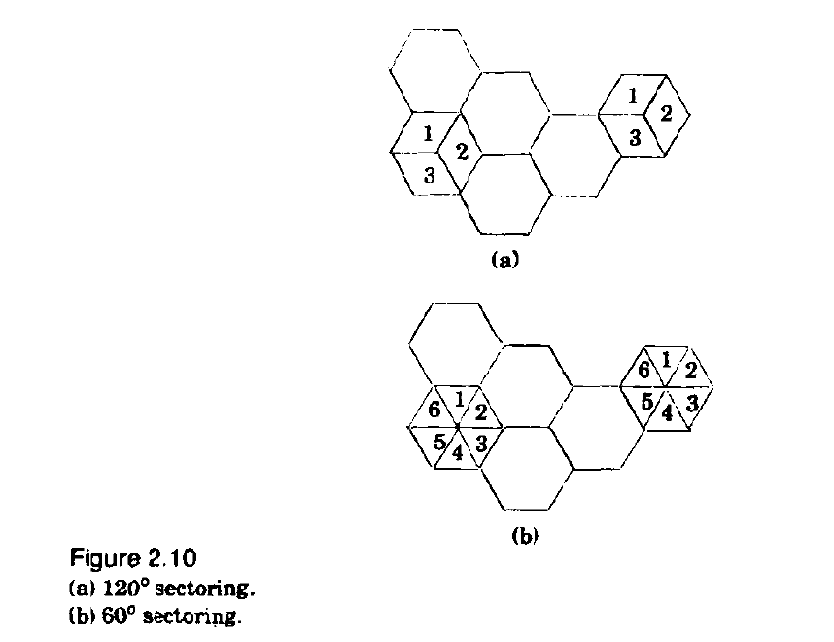
IT1122 Dr.Suresh Sankaranarayanan
27/06/2016

Slide 10
Microcell Zone
The increased number of handoffs required when sectoring is employed results in an increased load on the switching and control link elements of the mobile system
In this scheme, each of the three (or possibly more) zone sites (represented as Tx/Rx ) are connected to a single base station and share the same radio equipment.
The zones are connected by coaxial cable, fiberoptic cable, or microwave link to the base station.
Multiple zones and a single base station make up a cell.
As a mobile travels within the cell, it is served by the zone with the strongest signal.
This approach is superior to sectoring since antennas are placed at the outer edges of the cell, and any base station channel may be assigned to any zone by the base station
IT1122 Dr.Suresh Sankaranarayanan
27/06/2016

Slide 11
As a mobile travels from one zone to another within the cell, it retains the same channel.
Thus, unlike in sectoring, a handoff is not required at the MSC when the mobile travels between zones within the cell.
The base station simply switches the channel to a different zone site.
In this way, a given channel is active only in the particular zone in which the mobile is traveling, and hence the base station radiation is localized and interference is reduced.
The channels are distributed in time and space by all three zones and are also reused in co-channel cells in the normal fashion.
This technique is particularly useful along highways or along urban traffic corridors.
IT1122 Dr.Suresh Sankaranarayanan
27/06/2016

Slide 12
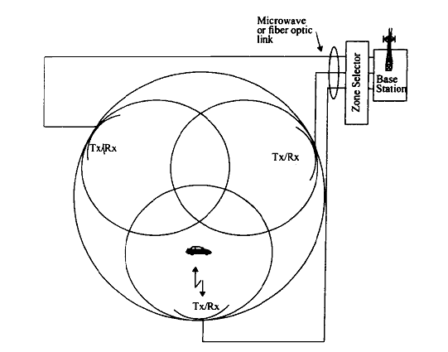
The advantage of the zone cell technique is that while the cell maintains a particular coverage radius, the co-channel interference in the cellular system is reduced since a large central base station is replaced by several lower powered transmitters (zone transmitters) on the edges of the cell.
Decreased co-channel interference improves the signal quality and also leads to an increase in capacity, without the degradation in trunking efficiency caused by sectoring
IT1122 Dr.Suresh Sankaranarayanan
27/06/2016

