Slide 1
IT 1122
Mobile and Wireless Communication
Spread Spectrum Multiple Access
IT1122 Dr.Suresh Sankaranarayanan
09/08/2016

Slide 2
Introduction
Spread Spectrum multiple access (SSMA) uses signals which have a transmission bandwidth that is several orders of magnitude greater than the minimum required RF bandwidth.
A PN sequence converts a narrowband signal to a wideband noise-like signal before transmission.
Advantage:
Immune to multipath interference and robust multiple access capability.
Efficient in a multiple user environment
Two main types of SSMA:
Frequency hopped multiple access (FH)
Direct sequence multiple access (DS)/Code division multiple access(CDMA)
IT1122 Dr.Suresh Sankaranarayanan
09/08/2016

Slide 3
Frequency Hopping Multiple Access
FHMA is a digital multiple access system in which the carrier frequencies of the individual users are varied in a pseudorandom fashion within a wideband channel
In a FH transmitter:
The digital data is broken into uniform sized bursts which are transmitted on different carrier frequencies.
The instantaneous bandwidth of any one transmission burst is much smaller than the total spread bandwidth.
The pseudorandom change of the carrier frequencies of the user randomizes the occupancy of a specific channel at any given time.
IT1122 Dr.Suresh Sankaranarayanan
09/08/2016

Slide 4
In FH receiver:
A locally generated PN code is used to synchronize the receivers instantaneous frequency with that of the transmitter.
At any given point in time, a frequency hopped signal only occupies a single, relatively narrow channel since narrowband FM or FSK is used.
FHMA systems often employ energy efficient constant envelope modulation.
Linearity is not an issue, and the power of multiple users at the receiver does not degrade FHMA performance
IT1122 Dr.Suresh Sankaranarayanan
09/08/2016

Slide 5
FHMA vs FDMA
The difference between FHMA and FDMA is that the frequency hopped signal changes channels at rapid interval.
If the rate of change of the carrier frequency is greater than the symbol rate, it is referred to as a fast frequency hopping. (FDMA)
If the channel changes at a rate less than or equal to the symbol rate, it is called slow frequency hopping system.
IT1122 Dr.Suresh Sankaranarayanan
09/08/2016

Slide 6
Advantages of FH System
A frequency hopped system provides a level of security, since an unintended receiver that does not know the pseudorandom sequence of frequency slots must retune rapidly to search for the signal it wishes to intercept.
FH signal is somewhat immune to fading, since error control coding and interleaving can be used to protect the frequency hopped signal against deep fades which may occasionally occur during the hopping sequence.
IT1122 Dr.Suresh Sankaranarayanan
09/08/2016

Slide 7
Code Division Multiple Access (CDMA)
The spreading signal is a pseudo-noise code sequence that has a chip rate which is orders of magnitudes greater than the data rate of the message.
All users in CDMA system, use the same carrier frequency and may transmit simultaneously.
In CDMA, the narrowband message signal is multiplied by a very large bandwidth signal called the spreading signal.
Each user has its own pseudorandom codeword which is approximately orthogonal to all other codewords.
The receiver performs a time correlation operation to detect only the specific desired codeword.
IT1122 Dr.Suresh Sankaranarayanan
09/08/2016

Slide 8
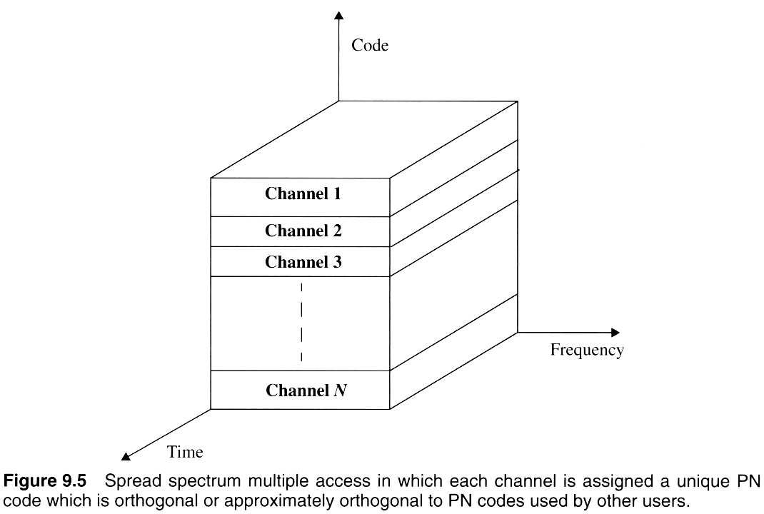
IT1122 Dr.Suresh Sankaranarayanan
09/08/2016

Slide 9
Features of CDMA
Many users of a CDMA system share the same frequency.
CDMA has a soft capacity. Increasing the number of users in a CDMA system raises the noise floor in a linear manner.
Multipath fading may be substantially reduced, because the signal is spread over a large bandwidth.
If the spread spectrum BW greater than the coherence BW of the channel, the inherent freq diversity will mitigate the effects of small scale fading.
Channel data rates are very high in CDMA system.
A Chip (symbol duration) is usually much smaller than the delay spread.
The PN sequences have low autocorrelation
Multipath which is delayed by more than a chip will appear as noise.
A rake receiver can be used to improve reception by collecting time delayed versions of the signal
IT1122 Dr.Suresh Sankaranarayanan
09/08/2016

Slide 10
Comparison of DS and FH System
 | DS | FH
Bandwidth | PN sequence clock rate or chip rate | The tuning range of frequencies
Synchronization | Very crucial | Less critical
Spectrum | Very wide | narrow
Near-far problem | More likely to occur | Less likely to occur
IT1122 Dr.Suresh Sankaranarayanan
09/08/2016

Slide 11
Comparison of FDMA, TDMA, CDMA
Feature | FDMA | TDMA | CDMA
High carrier frequency stability | Required | Not necessary | Not necessary
Timing/synchronization | Not required | Required | Required
Near-far problem | No | No | Yes,power control tech.
Variable transmission rate | Difficult | Easy | Easy
Fading mitigation | Equalizer not needed | Equalizer may be needed | RAKE receiver possible
Power monitoring | Difficult | Easy | Easy
Zone size | Any size | Any size | Large size difficult

