Slide 1
IT 1122 Mobile and Wireless Communication
Packet Radio

Slide 2
Packet Radio
Packet Radio Protocols
Carrier Sense Multiple Access(CSMA) Protocol
Reservation Protocols
2

Slide 3
Packet Radio
In packet radio (PR) access techniques, many subscribers attempt to access a single channel in an uncoordinated( or minimally coordinated) manner.
Collisions from the simultaneous transmissions of multiple transmitters are detected at the base station receiver, in which case an ACK or NACK signal is broadcast by the base station to alert the desired user of received transmission.
The subscribers use a contention technique to transmit on a common channel. ALOHA protocols are the best examples of contention techniques.
The performance of contention techniques can be evaluated by the throughput(T), and the average delay(D).
3

Slide 4
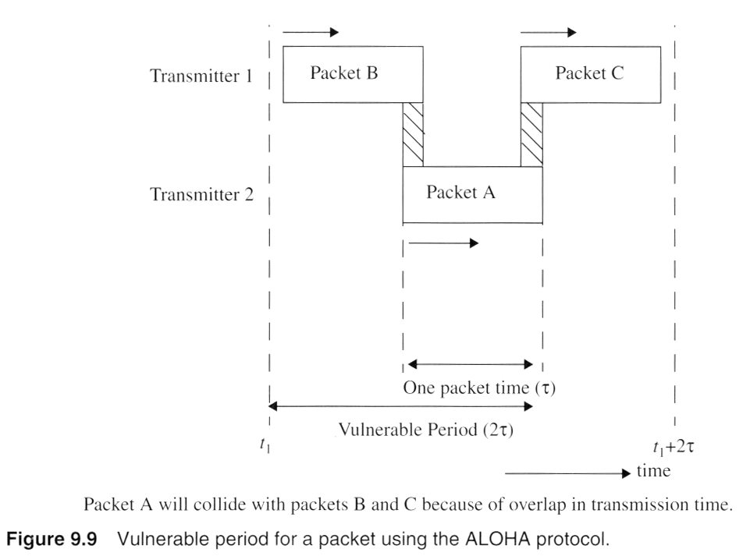
Packet Radio Protocol
Vulnerable period : the time interval during which the packets are susceptible to collisions with transmissions form other users.
4

Slide 5
Packet Radio Protocol (Cont’d)
Assumption:
All packets sent by all users have a constant packet length and fixed, channel data rate.
All other users may generate new packets at random time intervals.
Packet transmissions occur with a Poisson distribution having a mean arrival rate of λ packets per second.
The traffic occupancy or throughput R:
Is the is the packet duration in seconds
λ : Is the mean arrival rate in packets per second
5

Slide 6
Packet Radio Protocol (Cont’d)
T: the normalized throughput.
Pr[no collision]: the probability of a user making a successful packet transmission
Pr(n): the probability that n packets are generated by the user population during a given packet duration interval is assumed to be Poisson
(1)
A packet is assumed to be successfully transmitted if no other packets are transmitted during the given packet interval. The prob that no packets are generated during this interval is given by (1) with n =0 , ie Pr (0) = e ^{-R}
6

Slide 7
Packet contention protocols
Based on the type of access, contention protocols are categorized as :
Random access
No contention among the users, and packets are transmitted, as they arrive from the user
Scheduled access
Based on coordinated access by the users. Messages are transmitted within assigned time slots
Hybrid access
7

Slide 8
Pure ALOHA
The pure ALOHA protocol is a random access protocol used for data transfer. A user accesses the channel as soon as the packet is ready to be transmitted. Then it waits for an ack or nack, if it gets a nack (a collision) then it waits for a random amount of time and then retransmits the packet. The delay increases as the number of users increases, as the prob of collision increases
The vulnerable period is , the probability of no collision during the vulnerable period Pr(n):
At n=0
The throughput:
8

Slide 9
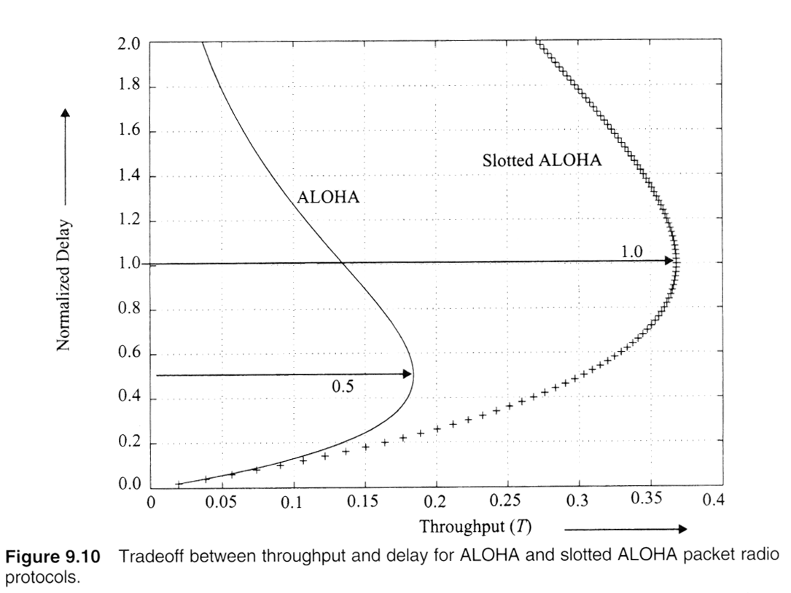
ALOHA Vs. Slotted ALOHA
Fig(9.10) shows how ALOHA and slotted ALOHA systems trade-off throughput for delay
Fig(8.10)
9

