Slide 1
AI Assisted Data Wrangling
Shreyas Cholia - scholia@lbl.gov
Scientific Data Division
Jun-2026

Slide 2
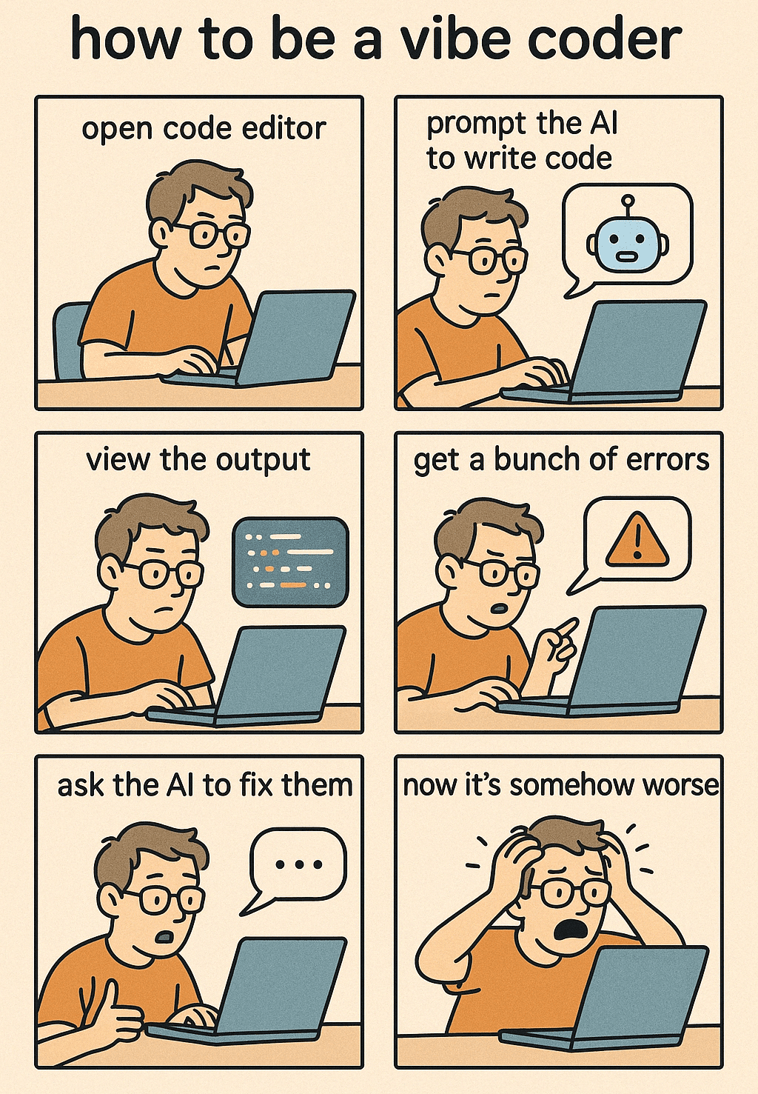
What I Mean by Agentic Coding
Working with an LLM assisted agent where the agent generates code
You as the human review the generated code
Tweak the code as needed
Test your code
Repeat
Your AI Coding Assistant is both really smart and kinda stupid.
It can be really useful but you really need to guide it.

Slide 3
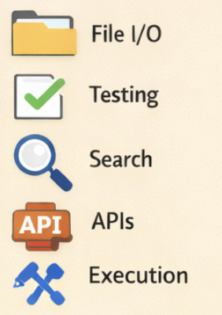




What’s Happening Under The Hood
User Interface
(Interactive Chat Window)
Tools
Agent
Context
LLM Model

Slide 4

The “agentic” things your coding agent does
Modify code: Read (Files, Data, Outputs) and Edit (Create and Modify)
Call external URLs to query information
Run things in the shell
Somewhat reductive, but close enough
Fun Link: The Emperor Has No Clothes: How to Code Claude Code in 200 Lines of Code
https://www.mihaileric.com/The-Emperor-Has-No-Clothes/

Slide 5
Coding Agent IDE Options
VS Code
Claude Code
GitHub CoPilot
Codex
Roo Code (Open Source + works with CBorg)
… and many others …
Integrated IDEs: Cursor, Windsurf, Antigravity …
LOTS of options - this session is more about general approach and less about specific tools

Slide 6
Cborg Setup
Set Environment Variables to use your CBORG access to LLMs
https://github.com/shreddd/ai_data_wrangling_demo/blob/main/cborg_claude_code_vscode_setup.md
Claude Code: ANTHROPIC_AUTH_TOKEN=sk-XXXXXXXX
ANTHROPIC_BASE_URL=https://api.cborg.lbl.gov
ANTHROPIC_MODEL=anthropic/claude-sonnet
…
(Different tools have different setups)

Slide 7
Picking a Model
Claude Sonnet works well enough for me
$$$ - Opus - most powerful (can take a bit longer with “reasoning”)
$$ - Sonnet - good enough for most tasks
$ - Haiku - fast and efficient for simple tasks
People have strong feelings about models, but new models are coming out all the time so YMMV
Be aware that you have a $50 quota on CBorg

Slide 8
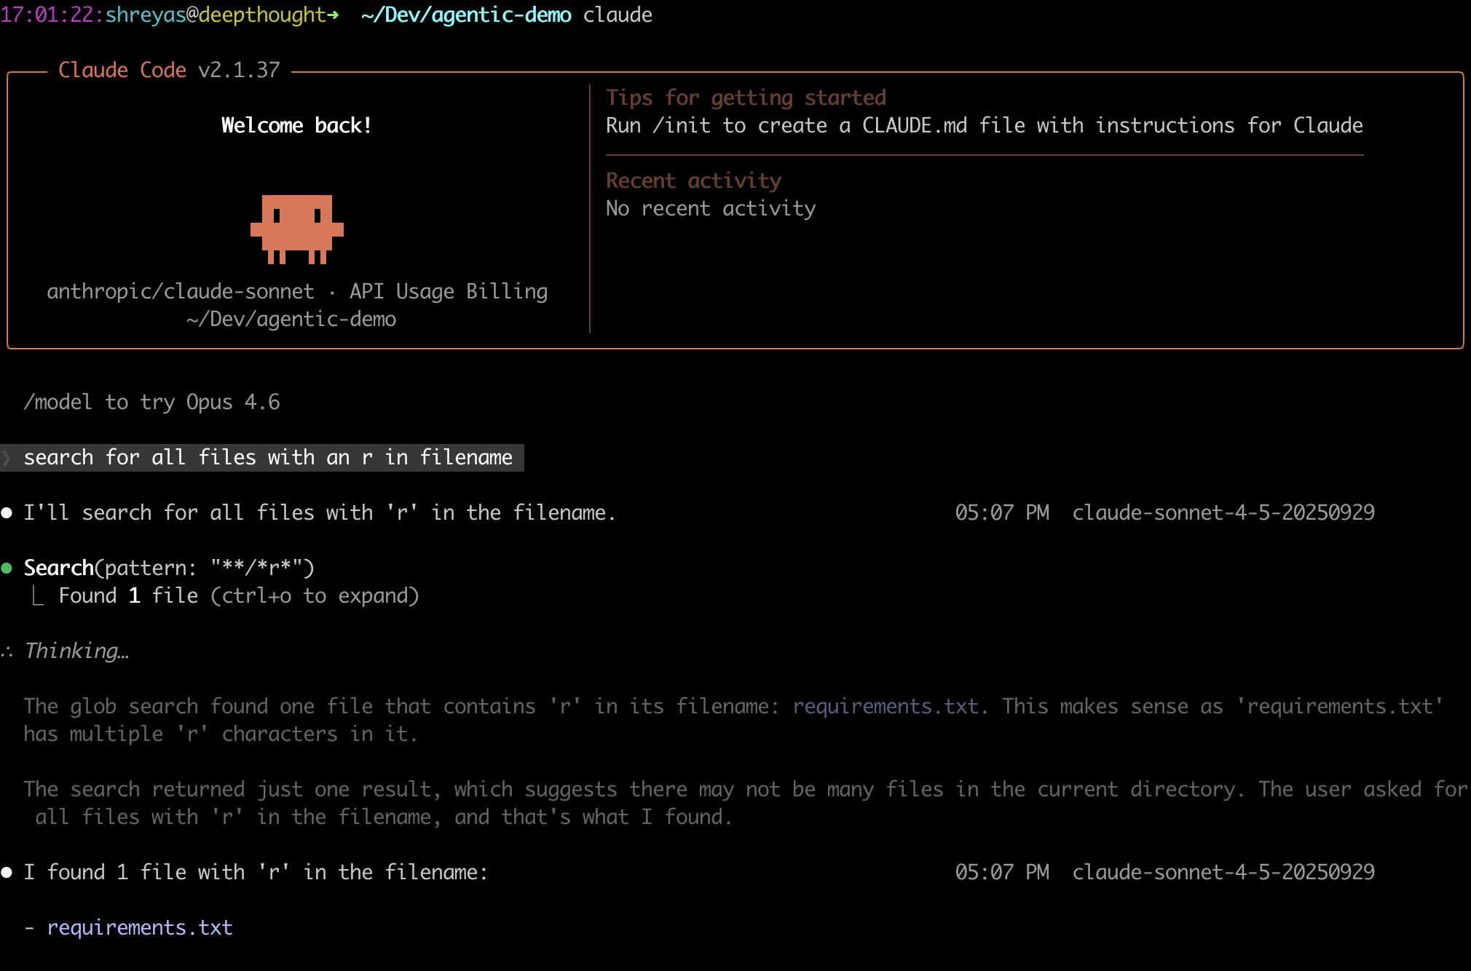
Standalone CLI Agentic Interfaces
Claude CLI, Open Code
Use it for specific tasks where I can steer the agent but don’t need much code
Analysis / Admin tasks
Can also be used in conjunction with code editors if you don’t mind a more decoupled workflow

Slide 9
Modes (Some version of this)
Agent modes:
Ask – No editing just interfaces with Chat Window
Edit – Just Edits Code
Execute/Agent – Access to your environment including execution privileges
Permissions:
Ask before running command
Auto Run without asking

Slide 10

Data Wrangling Agents
LLM does not read all your data and interpret it directly
Instead point it at some sample data to understand the structure of your dataset
The tool should actually be writing some code (usually Python) to parse and analyze data to perform the task
Agent isn’t analyzing the data – it is producing code to analyze the data
Give it access to APIs and Skills
Try: Ask Claude to pull down data from an API and analyze results
Prompt: “Pull down list of top 10 most populous countries from Wikipedia and create a bar graph.”

Slide 11
Additional Tips

Slide 12
Instructions
Provide your agent with a default set of instructions to always follow. eg: AGENTS.md or CLAUDE.md
---
applyTo: '**'
---
# Project Instructions
- Always develop a plan before writing code. Do not write code before confirming plan.
- Avoid fixing unrelated issues in the code when addressing a specific problem.
- State that you are using this .instructions.md file to guide your responses at the beginning of session.
# Testing
- If test object data fields or structures are not provided, ask the user to provide them.
- Look for `make test` to run tests if Makefile is present.

Slide 13
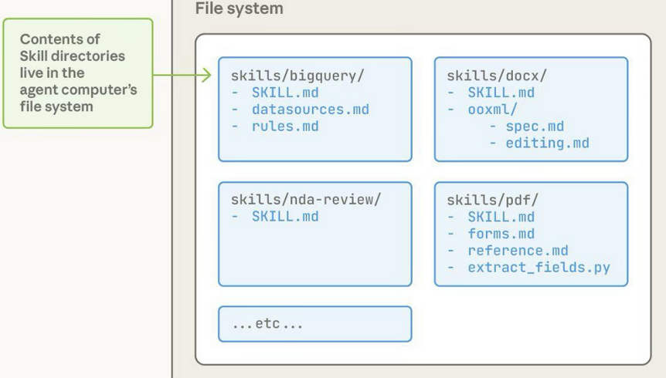
Agent Skills - Specialized Capabilities
⚙️ Reusable workflow logic 🧠 Domain expertise for agents 🔌 Composable with other capabilities 🚀 Efficient context usage with progressive disclosure
Skill structure
Every Skill requires a SKILL.md file with YAML frontmatter:
---
name: your-skill-name
description: Brief description of what this Skill does and when to use it
---
# Your Skill Name
## Instructions
[Clear, step-by-step guidance for Claude to follow]
## Examples
[Concrete examples of using this Skill]
TRY: Use Your Claude’s “skill-creator” Skill to create a new a new Skill

Slide 14
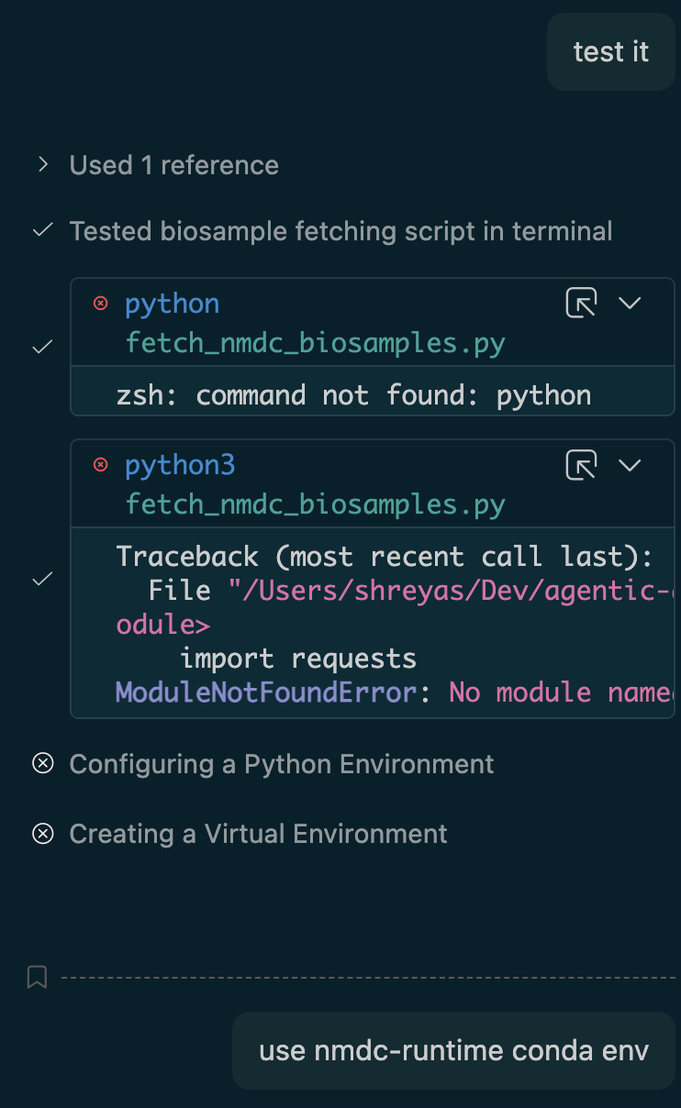
Execution Environments
Setup a separate execution environment for each project
Give it instructions on how to run code – otherwise it will try some potentially bad
Eg.
Point it at the execution env otherwise it may try and use system tools and install things you already have
Tell it about `make test` if you use Makefiles otherwise it will run pytest

Slide 15

The Good, The Bad and the Yee Haw
The Good:
Implementing well-understood software tasks (eg. write me a web app with a database)
Refactoring Code
Repeating an existing pattern in your code (write function Y similar to X)
Documentation
Writing Tests
The Bad:
AI agents may agree with you even if don’t make sense
Implementing obscure functionality that may need specialized knowledge (only as good as training data)
Hallucinating API endpoints, data models etc. - always give it explicit knowledge
Finite context windows constrain large codebases
The *#@%!
API errors, configuration errors
Software updates to tool suddenly changes interface and functionality
Half way through your coding session you run out of tokens!

Slide 16
Tips for Human in the Loop Iteration
It feels like magic but check what the agent is doing – it still makes mistakes!
Beware of over-zealous edits (correcting parts of the code you didn’t ask for)
Approve individual diffs rather than wholesale files
Use thinking mode and watch what it is doing
Don’t be afraid to stop the code generation it if it isn’t doing what you expected. Then re-prompt.
Don’t be afraid to start over if it is going down a weird path. If it has too many bad ideas in the context it is an uphill battle.
Write Tests

Slide 17
Resources
Join the Google Chat for CBORG Coders
Don’t feel like you need to constantly try and keep up with the new tools. Find something that works, and just use to get stuff done
You can periodically try something new but don’t get caught in the vortex of productivity hacking

