Slide 1
MINI PROJECT
VERSION CONTROL USING GIT
SHREESHIVAHARRI S
18MER189
MECHANICAL DEPARTMENT KONGU ENGINEERING COLLEGE

Slide 2
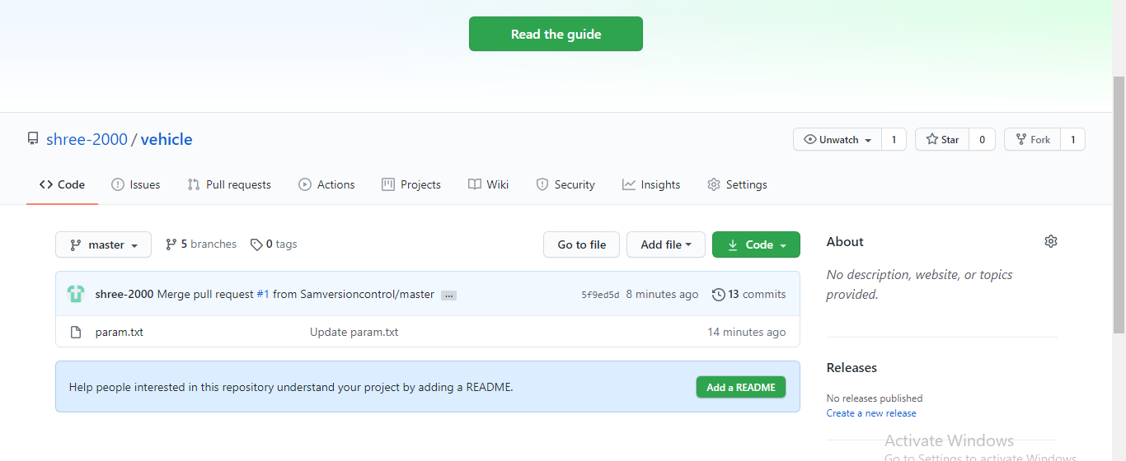
CREATING VEHICLE REMOTE REPOSITORY

Slide 3
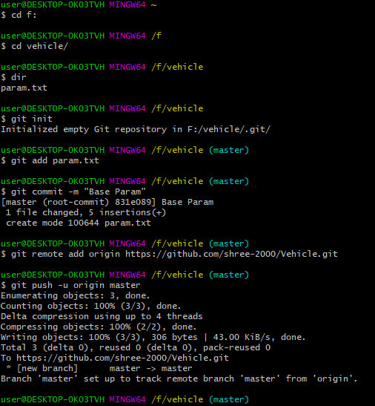
COMMIT 1: BASE PARAM IN MASTER

Slide 4
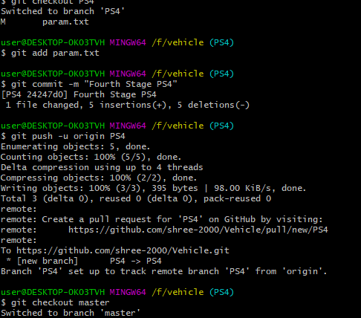
COMMIT 2: FOURTH STAGE IN PS4

Slide 5
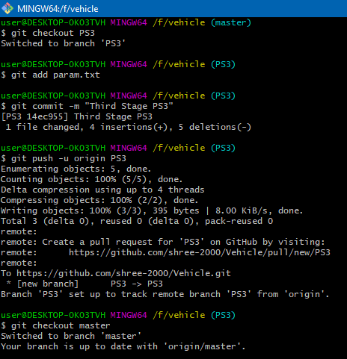
COMMIT 3: THIRD STAGE IN PS3

Slide 6
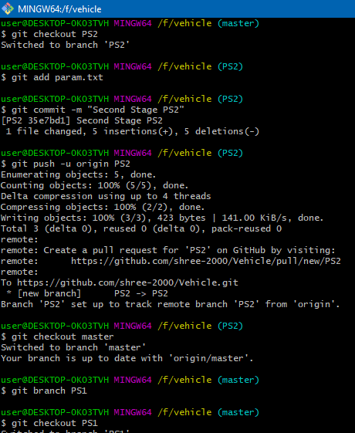
COMMIT 4: SECOND STAGE IN PS2

Slide 7
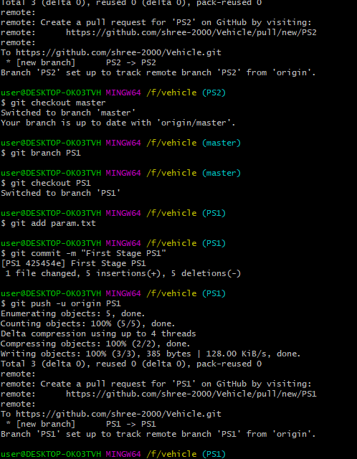
COMMIT 5: FIRST STAGE IN PS1

Slide 8
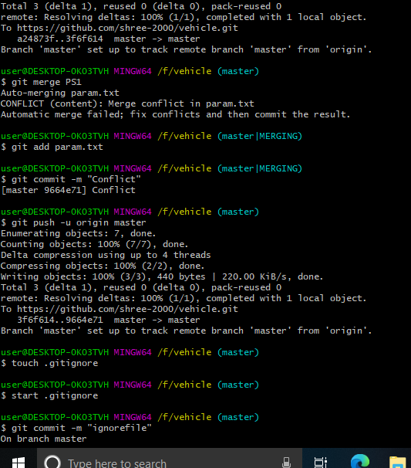
SOLVING MERGE CONFLICT MANUALLY

Slide 9
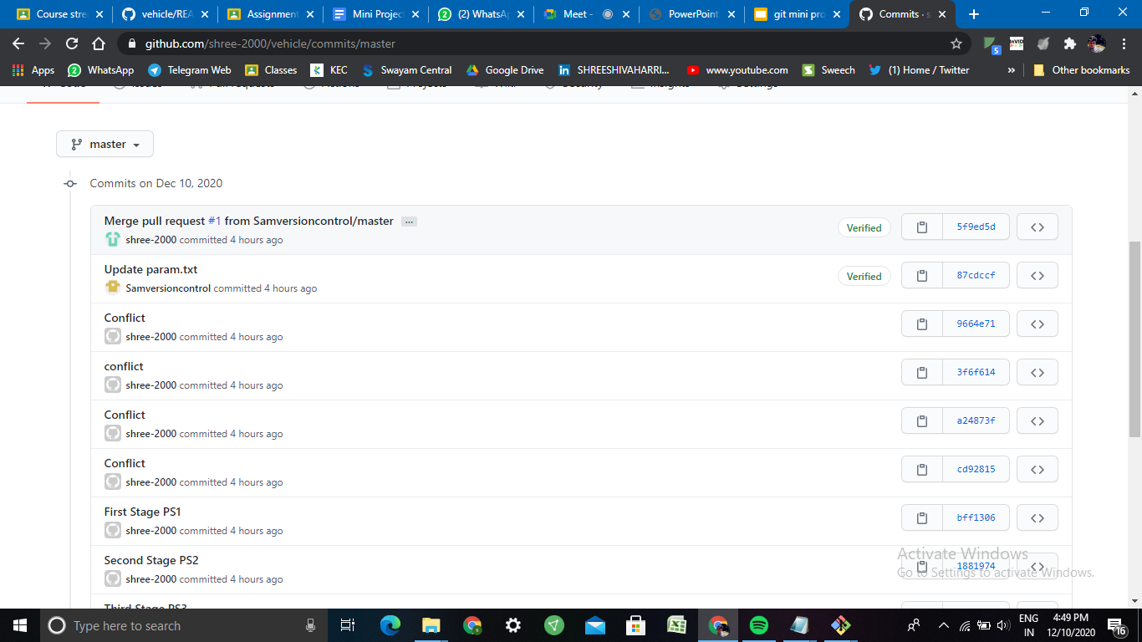
Pull request

Slide 10
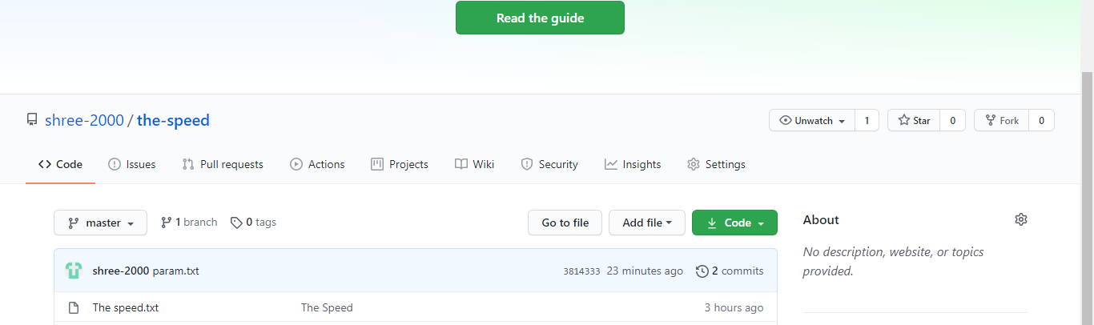
CREATING SPEED REPOSITORY

Slide 11
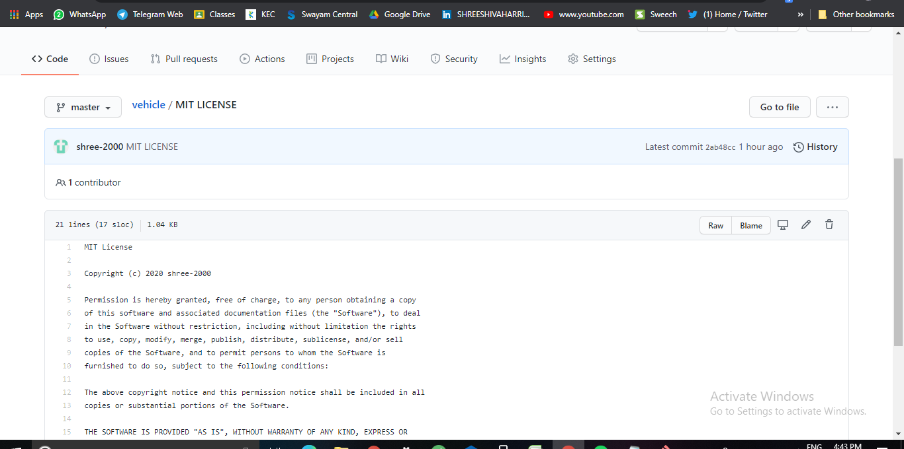
MIT LICENCE IS ADDED

Slide 12
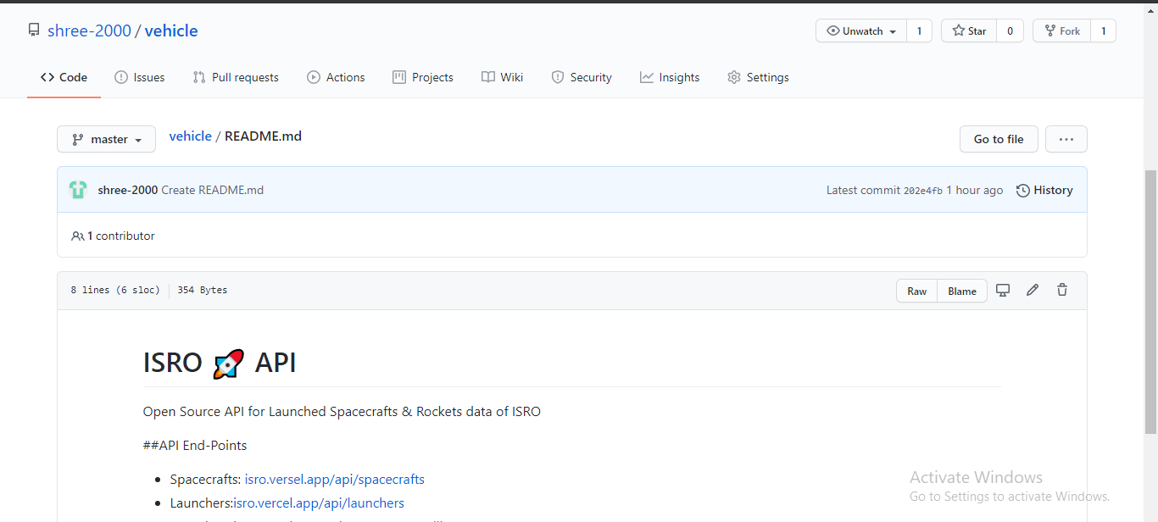
README FILE IS ADDED

Slide 13
GRAPHICAL VIEW OF COMMITS

Slide 14
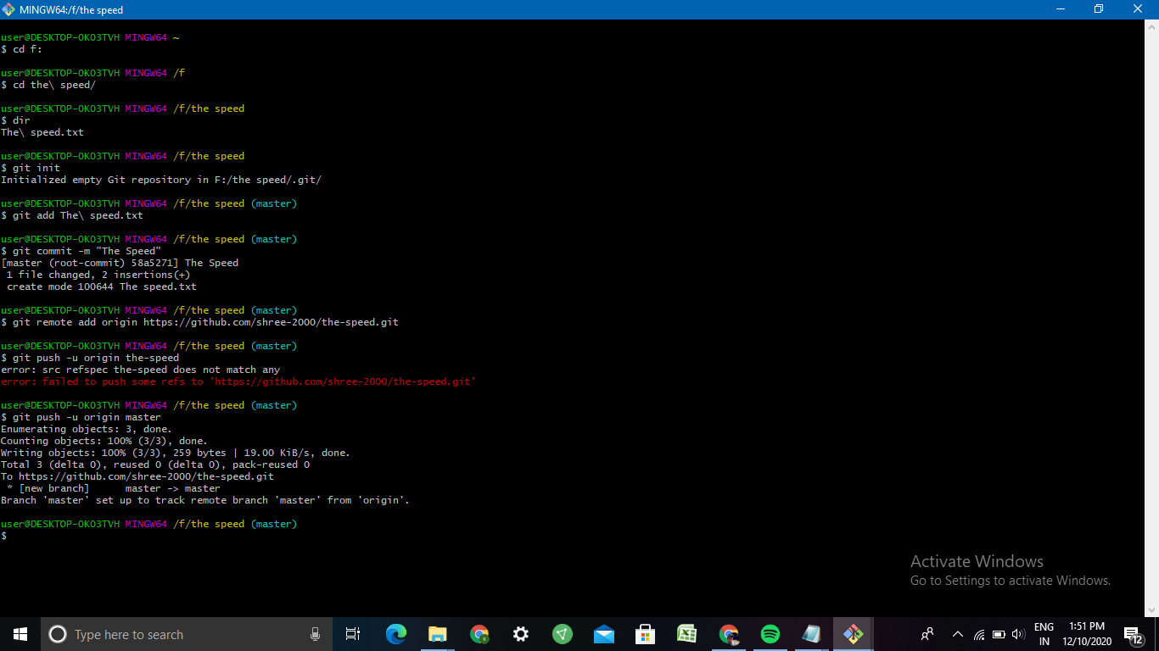
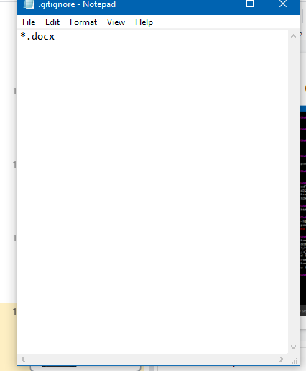
CREATING GIT IGNORE FILE

