Slide 1


Business Intelligence and Business Analytics Continuous Assessment || –Hustle_ADJ “Cyclist”
Contributors:-
1.Ajith Gundan - x23168978@student.ncirl.ie
2.Dineshkumar Lingapandiyan- x22225498@student.ncirl.ie
3. Jayashree Rajkumar- x23199491@student.ncirl.ie

Slide 2
Introduction
Introduction: Cyclist embarks on integrating Business Analytics to enhance operations and customer satisfaction. This presentation delves into methodologies, such as Six Sigma, and tools like Zoho CRM, shaping Cyclist's future. Join us to explore how these implementations optimize operations and elevate the customer experience.

Slide 3
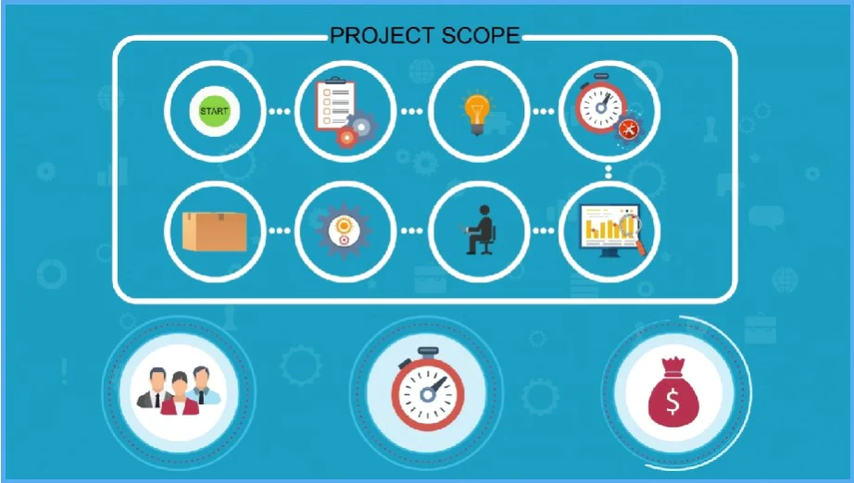
Organization Overview
Cyclist Overview: Cyclist, a fictional European Cycle manufacturing company, pioneers greener transportation solutions. With a commitment to social responsibility, it manufactures classic and electric bikes. This slide introduces Cyclist's journey and its mission to promote environmental sustainability and healthier lifestyles.

Slide 4
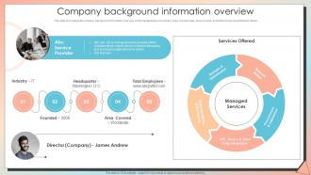
Background Information
Dive into Cyclist's history and incorporation. Discover its mission to promote greener transportation and social responsibility. Learn about Cyclist's significant role in the industry and its commitment to innovation and environmental sustainability

Slide 5
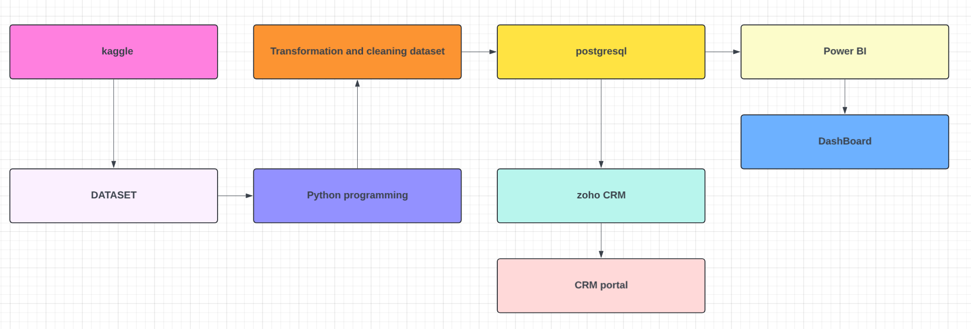
System Design Overview
Explore Cyclist's system design, including software approach processes and customer support lifecycles. Understand the intricacies of data capture points and their importance in optimizing operations and enhancing customer satisfaction

Slide 6
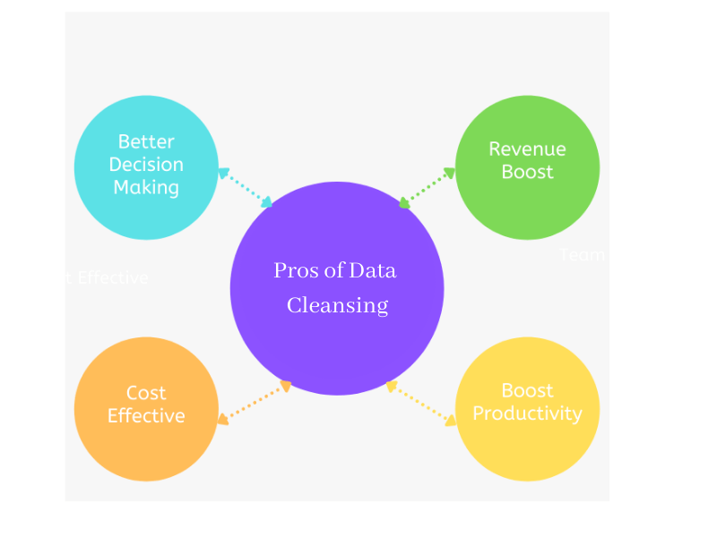
Data Capture Points
Learn about crucial data capture points in Cyclist's operations. From customer information to station details, discover how data is collected and utilized for analysis and decision-making.
Data Capture Points (continued): Explore additional data capture points, such as distance and pricing calculations. Understand how these data points contribute to operational efficiency and customer support effectiveness.

Slide 7
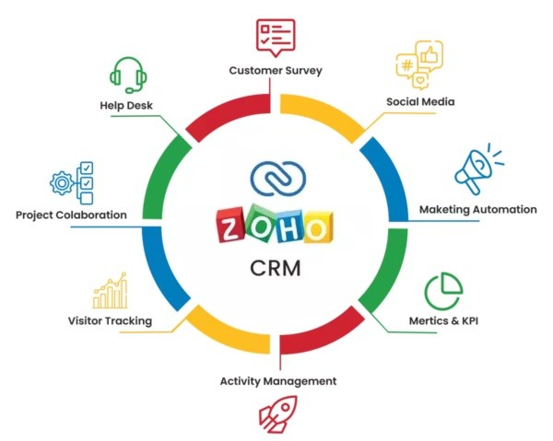
Analytics Requirement
Delve into the analytics requirements for Cyclist's operations. From tracking leads to evaluating pricing, discover how analytics tools are essential for performance monitoring and improvement.
Customer Integration: Explore how Zoho CRM facilitates customer integration for Cyclist. Learn about its role in managing customer interactions and enhancing communication for improved customer satisfaction.

Slide 8
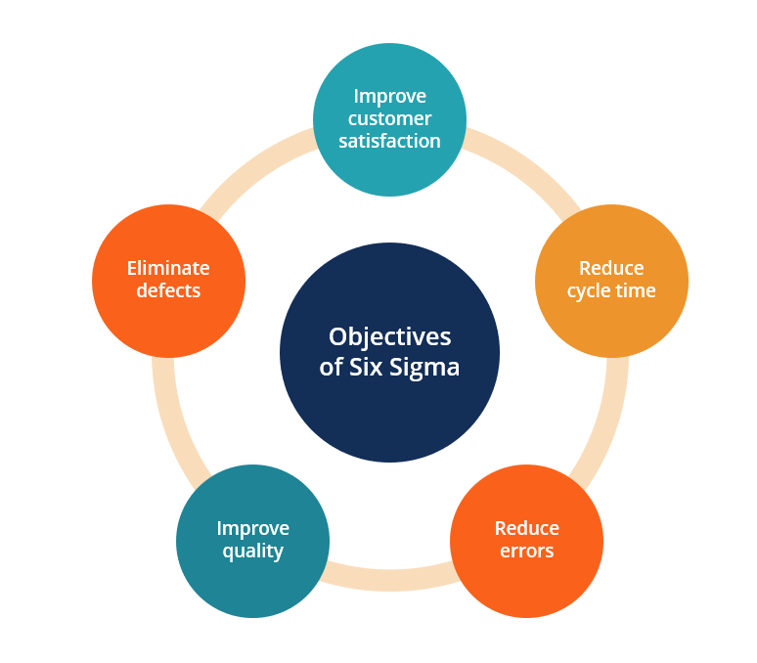
Implementation Overview
Understand the role of Six Sigma in Cyclist's operational optimization. Discover how it drives cost reduction, revenue growth, and internal operations efficiency for sustainable business growth.

Slide 9
Financial Perspective
Explore the financial benefits of Six Sigma implementation for Cyclist. From cost reduction to revenue growth, understand how these strategies contribute to overall business success.
Financial Perspective (continued): Delve deeper into Six Sigma's financial impact, emphasizing efficiency and resource utilization for improved profitability and sustainability.

Slide 10
Learning and Growth Perspective
Learn about the learning and growth perspective of Six Sigma implementation. From employee training to innovation, understand how these factors drive continuous improvement and business growth.
Learning and Growth Perspective (continued): Explore the importance of innovation and employee training in fostering a culture of improvement and driving business success for Cyclist.

Slide 11
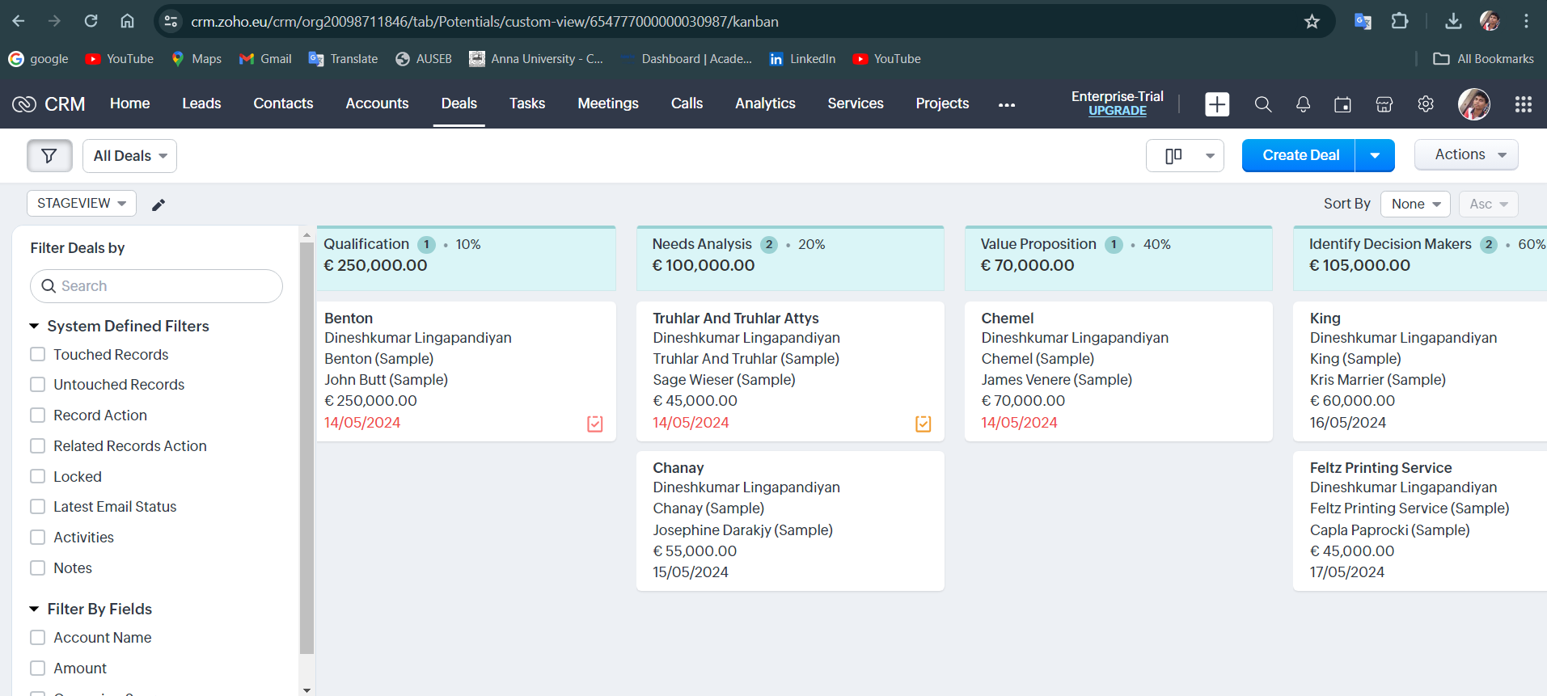
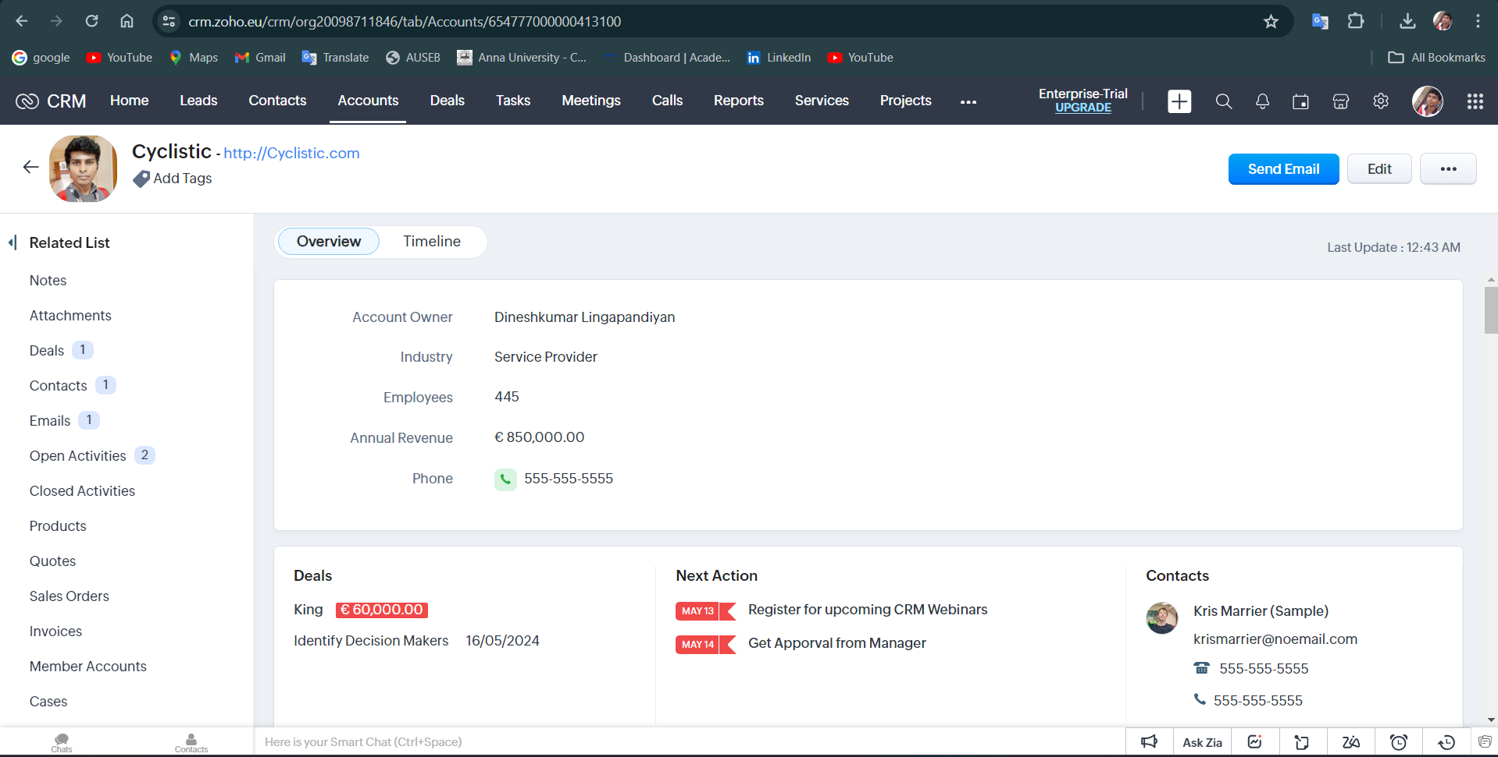
Implementation CRM

Slide 12
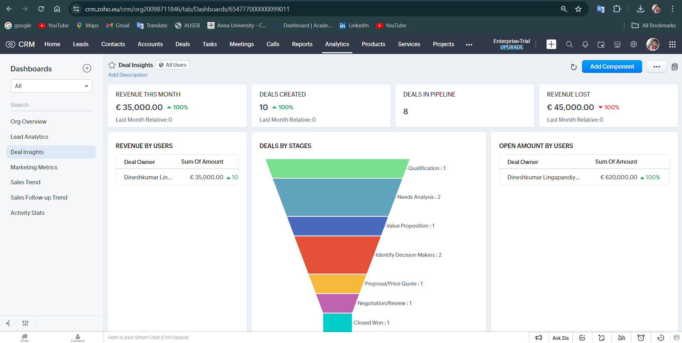
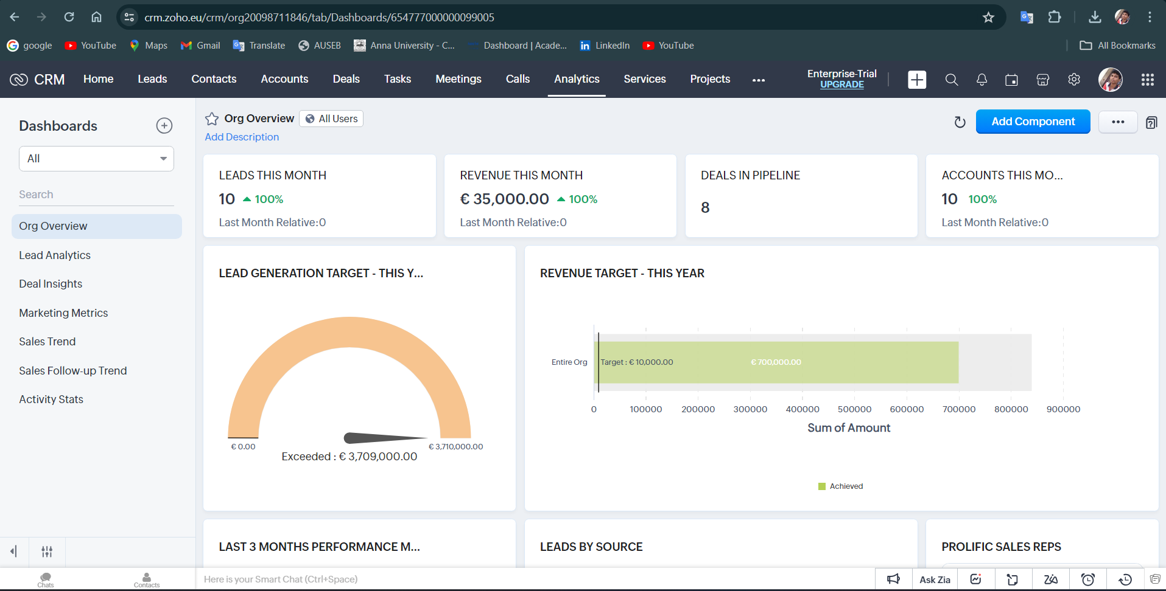
Implementation CRM

Slide 13
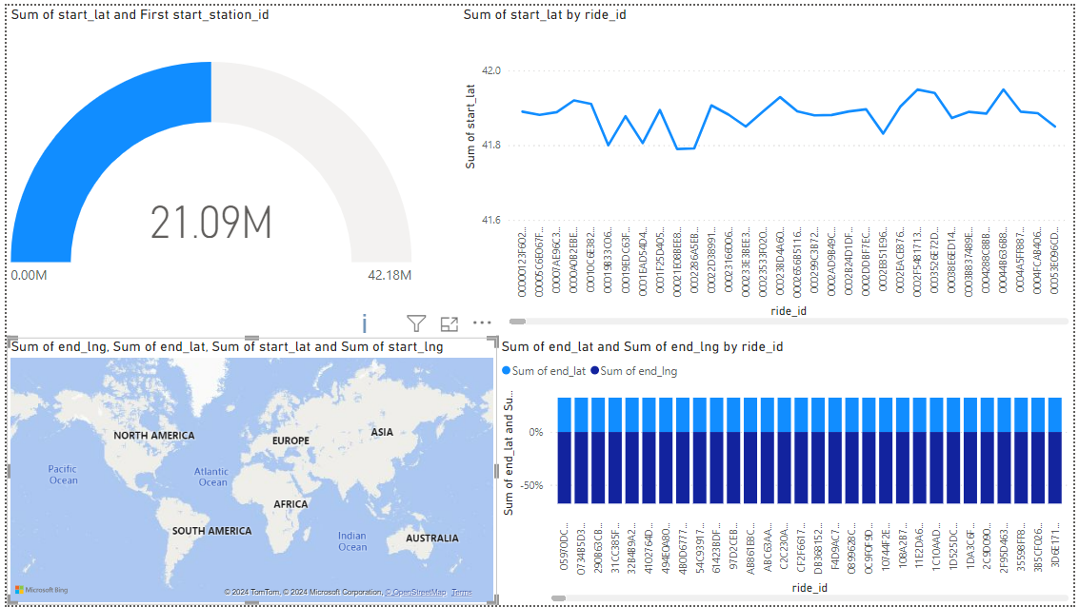
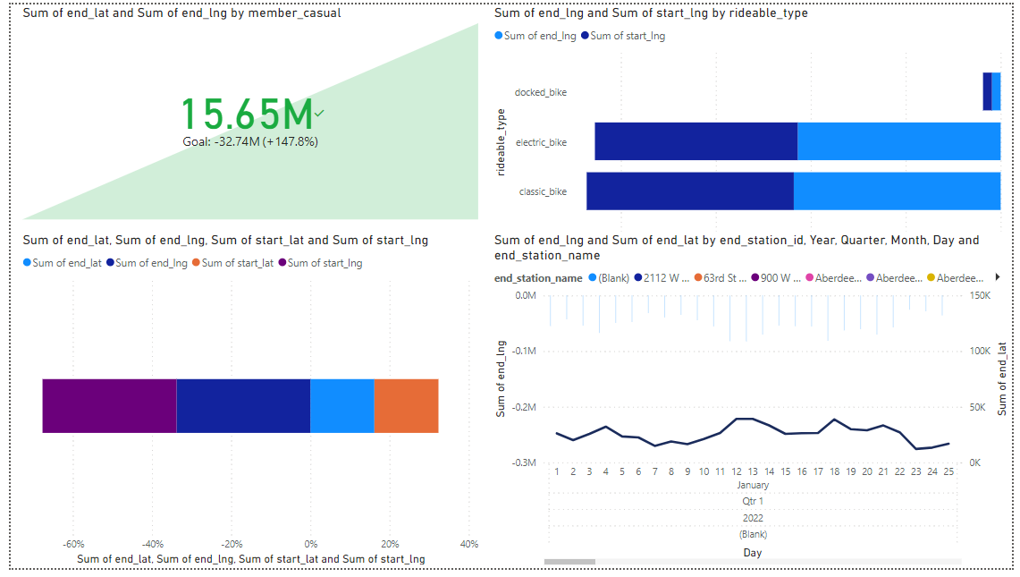
POWERBI : Visualization

Slide 14
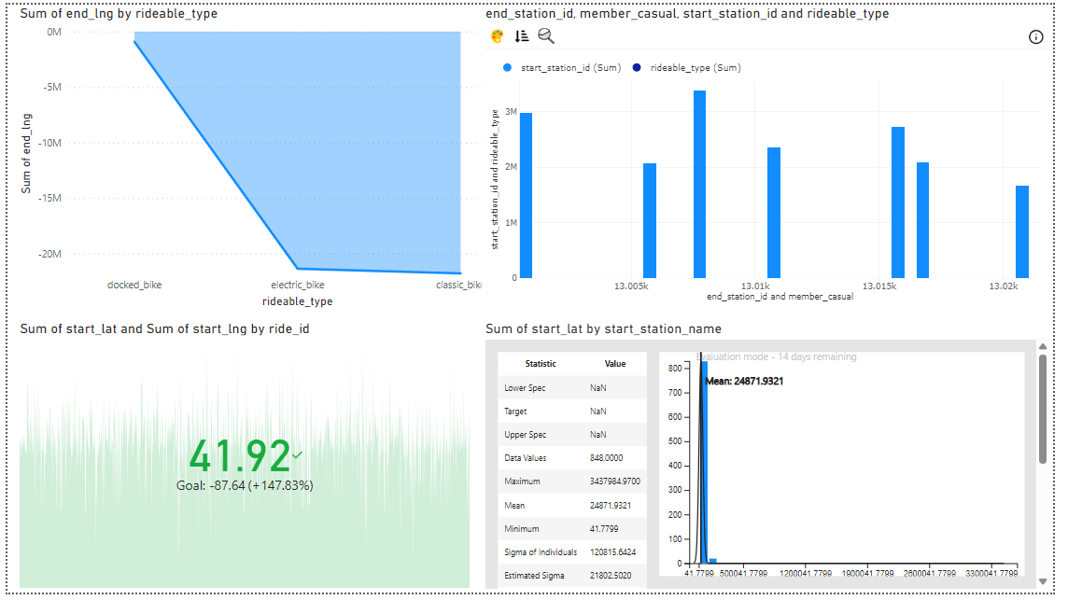
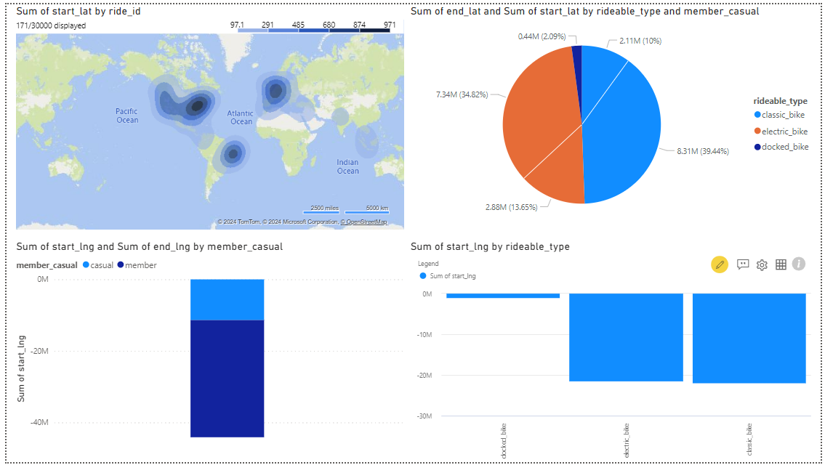
POWERBI : Visualization

Slide 15
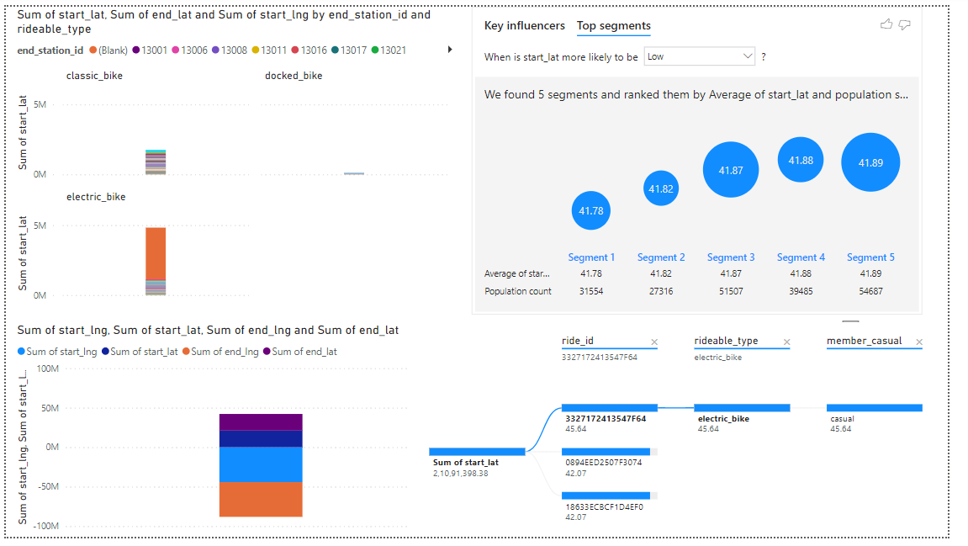
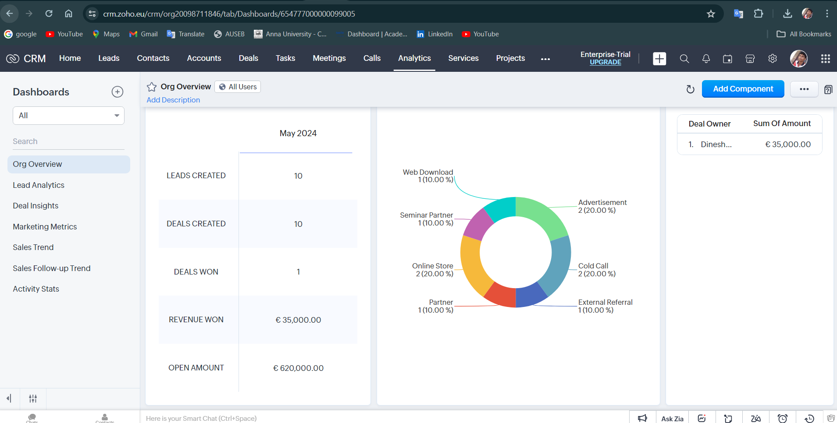
POWERBI : Visualization

Slide 16
Conclusion
Recap key points discussed in the presentation. Emphasize the significance of operational optimization and customer satisfaction for Cyclist's success. Invite further discussion and engagement from the audience.

Slide 17


