Slide 1



Educational Event Management System (EEMS)
Authors:
Saroj Baral
Srenka Bhandari
Anish Acharya
Dipen Pun
May, 2025

Slide 2

CONTENTS
1. Introduction
2. System Features
3. Benefits of the System
4. Diagram

Slide 3

01
Introduction

Slide 4

Overview of the Problem
In educational institutions, managing events can be a complex task involving multiple stakeholders, from students and faculty to administrators and volunteers.

Slide 5

Proposed Solution
To streamline and modernize this process, we propose the development of a Educational Event Management System (EEMS)—a centralized, web-based platform designed to simplify the proposal, approval, registration, participation, and verification processes of academic and extracurricular events.

Slide 6

02
System Features

Slide 7

User Roles
The EEMS will support various user roles including:
•Open users
•Registered students
•Faculty members
•Committee members
•Super administrators

Slide 8

Event Types
The system will facilitate multiple event types such as:
•Open events
•Insitutional events
•Faculty-specific events
•Committee-driven initiatives

Slide 9

Key Features
It will also offer features like:
•QR code-based attendance tracking
•online registration
•automated email certification for certified events
•Paid event integration with popular digital payment systems like eSewa and Khalti for financial transactions

Slide 10

03
Benefits of the System

Slide 11

User Experience
With user-friendly registration, dynamic QR code generation, and role-based access control, this system aims to bring transparency, efficiency, and accountability to school event operations.

Slide 12

Impact on Event Management
By digitizing and automating key components of event management, the proposed solution will enhance user experience, encourage participation, and ensure proper documentation and verification of every event.

Slide 13

04
Diagrams

Slide 14
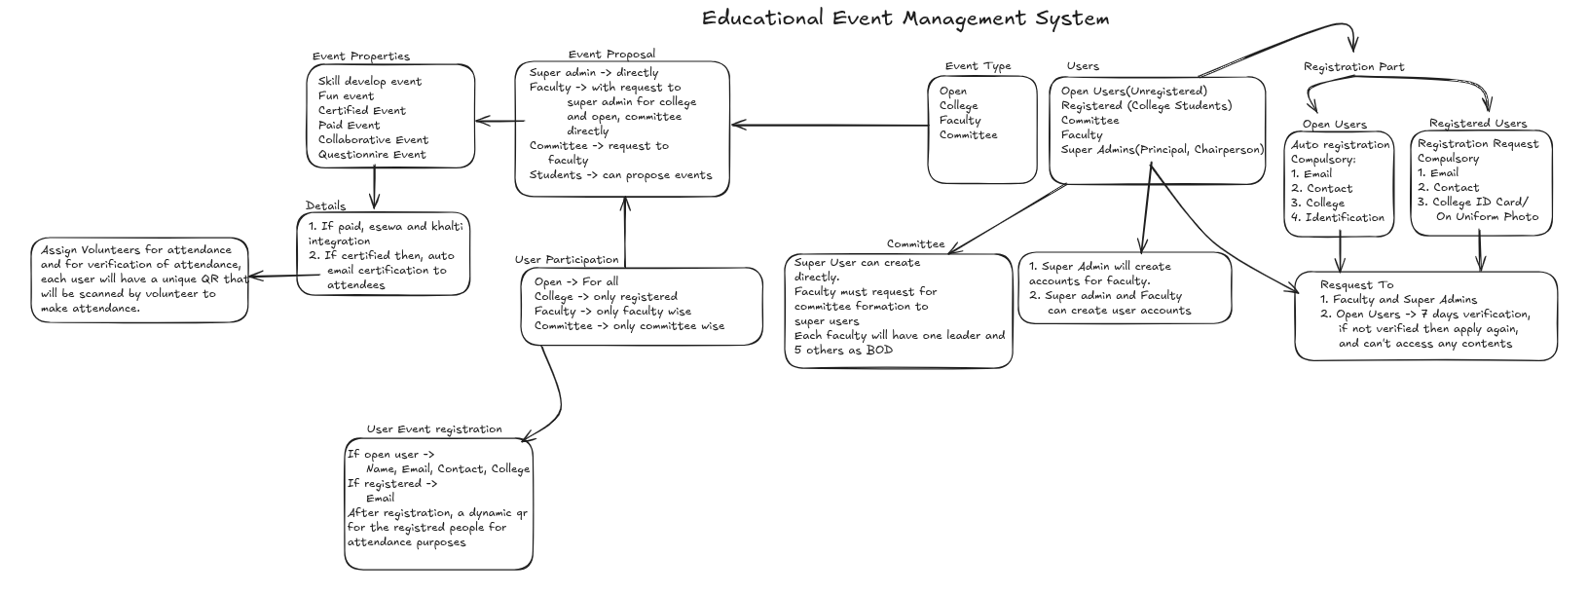

Slide 15

Thank You

