Slide 1

INVENTORY MANAGEMENT SYSTEM
Rajashree K

Slide 2
Introduction
An Inventory Management System is a web-based application used to manage and monitor product stock in real time. It centralizes all product data, including quantities, pricing, and updates, in a structured database. The system replaces manual stock-tracking methods with an online platform, reducing errors and improving the accuracy of inventory records. It helps businesses maintain the right stock levels, avoid shortages, and streamline daily operations.

Slide 3
Objective
To automate the inventory management process.
To support secure role-based login for Admin and Staff.
To enable automatic low-stock alerts for timely restocking.
To reduce manual errors in inventory tracking.
To Improve accuracy in inventory record.
To generate useful inventory reports.

Slide 4
1. Frontend:
HTML5,
CSS3,
JavaScript
Bootstrap 5 (Responsive UI)
2. Backend:
Java
Spring Boot
RestAPIs
Spring Security
JWT
Spring Mail
Direct JDBC for database operations
3. Tools & Testing:
Maven
Postman
JUnit
IntelliJ
4. Database:
MySQL
TECH STACK

Slide 5
System architecture

Slide 6
System Architecture
Presentation Layer (Frontend)
Provides separate interfaces for Admin and Staff
Sends requests to the backend through REST APIs
Controller Layer
Handles all HTTP requests and API routing
Example: Login, Product, Staff, Order controllers
Service Layer
Contains all business logic
Stock calculation, order processing, email triggering
JDBC
Used for database connection and SQL execution
Repository Layer
Performs database operations using JDBC
Insert, update, delete, fetch data
Model Layer
Represents database structure
Example: Staff, Product, Stock models
Security Layer
Controls login security and access rules
Password encryption using Bcrypt
JWT
Used for secure authentication
Token generated after login and validated for every request

Slide 7
MOdules

Slide 8
MODULES
The system is organized into three core modules: Authentication, Admin, and Staff.
Authentication controls secure access to the system.
Admin and Staff modules operate with role-based responsibilities.
1. Authentication Module
Signup
New user registration with name, email, password, and role
Password stored in encrypted form using BCrypt
User can log in after successful signup

Slide 9
MODULES
Login
This module is responsible for user registration and secure login.
User login using email and password
JWT token generated after successful authentication
Role-based redirection:
  Admin → Admin Dashboard
  Staff → Staff Dashboard
Admin login requires an additional Secret Key for second-level verification
1. Authentication Module

Slide 10
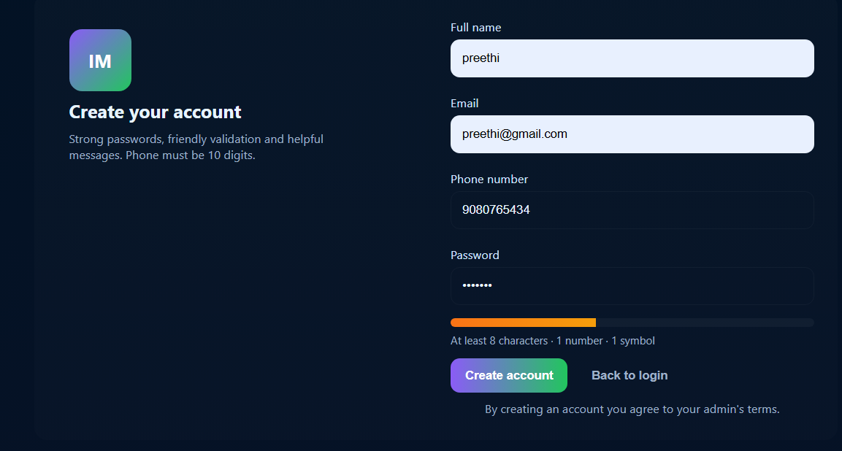
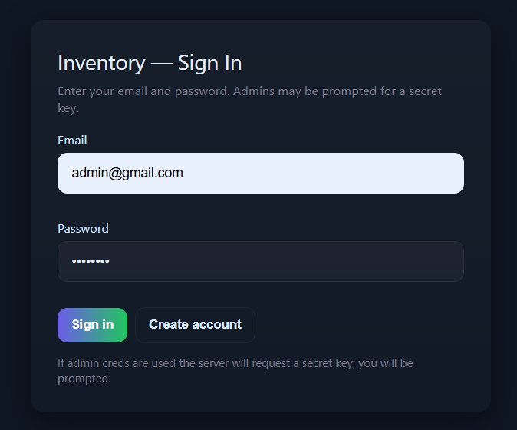
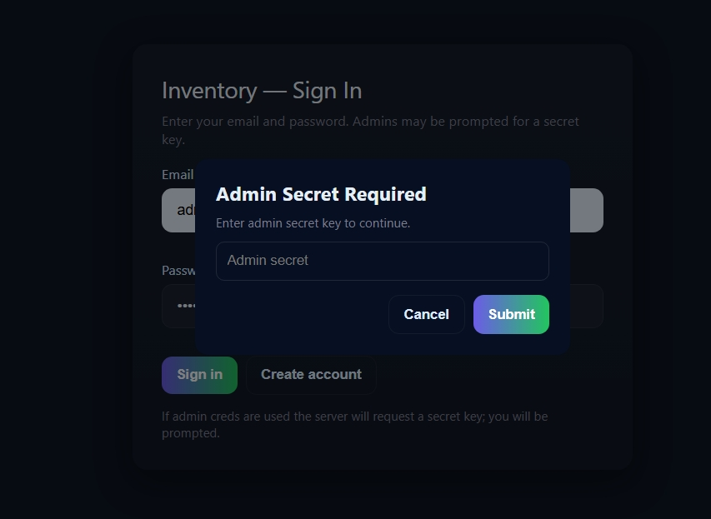

Slide 11
MODULES
Admin Dashboard
Displays real-time counts of total number of products, total staff, total orders for the day, and number of low-stock products.
Product Management
Supports adding new products, updating existing products, deleting products, and monitoring live stock levels.
Staff Management
Allows adding new staff users, viewing the complete staff list, and removing staff users from the system.
Report Management
Enables downloading inventory and system reports in Excel files for record keeping.
2. Admin Module

Slide 12
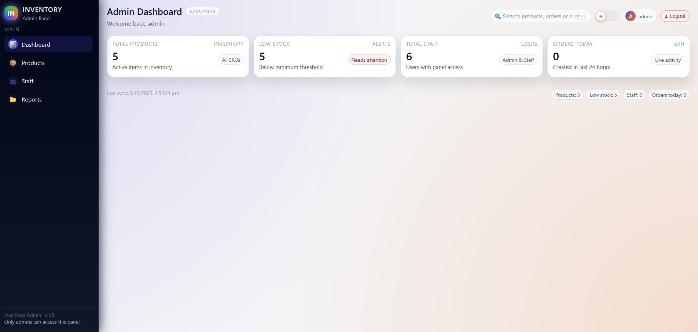
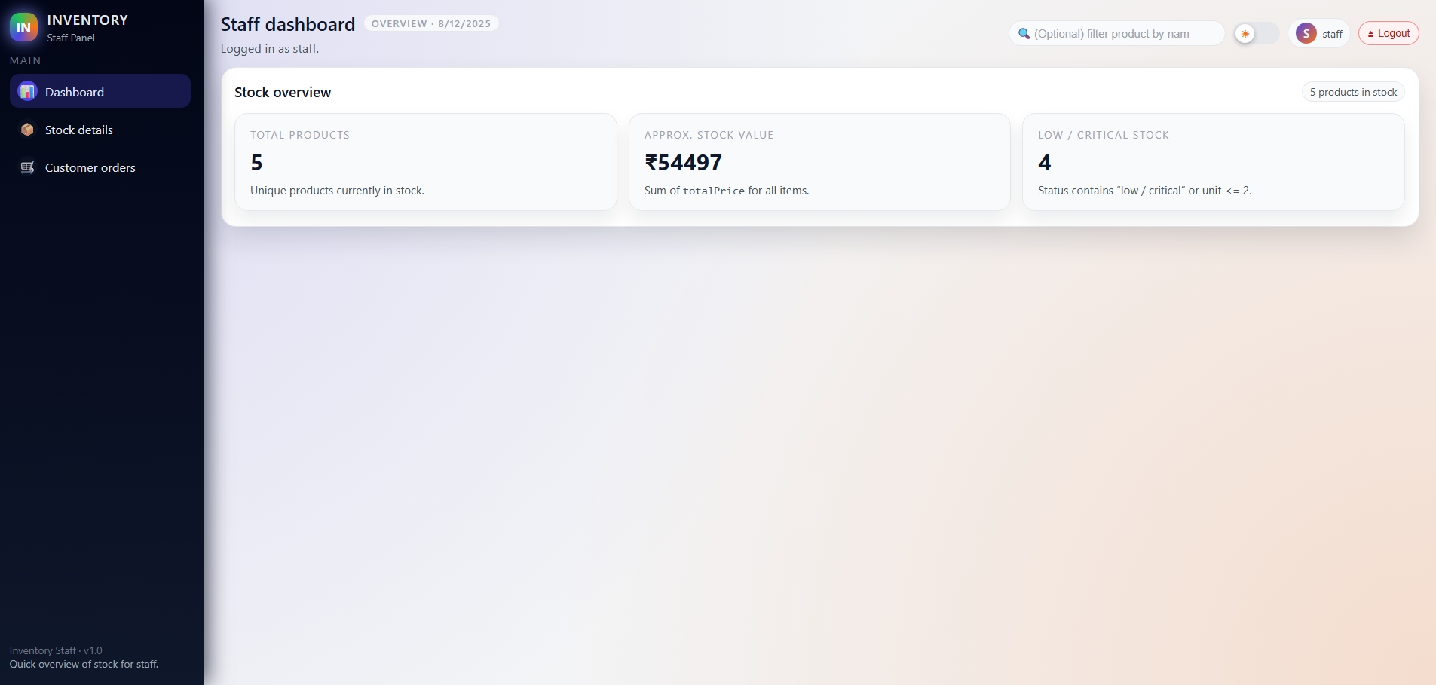

Slide 13
MODULES
Admin Dashboard
Displays real-time counts of total number of products, total staff, total orders for the day, and number of low-stock products.
Product Management
Supports adding new products, updating existing products, deleting products, and monitoring live stock levels.
Staff Management
Allows adding new staff users, viewing the complete staff list, and removing staff users from the system.
Report Management
Enables downloading inventory and system reports in Excel files for external use and record keeping.
2. Admin Module

Slide 14
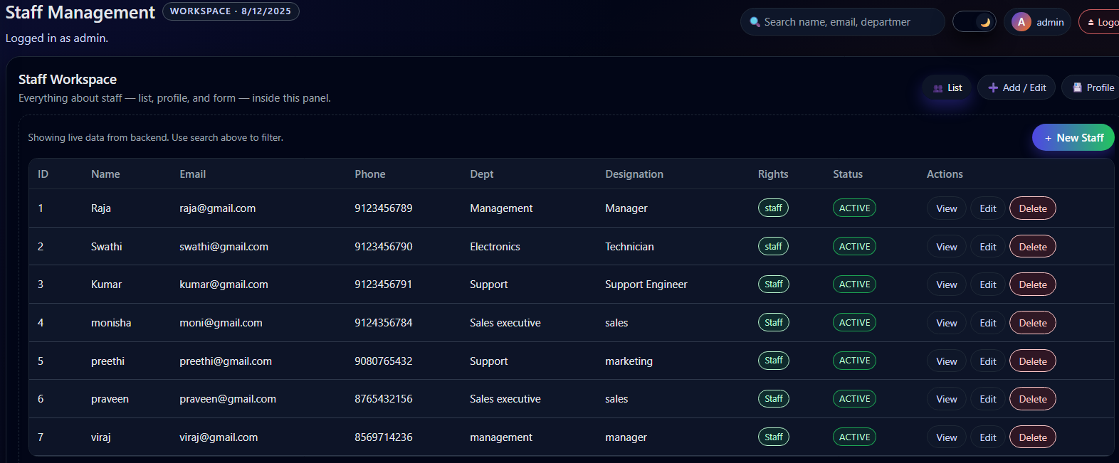
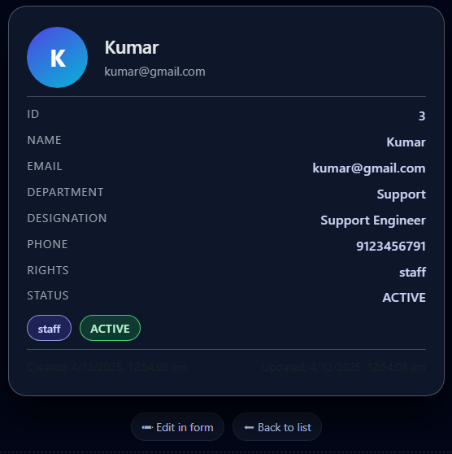
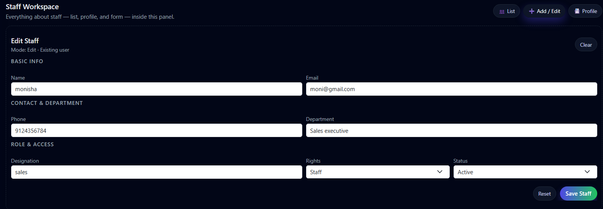
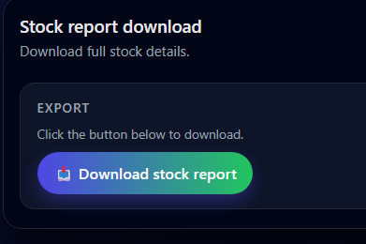

Slide 15
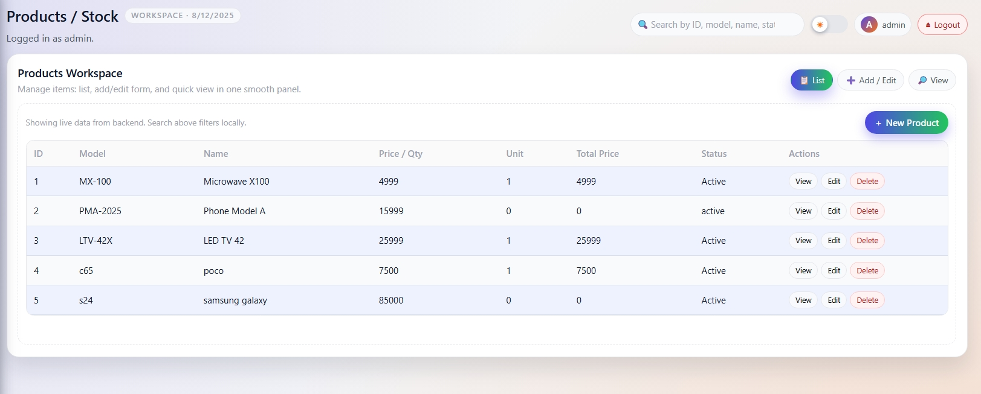
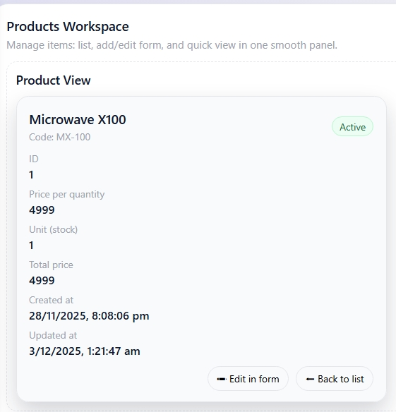
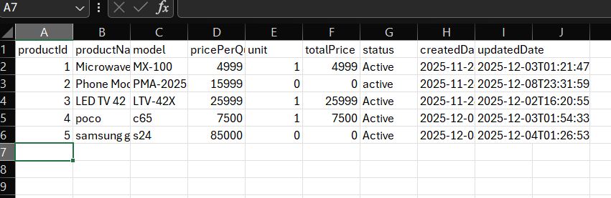
Datasheets are generated from backend using Apache POI (Excel) and CSV logic.
Files are returned as downloadable API responses to the Admin module.

Slide 16
MODULES
3. Staff Module
This module is designed for operational-level usage.
Staff Dashboard
Displays staff-specific activity and summary
View Products
View all available products
Check current stock before placing orders
Order for Customer
Place customer orders
Ordered quantity deducted from stock automatically
Order details saved in the database
Order confirmation email triggered
3. Staff Module

Slide 17
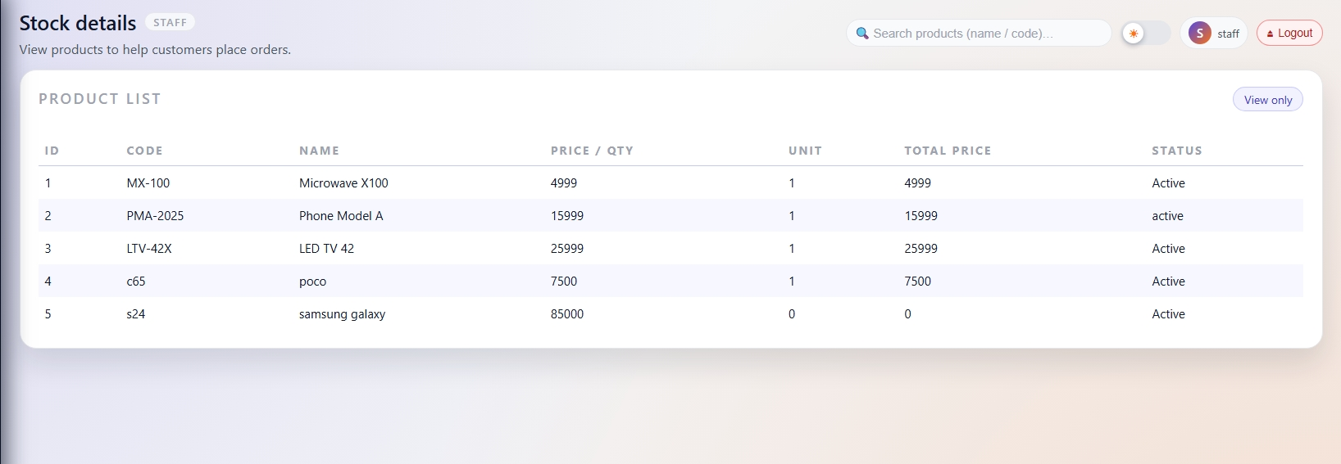
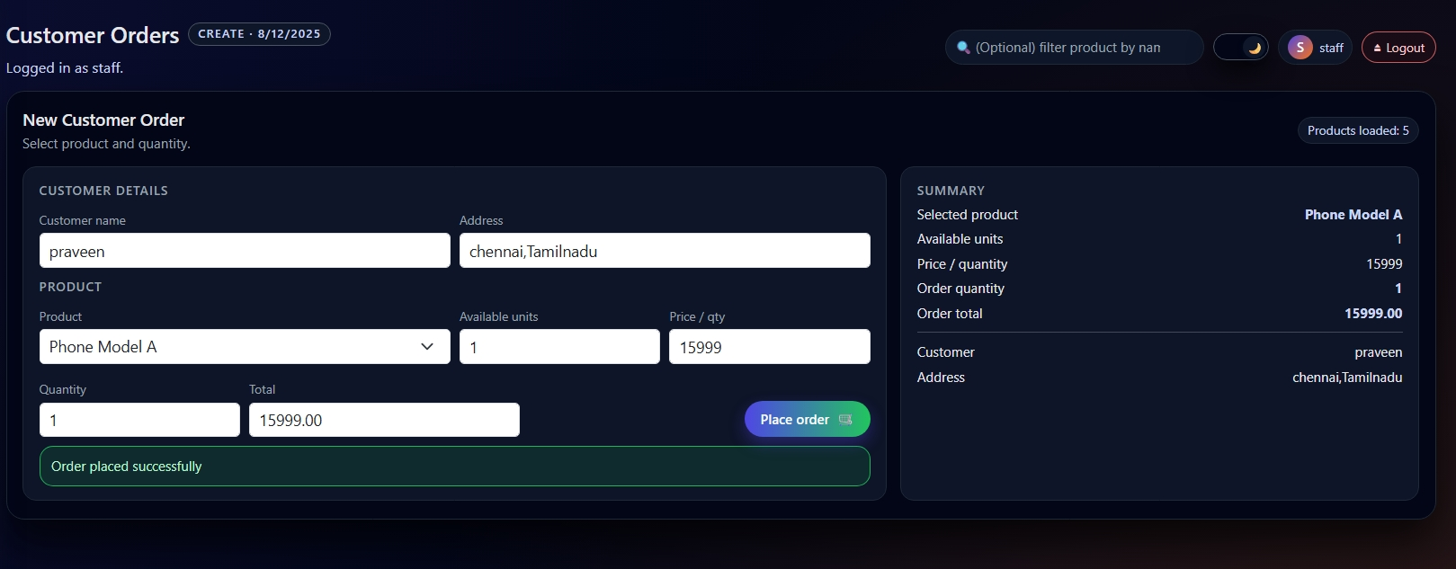

Slide 18
MODULES
4. Email Notification Module
Low-stock alert email sent to Admin
Order placed confirmation email sent after customer order
Implemented using Spring Mail (JavaMailSender, SMTP)
Triggered automatically from the Service layer
3. Email notification Module

Slide 19
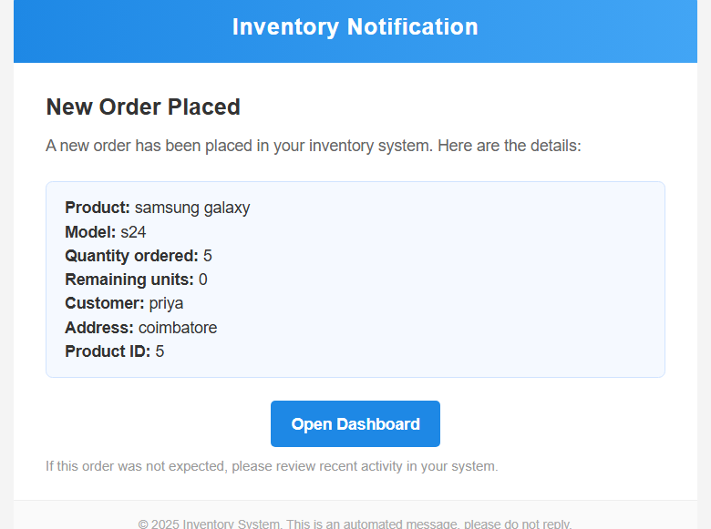
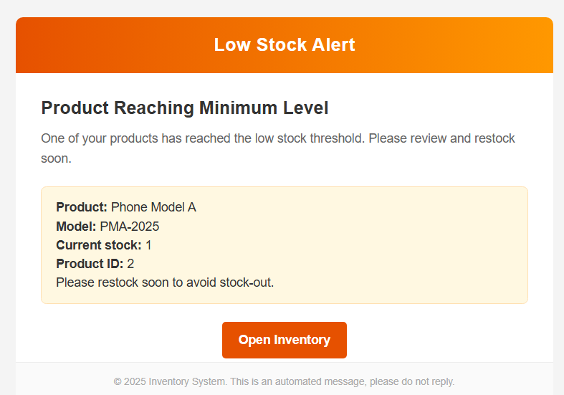
Order placed
Low stock alert

Slide 20
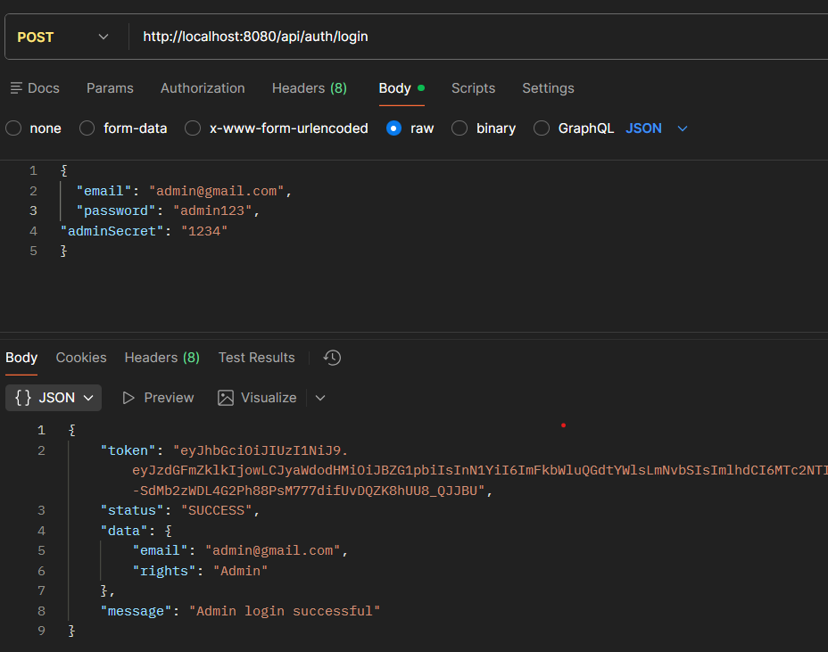
Security and Authorization
Implemented JWT-based authentication for secure, stateless API access
On successful login, a JWT token is generated and returned to the client
The token contains user identity and role (Admin / Staff)
JWT token is sent in the Authorization header as a Bearer token for all secured APIs
Backend validates the token before allowing access to protected resources
Added Admin Secret Key as a second-level authentication (2-factor style)
Admin access is granted only when email, password, and secret key are all valid
Passwords are secured using BCrypt encryption

Slide 21
Database design

Slide 22
DATABASE
The application uses MySQL as the relational database for persistent storage. The database layer is implemented using direct JDBC, and all database operations are performed using manually written SQL queries. The database schema is intentionally kept simple with only two core tables to ensure fast access, easy maintenance, and high performance.
DATABASE SCHEMA OVERVIEW
The system consists of two main tables:
Staff Table – Stores all authentication and user-related data
Inventory Table – Stores all product and stock-related data
Both tables are created and managed directly from the backend using SQL.
DATABASE OPERATIONS
All database operations are implemented using manual SQL queries through JDBC, including:
Database and table creation,Insert ,Update ,Delete ,Select operations
Uniqueness checks for email and phone number
Prepared Statements are used to prevent SQL injection and improve security.

Slide 23
STAFF TABLE
INVENTORY TABLE
The Staff table stores all user and authentication-related information.
Staff ID
Name
Designation
Department
Rights (Admin / Staff)
Email
Phone Number
Password (Encrypted)
Status (Active / Inactive)
Created Date (Timestamp)
Updated Date (Timestamp)
This table is used for authentication, role control, and staff management.
The Inventory table stores all product and stock-related information.
Product ID
Product Name
Model
Price per Quantity
Unit (Available Stock)
Total Price
Status
Created Date (Timestamp)
Updated Date (Timestamp)
This table is used for product management, stock tracking, low stock detection, and report generation.

Slide 24
REST API METHODS
POST: Login, signup, add staff, add inventory, place orders
GET: Fetch staff, inventory, product details, download Excel/CSV
PUT: Update staff details and inventory stock
DELETE: Remove staff users and inventory products
All requests use JSON and are secured using JWT authentication with database operations handled through manual JDBC SQL.
For testing ,It is executed by postman
REST API METHODS

Slide 25
JUnit Testing
JUnit is used for automated testing of backend functionality
Implemented 65+ test cases across:
  Controller Layer
  Service Layer
  Exception Handling
  Validation Logic
Tested full CRUD operations for Staff and Inventory
Covered success cases, failure cases, and edge cases
Used in-memory repositories to avoid real database dependency
Ensured correct API responses, validation errors, and exception behavior
JUNIT TESTING

Slide 26
Validations

Slide 27
Validations
Server-side validation implemented for Staff and Inventory modules
Prevents null, empty, and invalid input values
Annotations used:
  @NotNull – prevents null values
  @NotBlank – prevents empty strings
  @Email – validates email format
  @Pattern – restricts format (phone, status, etc.)
  @Size – controls input length
Applied during login, signup, staff, and inventory operations
Validation errors handled using Global Exception Handler
Ensures data integrity, API stability, and secure processing
Validation is enforced before database operations, ensuring only verified data reaches the repository layer.
Helps prevent runtime exceptions and data corruption caused by invalid user input.

Slide 28
THANK YOU

