Slide 1

Microgoals: Secure Goal Management Backend API
Development Team: Shree P, Mohammad Ezzath A, Deepak P, Gowtham P, Kameshwaran P
Institution: Arulmigu Kapaleeswarar Arts and Science College

Slide 2

Introduction to Microgoals
Microgoals is a sophisticated backend architecture designed to streamline objective setting. By focusing on granular, manageable tasks, the platform empowers users to break down complex ambitions into actionable data points, ensuring steady progress and measurable outcomes in any professional or academic environment.

Slide 3


The Importance of Goal Management
Clarity
Define clear, measurable objectives
Accountability
Assign owners and review progress
Consistent Progress
Track incremental wins regularly

Slide 4

Purpose of the Project
This project aims to build a robust, high-performance API that serves as the central nervous system for goal tracking. Our core objectives include:
Standardizing goal tracking processes.
Providing seamless integration for front-end applications.
Ensuring data integrity and security for sensitive user progress metrics.

Slide 5
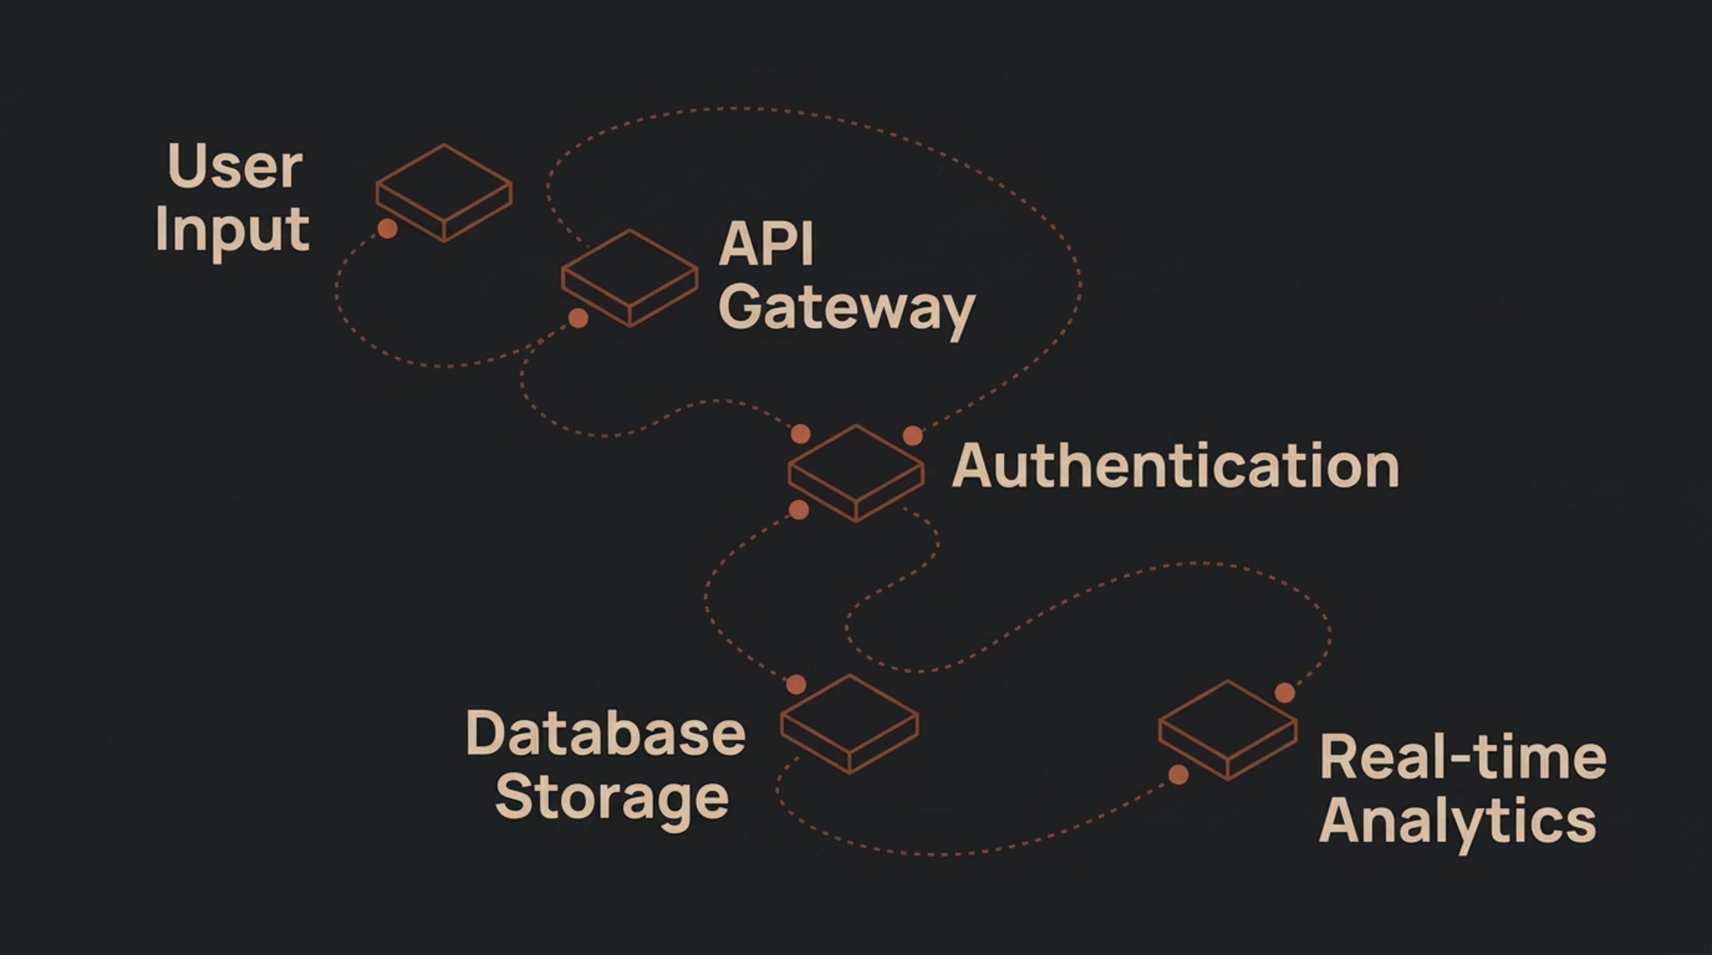

System Architecture Flow
The Microgoals system operates through a modular API structure. Users submit goals which are validated by our secure gateway, processed through business logic layers, and stored in a high-availability database to provide real-time updates.

Slide 6
Core System Functions
Goal Creation
Progress Tracking
Analytics
Simplified CRUD operations for defining new objectives.
Real-time updates and status synchronization.
Automated reporting on milestone completion rates.

Slide 7

Security Features
Security is built into our core, not added as an afterthought. We utilize:
JWT-based authentication tokens
Role-based access control (RBAC)
Encrypted data at rest and in transit
Rate limiting to prevent API abuse

Slide 8
Backend API Overview
GET /api/v1/goals POST /api/v1/goals/create PUT /api/v1/goals/:id DELETE /api/v1/goals/:id
Built with scalability in mind, our RESTful API ensures low latency and high concurrency. The infrastructure leverages modern frameworks to handle high-volume requests efficiently while maintaining strict documentation standards for easy developer integration.

Slide 9
Advantages of the System
High Performance
End-to-End Security
Developer Friendly
Optimized for rapid data retrieval and minimal latency.
Defense-in-depth approach protecting user data.
Intuitive endpoints and clean, documented code.

Slide 10

Conclusion
Microgoals represents a significant step toward smarter, more secure productivity management. By providing a reliable backend foundation, we enable developers to create applications that truly help users achieve their potential. Thank you for your time and interest in our academic project.

