Slide 1

Fabricated News Prediction System
Name: Shrilakshmi A S
Department: Computer Science and Engineering
Topic: Fake News Detection using AI/ML

Slide 2

Introduction
The rapid spread of misinformation on digital platforms has become a major problem.
It is difficult for people to distinguish between real and fake news.
Fake news spreads quickly through social media and online websites.

Slide 3
Problem Statement
Fake news is designed to be sensational and misleading.
It often uses specific linguistic patterns to attract readers.
Identifying fake news manually is difficult.

Slide 4
Objective
To develop a Machine Learning system to detect fake news.
The system analyzes text features and metadata.
It automatically classifies news as Real or Fake.

Slide 5
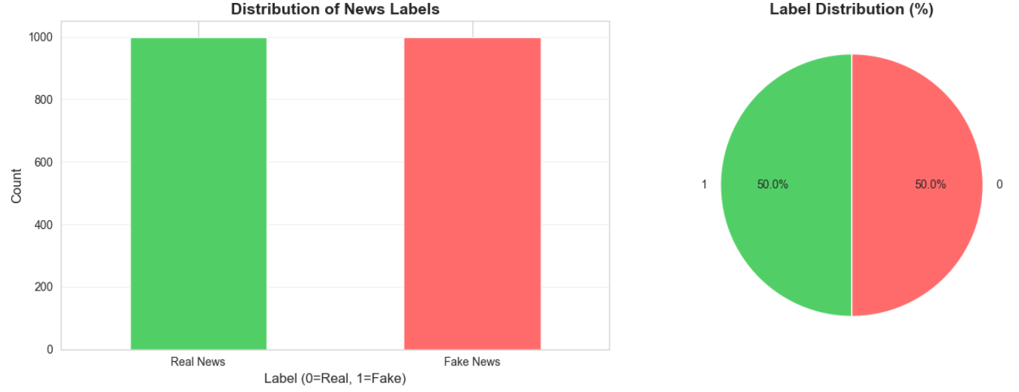
Dataset
Dataset contains 2000 news articles.
Includes both real and fabricated news samples.
Used for training and testing the ML models.

Slide 6
Data Pre-processing
Text converted to lowercase.
Special characters removed.
Cleaned text improves model performance.

Slide 7
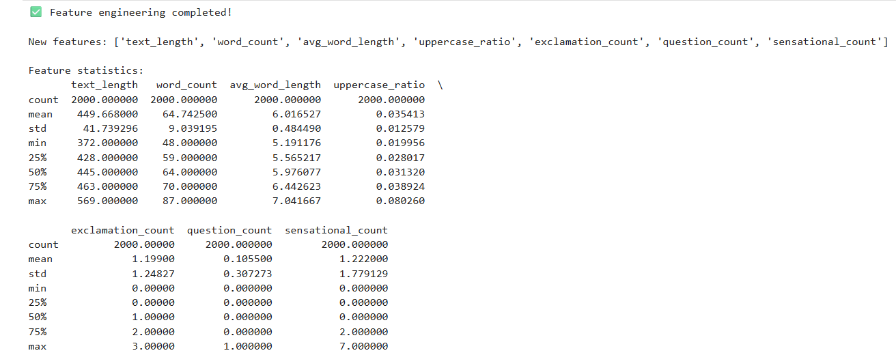
Feature Engineering
Custom features were extracted to identify fake news patterns:
Exclamation Count – counts “!” marks
Sensational Word Count – words like Shocking, Urgent
Uppercase Ratio – detects excessive capital letters

Slide 8
Vectorization
Used TF-IDF (Term Frequency – Inverse Document Frequency).
Converts text data into numerical vectors.
These vectors are used by Machine Learning models.

Slide 9
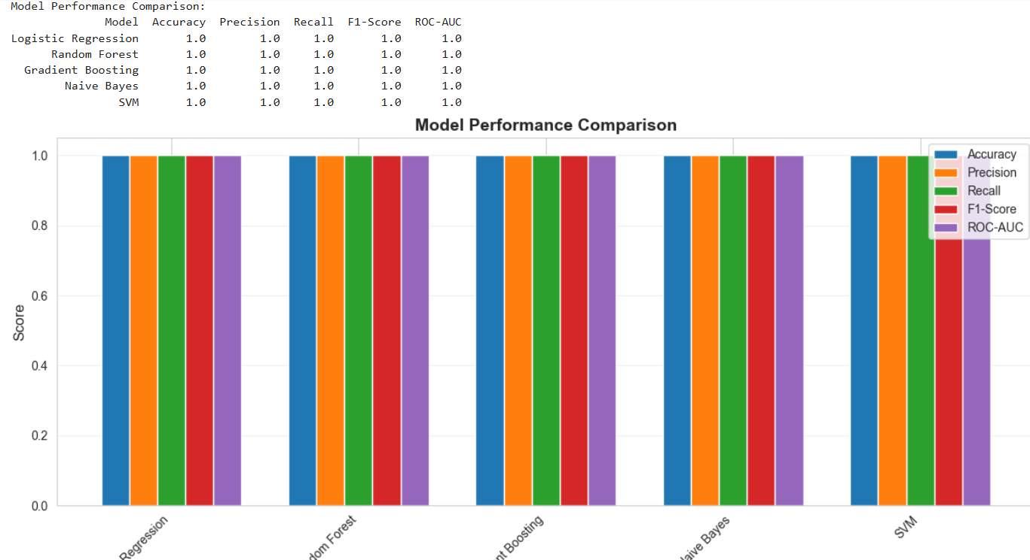
Model Comparison
Machine Learning models used:
Logistic Regression
Random Forest
Support Vector Machine (SVM)

Slide 10
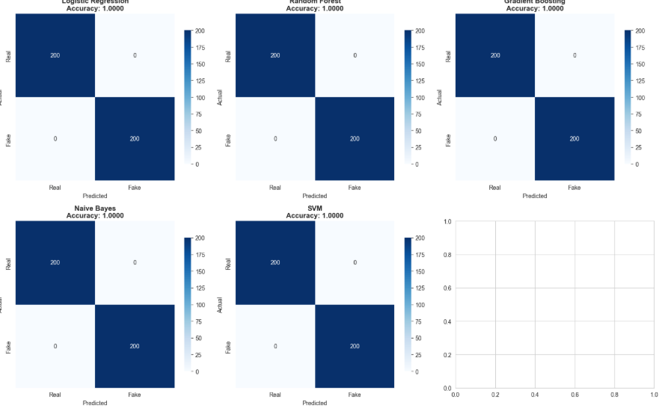
Results
Logistic Regression achieved highest accuracy (near 100%).
Model successfully classified real and fake news.

Slide 11
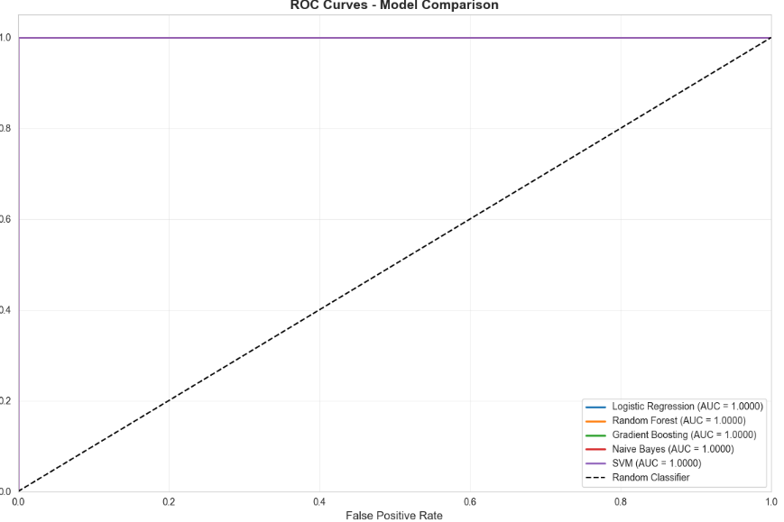
ROC Curve
ROC curve shows model performance and classification ability.
Confirms the high prediction accuracy of the system.

Slide 12

Conclusion
The system successfully detects fabricated news.
It uses linguistic features and machine learning techniques.
Helps in reducing the spread of misinformation.

Slide 13


