Slide 1

Project Title -
Seasonal Agriculture Performance Analysis
Student Name- College Name-
SHREE SINHA
GALGOTIAS UNIVERSITY
AICTE STU ID :
STU6a508e91047b61783664273

Slide 2

PROBLEM STATEMENT
Agricultural performance changes with seasons due to variations in rainfall, temperature, soil conditions, water usage, fertilizers, and other factors.
However, it can be difficult to identify which seasons and crops perform better and what factors affect crop yield.
“The project aims to analyze agricultural data across different seasons to identify patterns, compare crop performance, study resource efficiency, and understand the factors influencing agricultural productivity.’’

Slide 3
Project Description This project uses agricultural data to analyze crop yield, production, water usage, water efficiency, environmental conditions, nutrients, irrigation methods, and economic performance across different seasons. The data is cleaned and explored using Python, followed by statistical analysis and visualizations. Seasonal and crop-wise comparisons are performed to identify the best-performing conditions and important relationships between agricultural factors and yield. The project ultimately provides data-driven insights and recommendations that can help improve agricultural productivity and resource utilization.

Slide 4

WHO ARE THE END USERS?
The main end users can be:
👨‍🌾 Farmers – to understand suitable seasons, crops, and resource usage.
🌾 Agricultural planners – to plan crops and farming activities.
🏛️ Government & agricultural departments – for agricultural policies and planning.
🔬 Agricultural researchers – to study seasonal patterns and crop performance.
💧 Water/resource managers – to understand water usage and efficiency.
💼 Agribusinesses – to make better production and investment decisions.

Slide 5

Technology Used
.
Technology | Purpose
Python | Data analysis and processing
Pandas | Data cleaning and manipulation
NumPy | Numerical calculations
Matplotlib | Data visualization
Seaborn | Statistical graphs and charts
SciPy | Statistical analysis and ANOVA
Jupyter Notebook | Project development and documentation
GitHub | Project version control and sharing
CSV Dataset | Data storage

Slide 6
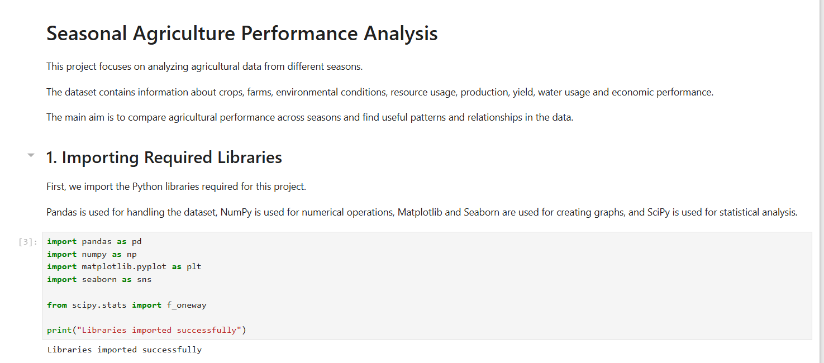
RESULTS

Slide 7
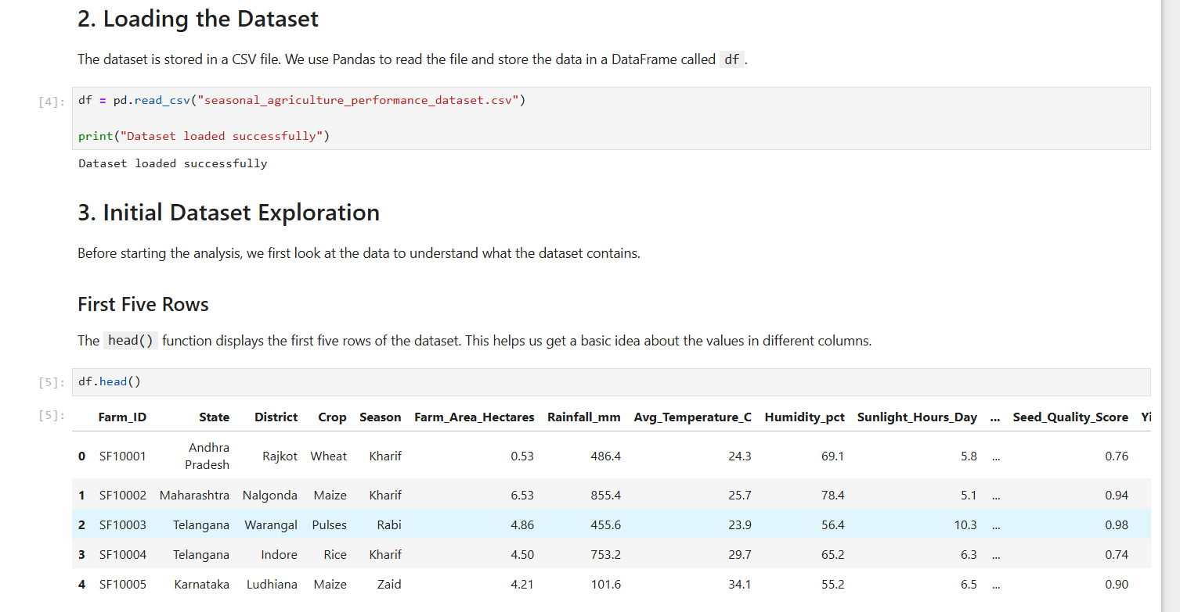
RESULTS
[Add screen shots of your code ]

Slide 8
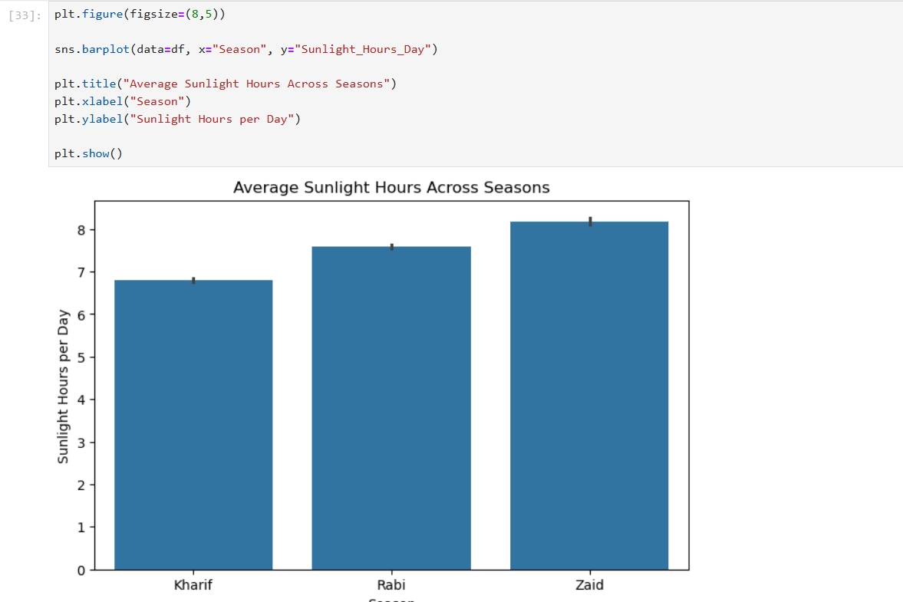
RESULTS
[Add screen shots of your code ]

Slide 9
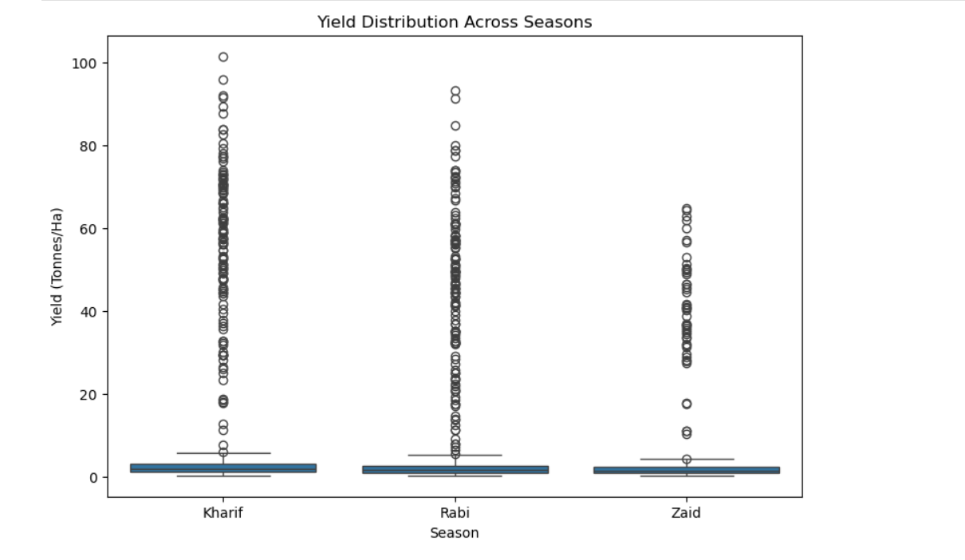
RESULTS
[Add screen shots of your code ]

Slide 10
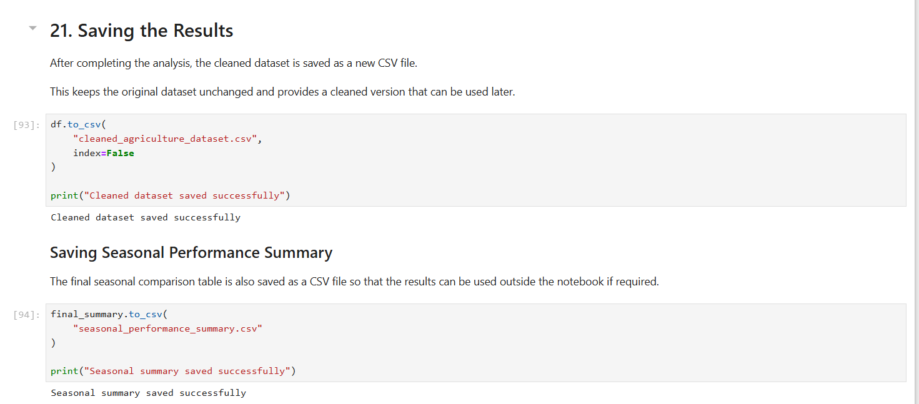
RESULTS
[Add screen shots of your code ]

Slide 11
Future scope
The project can be expanded in the future by:
1.Adding real-time weather and agricultural data.
2.Developing a crop recommendation system.
3.Using machine learning to predict crop yield.
4.Predicting water requirements for different crops.
5.Developing a farmer-friendly web or mobile application.
6.Adding soil and satellite data for more accurate analysis.
7.Creating an early warning system for crop diseases and unfavorable conditions.
8.Providing location-specific recommendations based on state, district, soil, and weather conditions.
9.Using historical data to predict future seasonal agricultural performance.

Slide 12
GitHub Link
The Github Repo Link : GitHub Repository

Slide 13
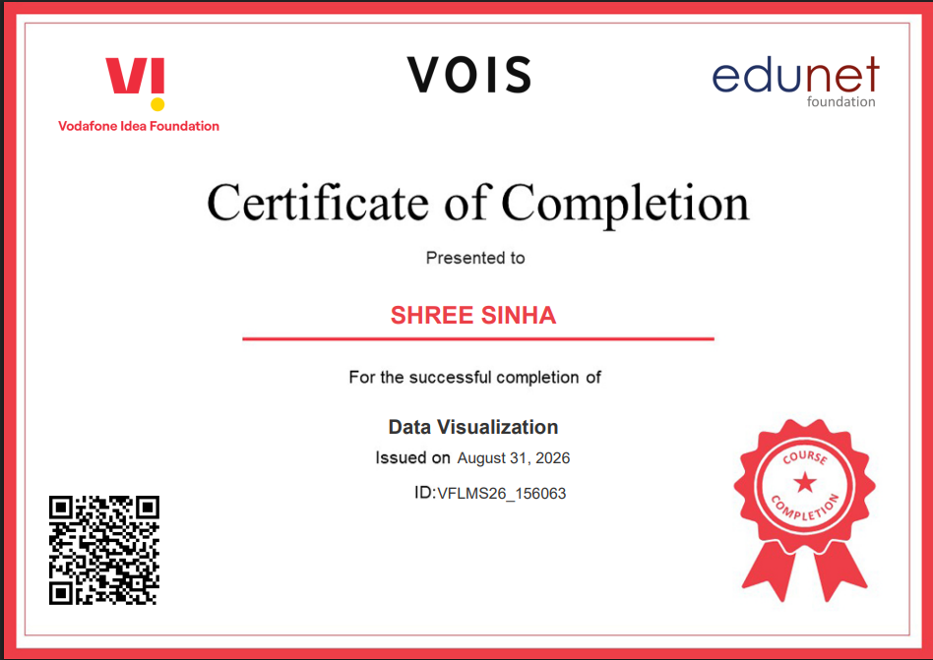
VOIS Course completion certificate - Course name- Data Visualization

Slide 14
Thank you
.
.
.

