Slide 1
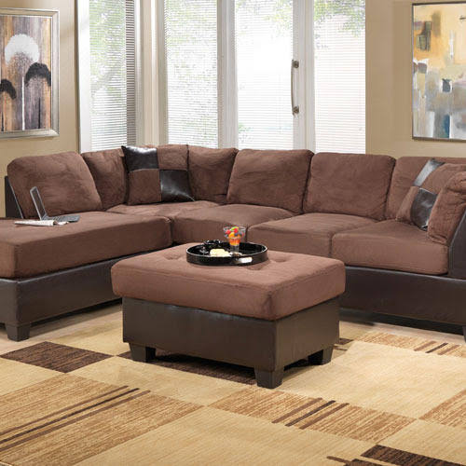
.
Get this
Amazing Couch
@ just Rs.30,000

