Slide 1
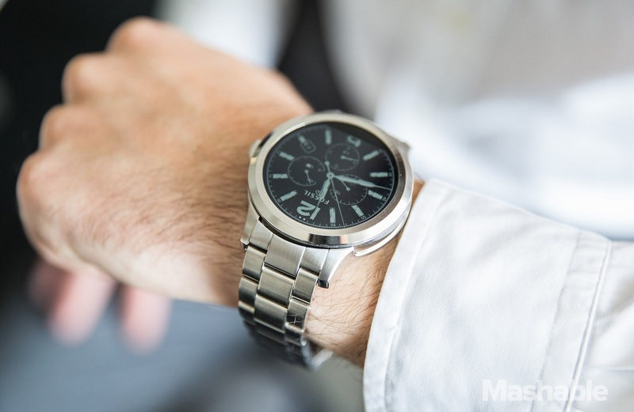
Get Fossil Watch
@ just Rs.17,000

