Slide 1


DATA VISUALISATION · FINAL PROJECT
Chess at Scale
A Lichess Analysis of 6.24 Million Games
Interactive dashboard and notebook analysis — ratings, openings, time controls, outcomes, and play patterns

Slide 2

THE DATASET
Project Overview
6.24M
1741
49.67%
finished Lichess games analysed
average player Elo rating
of games won by White
3.83%
Sicilian
12
of games end in a draw
most common opening family
analysis questions answered
Chess at Scale · Lichess Analysis
2

Slide 3
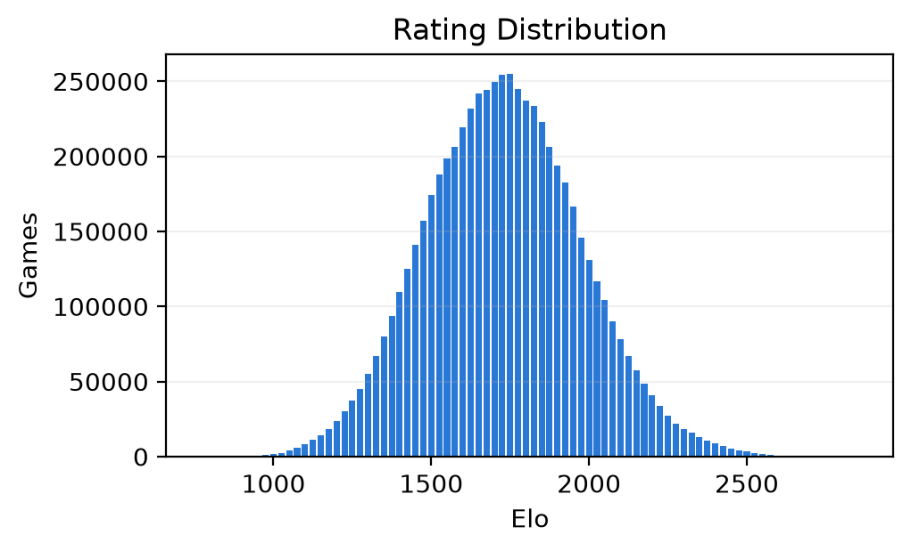
RATINGS
Rating Distribution
Ratings are concentrated in the 1200–2200 range.
The distribution shows strong participation from intermediate and advanced players.
The dashboard uses this view to compare player skill bands.
Chess at Scale · Lichess Analysis
3

Slide 4
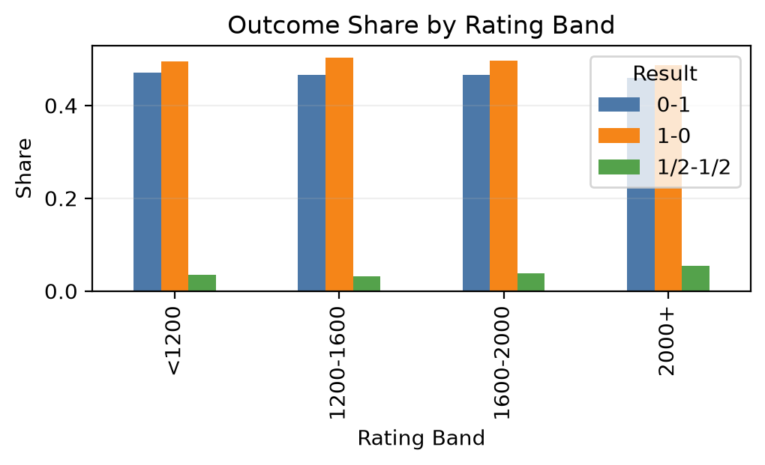
OUTCOMES
Outcome Shares by Rating Band
White wins are slightly more common overall.
Higher-rated players show more decisive outcomes and fewer draws.
Stronger players convert their advantage more often.
Chess at Scale · Lichess Analysis
4

Slide 5
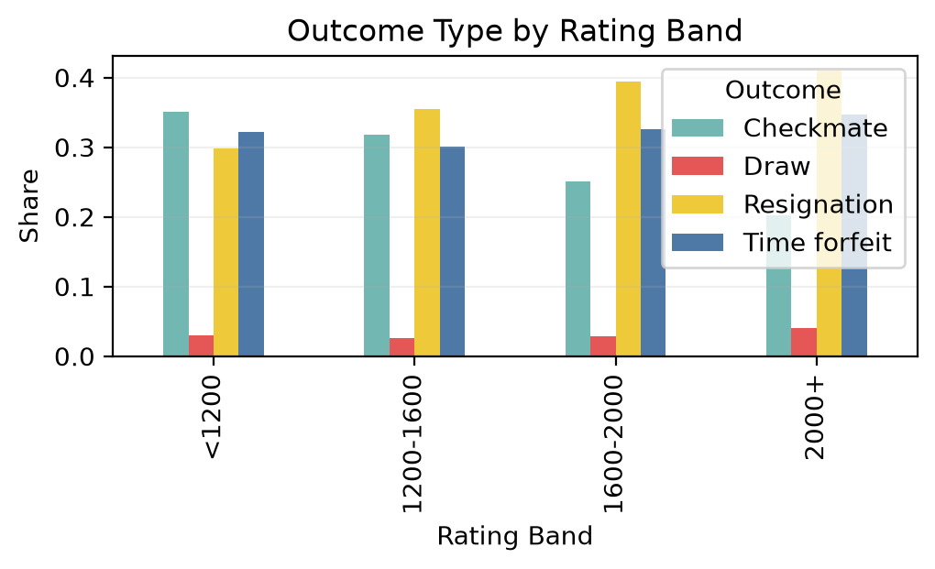
OUTCOMES
How Games End
Resignation and checkmate dominate the result types.
Time forfeit is common in lower-rated groups.
Lower-rated games are often decided by practical errors rather than pure tactical endings.
Chess at Scale · Lichess Analysis
5

Slide 6
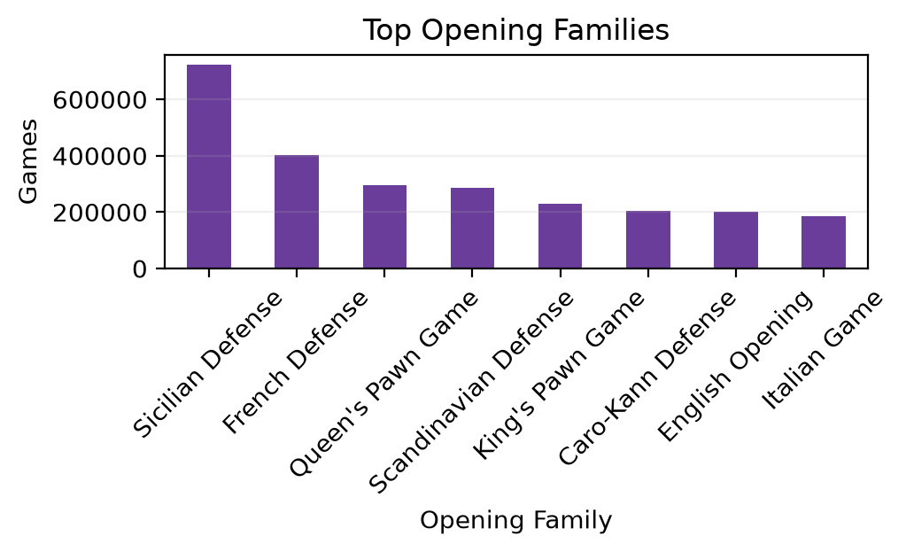
OPENINGS
Opening Preferences
The Sicilian Defense is the most prominent opening in the dataset.
Opening choice changes by rating band, suggesting different strategic preferences.
Openings are a strong lens for comparing player styles.
Chess at Scale · Lichess Analysis
6

Slide 7
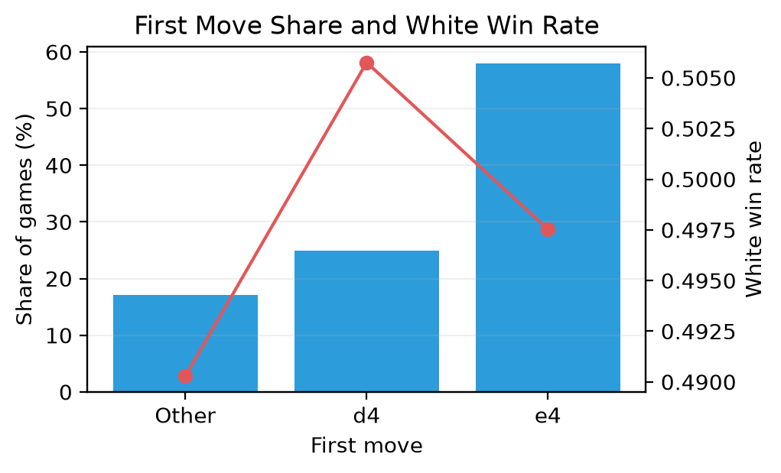
OPENINGS
First-Move Choices
1.e4 is the most common first move — about 58% of games.
1.d4 is next most common and shows a slightly higher White win rate.
This makes the opening phase a key part of the interactive dashboard.
Chess at Scale · Lichess Analysis
7

Slide 8
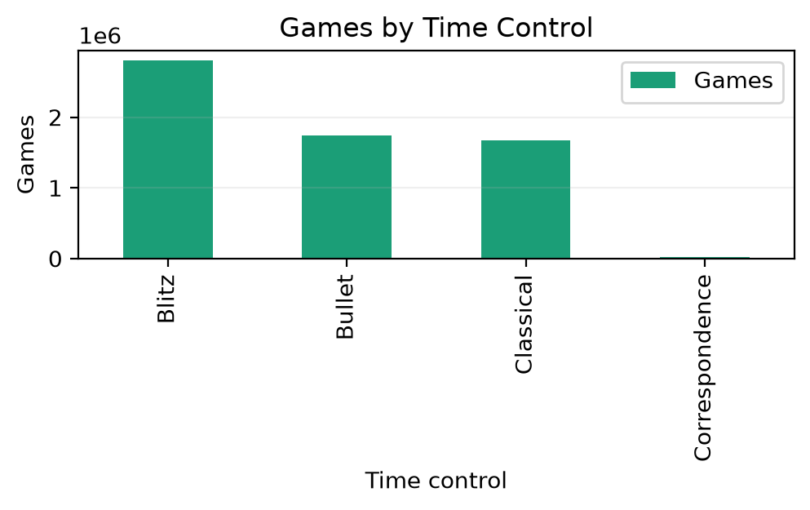
TIME CONTROLS
Time Controls
Blitz is the most common format, followed by Bullet and Classical.
Correspondence is far less frequent but still part of the dataset.
Rapid online chess dominates the sample.
Chess at Scale · Lichess Analysis
8

Slide 9
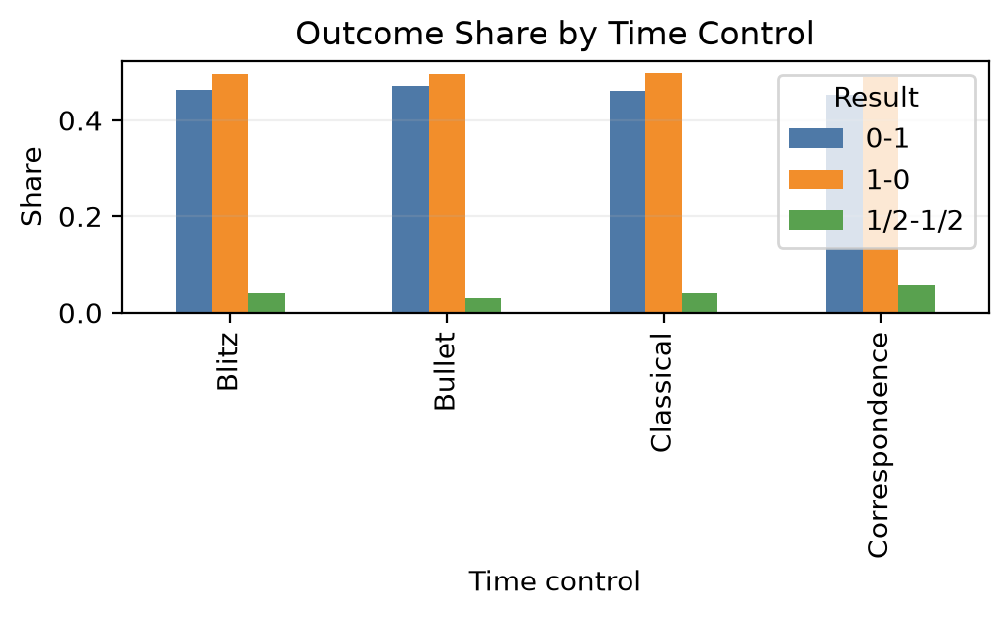
TIME CONTROLS
Fast Games, Decisive Results
Faster formats produce a slightly higher share of decisive outcomes.
Bullet and Blitz show less draw tendency than slower formats.
Pace clearly shapes the style of play.
Chess at Scale · Lichess Analysis
9

Slide 10
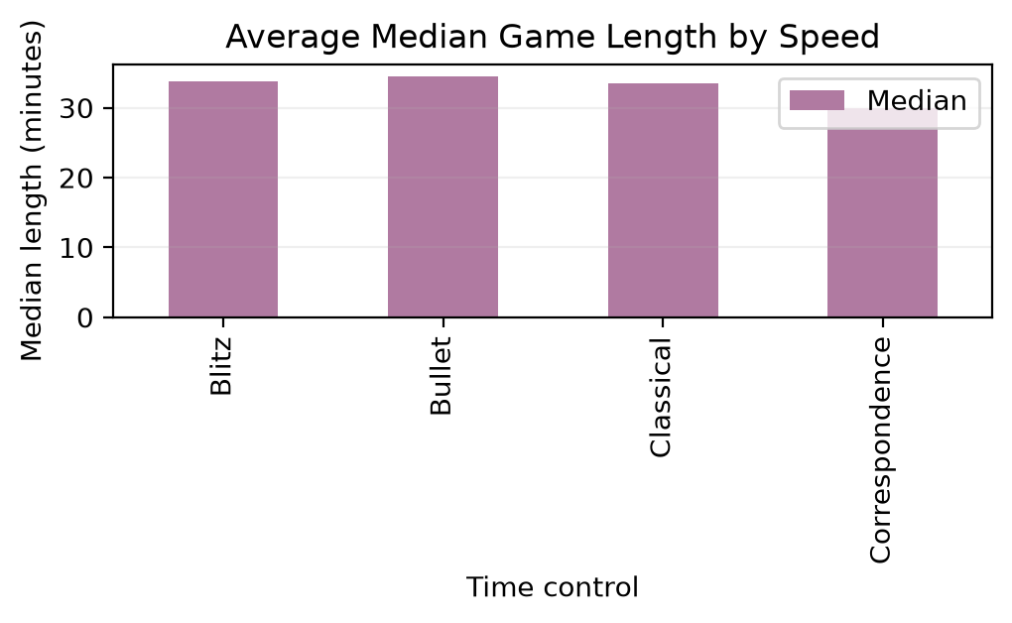
PACE
Game Length and Pace
Median game length rises as the format becomes slower.
Higher-rated players tend to play longer games within the same speed category.
Skill and time control together shape game structure.
Chess at Scale · Lichess Analysis
10

Slide 11
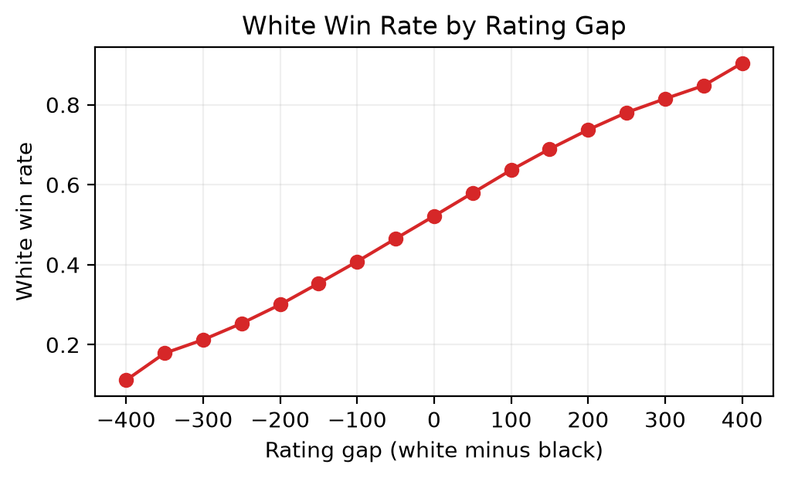
RATINGS
Rating Gap and Win Probability
As the rating advantage grows, the stronger side wins more often.
Rating is a strong predictor of game outcome.
The dashboard makes this relationship easy to explore interactively.
Chess at Scale · Lichess Analysis
11

Slide 12
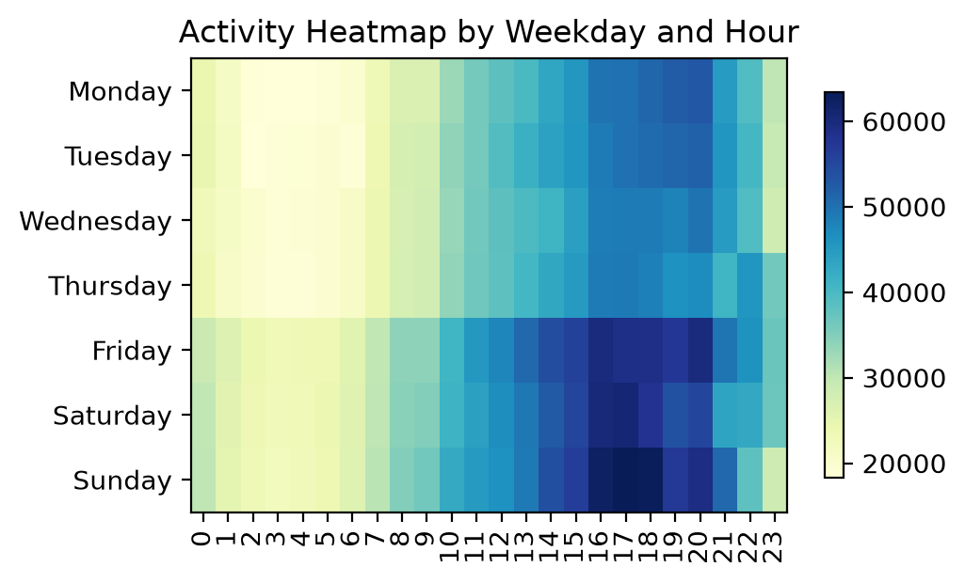
ACTIVITY
When Are Games Played?
The heatmap shows clear weekly and hourly activity patterns.
Online chess activity is concentrated in the evenings and at weekends.
This connects gameplay behaviour with audience and engagement patterns.
Chess at Scale · Lichess Analysis
12

Slide 13
CONCLUSIONS
Key Insights
1
Outcomes are shaped by fundamentals
2
Rating is the strongest predictor
Rating, opening choice, time control, and game pace all leave a measurable mark on how games end.
The win-probability curve rises steadily with rating advantage — skill converts to results.
3
Pace changes the game
4
Data becomes a story
Faster formats are more decisive; slower formats produce longer, more balanced games.
The interactive dashboard turns 6.24M games into explorable, understandable insights.

Slide 14
Explore the Project
All code, data preparation, and the live dashboard are public.
GITHUB REPOSITORY
LIVE STREAMLIT DASHBOARD
github.com/shreedevale-create/DV_Project
dvproject…streamlit.app

