Slide 1

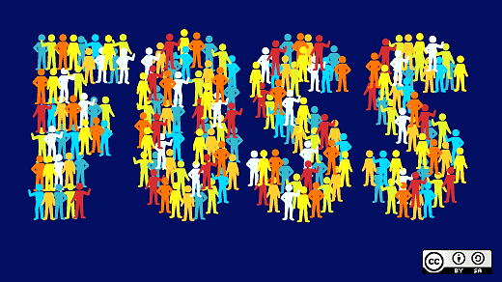
Free And Open Source System
Open-source software (OSS)

Slide 2


Drupal

Slide 3

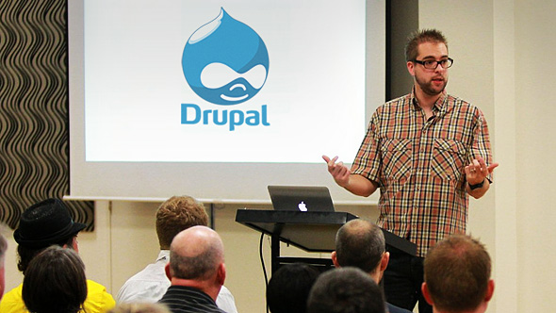
In 2000, two University of Antwerp students, Dries Buytaert and Hans Snijder are programmer of drupal software
Idea

Slide 4


The logo's concept is based on a drop. a drop within a circle, a circle within a drop. idea was to use a cartoon-like drop with a face. A 3D version created by Steven Witten.

Slide 5

What Problems Does It Solve
Drupal offers thousands of different modules
Drupal software is stable
It is easy to customize attributes

Slide 6


Licensing Model
GNU General Public License

Slide 7

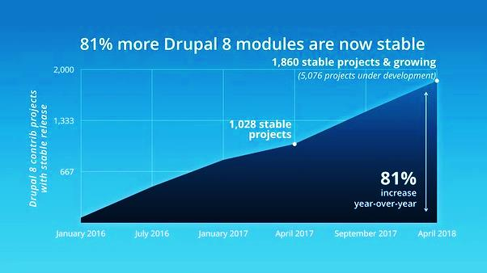
Popularity
Drupal is second most popular open source content-management framework

Slide 8

Monetization Model
Advertisement
purchasing inside the software

Slide 9

Impact
Smart Devices User Can Also View Drupal Sites Like A Desktop User
Drupal Gives Companies To Make Seo Friendly Websites
developers can make changes even after the website is deployed
Thanking you

