Slide 1


INTRODUCTION TO SIL OPEN FONT LICENSE(OPL)

Slide 2

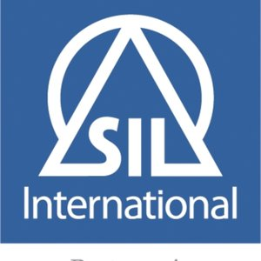
The SIL Open Font License (OFL) is a free, libre and open source license specifically designed for fonts and related software based on our experience in font design and linguistic software engineering

Slide 3

HISTORY
The SIL Open Font License is designed for fonts by SIL International for use with many of their Unicode fonts, including Gentium Plus, Charis SIL, and Andika.[4]
The Open Font License was first released in November 2005

Slide 4

IDEOLOGY
SIL serves language communities worldwide, building their capacity for sustainable language development, by means of research, translation, training and materials development. SIL makes its services available to all

Slide 5

The intent is to keep people from making money by simply redistributing the fonts. The only people who ought to profit directly from the fonts should be the original authors, and those authors have kindly given up potential direct income to distribute their fonts under the OFL.

Slide 6





Popular software released under
SIL Open Font License
Awam Nastaliqi
Dictionary App Builder
Andika
Keyman

Slide 7

Open-source fonts are a popular choice among designers.
Most open-source fonts utilize the Open Font License (or OFL) by SIL international.
The OFL license allows you to freely use, modify, and distribute the fonts you work with.
The only stipulation is that you cannot charge others to use them.

Slide 8

you can create a logo or website that utilizes an OFL licensed font like Google Font’s Open Sans and charge for it. What you can’t do is download Open Sans, modify it and sell it as a separate font.
Google Fonts is by far the most popular font distributor using the OFL license. Google Fonts allows users to freely use their fonts on your computer, in print, and within websites and apps.

Slide 9


Impact
The ability to read, write, type and publish in one's own language is one of the most critical needs for millions of people around the world.
This requires fonts that are widely available and support lesser-known languages. SIL develops - and encourages others to develop - a complete stack of writing systems implementation components available under open licenses.

