Slide 1
Interactive Online Yoga Academy . Live Sessions, Personalized Plans, and Video Tutorials
SHREENITHY RS
727723EUCS225

Slide 2
Content Table
01
02
03
Introduction
Functional Requirements
Non-Functional Requirements
06
UML Diagrams
04
05
Conclusion

Slide 3


Introduction
Powered by Spring Boot REST APIs
Building a secure, scalable backend to support live yoga sessions, personalized plans, and video tutorials.

Slide 4
Target Audience
Admins: for platform operations.
Instructors: for sharing expertise.
Yoga practitioners: for learning and tracking progress.

Slide 5
Functional Requirements
User Registration and Authentication.
Live Yoga Sessions.
Personalized Yoga Plans.
Video Tutorials.
Notifications and Reminders

Slide 6
Functional Requirements
Live Yoga Sessions
User Registration and Authentication
Real-time video streaming via integrations (Zoom/YouTube).
Notifications for session reminders.
Admin tools for session management.
Secure user registration.
JWT-based authentication for access control.

Slide 7
Functional Requirements
Video Tutorials
Personalized Yoga Plans
Categorized video library by skill level, type, and duration.
High-performance video streaming.
Easy browsing and access for users.
Custom plans based on user preferences and fitness goals.
Dynamic progress tracking.
Plan adjustment capabilities.

Slide 8
Functional Requirements
Notifications and Reminders
Automated notifications for session details and updates.
Encouragement for daily practice.
Push notifications for new content.

Slide 9
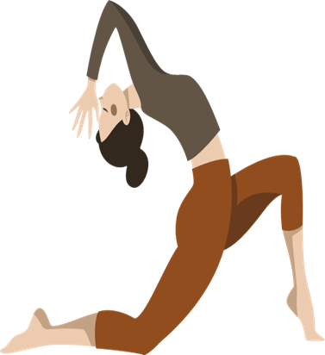
CRUD Operations
Create:
Register users, schedule sessions, upload tutorials.
Read:
View tutorials, session schedules, track progress.
Update:
Edit profiles, modify plans, reschedule sessions.
Delete:
Cancel sessions, remove videos, deactivate accounts.

Slide 10
Non-Functional Requirements
Performance:
Handle 1,000 concurrent users with <5s response time.
Scalability:
Spring Boot microservices for growth
Security:
JWT authentication, HTTPS communication.
Availability:
9.9% uptime.
Maintainability:
Modular backend design.

Slide 11
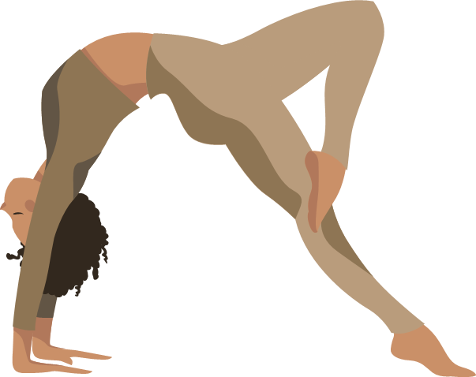
UML DIAGRAMS

Slide 12
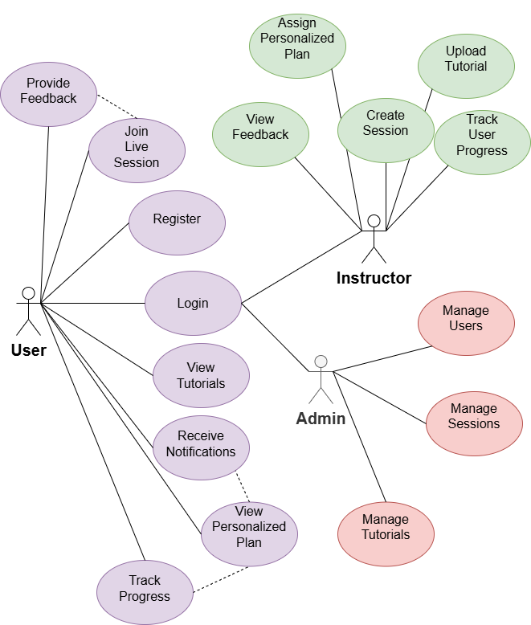
USE CASE DIAGRAM
.

Slide 13
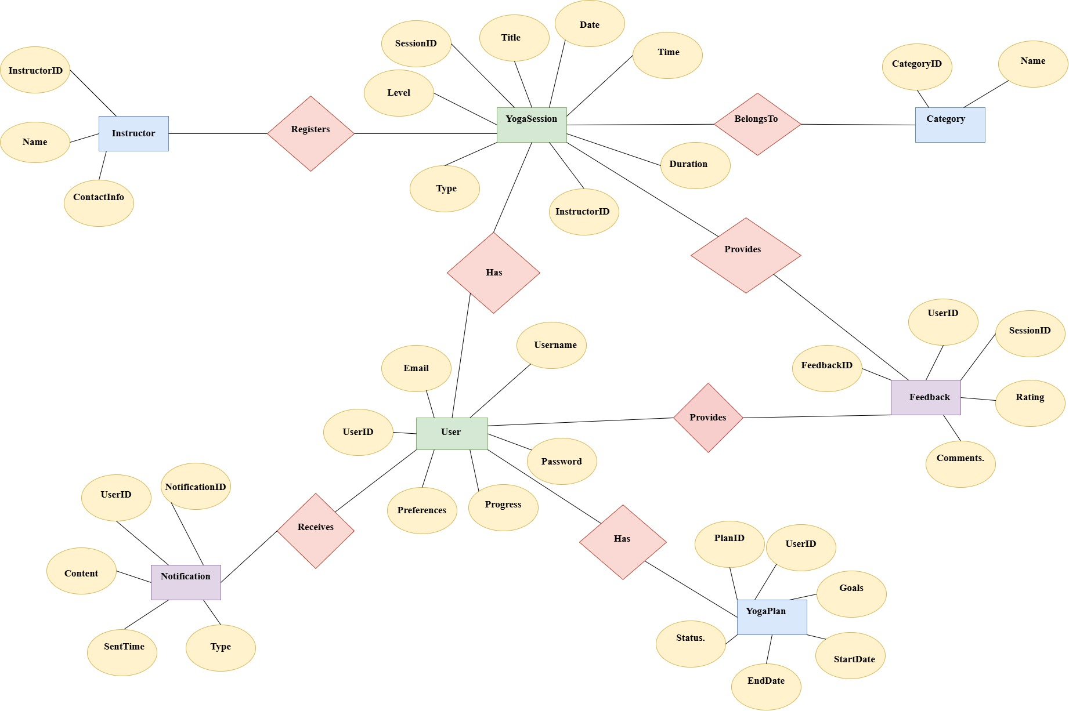
ER DIAGRAM
.

Slide 14
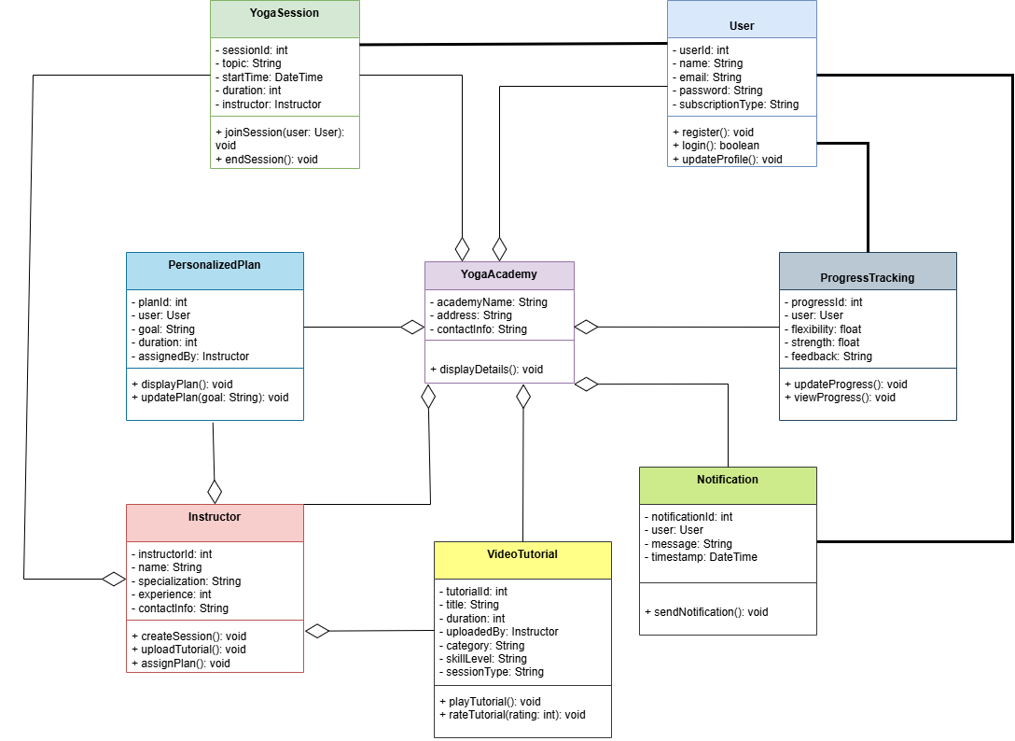
CLASS DIAGRAM
.

Slide 15
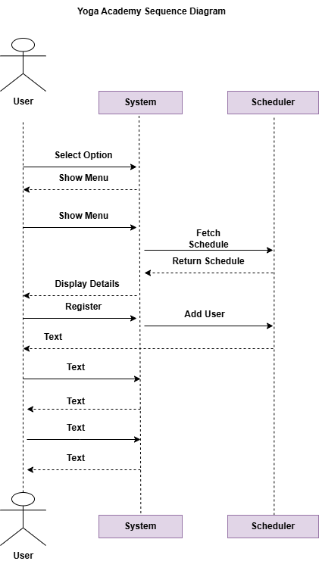
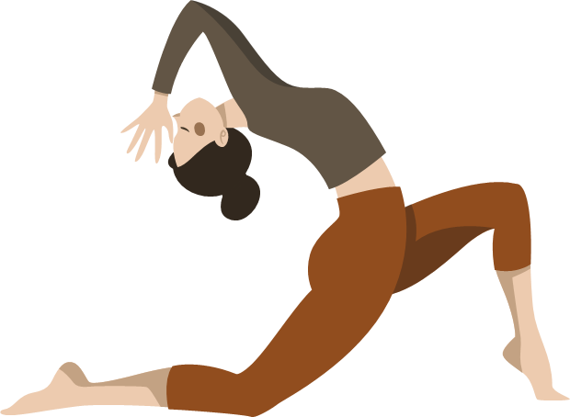
SEQUENTIAL DIAGRAM
.

Slide 16



CONCLUSION :-
.
A comprehensive backend for live sessions, personalized plans, and tutorials.
Built with secure, scalable, and
user-friendly REST APIs using
Spring Boot.

Slide 17

THANK YOU ☺

