Slide 1



Hotel Booking System
SHREENITHY RS
727723EUCS225
CSE-D

Slide 2




Introduction
This system helps guests to book rooms online easily.
It also helps hotel staff to manage bookings, rooms, and guests.
The system is secure, fast, and simple to use.
Built using Spring Boot for backend and React for frontend

Slide 3
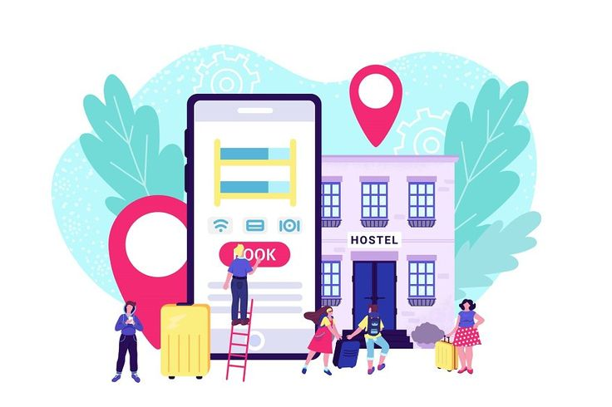

Problem Statement
Many hotels still use manual booking systems.
This can cause double bookings and confusion.
Guests may face trouble during booking.
Hotels need a system that works online, fast, and without mistakes.

Slide 4






Key Modules:-
User
Admin
Booking
Payment
Room
Hotel

Slide 5

Mappings
        User ↔ Booking: One-to-Many (Aggregation)
        Room ↔ Booking: One-to-Many (Aggregation)
        Booking → User / Room: Many-to-One
        Payment → Booking/User/Room: References only

Slide 6
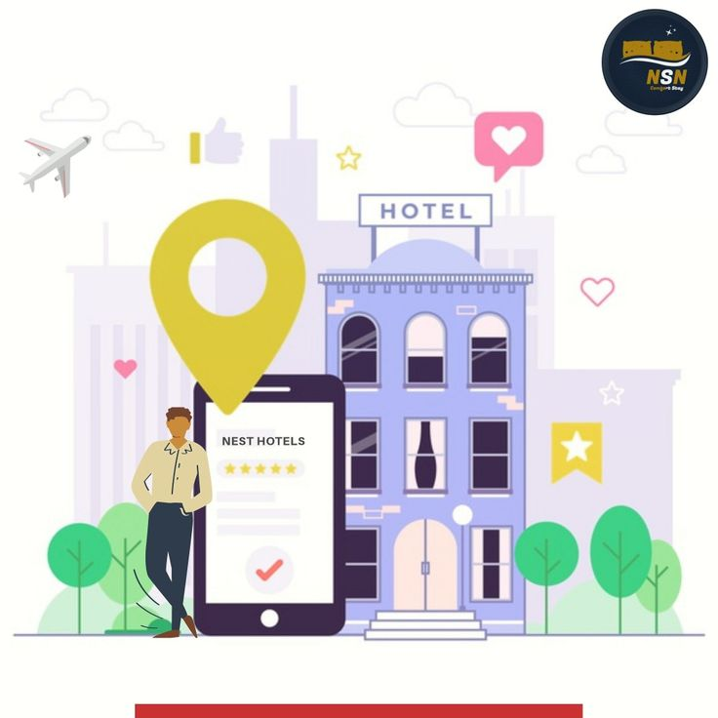
Objectives
Make the booking process simple for guests.
Help hotel admins manage rooms and bookings.
Keep user data safe and secure.

Slide 7


Outcome
✅ A fully working Hotel Booking System was successfully developed.
🔐 Secure login and registration with password encryption was implemented.
🔍 Guests can search rooms based on date, price, and type.
🏨 Detailed room pages show images, amenities, and availability.
📝 Guests can book rooms, view booking history, and cancel if needed.
🛠️ Admins can manage rooms, view all bookings, and update statuses.
📊 Admin can view reports and analytics on room occupancy and revenue.
📱 The system is responsive and user-friendly on both web and mobile.

Slide 8


Slide 9
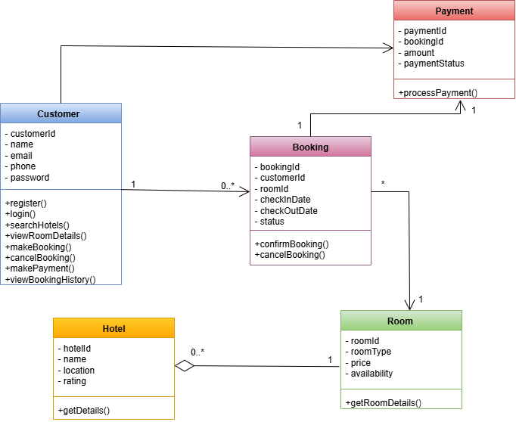
Class Diagram :-

Slide 10
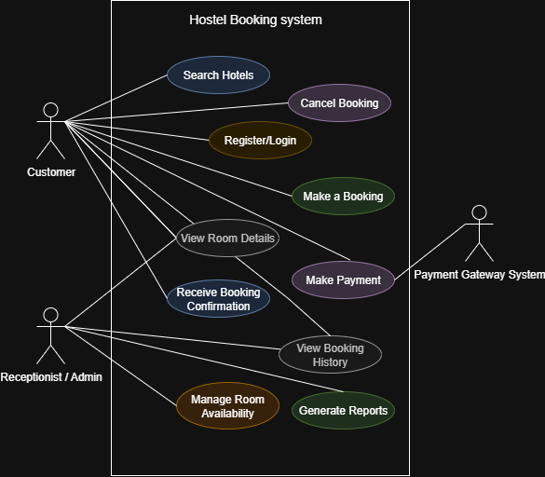
Use Case Diagram

Slide 11
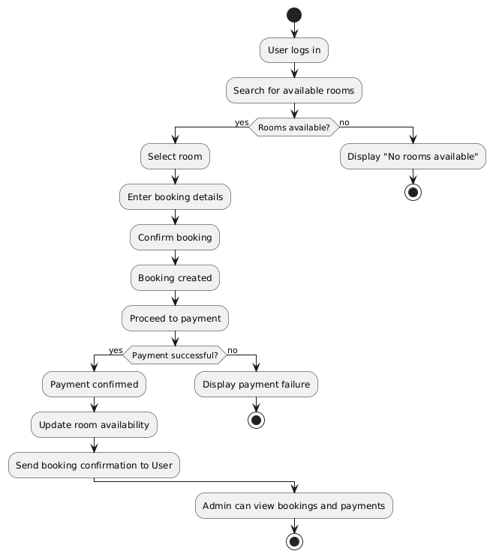
Activity Diagram

Slide 12
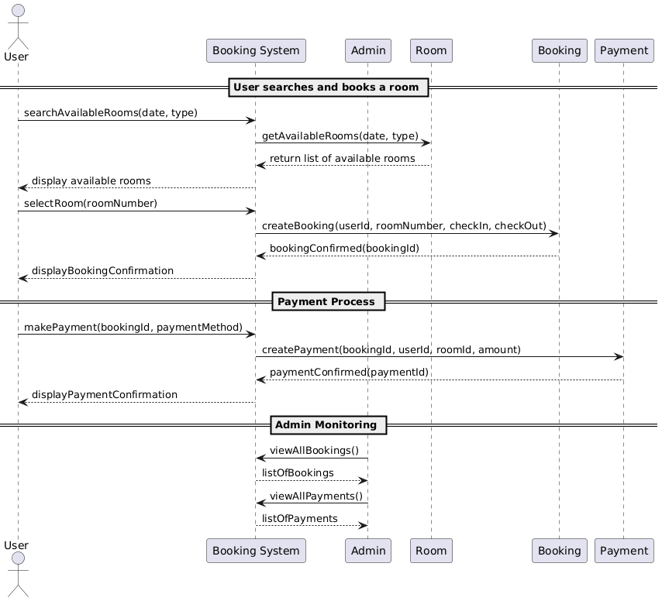
Sequence Diagram

Slide 13
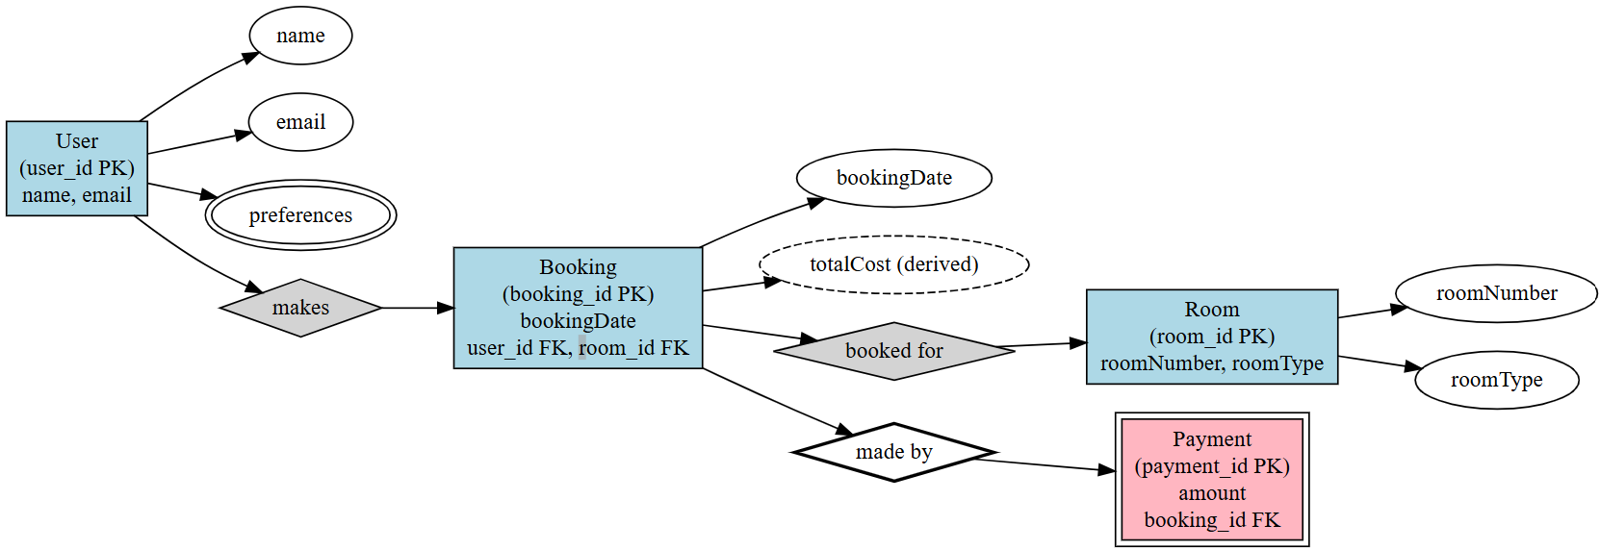
ER Diagram

Slide 14
Conclusion
This system helps both guests and hotel staff.
It makes booking easier and faster.
It is safe, modern, and user-friendly.
Useful for improving hotel service and operations.

Slide 15

THANKS !!

