Slide 1
ABSTRACT
AI-powered system for skill gap analysis and career recommendation.
Accepts resume PDF or manually entered skills as input.
Extracts and normalizes skills using NLP-based processing.
Uses TF-IDF and Cosine Similarity to calculate role-wise skill match percentage.
Uses Random Forest Classifier to predict a suitable career role.
Identifies missing skills and generates a personalized learning roadmap.
Stores analysis history for progress tracking over time.
Developed using React.js, Node.js/Express.js, Python, Scikit-learn, and MongoDB.
| Dept. of CSE | Batch – XI | Final Review |

Slide 2
PROBLEM STATEMENT
Students often lack clear, data-driven career guidance based on their existing skills.
Traditional job portals mainly use keyword-based matching, without measuring the actual skill gap.
Existing systems may recommend roles but often do not provide a quantified skill-match percentage.
Missing skills are not always clearly identified or converted into a personalized learning roadmap.
Users lack continuous progress tracking to measure improvement in their career readiness.
Hence, there is a need for an integrated, transparent, and personalized system that connects skills → career role → skill gap → learning roadmap.
| Dept. of CSE | Batch – XI | Final Review |

Slide 3
EXISTING SYSTEM
      Keyword-Based Job Portals : Match resumes with job descriptions mainly using keywords.
Traditional Resume Screening : Limited understanding of the candidate's complete skill profile.
Role Recommendation Systems: Recommend career roles but may not provide a quantified skill-match percentage.
Limited Skill-Gap Analysis : Missing skills are often not explicitly identified against a target career role.
Generic Learning Recommendations: Learning suggestions may not be directly connected to the user's specific skill gaps.
Limited Progress Tracking: Most approaches do not maintain a continuous history of skill-match improvement.
| Dept. of CSE | Batch – XI | Final Review |

Slide 4
PROPOSED SYSTEM
Dual Input: Resume PDF upload or manual skill entry.
Skill Extraction: NLP-based processing to extract and normalize skills.
Career Matching: TF-IDF + Cosine Similarity generates role-wise Match %.
Career Prediction: Random Forest Classifier predicts the career role.
Skill Gap Analysis: Identifies missing skills for the selected role.
Personalized Roadmap: Prioritizes missing skills into a structured learning path.
Progress Tracking: Stores previous analyses to monitor career readiness over time.
Secure Platform: JWT-based authentication with persistent user data.
| Dept. of CSE | Batch – XI | Final Review |

Slide 5
OBJECTIVES
The primary objective is to develop a secure, intelligent, and integrated AI-powered career guidance platform that analyzes a user’s skills, proficiency, educational background, and career interests to identify suitable career roles. The system uses NLP, TF-IDF, Cosine Similarity, and Machine Learning to perform skill matching, identify skill gaps, and compare existing skills with target-role requirements. It provides personalized career recommendations, missing-skill identification, learning suggestions, and structured career roadmaps through a unified web application with secure authentication, role-based access, and reliable data management.
| Dept. of CSE | Batch – XI | Final Review |

Slide 6
LITERATURE SURVEY
Author / Year | Technique | Key Contribution
Ashrafi et al., 2023 | TF-IDF + K-Means | Career recommendation & learning path
Rajput et al., 2024 | SVM + Cosine Similarity | Resume analysis & job recommendation
Gupta & Singh, 2024 | Gemini + PyPDF2 | Resume skill extraction & matching
Chandak et al., 2024 | TF-IDF + Cosine Similarity | Resume parsing & job recommendation
Decorte et al., 2025 | Bi-Encoder | Lightweight skill extraction
Anghel et al., 2025 | BERT + XGBoost + SHAP | Explainable resume–job matching
| Dept. of CSE | Batch – XI | Final Review |

Slide 7
RESEARCH GAP
Similarity scores not clearly surfaced → Users lack a measurable skill-match percentage.
Limited career role prediction → Existing systems often depend on basic matching or external platforms.
Skill gaps not explicitly identified → Missing skills are rarely quantified systematically.
Generic learning recommendations → Learning paths are not always personalized to identified gaps.
Dependence on external/paid services → Some approaches require third-party AI or platform services.
Lack of end-to-end integration → Skill analysis, role prediction, gap analysis, learning, and progress tracking are often handled separately.
| Dept. of CSE | Batch – XI | Final Review |

Slide 8
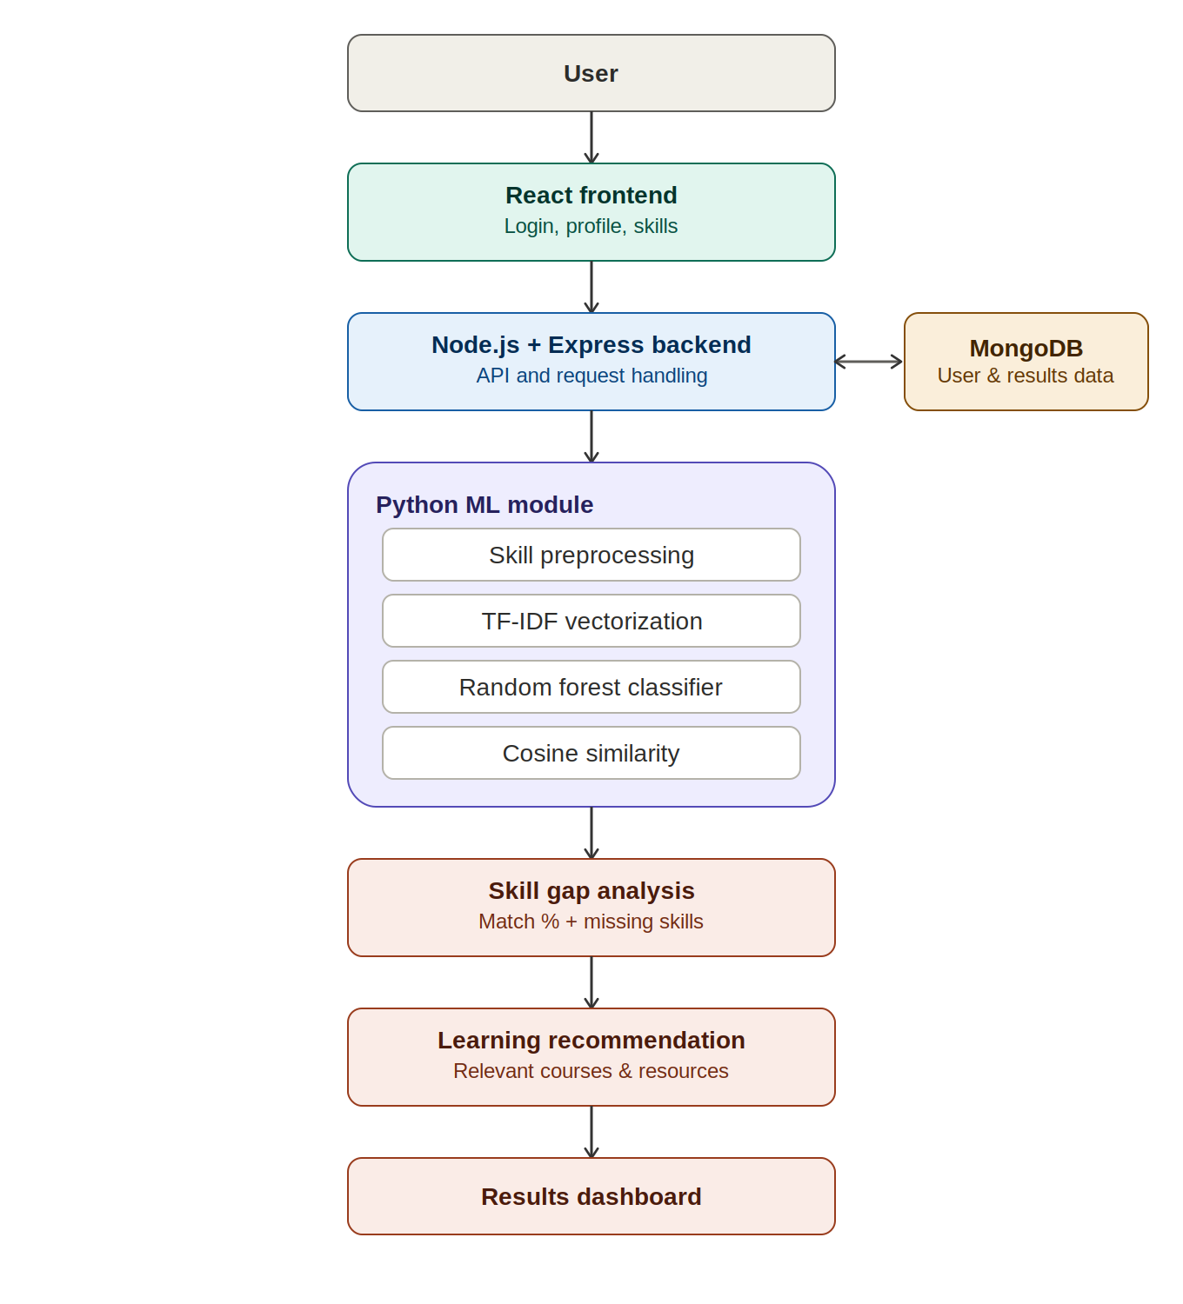
ARCHITECTURE DIAGRAM
| Dept. of CSE | Batch – XI | Final Review |

Slide 9
MODULE
    1. User Management Module
    Handles user registration, login, profile details, and skill information.
2. Skill Processing Module
Collects user skills, cleans the input data, and converts skills into a suitable format for analysis.
3. Career Prediction Module
Uses TF-IDF Vectorization and Random Forest Classifier to predict suitable career roles.
4. Skill Gap Analysis Module
Uses Cosine Similarity to compare user skills with job requirements and identifies missing skills.
5. Result & Progress Module
Displays career recommendations, skill-match percentage, and analysis results for user reference.
| Dept. of CSE | Batch – XI | Final Review |

Slide 10
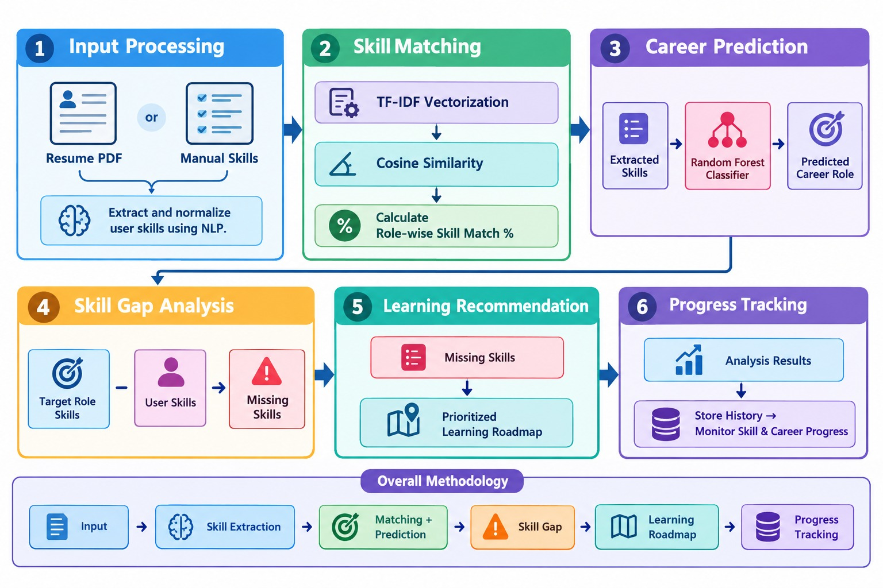
METHODOLOGY
| Dept. of CSE | Batch – XI | Final Review |

Slide 11
TECHNOLOGY STACK
Layer | Technology | Purpose
Frontend | React.js | User interface & dashboard
Backend | Node.js + Express.js | REST APIs & application logic
Database | MongoDB | User data & analysis history
ML Layer | Python + Scikit-learn | Skill matching & career prediction
NLP | TF-IDF + Cosine Similarity | Skill matching & similarity analysis
ML Algorithm | Random Forest | Career role prediction
Authentication | JWT + bcrypt | Secure login & authentication
Resume Processing | PDF Text Extraction | Extract skills from resumes
Communication | REST API | Frontend–Backend integration
| Dept. of CSE | Batch – XI | Final Review |

Slide 12
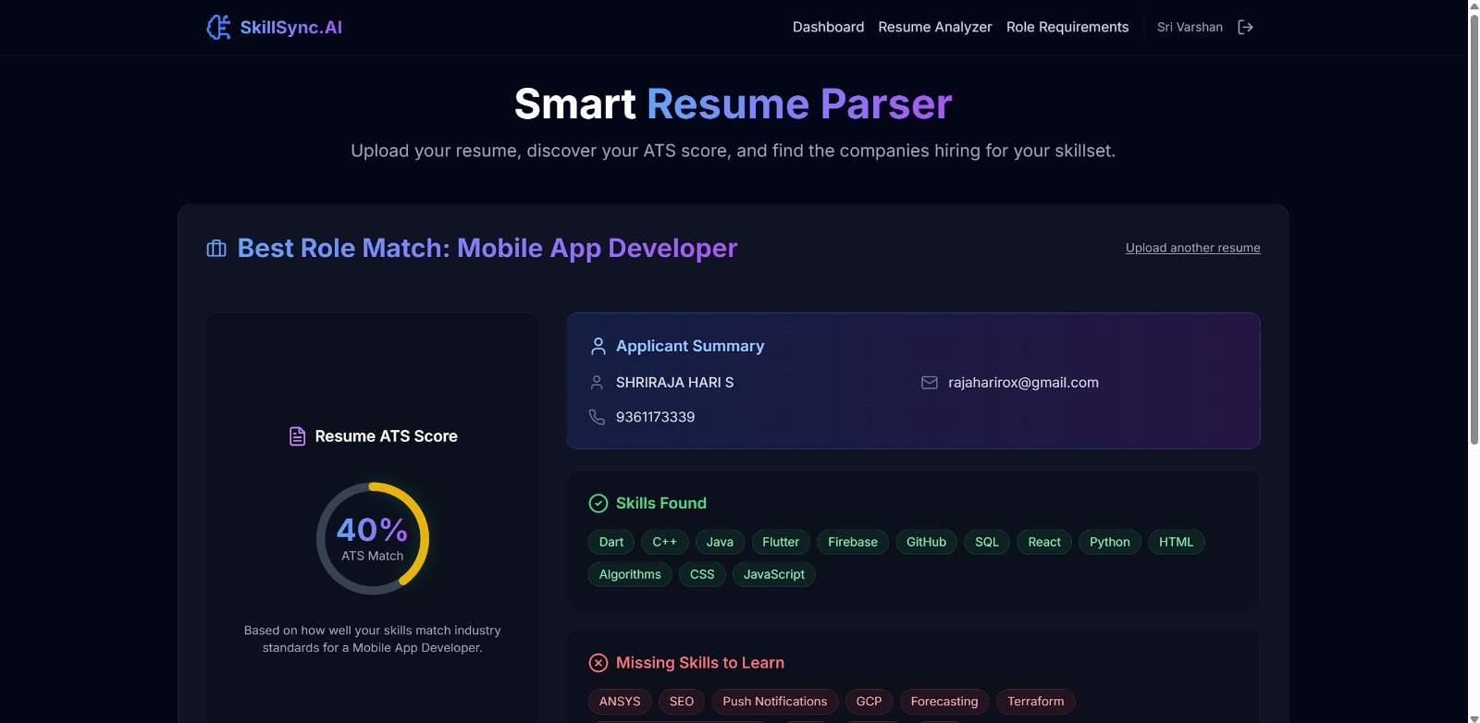
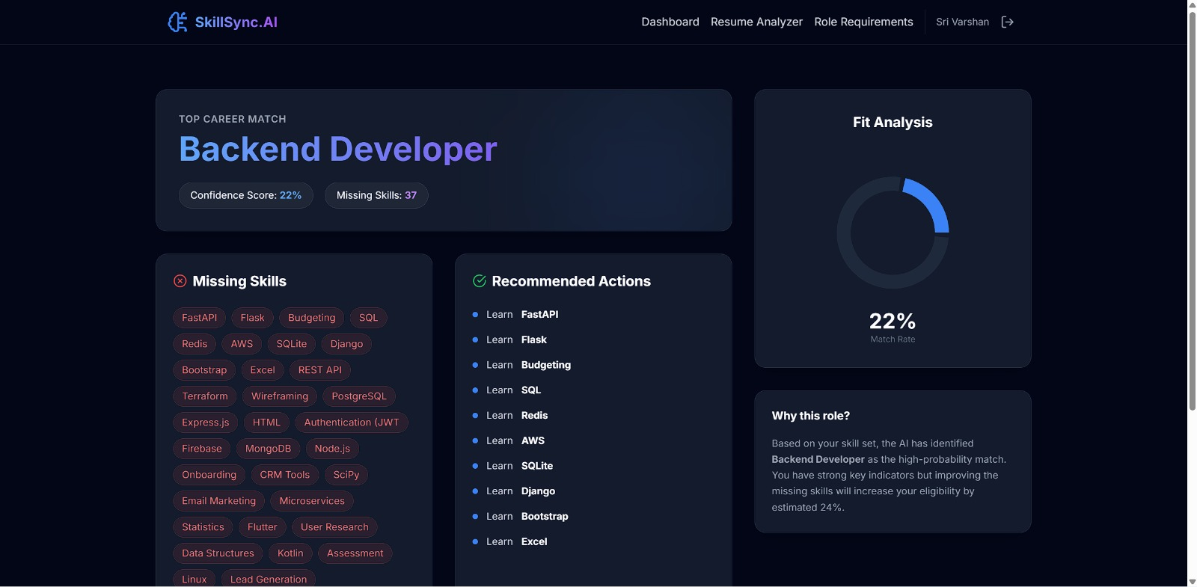
SCREENSHOTS
Resume analysis page
Skill analyzing page
| Dept. of CSE | Batch – XI | Final Review |

Slide 13
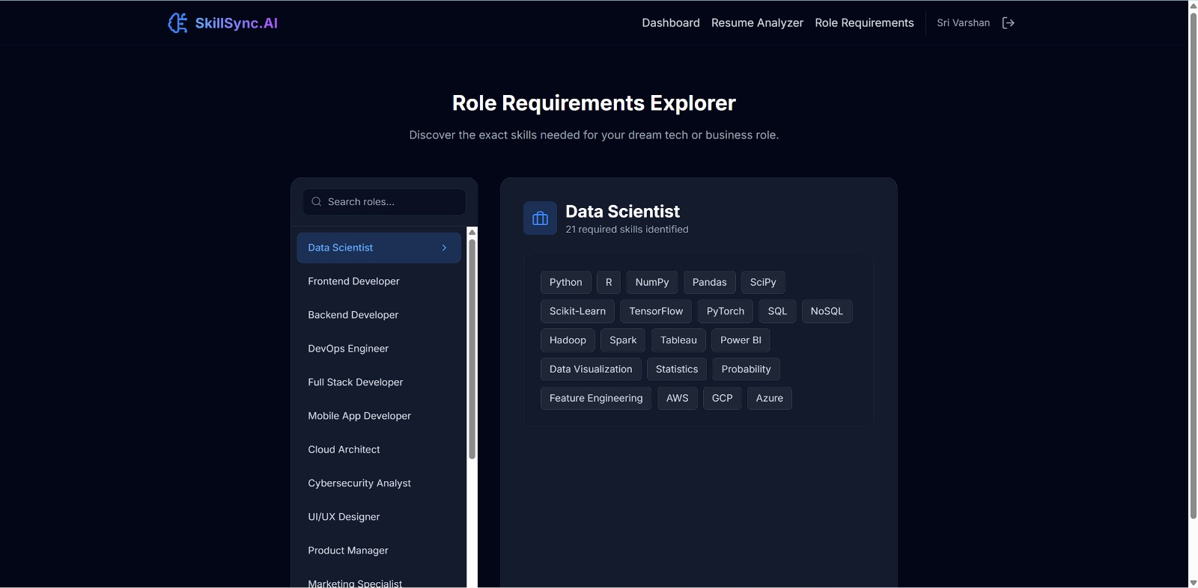
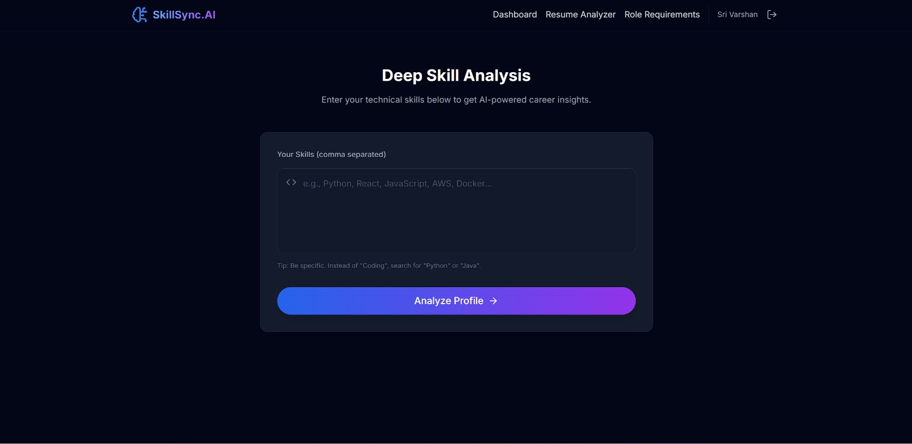
SCREENSHOTS
Role Requirement Page
Skill analysis page
| Dept. of CSE | Batch – XI | Final Review |

Slide 14
RESEARCH PAPER PUBLICATION STATUS
Conference : ICAIDIET’26 – International Conference on AI-Driven Innovation in Engineering and Technology
Publishing Partner: Wiley
Indexing: Scopus
Our Paper : AI-Powered Skill Gap Analysis and Career Recommendation System
Status: Paper Submitted → Accepted → Registration Yet to be Completed
Mentor : Rehan Krishnan S (Assistant Professor, Department of CSE)
Authors
1. Sri Varshan B
2. Shreenithy R S
3. Shri Raja Hari S
Current Stage : Registration Yet to be Completed for ICAIDIET’26 → Preparing for Conference Presentation
| Dept. of CSE | Batch – XI | Final Review |

Slide 15

Sustainable Development Goals
SDG 4 – Quality Education
Identifies individual skill gaps.
Provides a structured learning roadmap.
Supports continuous learning progress tracking.
SDG 8 – Decent Work & Economic Growth
Helps users identify suitable career roles.
Improves alignment between skills and job requirements.
Supports career readiness and employability.
| Dept. of CSE | Batch – XI | Final Review |

Slide 16
CONCLUSION & FUTURE ENHANCEMENTS
CONCLUSION
AI-based system for career prediction & skill-gap analysis
TF-IDF + Cosine Similarity for skill matching
Random Forest for career role prediction
Generates personalized learning roadmap
Enables continuous progress tracking
FUTURE ENHANCEMENTS
Advanced LLM-based skill understanding
Real-time job market integration
Adaptive & personalized recommendations
Mobile application
Advanced career analytics
| Dept. of CSE | Batch – XI | Final Review |

Slide 17
REFERENCE
Ashrafi et al. (2023) — Career Recommendation & Learning Path using TF-IDF and K-Means
Rajput et al. (2024) — Resume Analysis & Job Recommendation using SVM and Cosine Similarity
Gupta & Singh (2024) — Resume Skill Extraction & Matching using Gemini and PyPDF2
Chandak et al. (2024) — Resume Parsing & Job Recommendation using TF-IDF and Cosine Similarity
Decorte et al. (2025) — Lightweight Skill Extraction using Bi-Encoder
Anghel et al. (2025) — Explainable Resume–Job Matching using BERT, XGBoost & SHAP
| Dept. of CSE | Batch – XI | Final Review |

